Slide 1

SRM INSTITUTE OF SCIENCE AND TECHNOLOGY
Ramapuram , Chennai – 600 089
DEPARTMENT OF COMPUTER SCIENCE AND ENGINEERING
21CSC305P/MACHINE LEARNING/PROJECT EVALUATION
REAL-TIME EXERCISE REPETITION TRACKING SYSTEM USING
COMPUTER VISION AND IP WEBCAM VIDEO STREAM INPUT
BATCH NUMBER : 11
Team Members | Supervisor
C S Ashwin (RA2311003020396) S M Vivek Rao (RA2311003020409) S Krithika (RA2311003020416) | NAME: Mr. Kingsly Stephen

Slide 2
Agenda(Only for Reference-Modify accordingly)
Abstract
Scope and Motivation
Introduction
Literature Survey ( Table)
Objective
Problem Statement
Proposed Work
  Architecture Diagram/Flow Diagram/Block Diagram
  Novel idea
  Modules
  Module Description

Slide 3
ABSTRACT
This project presents a real-time exercise tracking system that utilizes computer vision and machine learning techniques for fitness monitoring. The system employs OpenCV and MediaPipe to accurately detect and count squats and bicep curls using pose estimation and joint angle calculations. It provides live feedback through camera overlays, tracks calories burned, and maintains logs in CSV format. Additionally, the system generates an automatic PDF summary report and visualizes workout progress through graphs. To enhance usability, the solution integrates email automation to send workout summaries directly to the user. This ensures a complete end-to-end fitness monitoring solution that is affordable, accessible, and easy to use with just a webcam.

Slide 4
Scope and Motivation
The primary motivation of this project is to provide a simple, affordable, and effective solution for fitness monitoring using just a webcam. Traditional workout tracking methods are either manual, error-prone, or dependent on expensive smart devices and wearables. This system eliminates the need for additional hardware by leveraging computer vision and pose estimation techniques to track exercises in real time. It enables users to receive personalized progress reports, calorie estimations, and visual feedback, making fitness accessible at home. By integrating automated report generation and email delivery, the system not only promotes consistent workout tracking but also encourages users to adopt a healthier lifestyle through technology-driven motivation.

Slide 5
Introduction
In recent years, technology has increasingly played a significant role in health and fitness, offering innovative solutions to monitor physical activities. However, most existing systems rely on wearable devices or costly equipment, which limits accessibility for many users. This project introduces a webcam-based exercise tracker that uses computer vision and machine learning techniques to detect and count squats and bicep curls in real time. By utilizing OpenCV and MediaPipe for pose estimation, the system analyzes body landmarks and joint angles to ensure accurate detection of movements. Along with live feedback overlays, the system estimates calories burned, generates workout logs, creates automated reports, and delivers them via email. This integrated solution bridges the gap between affordability and functionality, providing a user-friendly platform for fitness monitoring at home.

Slide 6
Literature Survey
S.No. | Title of the Paper | Year | Journal/ Conference Name | Inferences
1. 2. 3. | Human pose estimation via deep neural Network Part Affinity Fields LogRF | 2014 2017 2023 | CVPR (IEEE) CVPR (IEEE) Applied in Physiotherapy/ Fitness | Showed deep learning can accurately estimate human joints. Foundation for rep counting systems. Developed Part Affinity Fields for real-time pose tracking. Essential for webcam fitness monitoring. Detected reps and incorrect form using skeleton landmarks. Useful in fitness and physiotherapy.

Slide 7
Literature Survey
S.No | Title of project | Year | Journal/ Conference name | Inference
4. 5. | Human pose estimation and its application Introduced 3D pose recovery from monocular images. | 2021 2006 | ACM Computing Surveys IEEE Transactions on Pattern Analysis & Machine Intelligence (TPAMI) | Reviewed major pose estimation methods. Highlighted applications in action and exercise tracking. Developed 3D pose recovery from monocular images. Improved angle precision in exercise tracking.

Slide 8
Problem Statement
Manual workout tracking is often inaccurate and unreliable.
Existing fitness monitoring solutions rely heavily on expensive wearables or gym equipment.
Lack of affordable, camera-based real-time exercise tracking systems for home users.
No integrated solution that combines exercise detection, calorie estimation, and report generation.
Difficulty in maintaining consistent workout records and progress tracking without automation.

Slide 9
Objective
To develop a real-time system for detecting and counting squats and bicep curls using pose estimation.
To provide live feedback with exercise counts, calorie tracking, and user details displayed on the screen.
To log workout data in CSV format and generate a detailed PDF summary report.
To visualize workout progress through graphs for better performance analysis.
To integrate email automation for sending workout reports directly to the user.

Slide 10
METHODOLOGY
The system captures real-time video streams from an IP webcam to monitor and analyze exercise movements. The captured frames are preprocessed by resizing, noise reduction, and normalization to ensure consistent input quality. A real-time pose estimation model such as MediaPipe or OpenPose is then applied to extract human body keypoints and joint coordinates. These keypoints are analyzed to identify the type of exercise being performed using pattern recognition or machine learning classifiers. Once the exercise type is recognized, the system tracks the motion of key joints, calculates angles, and detects repetitions based on changes in posture and movement cycles. Repetition counting is achieved through threshold-based logic or temporal pattern analysis to ensure accurate tracking. The results, including live repetition count and posture feedback, are displayed on screen in real time, providing visual and audio cues to guide the user.

Slide 11
Proposed Work
Implement a webcam-based system to capture real-time exercise movements.
Use MediaPipe and OpenCV to detect body landmarks and calculate joint angles.
Apply threshold-based logic to identify and count squats and bicep curls accurately.
Generate workout logs (CSV), PDF summary reports, and graph visualizations for progress tracking.
Integrate email automation to deliver workout reports directly to the user.

Slide 12
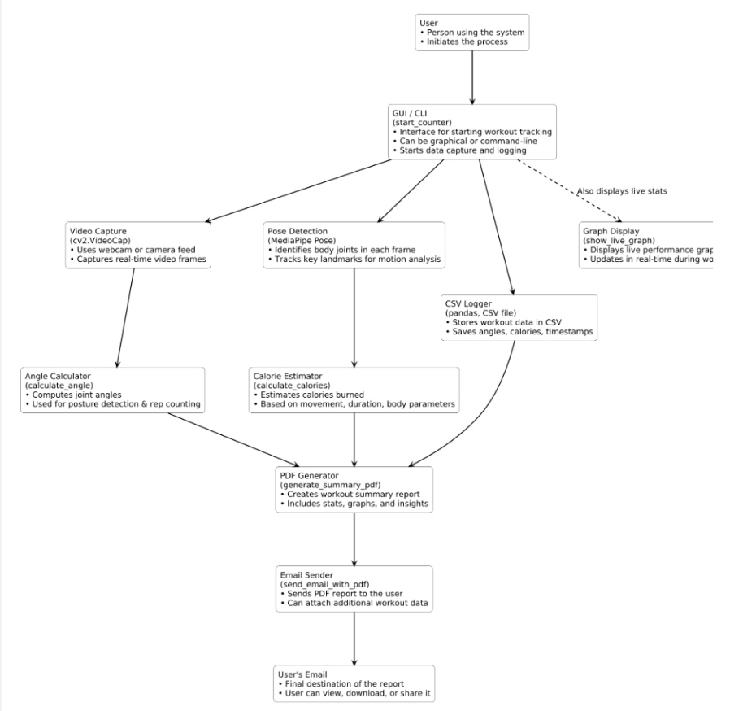
Architecture Diagram

Slide 13
Novel Idea
Camera-Only System → Unlike most fitness trackers requiring smartwatches or IoT sensors, this project uses just a normal webcam or mobile camera, making it low-cost and widely accessible.
Pose-Aware Rep Counting → Instead of simple motion detection, it calculates joint angles (hip–knee–ankle for squats, shoulder–elbow–wrist for curls), ensuring correct posture before counting a rep.
Gesture-Based Control (Thumbs-Up Exit) → Hands-free way to end a session; no need to press keys while exercising, which makes it more user-friendly and safe.
Exercise-Specific Calorie Estimation → Uses different MET values for different workouts (squats vs curls) instead of a one-size-fits-all calorie count, making it more accurate.
Real-Time Feedback Overlay → The system overlays count + calories burned live on the camera feed, helping users stay motivated while exercising.
Automatic Report Generation → At the end of each workout, a PDF summary (with name, age, total reps, calories, date, and graphs) is generated automatically.
Integrated Email Delivery → The system sends the workout summary to the user’s email instantly – something not found in most free trackers.
Data Logging for Progress Tracking → Each session is stored in CSV format, allowing users to track improvement over days/weeks without relying on external apps.

Slide 14
Modules
tkinter: For creating graphical user interfaces (GUI), including windows, buttons, and input fields.
cv2 (OpenCV): For capturing and processing video frames from the webcam.
mediapipe: For real-time pose and hand tracking, used to detect squats, curls, and thumbs-up gestures.
numpy: For numerical operations, mainly to calculate joint angles.
pandas: For creating, saving, and managing exercise logs in CSV files.
matplotlib.pyplot: For plotting graphs (e.g., reps over time).
datetime: For handling dates and timestamps.
os: For file operations, such as checking, deleting, or creating CSV/PDF files.
time: For measuring elapsed time during workouts.
fpdf: For generating PDF summary reports of the workout.
smtplib: For sending emails using SMTP protocol.
email.message (EmailMessage): For structuring and sending emails with attachments.

Slide 15
Modules Description
tkinter → Standard Python GUI library for creating windows, buttons, and input fields.
cv2 (OpenCV) → Computer vision library for webcam capture, image, and video processing.
mediapipe → ML-based library for real-time pose, hand, and face tracking.
numpy → Numerical computing library for arrays, math, and angle calculations.
pandas → Data handling library for working with CSV/Excel and structured data.
matplotlib.pyplot → Plotting library for creating graphs and visualizations.
datetime → Standard library for working with dates, times, and timestamps.
os → Provides functions to interact with the operating system and files.
time → Standard library for measuring elapsed time and delays.
fpdf → Lightweight library for generating PDF reports programmatically.
smtplib → Standard library for sending emails via the SMTP protocol.
email.message (EmailMessage) → Class for creating structured emails with attachments.

Slide 16
Algorithm
1. Start system and load user details (Name, Age, Weight, Email).
2. Load dataset of exercise sessions:
• Columns may include: timestamp, joint_angles, exercise_type, reps, calories, user_id.
• Dataset can come from CSV files, motion sensor logs, or previously recorded videos.
3. Preprocess dataset: Clean missing values, Normalize joint angles,Segment data into individual reps.
4. Extract features from dataset:
• Angles of key joints (hip-knee-ankle, shoulder-elbow-wrist), Time duration of each rep.
5. Apply classification model (if ML is used):
• Train a model to identify exercise type (squat, curl, push-up, etc.), Validate on test data.
6. Count repetitions automatically by detecting valid cycles in dataset.
7. Estimate calories per exercise using:
• Repetition counts, MET values for each exercise, User’s weight.
8. Store processed results (total reps, exercise type, calories burned, session duration) into a results dataset.
9. Generate analytics: Performance trends across sessions, Compare with historical data of same user, Detect improvements or inconsistencies.
10. Visualize data with graphs: Reps over time, Calories burned vs. days, Exercise distribution (pie/bar chart).
11. Generate PDF report summarizing analysis.
12. Send PDF report via email to user.
13. End system.

Slide 17
Software and Hardware Requirements
Software Requirements
Operating System: Windows 10/11, Linux (Ubuntu), or macOS.
Python Version: Python 3.8 or higher.
Python Libraries:
  tkinter (comes with Python)
  opencv-python (cv2)
  mediapipe
  numpy
  pandas
  matplotlib
  fpdf
  smtplib & email (built-in with Python)
Email Configuration: Gmail account (with app password enabled for SMTP).
Hardware Requirements
Processor (CPU): At least Intel i5 / AMD Ryzen 3 (for real-time pose detection).
Memory (RAM): Minimum 4 GB (8 GB recommended).
Webcam:
  Built-in or external webcam with at least 720p resolution.
  (Optional) Mobile phone camera via IP Webcam app.
Graphics: Basic GPU (integrated is fine, but dedicated GPU improves speed).
Storage: At least 500 MB free (for logs, PDFs, and libraries).
Internet Connection: Needed for email sending and (optionally) using phone camera stream.

Slide 18
Implementation
import pandas as pd
import matplotlib.pyplot as plt
from datetime import datetime
import os
import time
from fpdf import FPDF
import smtplib
from email.message import EmailMessage
# --- Config ---
PERSON_WEIGHT_KG = 50
CSV_FILE = "exercise_log.csv"
PDF_FILE = "exercise_summary.pdf"
SENDER_EMAIL = "vivekraosm2005@gmail.com"
SENDER_PASSWORD = "upoxwpgdlqczaxcf"
SQUAT_DOWN = 160
SQUAT_UP = 70
CURL_DOWN = 150
CURL_UP = 60
HOLD_THRESHOLD = 3
squat_counter = 0
curl_counter = 0
squat_stage = None
curl_stage = None
time_started = None

Slide 19
reps_over_time = []
user_name = ""
user_age = ""
receiver_email = ""
curl_hold_frames = 0
# --- Mediapipe setup ---
mp_drawing = mp.solutions.drawing_utils
mp_pose = mp.solutions.pose
pose = mp_pose.Pose()
# --- Prepare CSV ---
if not os.path.exists(CSV_FILE):
pd.DataFrame(columns=["timestamp", "squat", "curls", "calories"]).to_csv(CSV_FILE, index=False)
def calculate_angle(a, b, c):
a, b, c = np.array(a), np.array(b), np.array(c)
radians = np.arctan2(c[1]-b[1], c[0]-b[0]) - np.arctan2(a[1]-b[1], a[0]-b[0])
angle = np.abs(radians * 180.0 / np.pi)
return 360 - angle if angle > 180 else angle
def calculate_calories(squats, curls):
squat_met = 5.0
curl_met = 3.5
time_min = 1
cal = ((squat_met * PERSON_WEIGHT_KG * 3.5) / 200) * time_min * squats
cal += ((curl_met * PERSON_WEIGHT_KG * 3.5) / 200) * time_min * curls
return round(cal, 2)

Slide 20
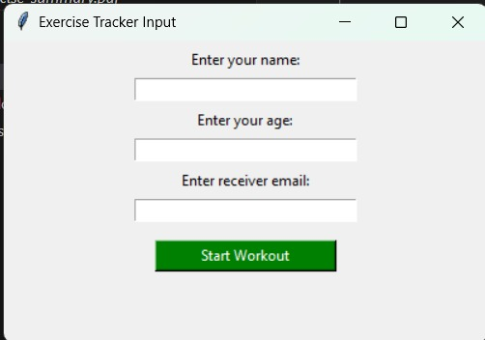
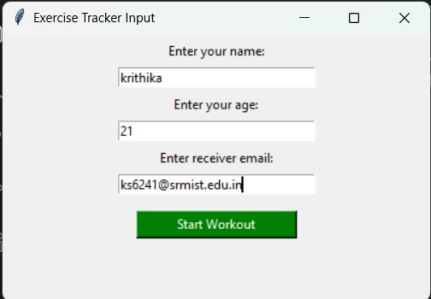
Result And Discussion
FIG 1 : INPUT
FIG 2 : INPUT

Slide 21
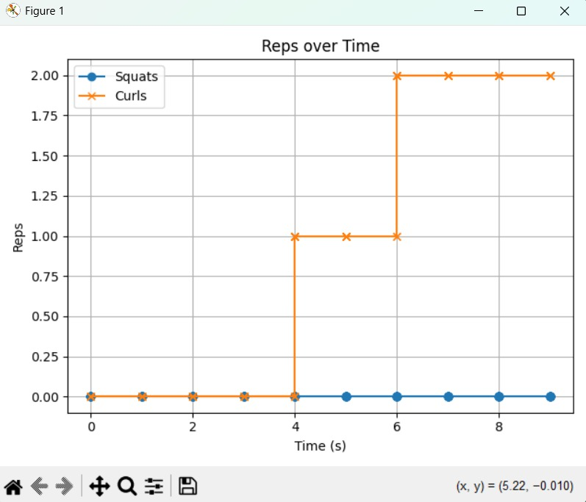
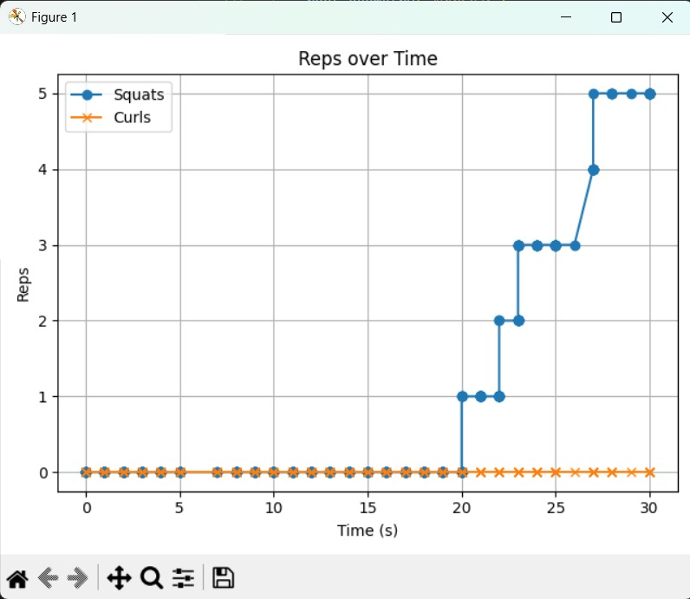
FIG 3 : GRAPH OF CURLS REP OVER TIME
FIG 4 : GRAPH OF SQUATS FOR REP OVER TIME

Slide 22
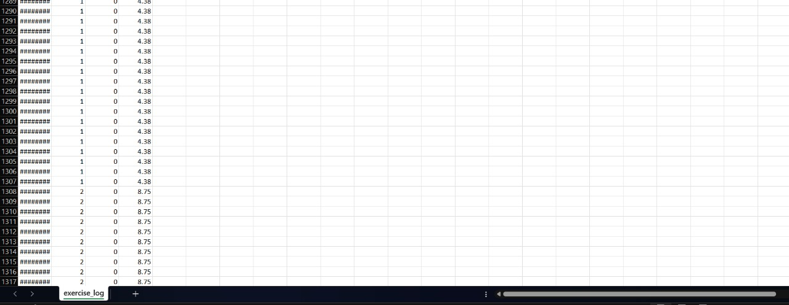
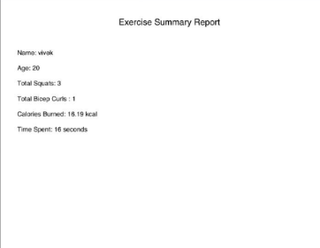
FIG 5: DATASET
FIG 6 : CSV FORMAT OUTPUT

Slide 23
Conclusion
The project successfully demonstrates a real-time exercise tracking system that combines computer vision and machine learning for effective fitness monitoring. By utilizing OpenCV and MediaPipe, the system accurately detects and counts squats and bicep curls based on joint angle calculations. It provides live feedback with calorie estimation, making the workout experience more interactive and informative. Additionally, the system automates workout data logging, generates PDF summary reports, and sends them to the user via email, ensuring seamless record keeping. Overall, this solution proves to be affordable, accessible, and user-friendly, offering a practical alternative to expensive fitness devices and enabling individuals to monitor their workouts effectively at home.

Slide 24
Future Work
• Collect a larger dataset covering multiple exercises (push-ups, lunges, planks, jumping jacks, etc.).
• Ensure dataset diversity in terms of age, gender, body types, and exercise environments.
• Machine Learning Models.
• Replace fixed angle-threshold rules with CNN or LSTM-based models trained on exercise datasets.
• Improve flexibility in recognizing different postures and reduce misclassification errors.
• Pose Quality Feedback
• Add real-time form correction by detecting incorrect postures.
• Provide instant visual/audio guidance, making the system act like a virtual trainer.
• Personalized Calorie Tracking.
• Move beyond generalized MET values by integrating physiological data (heart rate, oxygen consumption, etc.).
• Use wearables (smartwatches, fitness bands) to enhance calorie estimation accuracy.
• Cloud and Mobile Integration
• Store logs and reports in a cloud database instead of only local CSV/PDF files.
• Build a companion mobile app/web dashboard for long-term progress tracking, goal-setting, and analytics.
•AI-Generated Workout Plans

Slide 25
References
Nagarkoti, A., et al. (2019). Real-time indoor workout analysis using ML & CV. IJERT.
Raza, L., & Van Eetvelde, A. (2021). ML methods in sport injury prediction and prevention: A review.
Xi, X., et al. (2024). Enhancing human pose estimation in sports training with spatiotemporal transformer. Alexandria Engineering Journal, Elsevier.
Yeh, S. C., & Yang, C. K. (2025). Yoga pose recognition and motion analysis for home fitness. Springer (Signal, Image & Video Processing).
Springer Review (2022). CV-based approaches for physical rehabilitation and assessment. Multimedia Systems, Springer.
Chen, Z., & Wei, H. (2006). Recovering 3D human pose from monocular images. IEEE TPAMI.

Slide 26
OUTCOME
Proof for Paper Submission/Patent Filing
Research Paper

