Slide 1
JACOCO Java Code Coverage Tool
Vivek S. Kulkarni

Slide 2
Software QA : What is it ?
Process Orientation
Focuses on “Process impromevements “ .
Goal : Prevention of bugs through robust processes and compilaces
Does Not focus on : “Actual Testing Activities”.
Periodic Audit of Process compliance is conducted based on certain matrix.

Slide 3
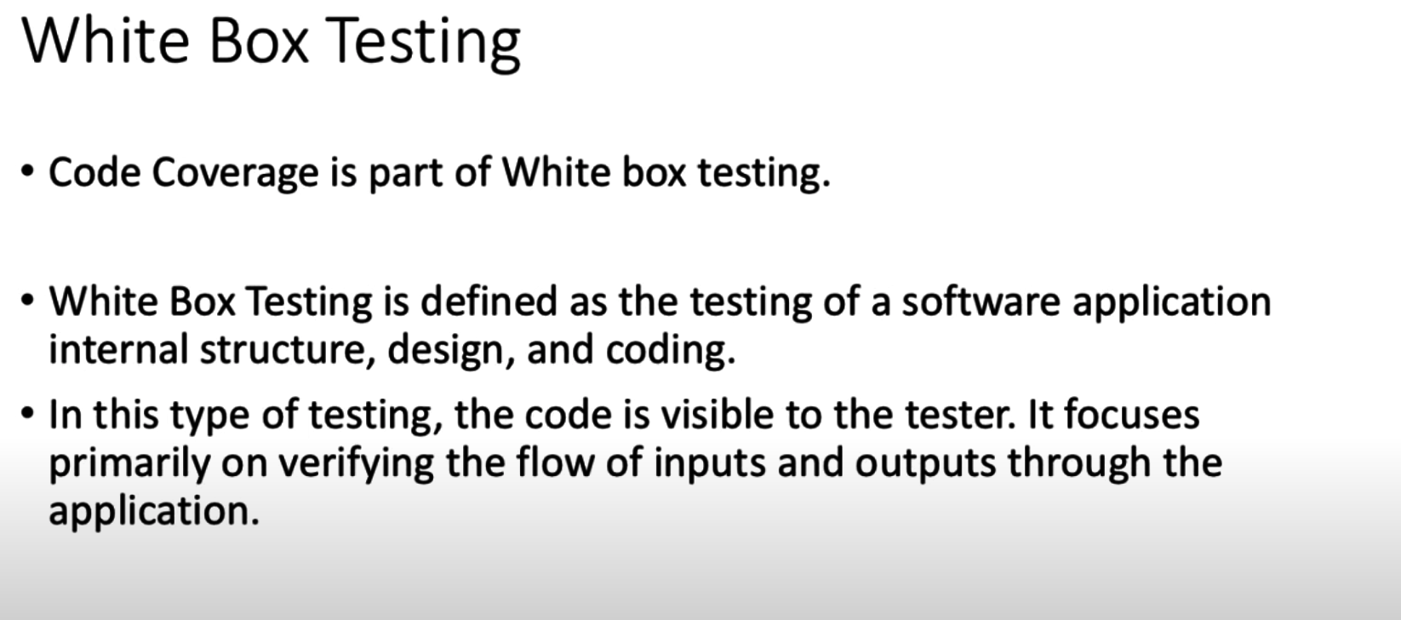
WhiteBox Testing

Slide 4
What do you verify in White Box Testing?
White box testing involves the testing of the software code for the following:
Internal security holes
Broken or poorly structured paths in the coding processes
The flow of specific inputs through the code
Expected output
The functionality of conditional loops
Testing of each statement, object, and function on an individual basis

Slide 5
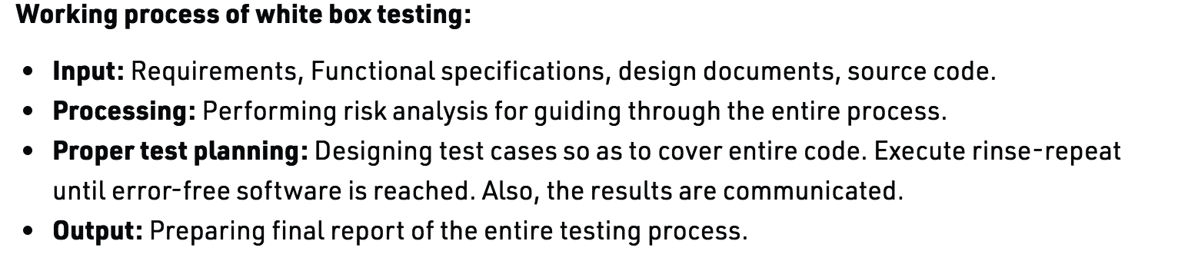
Working Process of White Box Testing

Slide 6
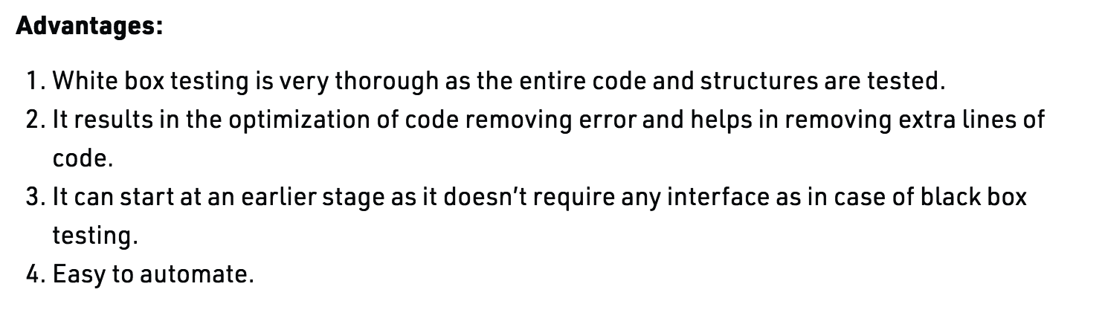
Advantage of White Box Testing

Slide 7
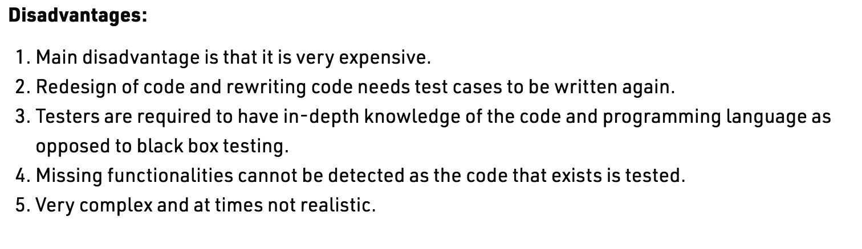
Disadvantages

Slide 8
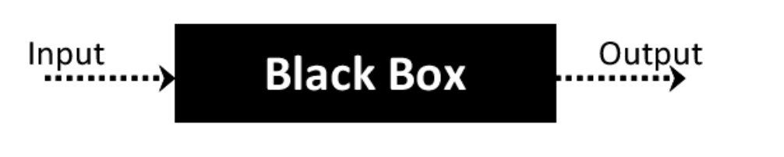
BlackBox Testing
Black Box Testing is a software testing method in which the functionalities of software applications are tested without having knowledge of internal code structure, implementation details and internal paths.
Black Box Testing mainly focuses on input and output of software applications and it is entirely based on software requirements and specifications.
It is also known as Behavioral Testing.

Slide 9
How to do BlackBox Testing
Initially, the requirements and specifications of the system are examined.
Tester chooses valid inputs (positive test scenario) to check whether SUT processes them correctly. Also, some invalid inputs (negative test scenario) are chosen to verify that the SUT is able to detect them.
Tester determines expected outputs for all those inputs.
Software tester constructs test cases with the selected inputs.
The test cases are executed.
Software tester compares the actual outputs with the expected outputs.
Defects if any are fixed and re-tested.

Slide 10
Types of Black Box Testing
Functional testing - This black box testing type is related to the functional requirements of a system; it is done by software testers.
Non-functional testing - This type of black box testing is not related to testing of specific functionality, but non-functional requirements such as performance, scalability, usability.
Regression testing - Regression Testing is done after code fixes, upgrades or any other system maintenance to check the new code has not affected the existing code.

Slide 11
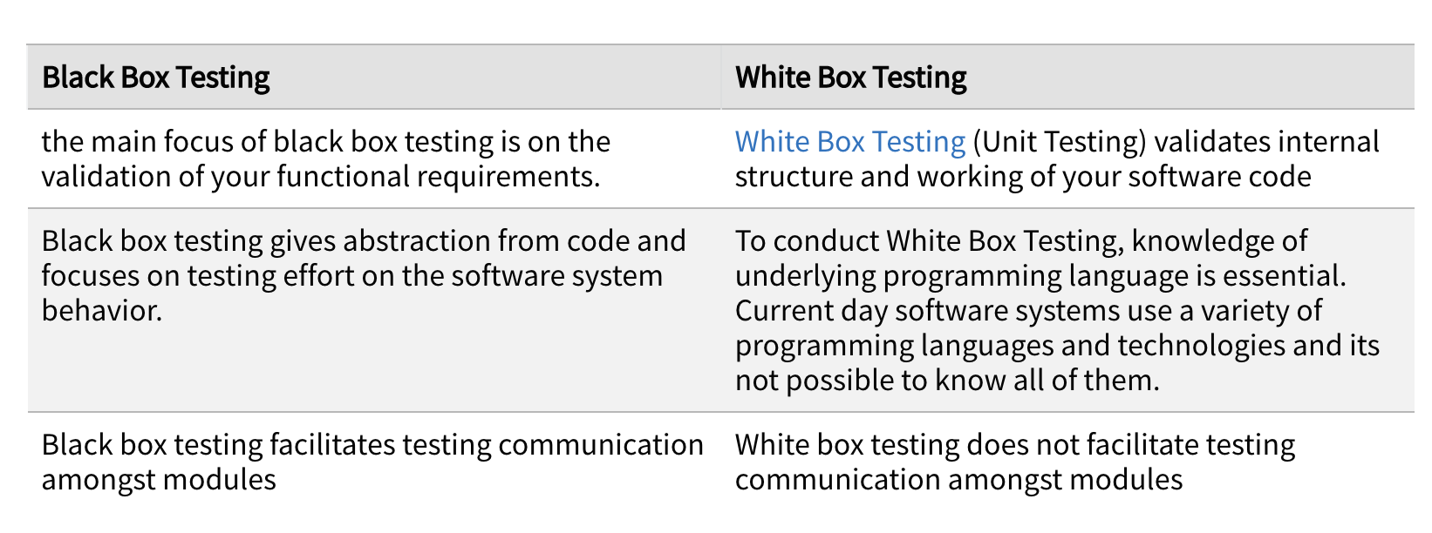
Comparison of Black Box and White Box Testing:

Slide 12
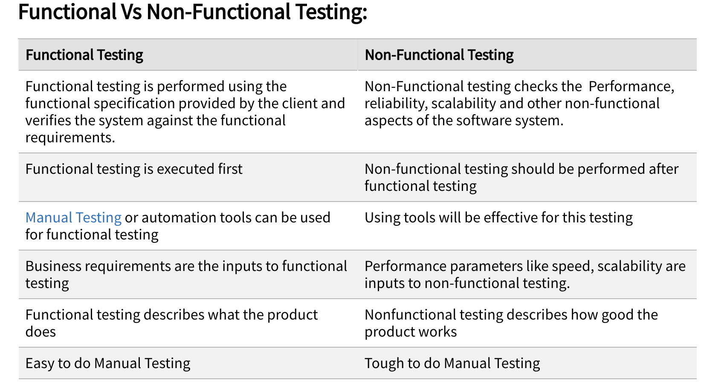
Function V/S Non Funtional

Slide 13
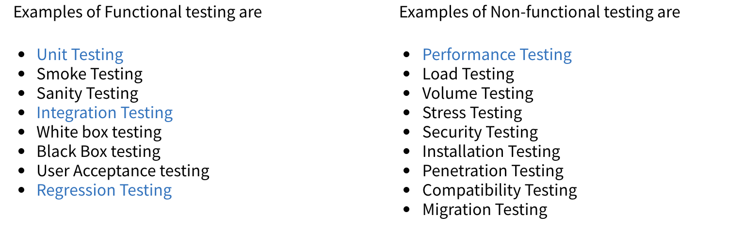
Function V/S Non Funtional

Slide 14
Sanity Testing
Software Testing performed after receiving a software build, with minor changes in code, or functionality, to ascertain that the bugs have been fixed and no further issues are introduced due to these changes.
The goal is to determine that the proposed functionality works roughly as expected. If sanity test fails, the build is rejected to save the time and costs involved in a more rigorous testing.
Smoke testing performed on a particular build is also known as a build verification test.
One of the best industry practice is to conduct a Daily build and smoke test in software projects.

Slide 15
Smoke Testing
A software testing process that determines whether the deployed software build is stable or not. Smoke testing is a confirmation for QA team to proceed with further software testing. It consists of a minimal set of tests run on each build to test software functionalities. Smoke testing is also known as "Build Verification Testing" or “Confidence Testing.”
It is a mini and rapid regression test of major functionality. It is a simple test that shows the product is ready for testing. This helps determine if the build is flawed as to make any further testing a waste of time and resources.

Slide 16
Why Smoke Testing ?
Smoke testing plays an important role in software development as it ensures the correctness of the system in initial stages.
All the show stoppers in the build will get identified by performing smoke testing.
Smoke testing is done after the build is released to QA. With the help of smoke testing, most of the defects are identified at initial stages of software development.
With smoke testing, we simplify the detection and correction of major defects.
By smoke testing, QA team can find defects to the application functionality that may have surfaced by the new code.
Smoke testing finds the major severity defects.

Slide 17
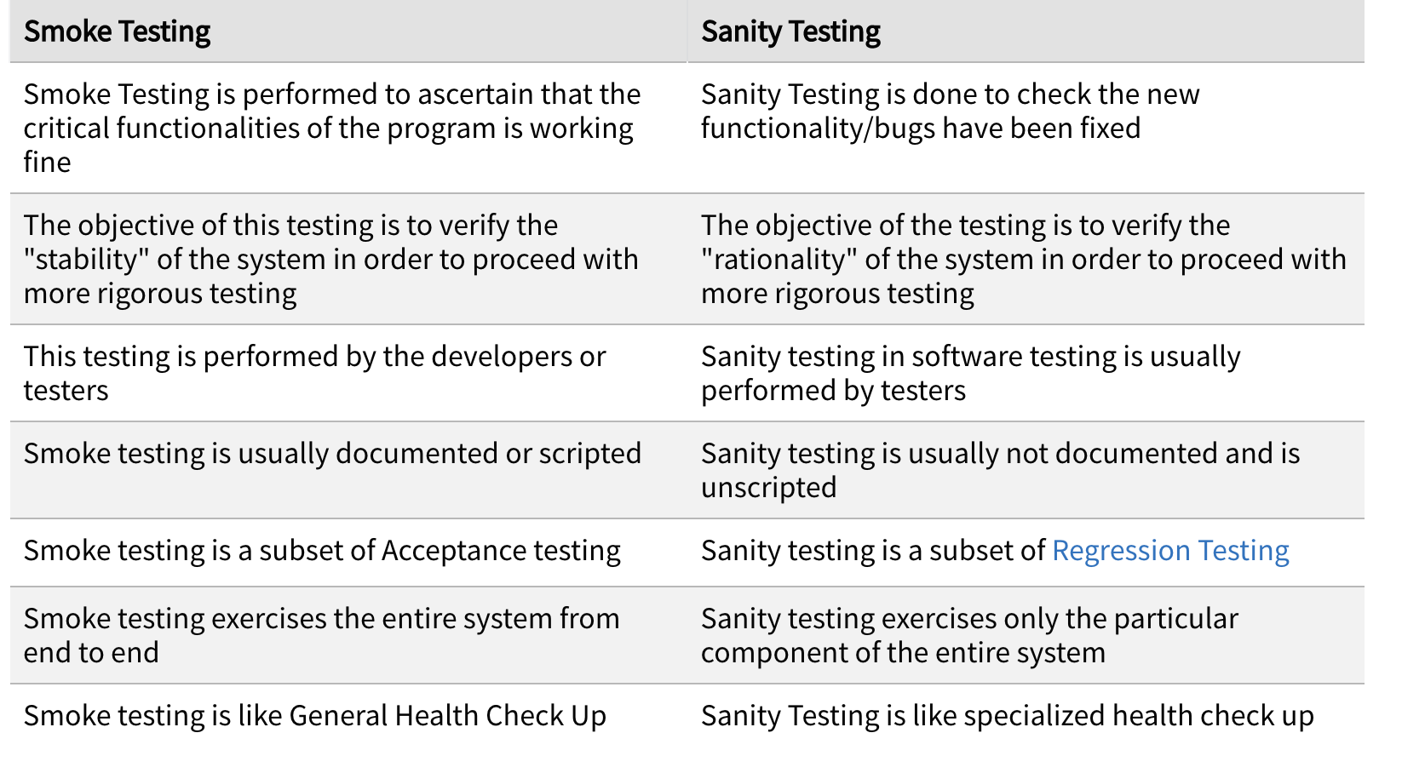
Smoke V/S Sanity Testing

Slide 18
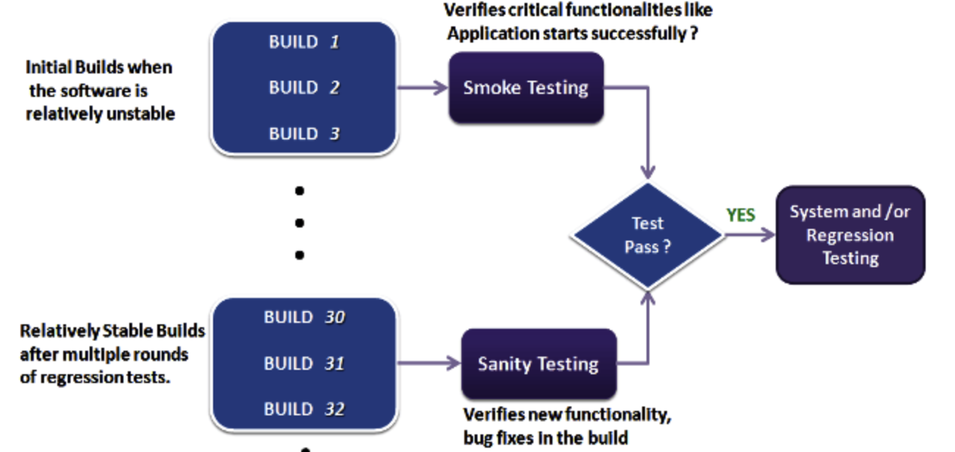
Smoke V/S Sanity Testing
Rapid Regression Testing is Smoke testing

Slide 19
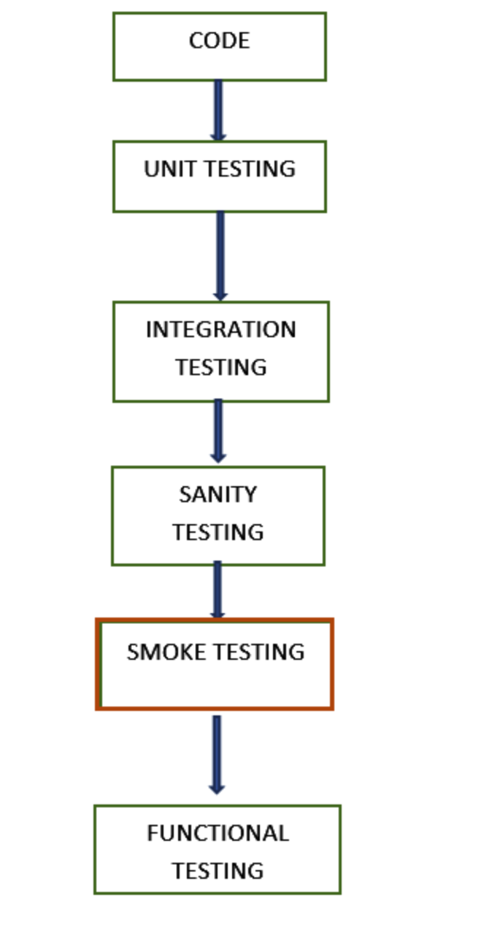
Testing Stages in a Nut-shell

Slide 20
Maintenance Testing : Testing After Release
In general, the software runs many years after it is released.
At times we need to correct or upgrade the software during its run time.
Planned enhancements by the Software Development Firms such as corrective and emergency changes, changes of the operational environment, and patches for defects and vulnerabilities
Request from the end-users to add new features to the existing software.
End-users may want to migrate from one platform to another such as upgrading their environment like operating system, database, etc.,
With the latest updates in the technology if we don’t upgrade the software then it will become obsolete.
It becomes a compulsion on the Software Development Firms to upgrade the software regularly to keep the software up-to-date.
These modifications need to be tested thoroughly. The testing type that is done during this upgrading or enhancing or migration phase is known as Maintenance Testing.

Slide 21
What is Code Coverage?
It’s a measure of your Unit Testing effectiveness
It is used to check if we have sufficient number of Test cases.
Higher the coverage better it is
Min 80% of code coverage is considered farily good Test Suit

Slide 22
What is JCOCO ?
It’s a library (maven plug-in) for measuring Unit Test coverage
It generates reports after you run test suit.
It shows class wise/method-wise coverage
It highlights lines of code with 3 colors
“Fully Covered (Green Diamond)”
Partially Covered (Yellow Diamond)
Not Covered(red diamond).

Slide 23
Setting up JACOCO
<build>
<plugins>
<plugin>
<groupId>org.apache.maven.plugins</groupId>
<artifactId>maven-compiler-plugin</artifactId>
<version>3.6.1</version>
<configuration>
<skipMain>true</skipMain>
<skip>true</skip>
<source>1.8</source>
<target>1.8</target>
</configuration>
</plugin>
<plugin>
<groupId>org.jacoco</groupId>
<artifactId>jacoco-maven-plugin</artifactId>
<version>${jacoco.version}</version>
<executions>
<execution>
<id>prepare-agent</id>
<goals>
<goal>prepare-agent</goal>
</goals>
</execution>
<execution>
<id>report</id>
<phase>prepare-package</phase>
<goals>
<goal>report</goal>
</goals>
</execution>
<execution>
<id>post-unit-test</id>
<phase>test</phase>
<goals>
<goal>report</goal>
</goals>
<configuration>
<!-- Sets the path to the file which contains the execution data. -->
<dataFile>target/jacoco.exec</dataFile>
<!-- Sets the output directory for the code coverage report. -->
<outputDirectory>target/jacoco-ut</outputDirectory>
</configuration>
</execution>
</executions>
<configuration>
<systemPropertyVariables>
<jacoco-agent.destfile>target/jacoco.exec</jacoco-agent.destfile>
</systemPropertyVariables>
</configuration>
</plugin>
</plugins>
</build>
Create a Simple Maven Project
Name it as JcocoDemo
Make changes to pom.xml in plugin section
Create a Junit Test Case for the class
From project folder
Run as Maven test
Got to target/myreports folder and open index.html
Keep modifying it check the coverage
Notes:
Open Project JacocoDemo from ~/CourseMaterial. Workspace and see pom.xml

