Slide 1

Enterprise Knowledge Assistant
Project 2 — Advanced RAG Application
Vivek Kumar | IIT Patna GenAI Development Program
Oeeggis Corporation (Fictional — Academic Project)

Slide 2
Problem Statement
Employees need quick answers from HR, IT, travel, and benefits policies.
Policy information is spread across multiple PDF and text documents.
Manual search is slow, inconsistent, and time-consuming.
Need: a reliable assistant that answers from official company documents only.

Slide 3
Solution Overview
Built an Employee Knowledge Assistant using Retrieval-Augmented Generation (RAG).
Indexes local company documents and retrieves relevant chunks for each question.
Uses hybrid search + reranking for better accuracy.
Generates grounded answers with source citations in a Streamlit chat UI.
Remembers follow-up questions using conversational memory.

Slide 4
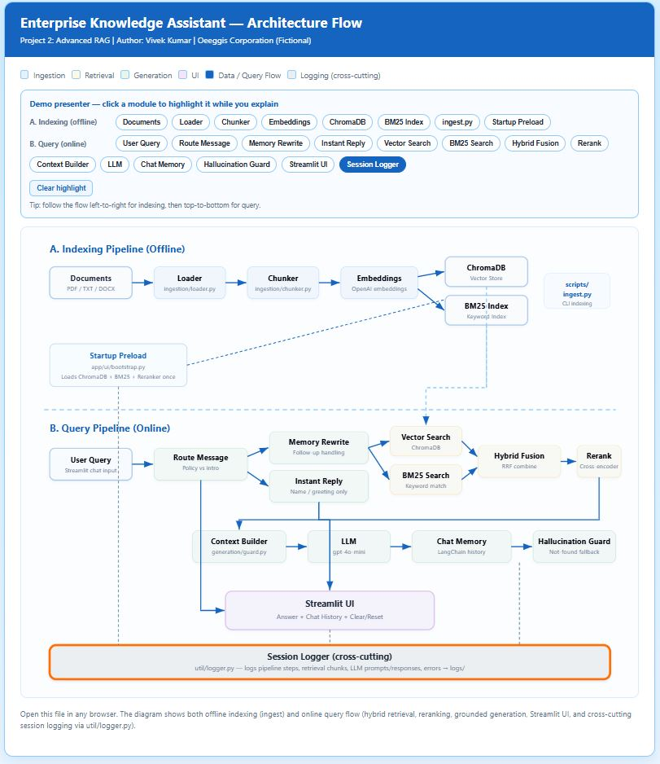
Architecture Flow Diagram
A: Indexing Pipeline (offline) | B: Query Pipeline (online)

Slide 5
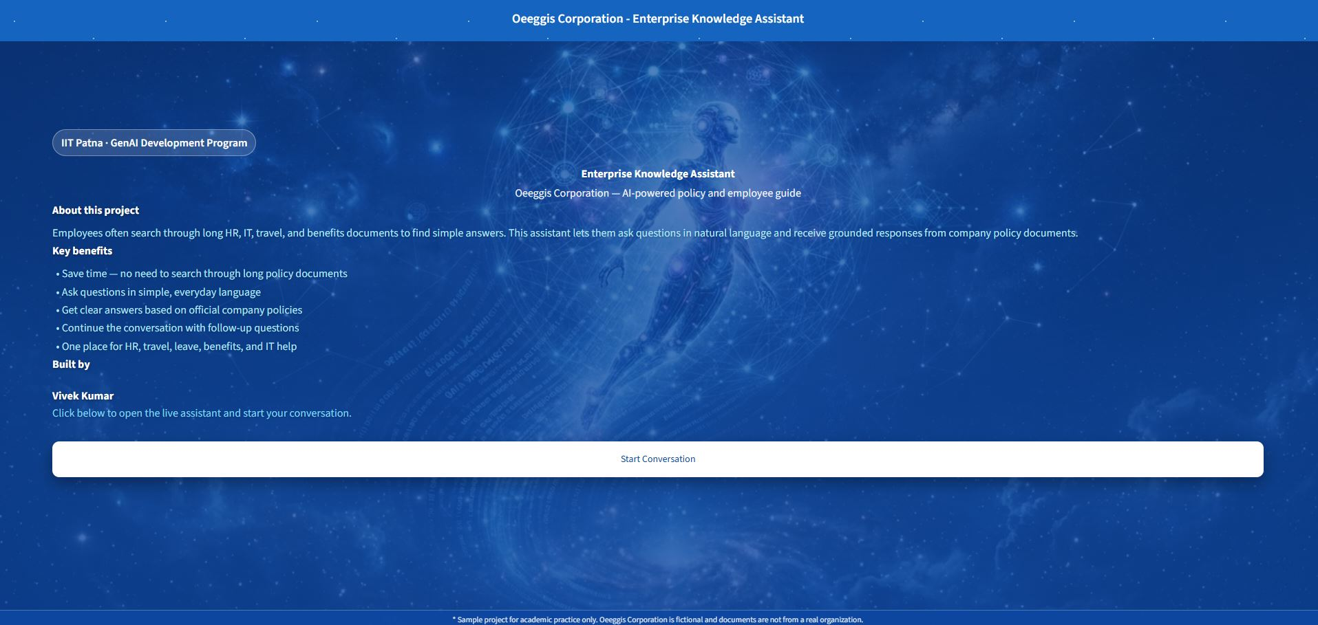
Welcome Screen
Landing page before the user starts a live conversation.

Slide 6
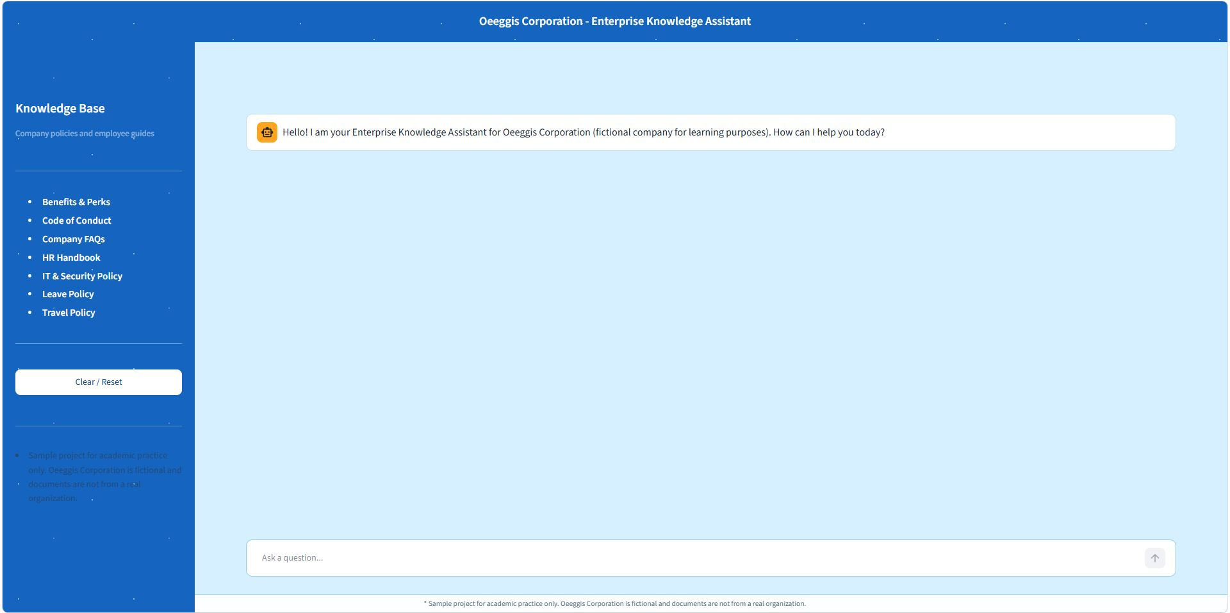
Live Application Screen
Streamlit chat UI with knowledge scope sidebar and assistant greeting.

Slide 7
Technology Stack
Language: Python 3.10+
UI: Streamlit
Framework: LangChain
LLM & Embeddings: OpenAI (gpt-4o-mini, text-embedding-3-small)
Vector Database: ChromaDB
Keyword Search: BM25 (rank-bm25)
Reranking: sentence-transformers cross-encoder

Slide 8
Key Features Implemented
Document ingestion from local folder (PDF, DOCX, TXT)
Chunking, embeddings, and vector storage
Semantic retrieval + BM25 hybrid search
Cross-encoder reranking for relevance
Conversational memory for follow-up questions
Source citations displayed in the UI
Hallucination guard with clear not-found responses

Slide 9
Setup Flow
1. Run setup.bat and python scripts/ingest.py
2. Start app with start.bat → http://localhost:8501
3. Welcome screen → Start Conversation
4. Ask: What is the leave policy?
5. Follow-up: What about carry-forward?
6. Show source citations and Clear / Reset button

Slide 10
How to Run
1. setup.bat (first time only)
2. copy .env.example .env and add OPENAI_API_KEY
3. python scripts/ingest.py
4. start.bat
5. Open http://localhost:8501

Slide 11
Thank You
Questions & Discussion
Vivek Kumar
Enterprise Knowledge Assistant — Advanced RAG

