Slide 1
COLLEGE MINI PROJECT
Library Management System
A simple, reliable web system to manage books, students, and issue–return records from one dashboard.
HTML
CSS
Python · Flask
SQLite
Presented by: [Student Name] | [Roll No.] | [Class / Department]
Guided by: [Faculty Name]

Slide 2
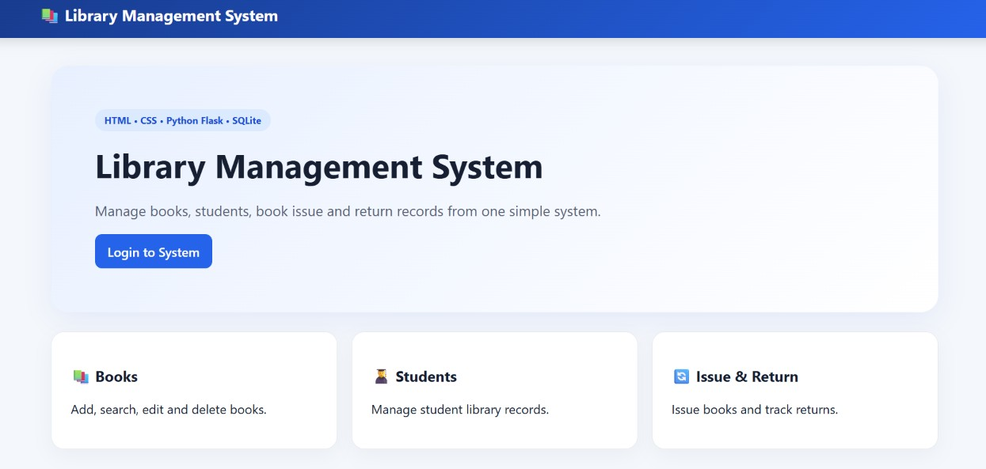
INTRODUCTION
Why a Library Management System?
Manual library registers are slow and error-prone — books get misplaced, dues are forgotten, and student records pile up on paper. This project replaces that process with a lightweight web application that keeps every book, student, and transaction organized and searchable in one place.
🗂️
Centralized records
All book, student, and transaction data lives in a single SQLite database.
⚡
Fast day-to-day use
Add, search, edit, and delete books or students in a few clicks.
🔁
Automatic tracking
Issue and return actions update availability counts instantly.
02

Slide 3
OBJECTIVES
What the System Aims to Achieve
📚
🎓
🔄
Book Management
Student Management
Issue & Return
Add, search, edit and delete book records with title, author, category, ISBN and quantity.
Maintain student details — name, roll number, email and phone — for quick lookup.
Track which book is issued to which student, with issue and due dates.
📊
🔐
🗄️
Live Dashboard
Admin Login
Persistent Storage
See total titles, copies, available books and issued books at a glance.
Restrict management actions to an authenticated admin panel.
Store all data reliably in a lightweight SQLite database.
03

Slide 4
TECHNOLOGY STACK
Built With a Simple, Proven Stack
🧱
🎨
🐍
🗃️
HTML
CSS
Python (Flask)
SQLite
Structures every page — dashboard, forms and tables.
Styles the interface for a clean, readable layout.
Powers the backend — routes, logic and server responses.
Lightweight relational database storing books, students and transactions.
Front end (HTML/CSS) → Flask routes handle requests → SQLite stores and returns data.
04

Slide 5
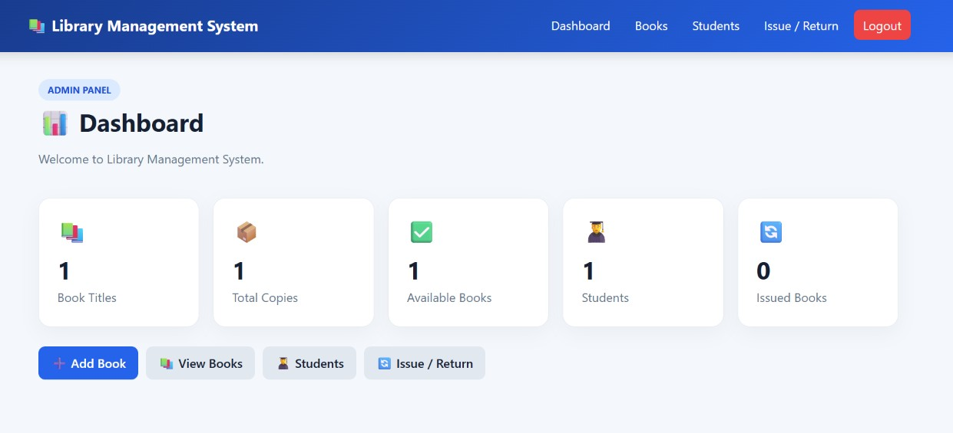
SYSTEM OVERVIEW
Three Core Modules, One Dashboard
📗
🎓
🔁
→
→
Books
Students
Issue & Return
Add, search, edit and delete book records.
Manage student library records.
Issue books and track returns.
All three modules read and write to the same SQLite database, which feeds live counts to the admin dashboard shown below.
05

Slide 6
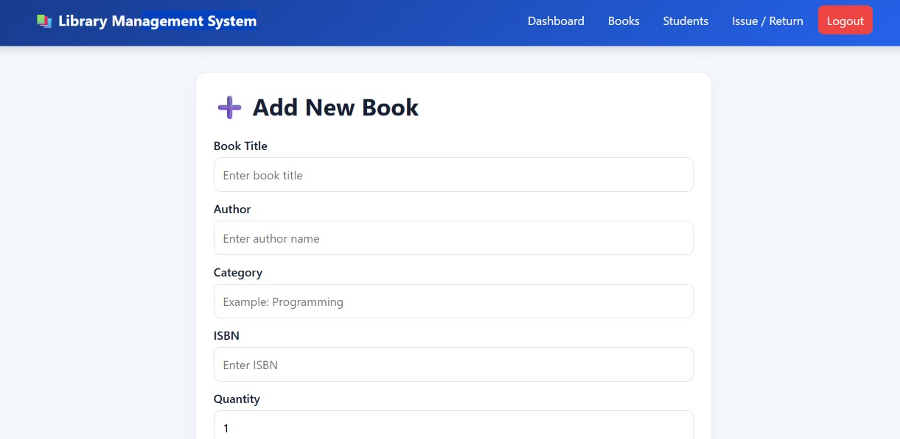
FEATURE WALKTHROUGH
Adding a New Book
The Add Book form captures the details every library needs to track a title — its author, category, ISBN and how many copies are available for issue.
Book Title
Author
Category
ISBN
Quantity
06

Slide 7
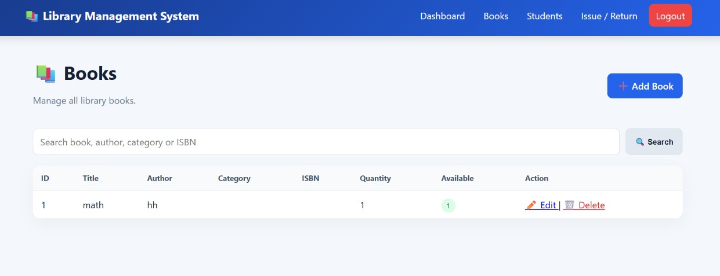
FEATURE WALKTHROUGH
Viewing & Searching Books
🔍
Instant search
Filter by title, author, category or ISBN from one search bar.
📦
Live availability
The Available column updates automatically as books are issued or returned.
✏️
Quick actions
Edit or delete any book directly from the list.
07

Slide 8
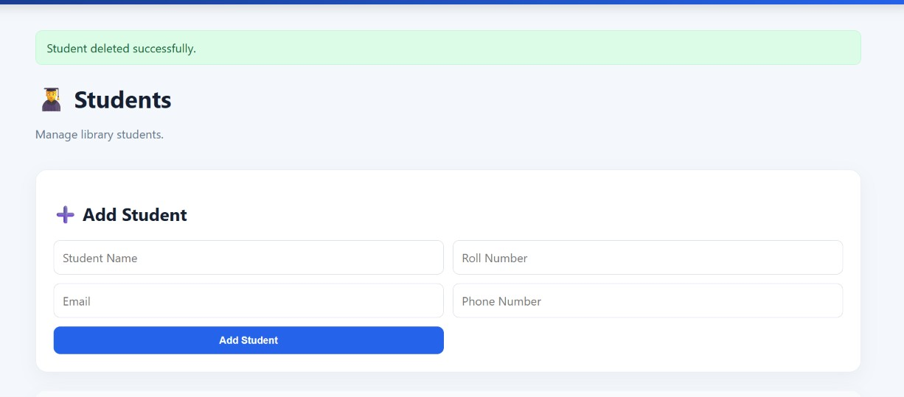
FEATURE WALKTHROUGH
Managing Student Records
Every student is registered with a name, roll number, email and phone number, making it easy to identify who currently holds a book.
Student Name
Roll Number
Email
Phone Number
Records can be added, edited or removed at any time — confirmations like “Student deleted successfully” keep the admin informed.
08

Slide 9
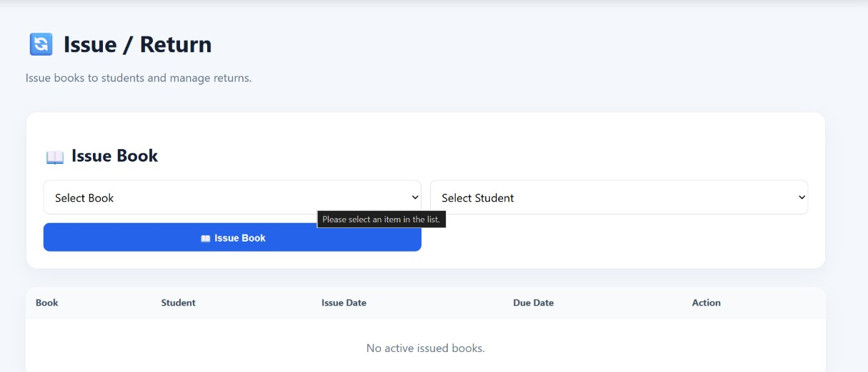
FEATURE WALKTHROUGH
Issuing & Returning Books
1
Select a book and a student from the dropdown lists.
2
Click Issue Book to log the transaction with an issue and due date.
3
Active loans appear in the table below until they are returned.
09

Slide 10
CONCLUSION
Conclusion & Future Scope
The Library Management System successfully replaces manual registers with a fast, searchable web app — giving the admin real-time visibility into books, students and active loans.
Future Enhancements
⏰
Automated overdue reminders via email or SMS
Thank You
📈
Reports and analytics on borrowing trends
Questions & Feedback are welcome
🧾
Barcode/QR scanning for faster issue & return
Library Management System | HTML · CSS · Flask · SQLite
👥
Role-based logins for multiple staff members
10

