Slide 1
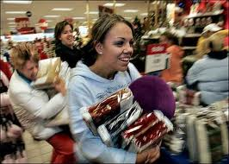
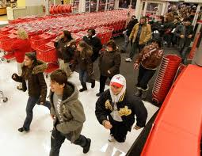
Black Friday
Black Friday is the day after Thanksgiving.

Slide 2
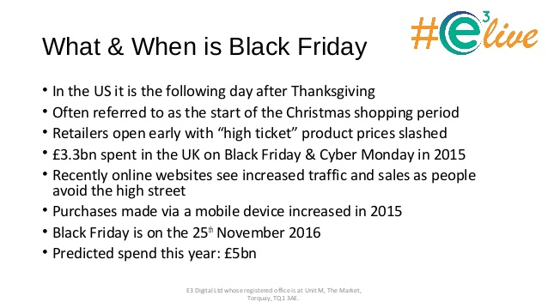
BLACK FRIDAY SALES

Slide 3
Black Friday
For retailers – Black Friday is a big shopping day
There are special deals – discounts – limited quantities
Black = accounting term – black means making a profit; red – means losing money

Slide 4
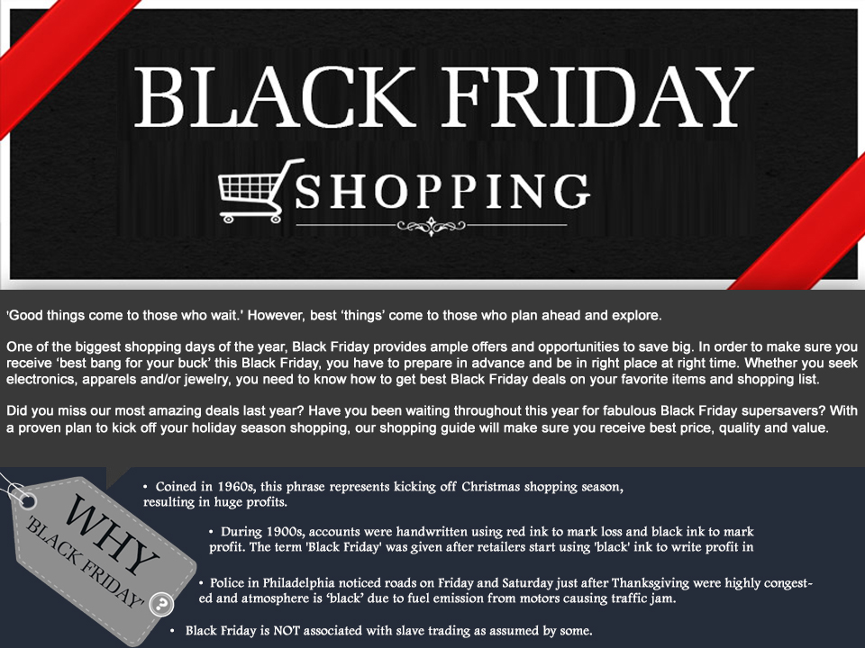
Black Friday

Slide 5
Black Friday sales
Black Friday sales prediction is basically used to predict the sales which helps an organization or company to take decision based on prediction.
There is two variables : Dependent and independent variable
Dependent variable is : Purchase
Rest all is independent variable (data scientist could chose based on his/her requirements)

Slide 6
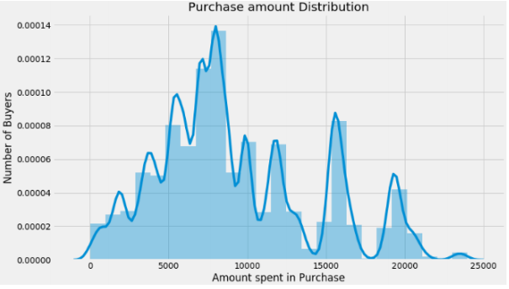
Univarate Analysis
To get an idea of the distribution of numerical variables, histograms are an excellent starting point. Let’s begin by generating one for Purchase, our target variable.

Slide 7
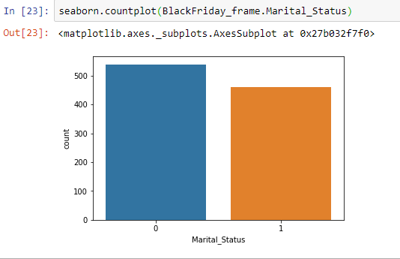
Distribution of the variable Marital Status

Slide 8
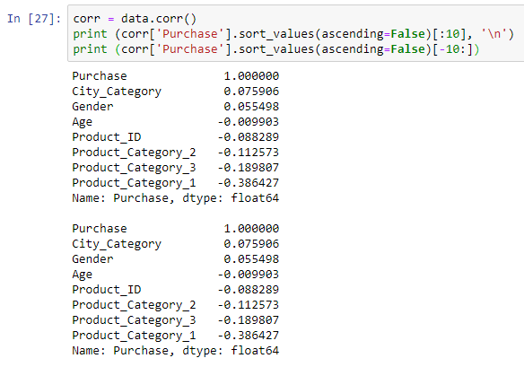
Correlation between Numerical Predictors and Target variable

Slide 9
Applying Algorithm
Basically data scientist applies at least 2-3 algorithm and based on accuracy score he/she decide which model and algorithm is quite efficient .
If the accuracy score is > 70% then that model and algorithm is efficient otherwise need to change the model or need to alter datasets sometimes.

Slide 10
VISUALIZATION
There are multiple no of tools available to visualize the data and predictions.
Visualization basically useful for the representation of data in different graphs,charts and many more which could be easily understand by clients.

Slide 11
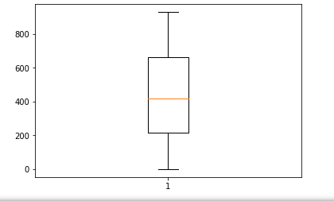
Box Plot
It is the visual representation of the depicting groups of numerical data through their quartiles. Boxplot is also used for detect the outlier in data set. It captures the summary of the data efficiently with a simple box and whiskers and allows us to compare easily across groups.

Slide 12
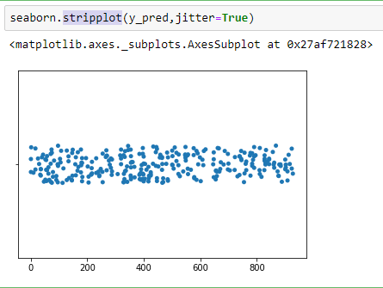
Stripplot :
A strip plot can be drawn on its own, but it is also a good complement to a box or violin plot in cases where you want to show all observations along with some representation of the underlying distribution.

Slide 13
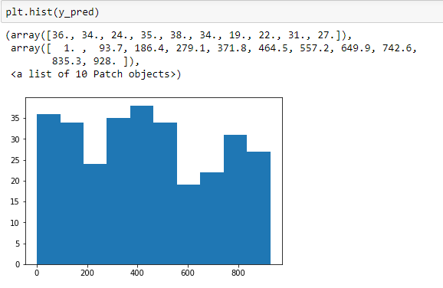
Histogram

Slide 14
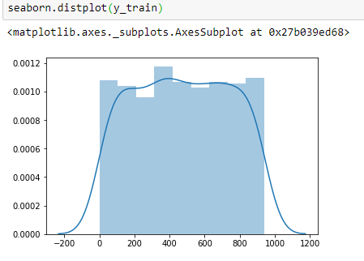
Distplot

Slide 15
Conclusion:
The future of Black Friday will rely on customer experience and the offerings driving demand. People need to feel like the While more bargain hunters opened their wallets for Black Friday this year, on average they spent a little less than in last year. Black Friday sales are still increasing, which is promising for retail. Effectively utilising this strong online trend is key for retailers to ensure Black Friday is still a profitable event. But a slow down in the intent of customers to buy things may indicate that interest is waning and expectation is increasing.

