Slide 1
Anomaly detection in crowd through smartphone dataset
Objective: Anomaly detection in crowd behavior using smartphone datasets means identifying unusual patterns or behaviors among individuals in a crowd. Smartphones, installed with various sensors like GPS, accelerometers, cameras, and gyroscopes, collect extensive data that can be analyzed to monitor movement, location, and activity. By applying machine learning algorithms and statistical methods to this data, anomalies such as sudden stops, erratic movements, or unexpected gatherings can be detected. This process helps in enhancing public safety, managing crowds in real-time, and preventing potential hazards. Effective anomaly detection leverages both the diversity and richness of smartphone data to provide timely and accurate insights.

Slide 2
Data Parameters: 'timestamp', 'X', 'Y', 'Speed', 'Heading', 'AgentCount', 'Density', 'Acc', 'LevelOfCrowdness', 'label',
Importing Libraries:
import numpy as np
import pandas as pd
import matplotlib.pyplot as plt # visualizing data
%matplotlib inline
import seaborn as sns
from sklearn.neighbors import LocalOutlierFactor
from sklearn.neighbors import KNeighborsClassifier
from sklearn.tree import DecisionTreeClassifier
from sklearn.model_selection import train_test_split
from sklearn.metrics import classification_report, accuracy_score

Slide 3
df.head() # sample of dataset
timestamp | X | Y | Speed | Heading | AgentCount | Density | Acc | LevelOfCrowdness | label | label2 | Severity_level
0 | 0:05:36 | 0.4225 | 19.1176 | 1.1432 | 89.1222 | 81 | 0.81 | -0.0027 | 1 | 0 | normal | 0
1 | 0:05:37 | 0.3704 | 19.5130 | 1.1476 | 89.5976 | 83 | 0.83 | -0.0027 | 1 | 0 | normal | 0
2 | 0:05:38 | 0.3999 | 19.8316 | 1.1466 | 89.4905 | 86 | 0.86 | -0.0051 | 1 | 0 | normal | 0
3 | 0:05:39 | 0.3787 | 20.0386 | 1.1521 | 89.2123 | 88 | 0.88 | -0.0009 | 1 | 0 | normal | 0
4 | 0:05:40 | 0.4031 | 20.4625 | 1.1499 | 89.2521 | 88 | 0.88 | -0.0012 | 1 | 0 | normal | 0

Slide 4
Feature Engineering
#check for null values
pd.isnull(df).sum()
timestamp 0
X 0
Y 0
Speed 0
Heading 0
AgentCount 0
Density 0
Acc 104 Total 104 attributes found with null values
LevelOfCrowdness 0
label 0
label2 0
Severity_level 0
dtype: int64
It can be removed by---
df.dropna(inplace=True) # drop null values

Slide 5
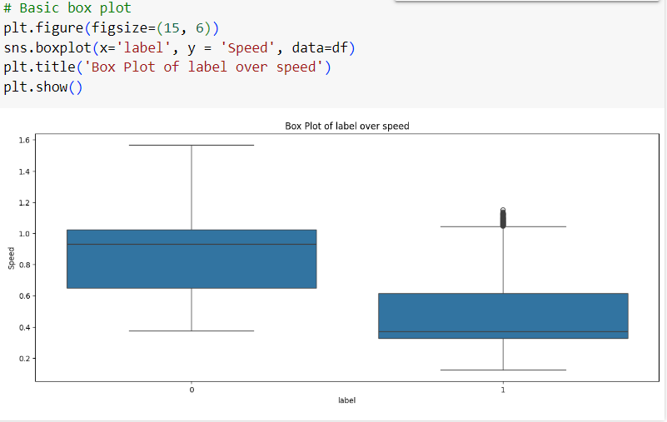
Exploratory Data Analysis (EDA)

Slide 6
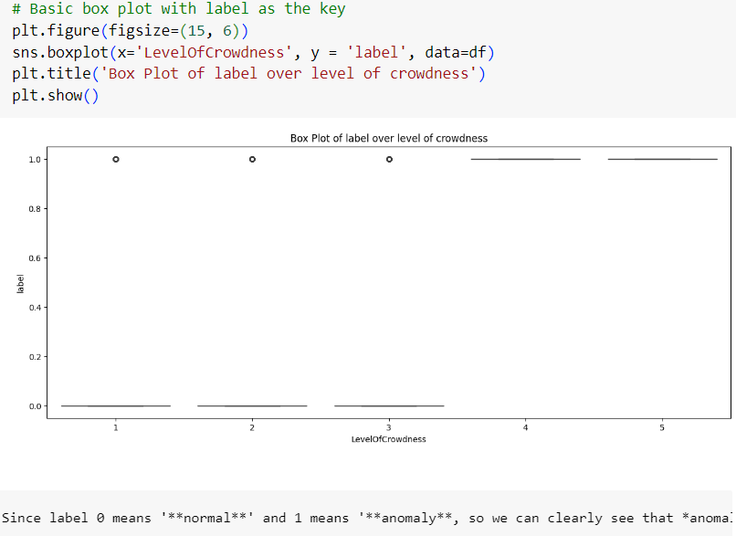

Slide 7
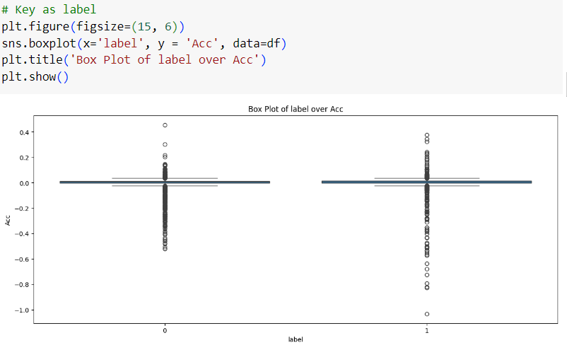

Slide 8
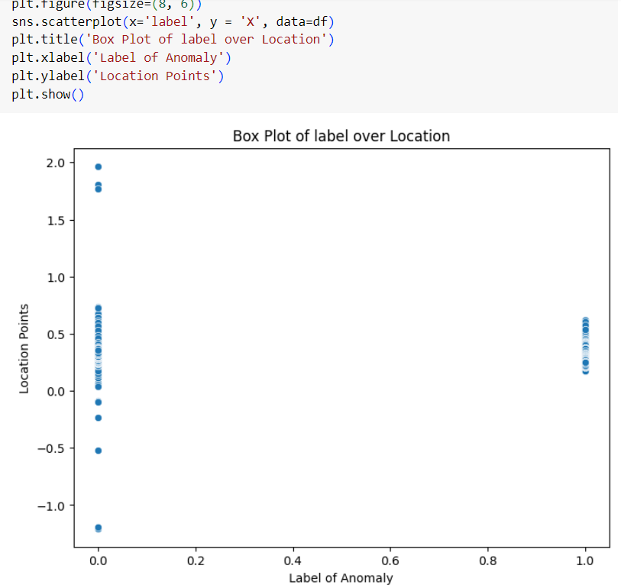

Slide 9
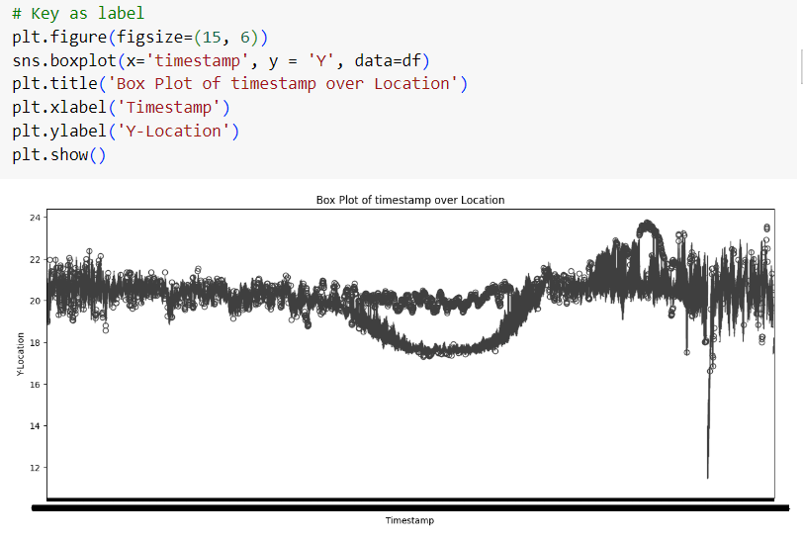

Slide 10
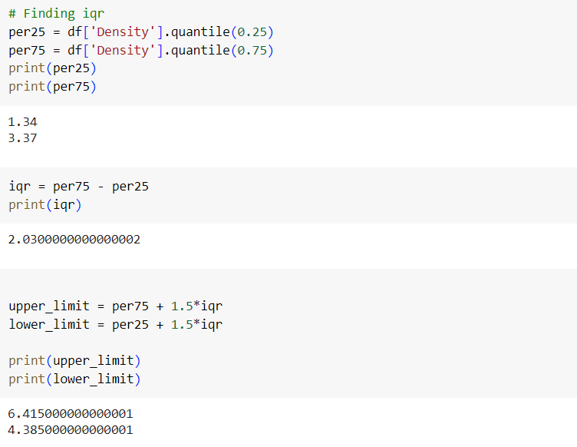
Interquartile Range (IQR)

Slide 11
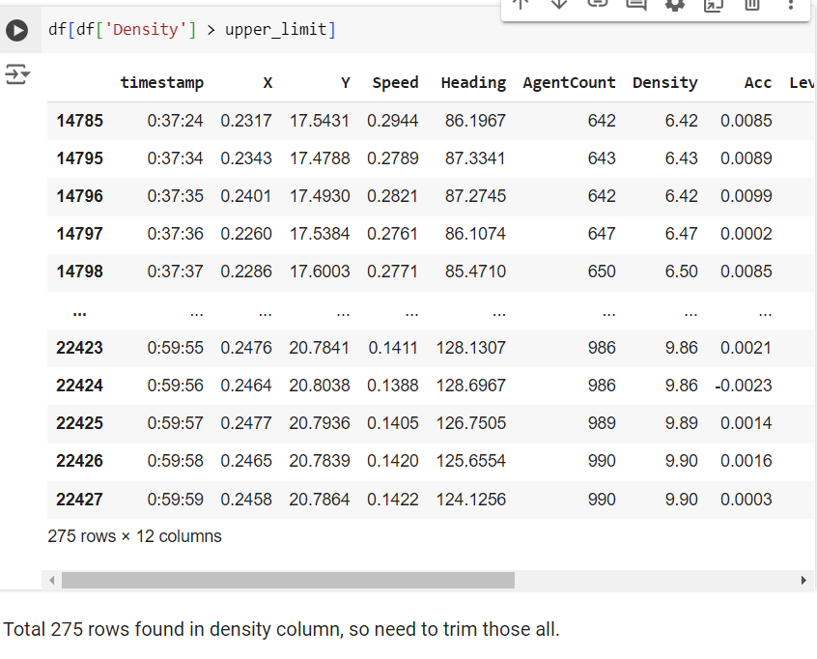
Finding Outliers

Slide 12
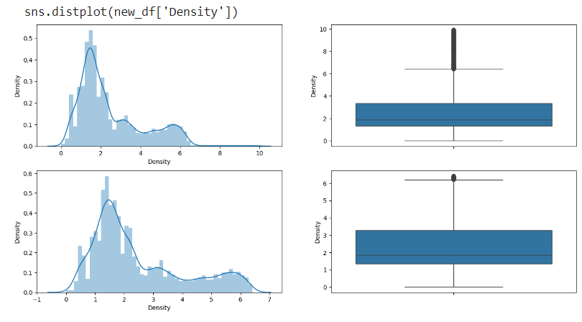
TRIMMING OF DATASET

Slide 13
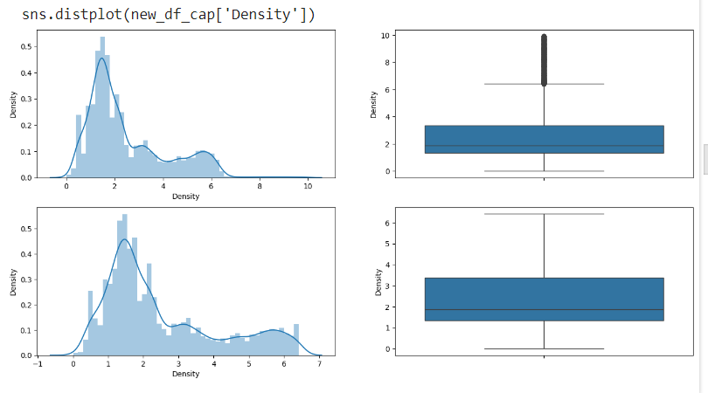
CAPPING
(since Triming was not able to remove all those outliers)

Slide 14
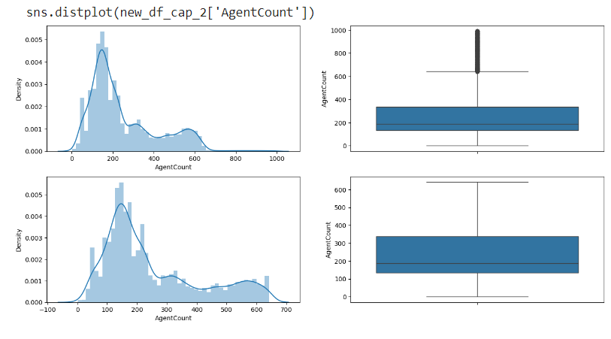
Similarly for AgentCount coulumn

Slide 15
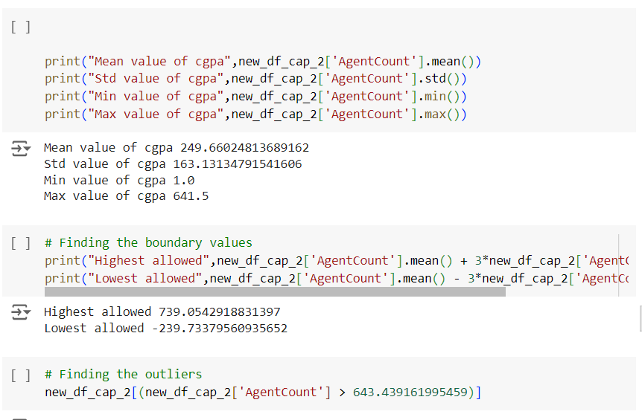
Z-Squared Testing

Slide 16
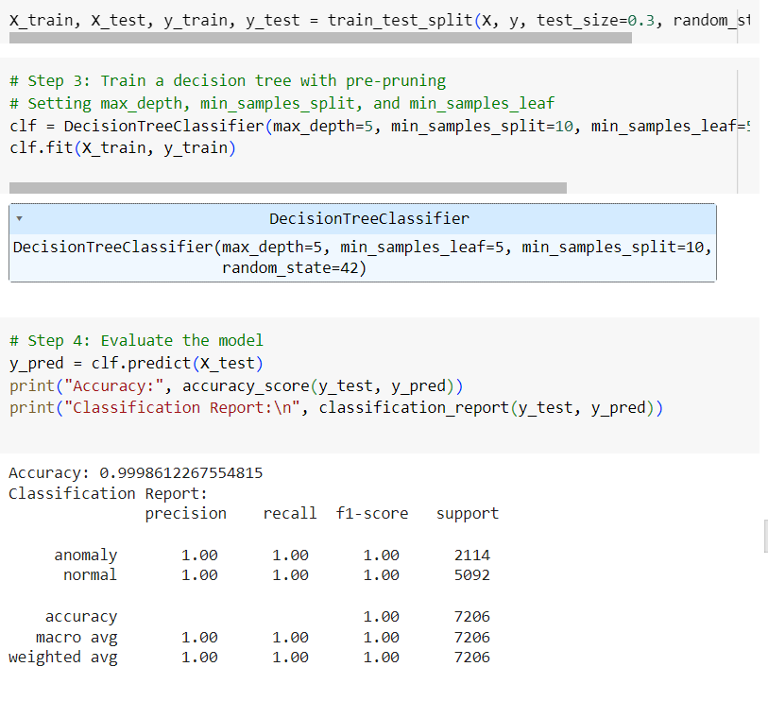
Decision Tree Model (post pruning)

Slide 17
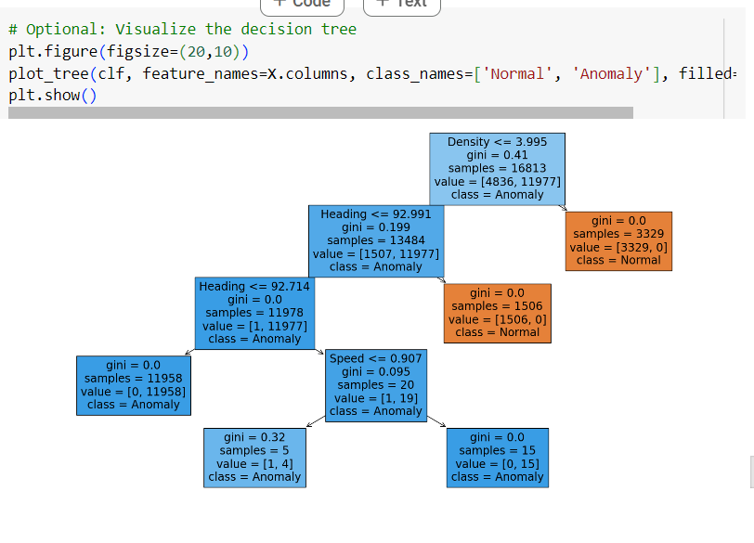
Visualizing Decision Tree

Slide 18
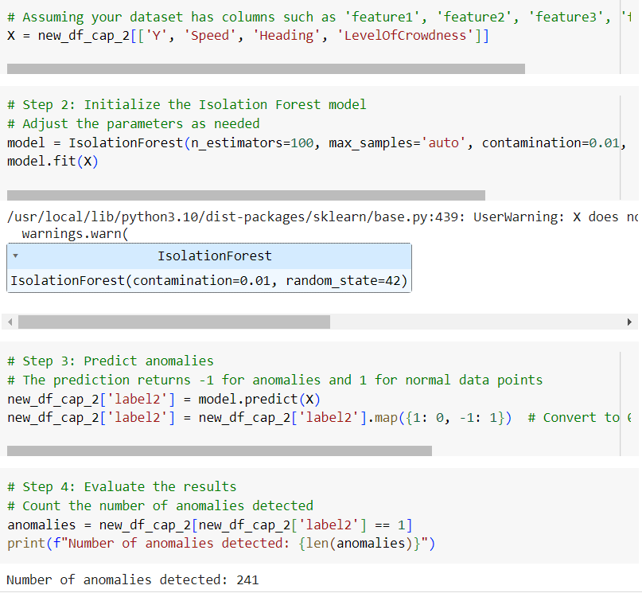
ISOLATION FOREST

Slide 19
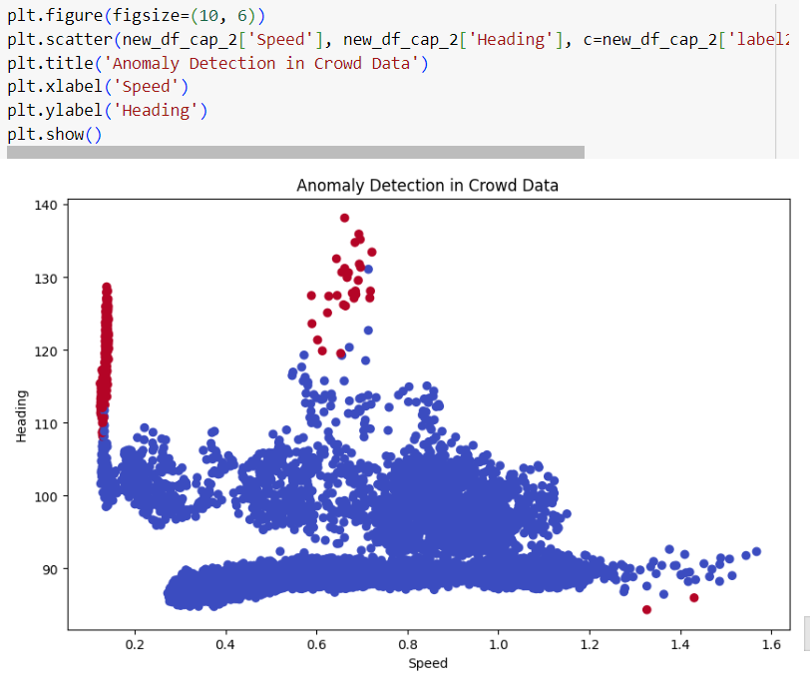
Visualizing the Graph

Slide 20
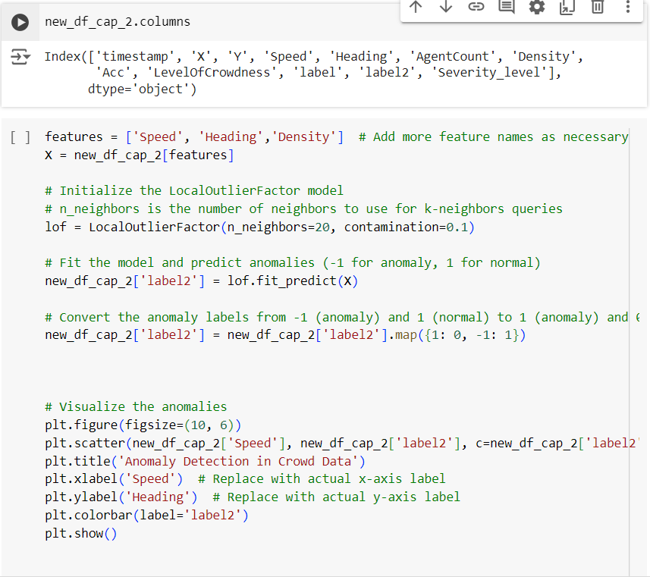
K-NN Model Training

Slide 21
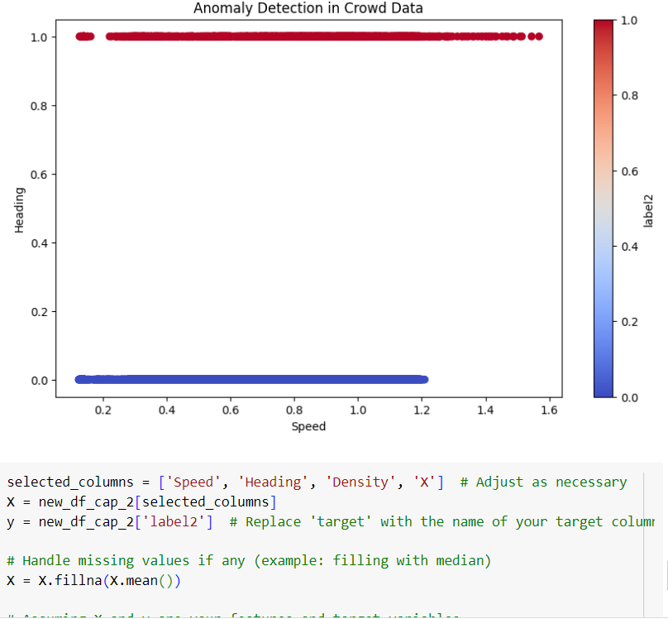
Visualizing the Graph

Slide 22
