Slide 1

End Term Presentation for Course Project in IE506
Title: PRanking with Ranking
Team: Vasusena
Vivek Kumar Trivedi (22N0457)
Instructor: Prof. P. Balamurugan
IEOR,IIT Bombay

Slide 2
Outline
Problem Overview
Work done before Midsem
Major Comment
Proposed idea
Work Done after Midsem
Conclusion
Future Direction
References

Slide 3













Problem Overview
Problem Setting
Online Framework
n
Algorithm works in rounds
On each round the ranking algorithm
Gets an input instance
Outputs a rank as prediction
Receives the correct rank-value
Computes loss
Updates the rank-prediction rule
Instances X ∈ R
Labels y ∈ {1,2,…,k}
Structure 1<2<3<…….<k
Ranking rule f:R → {1,2,….,k}
n
Machine prediction
User’s Rating
Image Source: IMDb and google

Slide 4
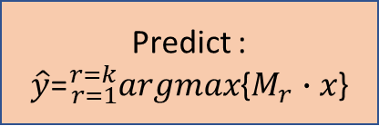
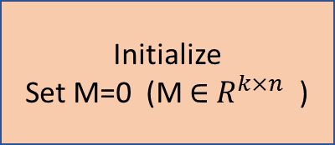
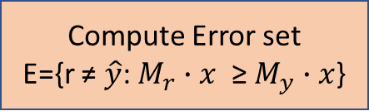
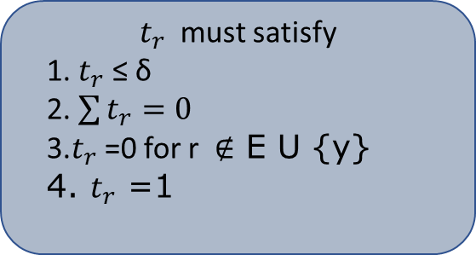
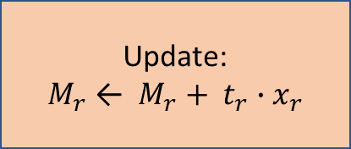
Work done before Mid-sem (contd..)
$t_{r}$ must satisfy
1. $t_{r}$ ≤ δ
2. $\sum{t_{r}}=0$
3.$t_{r}$ =0 for r ∉ E U {y}
4. $t_{r}$ =1
Initialize
Set M=0 (M ∈ $R^{k×n}$ )
Get an instance x
t2*X
Maintain M
M1+t1*X
Predict :
$\hat{y}$=${}_{r=1}^{r=k}{argmax}${$M_{r}∙x$}
M2+t2*X
t1*X
M2
M1
Update:
$M_{r}$ ← $M_{r}+ t_{r}∙x_{r}$
X
M4
Get the true rank y
M3
No
M3+t3*X
Compute Error set
E={r ≠ $\hat{y}$: $M_{r}∙x$ ≥ $M_{y}∙x$}
E ≠ ϕ
Four class probem
Yes
?

Slide 5
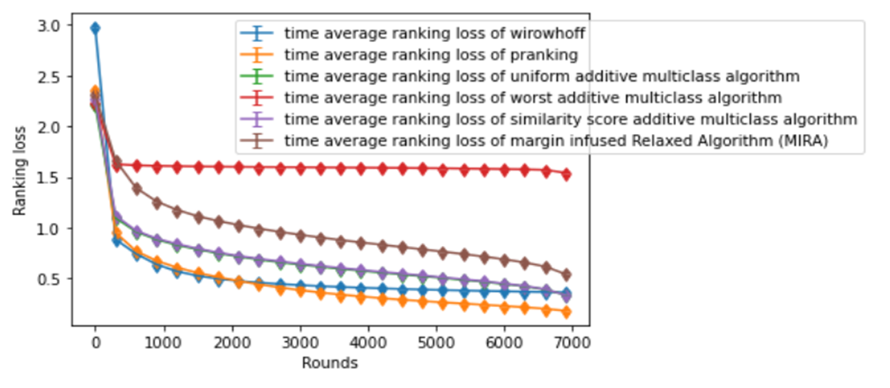
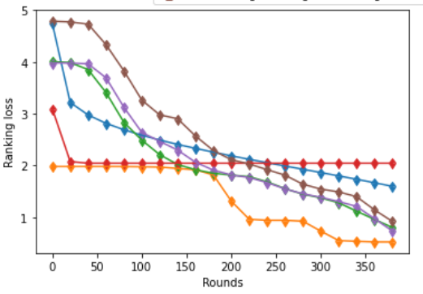
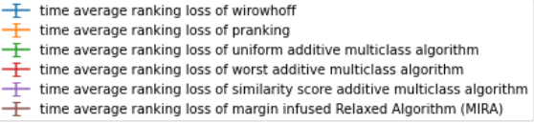
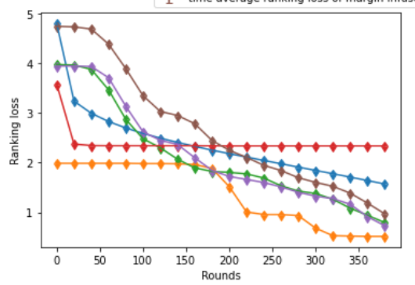
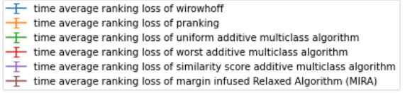
Work done before Mid-sem (contd..)
Synthetic Dataset
Ranking loss (at least 100 movies) with 95% Confidence Interval
Ranking loss (at least 200 movies) with 95% Confidence Interval
Data Source: Paul McJones. Each movie collaborative filtering data set. DEC Systems Research Center, 1997. http://www.research.digital.com/SRC/eachmovie/

Slide 6
Major Comment
Will Try to apply multilayer instead of one layer as given in paper
Will try to implement on IMDb movie review dataset

Slide 7
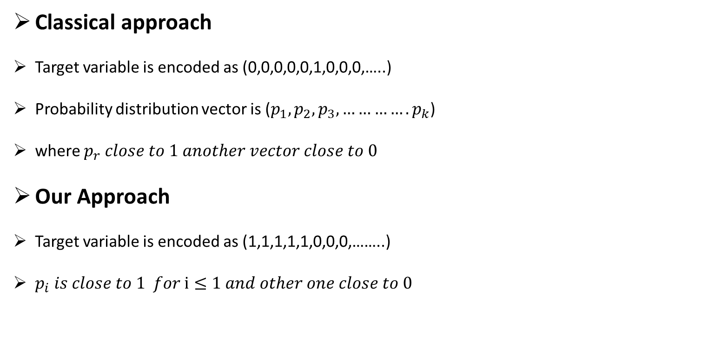
Proposed Idea
Classical approach
Target variable is encoded as (0,0,0,0,0,1,0,0,0,…..)
Probability distribution vector is ($p_{1},p_{2},p_{3},………….p_{k}$)
where $p_{r} close to 1 another vector close to 0$
Our Approach
Target variable is encoded as (1,1,1,1,1,0,0,0,……..)
$p_{i} is close to 1 for i≤1 and other one close to 0$

Slide 8
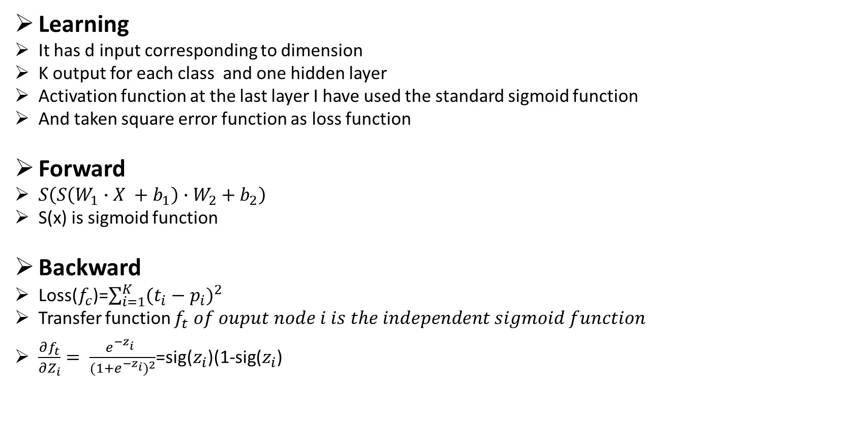
Proposed Idea (contd..)
Learning
It has d input corresponding to dimension
K output for each class and one hidden layer
Activation function at the last layer I have used the standard sigmoid function
And taken square error function as loss function
Forward
$S\left(S\left(W_{1}∙X +b_{1}\right)∙W_{2}+b_{2}\right)$
S(x) is sigmoid function
Backward
Loss($f_{c}$)=$\sum_{i=1}^{K}{{(t_{i}−p_{i})}^{2}}$
Transfer function $f_{t} of ouput node i is the independent sigmoid function$
$\frac{∂f_{t}}{∂Z_{i}}= \frac{e^{{−z}_{i}^{}}}{{(1+e^{{−z}_{i}})}^{2}}$=sig($z_{i}$)(1-sig($z_{i}$)

Slide 9
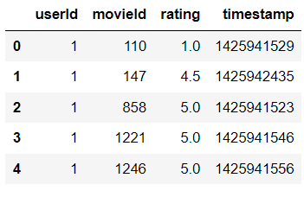
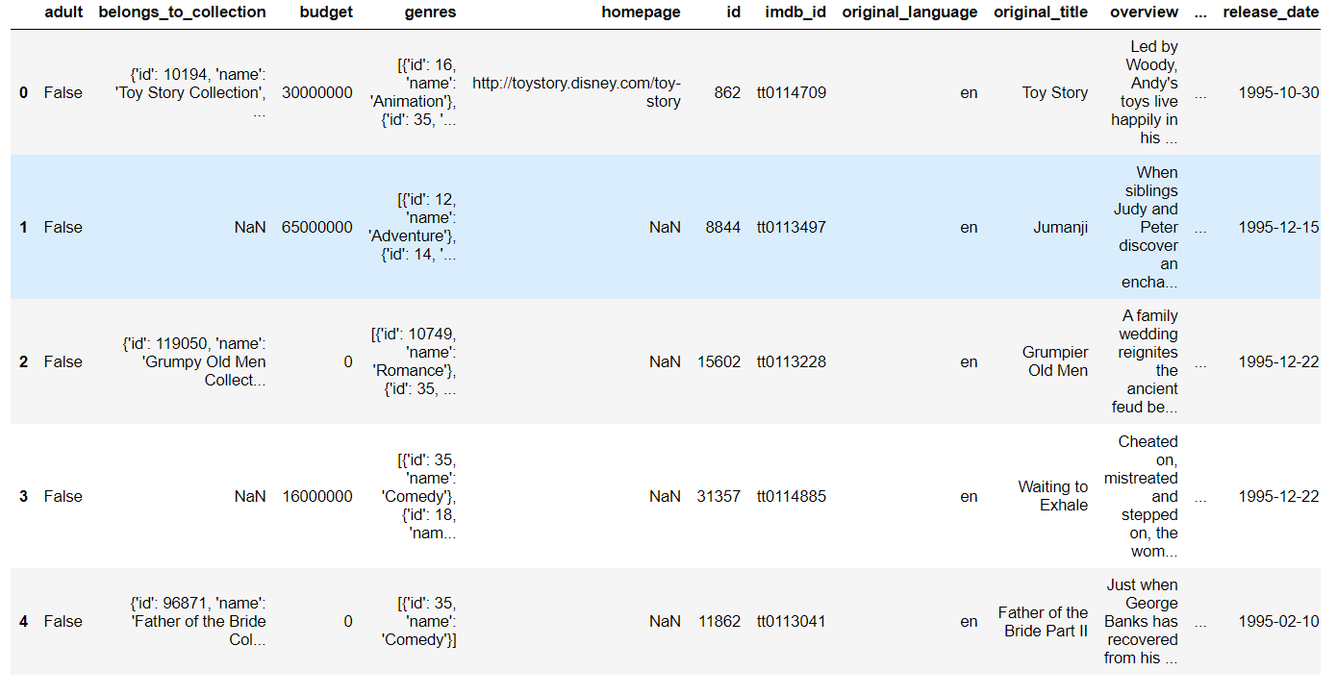
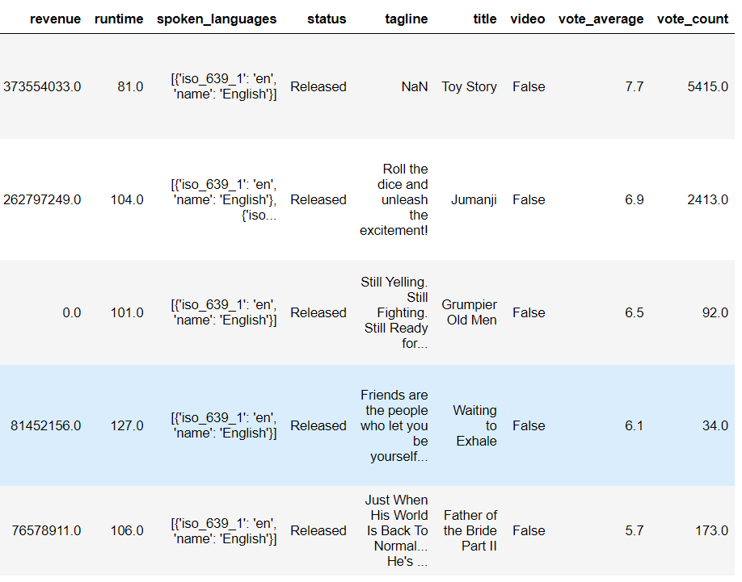
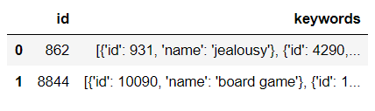
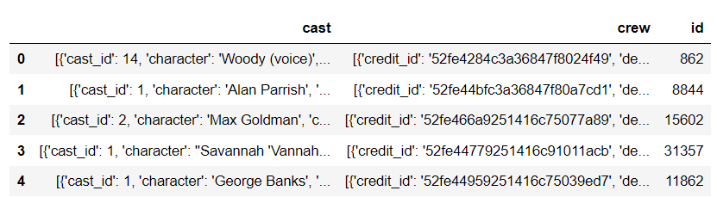
Work done after Mid-sem
Source: https://www.kaggle.com/datasets/rounakbanik/the-movies-dataset
Implemented Code on IMDB and TMDB movie Review Dataset
Description
Metadata files for 45,000 movies listed in the Full MovieLens Dataset
Dataset includes movies released on or before July 2017
Data points in metadata files include: cast, crew, plot keywords, budget, revenue, posters, release dates, languages, production companies, countries, TMDB vote counts and vote averages
Dataset also includes files containing 26 million ratings from 270,000 users for all 45,000 movies
Ratings are on a scale of 1-5 and obtained from the official GroupLens website
Rating
Movie Meta Data
Keywords
Credit DataFrame

Slide 10
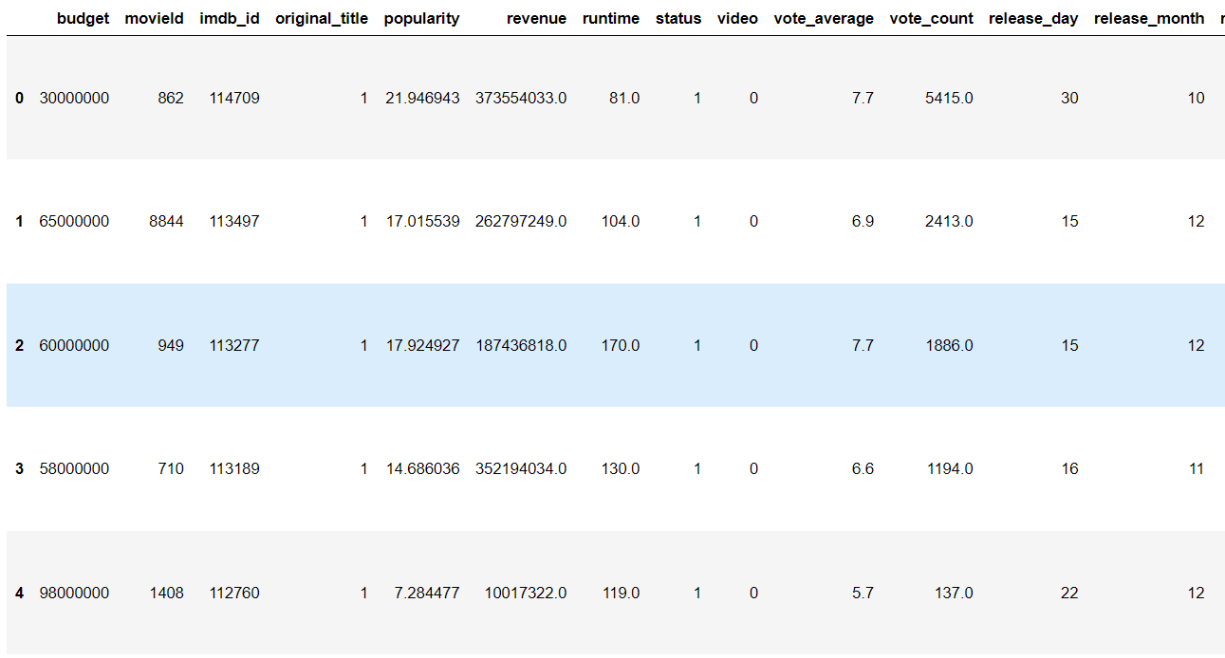
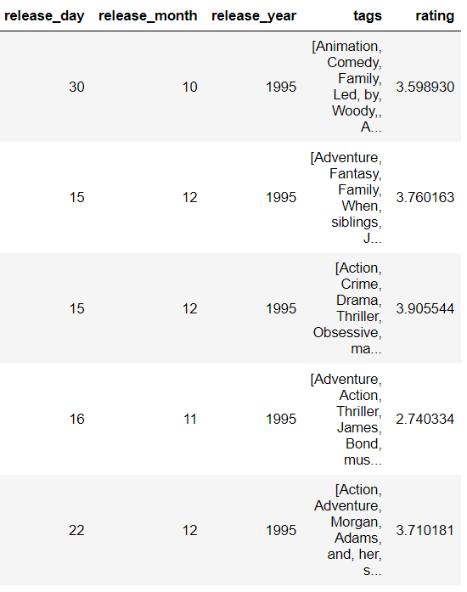
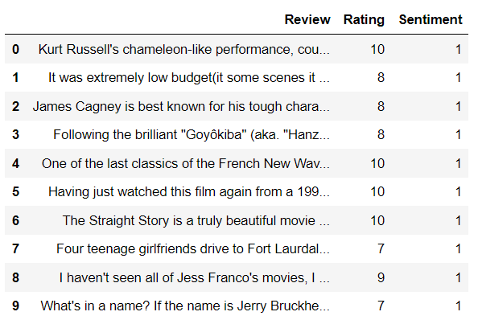
Work done after Mid-sem(contd..)
Merging Dataset and Pre-processing
After Pre-processing
IMDB movie Review Dataset
Source: https://www.kaggle.com/code/nisargchodavadiya/movie-review-analytics-sentiment-ratings/notebook

Slide 11
Work done after Mid-sem(contd...)
Using Stopword Module from NLTK
provides a list of commonly used words that are often excluded from text analysis
These stopwords typically include words like a ,an ,the ,in ,of and many others that are considered to be of little value in determining the meaning of a text
Using Porter Stemmer from NLTK
The stemming process involves removing suffixes from words to obtain their root form, which may not always be an actual word.
The Porter Stemmer algorithm follows a set of rules for stemming that are based on common English word endings.
Like jumping to jump, singing to sing, and walked to walk

Slide 12
Work done after Mid-sem(Contd...)
Using Count Vectorizer from Sklearn
Tokenization: The text data is split into individual words (or tokens) using the specified analyzer.
By default, Count Vectorizer uses the 'word' analyzer, which splits text on whitespace and punctuation.
Vocabulary creation: A vocabulary of unique tokens is created from the text data.
Each token is assigned a unique integer index in the vocabulary, which corresponds to the column in the feature matrix.
Counting: For each document, the occurrence count of each token in the vocabulary is computed
result is stored in the corresponding row of the feature matrix.
Transformation: The resulting feature matrix is a sparse matrix, where each row represents a document and each column represents a token in the vocabulary.
The values in the matrix indicate the occurrence count of each token in the corresponding document.

Slide 13
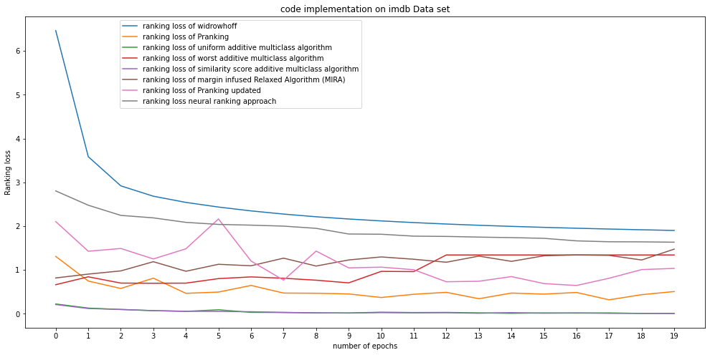
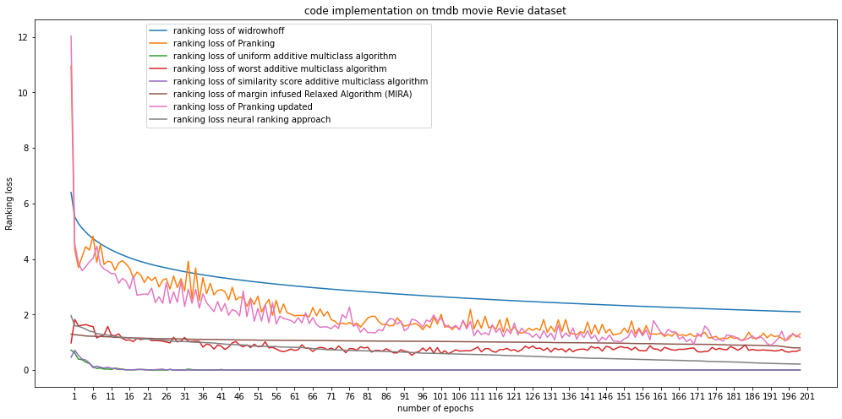
Work done after Mid-sem(Contd..)

Slide 14
Conclusion
Pranking Outperform only when if there is the possibility that in higher dimension label is parallelly separable
Our neural network approach performs well in all scenario
additive multiclass algorithm is also perform well on IMDB and TMDB movie review Dataset

Slide 15
Future Direction
We can use pairwise approach for ranking if we only care about order not their actual rank
Developing Recommendation System

Slide 16
References
[1]Crammer, K., Singer, Y.: Pranking with ranking. In: Advances in Neural Information Processing Systems 14 [Neural Information Processing Systems: Natural and Synthetic, NIPS 2001], pp. 641–647. MIT Press (2001)
[2] William W. Cohen, Robert E. Schapire, and Yoram Singer. Learning to order things. Journal of Artificial Intelligence Research, 10:243- 270, 1999.
[3] Crammer and Y. Singer. Ultraconservative online algorithms for multiclass problems. Proc. of the Fourteenth Annual ConI on Computational Learning Theory, 200l.
[4] Y. Freund, R. Iyer, R. E. Schapire, and Y. Singer. An efficient boosting algorithm for combining preferences. Machine Learning: Proc. of the Fifteenth Inti. ConI, 1998
[5] R. Herbrich, T. Graepel, and K. Obermayer. Large margin rank boundaries for ordinal regression. Advances in Large Margin Classifiers. MIT Press, 2000
[6] Paul McJones. EachMovie collaborative filtering data set. DEC Systems Research Center, 1997. http://www.research.digital.com/SRC/eachmovie/
[7] F. Rosenblatt. The perceptron: A probabilistic model for information storage and organization in the brain. Psychological Review, 65:386–407, 1958
[8] TMDB movie review Data https://www.kaggle.com/datasets/rounakbanik/the-movies-dataset
[9] IMDB movie review Dataset Source: https://www.kaggle.com/code/nisargchodavadiya/movie-review-analytics-sentiment-ratings/notebook

