Slide 1
Modelling and Analysis of Cryptocurrencies

Slide 2
Introduction
The dataset of cryptocurrencies starting from 1st January 2015 to 31st December 2024, is used to analyse market trends, volatility of the crypto market and make price predictions of different coins for specific duration (next day or next week). Collected from Kaggle, it includes daily price points of different coins, allowing comparison and helping in making more informed decisions about trading in extremely agile crypto currency market.

Slide 3


Objective
The objective is to accurately predict the opening prices of cryptocurrencies by analyzing historical market data, identifying key trends, and leveraging advanced regression models for precise forecasting.

Slide 4
Data Description
Date
Open
High
Volume
Date/Time
Numerical
Numerical
Numerical
Symbol
Close
Low
String
Numerical
Numerical

Slide 5
Data Pre-Processing
Data Cleaning and Formatting
Filtering the Data for Unique Values
Checking for missing data for specific time period
Counting Data Points for Each Symbol
Filtering Cryptos Based on Data Availability
Final Data Filtering

Slide 6
Descriptive Analysis

Slide 7
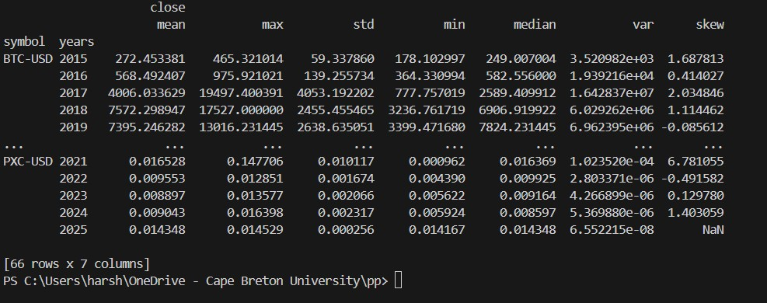
Statistical Summary

Slide 8
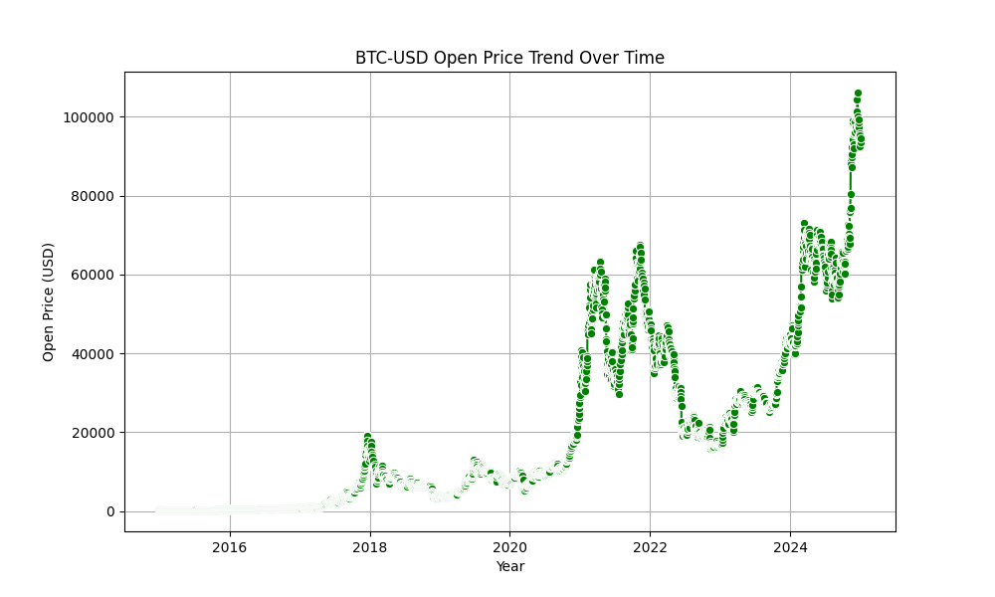
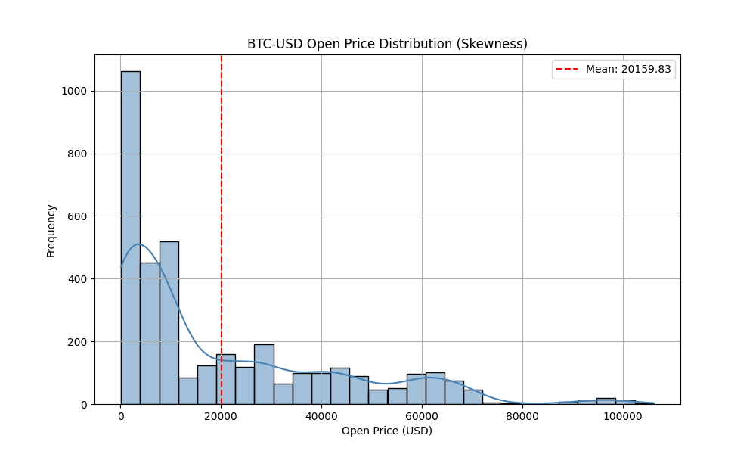
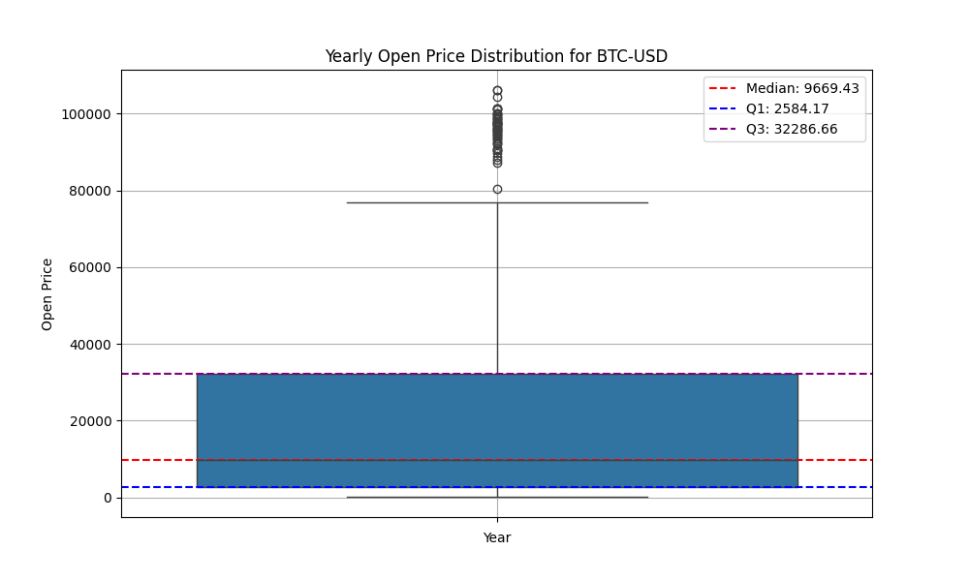
Bitcoin ”BTC-USD”

Slide 9
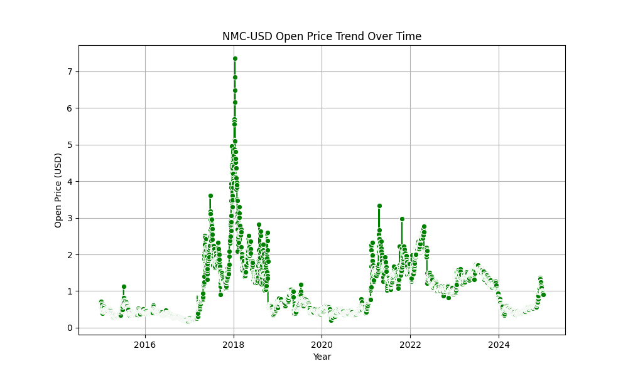
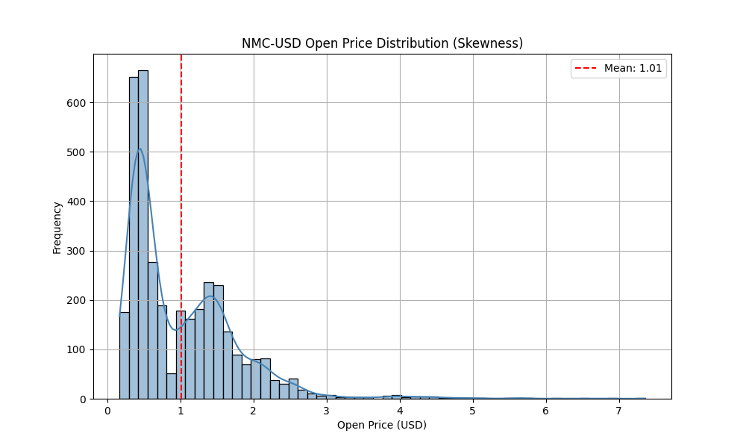
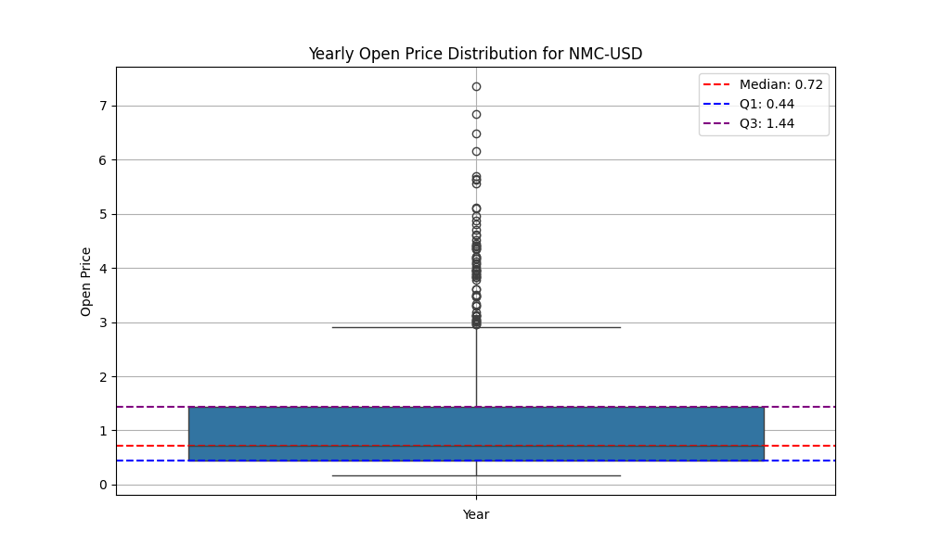
Namecoin ”NMC-USD”

Slide 10
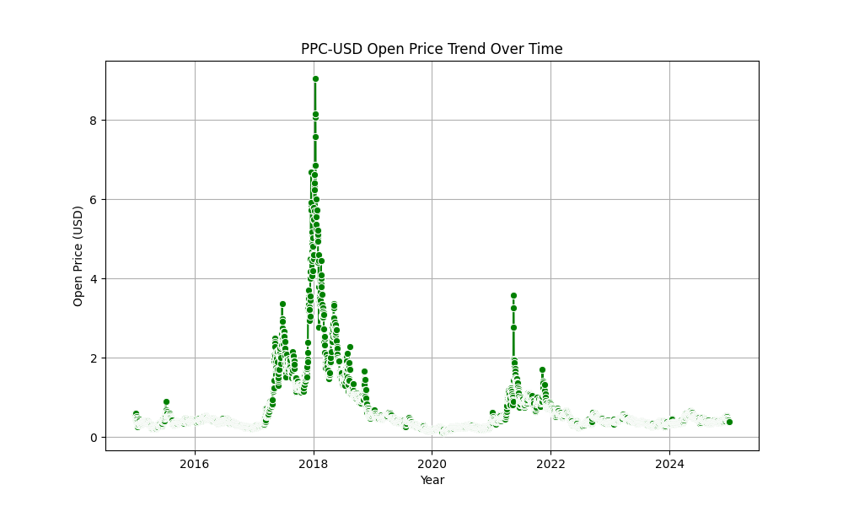
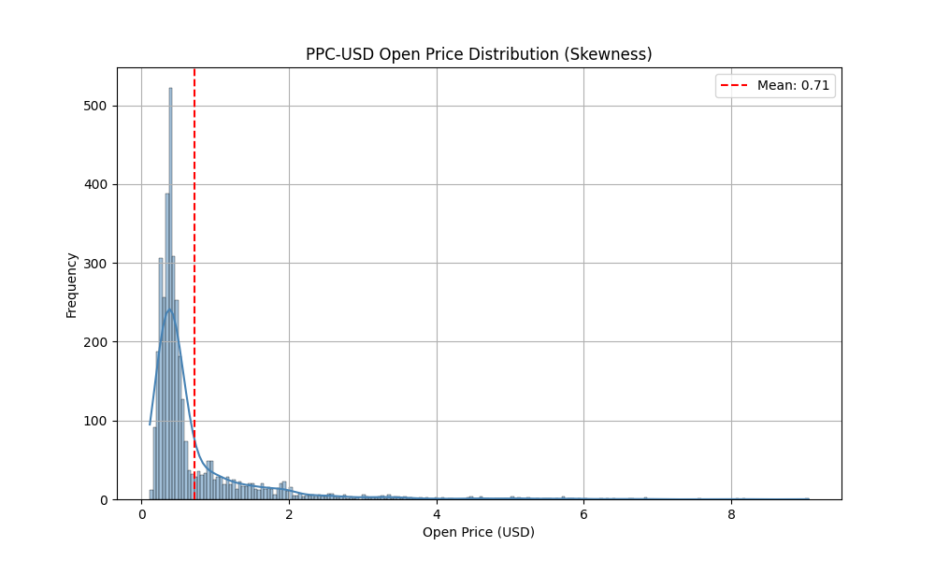
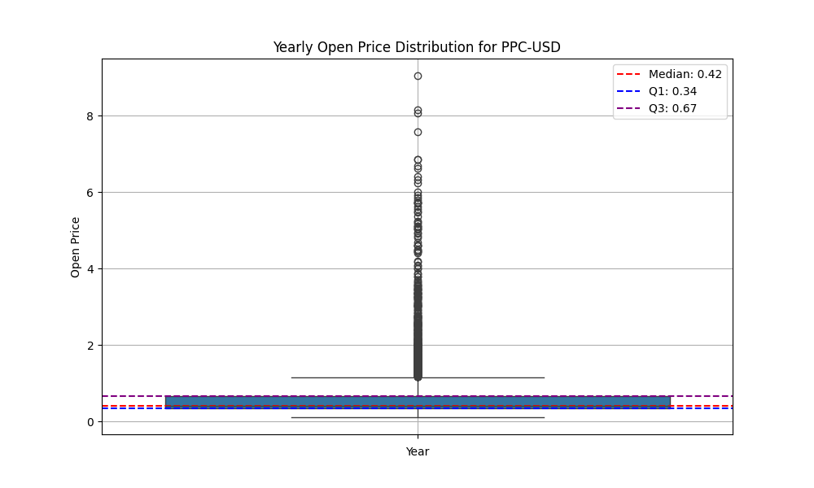
Peercoin ”PPC-USD”

Slide 11
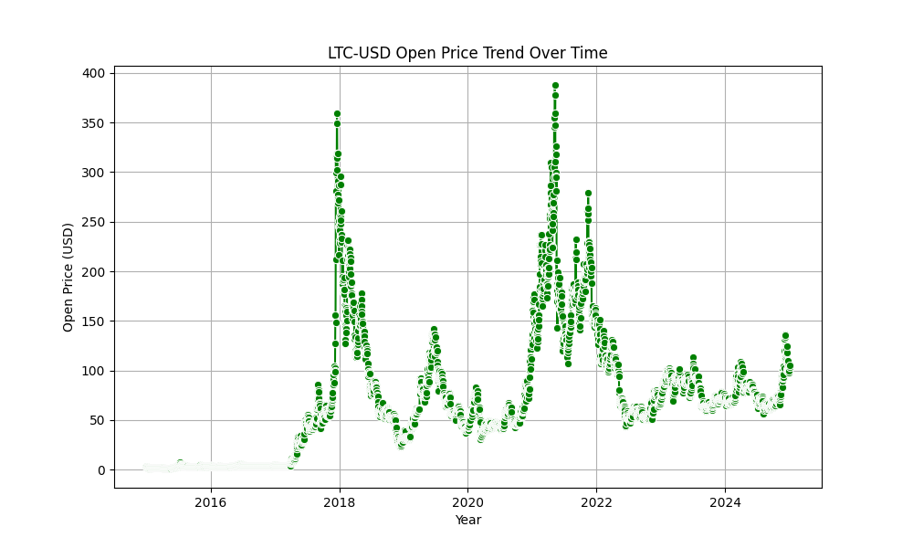
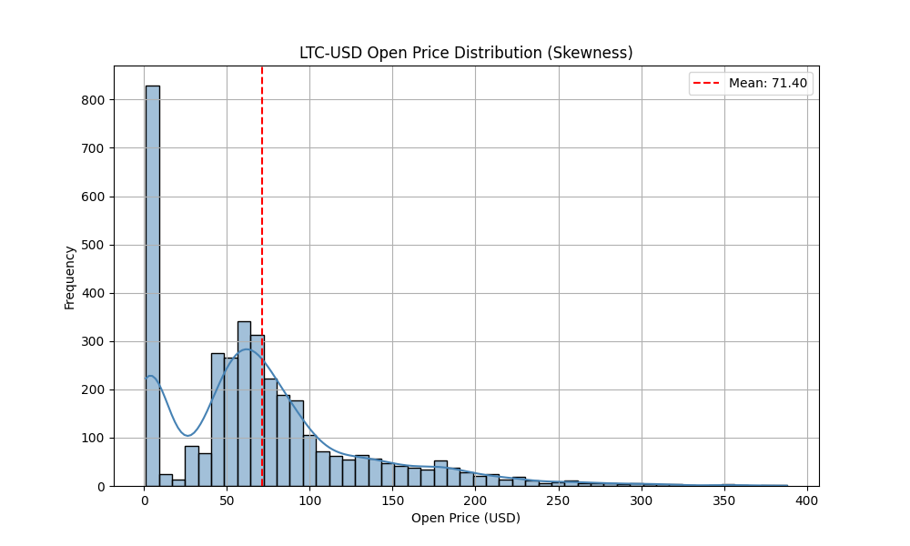
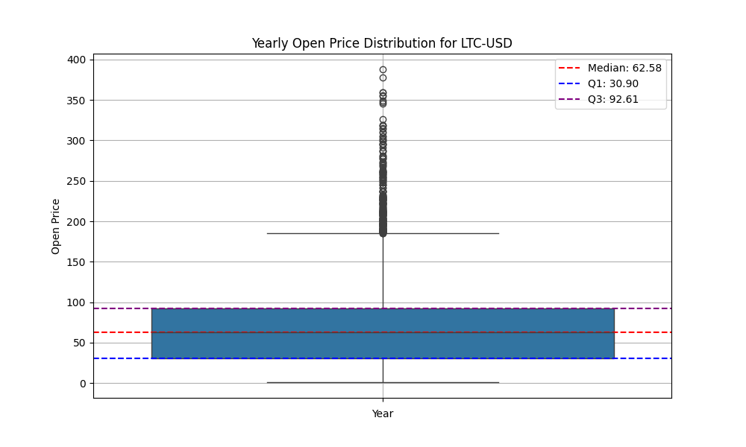
Litecoin ”LTC-USD”

Slide 12
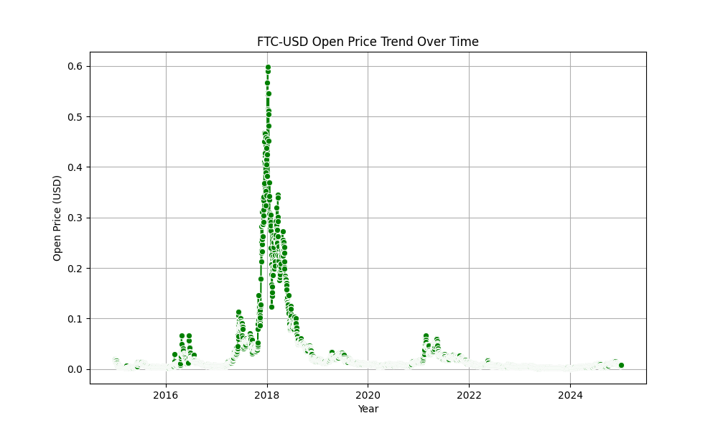
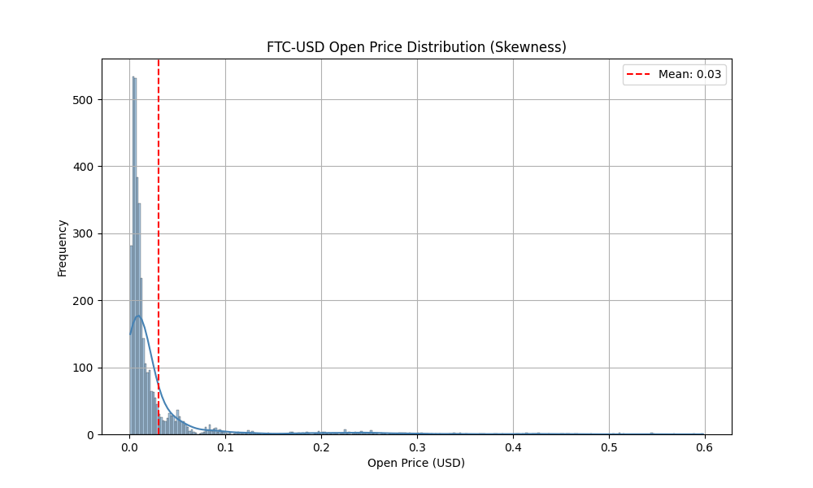
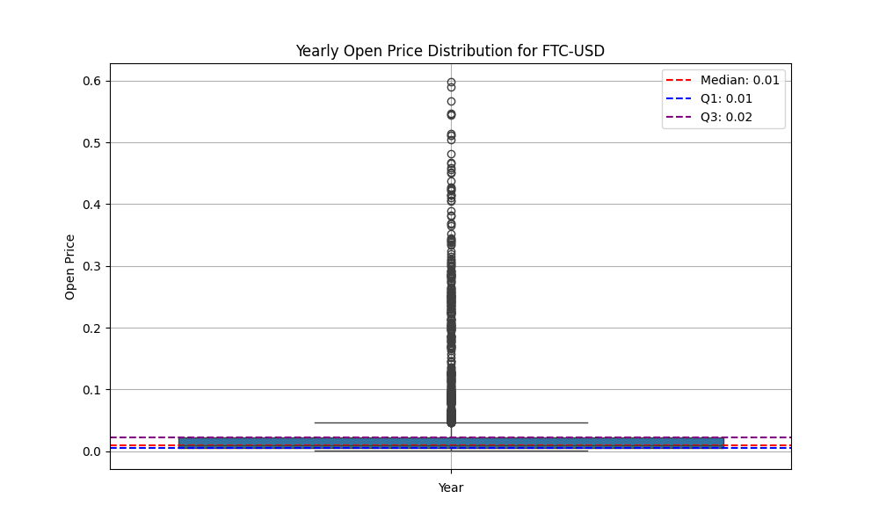
Feathercoin ”FTC-USD”

Slide 13
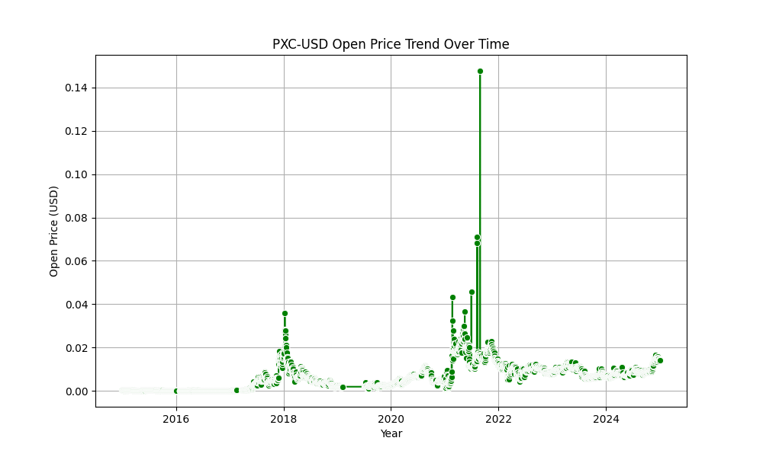
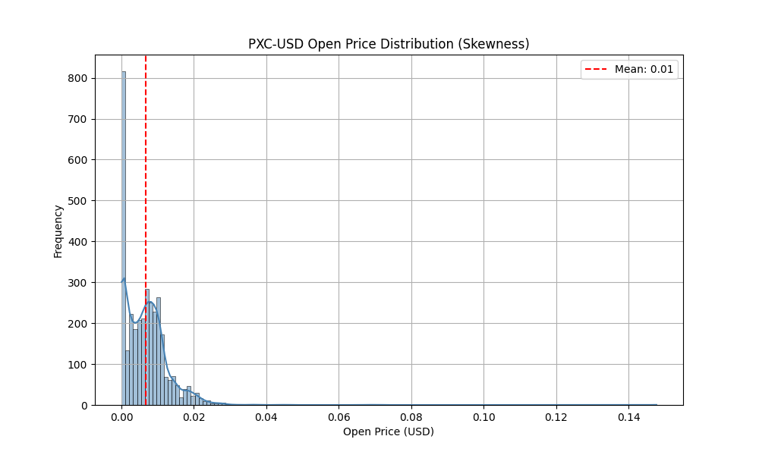
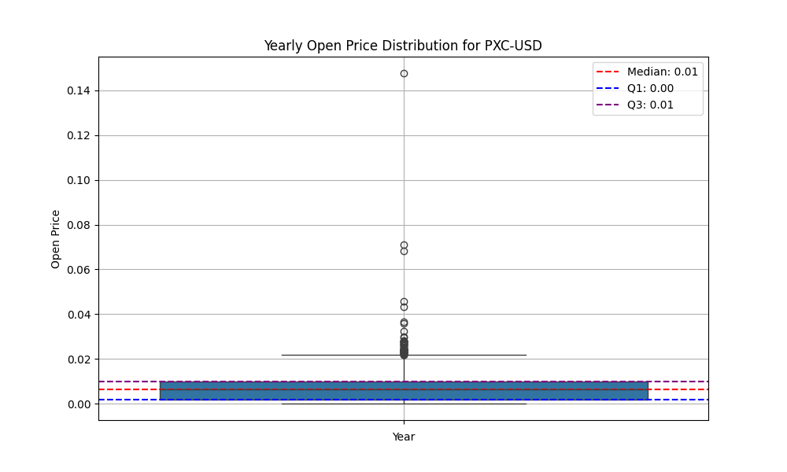
Phoenixcoin ”PXC-USD”

Slide 14
Model Training & Testing

Slide 15
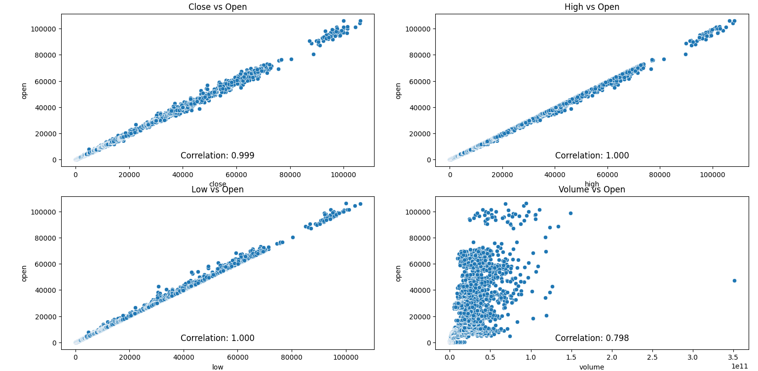
Checking for Correlation

Slide 16
Creating Variations
01
03
05
X = [["high", "low", "close", "volume"]]
y = [[“open”]]
X = [[“volume”]]
y = [[“open”]]
X = [[“high”]]
y = [[“open”]]
02
04
06
X = [["high", "low", "close"]]
y = [[“open”]]
X = [[“low”]]
y = [[“open”]]
X = [[“close”]]
y = [[“open”]]

Slide 17
Models
a. Linear
Regression
b. Ridge
Regression
c. Lasso
Regression
d. Ensemble
e. Random Forest
f. XG Boost

Slide 18
Train Test Data
Variations | Models | MSE | RMSE | MAE | R² | CV R²-Mean | CV R²-Std Dev
X = [["high", "low", "close", "volume"]] y = [[“open”]] | Linear | 33962.1556 | 184.2882 | 36.6581 | 0.9997 | 0.9998 | 0.0001
 | Ridge (Alpha = 1000) | 33962.1416 | 184.2882 | 36.6581 | 0.9997 | - | -
 | Lasso (Alpha = 0.01) | 50052.0810 | 223.7232 | 53.2631 | 0.9996 | - | -
 | Ensemble | - | - | - | - | - | -
 | Random Forest | 50842.8620 | 225.4836 | 44.2118 | 0.9996 | 0.9996 | 0.0001
 | XGBoost | 519943.8173 | 721.0713 | 114.4216 | 0.9961 | 0.9958 | 0.0019

Slide 19
Unseen Data
Variations | Models | MSE | RMSE | MAE | R²
X = [["high", "low", "close", "volume"]] y = [[“open”]] | Linear | 423622.0576 | 650.8625 | 183.2703 | 0.9997
 | Ridge (Alpha = 1000) | 423621.4602 | 650.8621 | 183.2703 | 0.9997
 | Lasso (Alpha = 0.01) | 454529.0169 | 674.1877 | 219.2488 | 0.9997
 | Ensemble | - | 647.7303 | - | -
 | Random Forest | 584034.1548 | 764.2213 | 264.9630 | 0.9996
 | XGBoost | 43082021.8516 | 6563.6897 | 2348.3754 | 0.9688

Slide 20
Train Test Data
Variations | Models | MSE | RMSE | MAE | R² | CV R²-Mean | CV R²-Std Dev
X = [["high", "low", "close"]] y = [[“open”]] | Linear | 33936.6868 | 184.2191 | 36.2190 | 0.9997 | 0.9998 | 0.0001
 | Ridge (Alpha = 1000) | 33936.6728 | 184.2191 | 36.2190 | 0.9997 | - | -
 | Lasso (Alpha = 0.01) | 48114.2162 | 219.3495 | 45.2369 | 0.9996 | - | -
 | Ensemble | - | - | - | - | - | -
 | Random Forest | 46208.0115 | 214.9605 | 42.2924 | 0.9997 | 0.9996 | 0.0001
 | XGBoost | 428862.9515 | 654.8763 | 98.1871 | 0.9968 | 0.9955 | 0.0024

Slide 21
Unseen Data
Variations | Models | MSE | RMSE | MAE | R²
X = [["high", "low", "close"]] y = [[“open”]] | Linear | 423857.4565 | 651.0434 | 182.8597 | 0.9997
 | Ridge (Alpha = 1000) | 423856.8598 | 651.0429 | 182.8597 | 0.9997
 | Lasso (Alpha = 0.01) | 479434.5017 | 692.4121 | 224.5735 | 0.9997
 | Ensemble | - | 652.9295 | - | -
 | Random Forest | 573941.7709 | 757.5894 | 259.8266 | 0.9996
 | XGBoost | 23992545.7233 | 4898.2186 | 1881.2063 | 0.9827

Slide 22
Train Test Data
Variations | Models | MSE | RMSE | MAE | R² | CV R²-Mean | CV R²-Std Dev
X = [[“volume”]] y = [[“open”]] | Linear | 45184509.7131 | 6721.9424 | 2308.9926 | 0.6645 | 0.6182 | 0.0988
 | Ridge (Alpha = 1000) | 45184509.7131 | 6721.9424 | 2308.9926 | 0.6645 | - | -
 | Lasso (Alpha = 0.01) | 45184509.7131 | 6721.9424 | 2308.9926 | 0.6645 | - | -
 | Ensemble | - | - | - | - | - | -
 | Random Forest | 59916401.9415 | 7740.5686 | 2130.6780 | 0.5551 | 0.5677 | 0.0486
 | XGBoost | 40232896.0360 | 6342.9406 | 1859.1027 | 0.7013 | 0.6896 | 0.0181

Slide 23
Unseen Data
Variations | Models | MSE | RMSE | MAE | R²
X = [[“volume”]] y = [[“open”]] | Linear | 551359509.5503 | 23481.0458 | 9531.5106 | 0.6013
 | Ridge (Alpha = 1000) | 551359509.5503 | 23481.0458 | 9531.5106 | 0.6013
 | Lasso (Alpha = 0.01) | 551359509.5562 | 23481.0458 | 9531.5106 | 0.6013
 | Ensemble | - | 23481.0458 | - | -
 | Random Forest | 614983059.6512 | 24798.8520 | 9594.0459 | 0.5553
 | XGBoost | 547686472.8772 | 23402.7023 | 9410.6352 | 0.6040

Slide 24
Train Test Data
Variations | Models | MSE | RMSE | MAE | R² | CV R²-Mean | CV R²-Std Dev
X = [[“low”]] y = [[“open”]] | Linear | 93318.2881 | 305.4804 | 61.2309 | 0.9993 | 0.9992 | 0.0003
 | Ridge (Alpha = 1000) | 93318.2880 | 305.4804 | 61.2309 | 0.9993 | - | -
 | Lasso (Alpha = 0.01) | 93316.2615 | 305.4771 | 61.2446 | 0.9993 | - | -
 | Ensemble | - | - | - | - | - | -
 | Random Forest | 112138.2486 | 334.8705 | 65.1984 | 0.9992 | 0.9989 | 0.0003
 | XGBoost | 561846.2069 | 749.5640 | 121.7182 | 0.9958 | 0.9938 | 0.0024

Slide 25
Unseen Data
Variations | Models | MSE | RMSE | MAE | R²
X = [[“low”]] y = [[“open”]] | Linear | 539661.6184 | 734.6166 | 263.8444 | 0.9996
 | Ridge (Alpha = 1000) | 539661.6120 | 734.6166 | 263.8444 | 0.9996
 | Lasso (Alpha = 0.01) | 539566.1295 | 734.5517 | 263.8211 | 0.9996
 | Ensemble | - | 734.5950 | - | -
 | Random Forest | 813995.7707 | 902.2171 | 296.9941 | 0.9994
 | XGBoost | 32604407.8634 | 5710.0270 | 2229.9252 | 0.9764

Slide 26
Train Test Data
Variations | Models | MSE | RMSE | MAE | R² | CV R²-Mean | CV R²-Std Dev
X = [[“high”]] y = [[“open”]] | Linear | 71504.3393 | 267.4030 | 54.2302 | 0.9995 | 0.9995 | 0.0001
 | Ridge (Alpha = 1000) | 71504.3393 | 267.4030 | 54.2302 | 0.9995 | - | -
 | Lasso (Alpha = 0.01) | 71504.3393 | 267.4030 | 54.2302 | 0.9995 | - | -
 | Ensemble | - | - | - | - | - | -
 | Random Forest | 117251.1185 | 342.4195 | 63.5238 | 0.9991 | 0.9993 | 0.0001
 | XGBoost | 575497.4981 | 758.6155 | 120.9580 | 0.9957 | 0.9939 | 0.0019

Slide 27
Unseen Data
Variations | Models | MSE | RMSE | MAE | R²
X = [[“high”]] y = [[“open”]] | Linear | 576147.5577 | 759.0438 | 257.9822 | 0.9996
 | Ridge (Alpha = 1000) | 576147.5577 | 759.0438 | 257.9822 | 0.9996
 | Lasso (Alpha = 0.01) | 576147.5577 | 759.0438 | 257.9822 | 0.9996
 | Ensemble | - | 759.0438 | - | -
 | Random Forest | 703776.3404 | 838.9138 | 282.0295 | 0.9995
 | XGBoost | 32143923.2290 | 5669.5611 | 2213.1960 | 0.9768

Slide 28
Train Test Data
Variations | Models | MSE | RMSE | MAE | R² | CV R²-Mean | CV R²-Std Dev
X = [[“close”]] y = [[“open”]] | Linear | 137988.1128 | 371.4675 | 73.8594 | 0.9990 | 0.9989 | 0.0002
 | Ridge (Alpha = 1000) | 137988.1128 | 371.4675 | 73.8594 | 0.9990 | - | -
 | Lasso (Alpha = 0.01) | 137988.1128 | 371.4675 | 73.8594 | 0.9990 | - | -
 | Ensemble | - | - | - | - | - | -
 | Random Forest | 197364.3828 | 444.2571 | 93.1929 | 0.9985 | 0.9984 | 0.0003
 | XGBoost | 615563.2701 | 784.5784 | 137.1472 | 0.9954 | 0.9932 | 0.0024

Slide 29
Unseen Data
Variations | Models | MSE | RMSE | MAE | R²
X = [[“close”]] y = [[“open”]] | Linear | 847683.2000 | 920.6971 | 287.2504 | 0.9994
 | Ridge (Alpha = 1000) | 847683.2000 | 920.6971 | 287.2504 | 0.9994
 | Lasso (Alpha = 0.01) | 847683.1999 | 920.6971 | 287.2504 | 0.9994
 | Ensemble | - | 920.6971 | - | -
 | Random Forest | 1276508.4724 | 1129.8267 | 362.7830 | 0.9991
 | XGBoost | 32863027.8088 | 5732.6284 | 2239.7715 | 0.9762

Slide 30
Train Test Data
MSE | RMSE | MAE | R² | CV R²-Mean | CV R²-Std Dev
33936.6728 (2, a) | 184.2191 (2, a) | 36.2190 (2, a) | 0.9997 (2, a) | 0.9998 (2, a) | 0.0001 (2, a)
Min | Min | Min | Max | Max | Min

Slide 31
Unseen Data
MSE | RMSE | MAE | R²
423621.4602 (2, a) | 647.7303 (1, a) | 182.8597 (2, a) | 0.9997 (2, a)
Min | Min | Min | Max

Slide 32
Variation Selected

Slide 33
X = [["high", "low", "close"]] y = [[“open”]]
Variation Selected

Slide 34
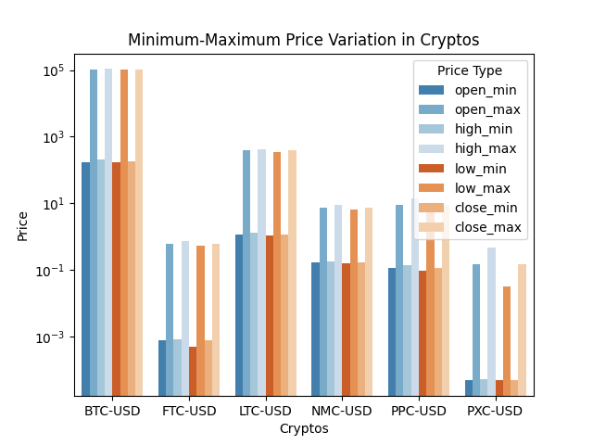
Variations in the Data

Slide 35
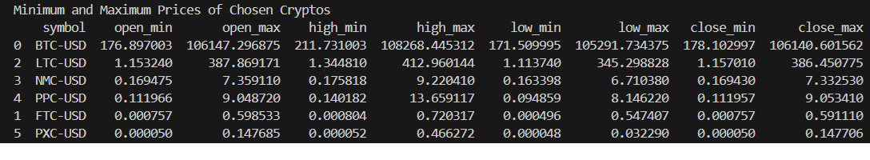
Variations in the Data

Slide 36
Linear Regression
Why
Result
Accuracy on Test Data
Closing, highest, & lowest prices strongly correlate with opening price (0.999 - 1.00).
Model has near-perfect R² of 0.9997, indicating high accuracy on test data and excellent predictions within its scope.
Measures | Test Data | Unseen Data
MSE | 33936.6868 | 423857.4565
RMSE | 184.2191 | 651.0434
MAE | 36.2190 | 182.8597
R² | 0.9997 | 0.9997
CV R²-Mean | 0.9998
CV R²-Std Dev | 0.0001
How
K-fold cross-validation (k=10) with R², MSE, MAE, RMSE calculated for accuracy and error evaluation.
Error on Unseen Data
High MSE (423,622.06) for unseen data shows the model struggles to generalize, highlighting the need for better generalization.

Slide 37
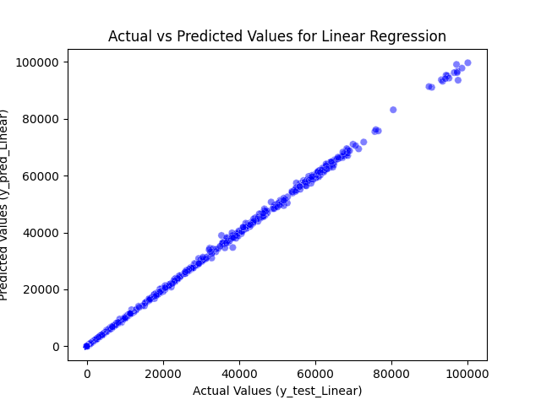
Actual vs Predicted Values for Testing Data Linear Regression

Slide 38
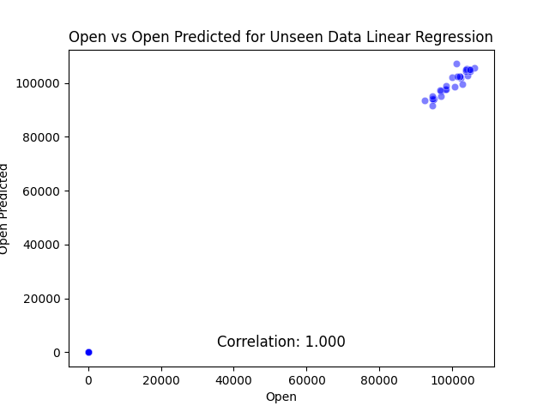
Actual vs Predicted Values for Unseen Data Linear Regression

Slide 39
Ridge Regression
Why
Result
Accuracy on Test Data
Reduces overfitting, handles multicollinearity, improves accuracy, and generalizes better.
shows near-perfect accuracy with low error metrics (MSE, RMSE, MAE) and R² = 0.9997.
Measures | Test Data | Unseen Data
MSE | 33936.6728 | 423856.8598
RMSE | 184.2191 | 651.0429
MAE | 36.2190 | 182.8597
R² | 0.9997 | 0.9997
CV R²-Mean | -
CV R²-Std Dev | -
How
Used GridSearchCV with 10-fold CV and R² scoring to find best alpha for Ridge
Error on Unseen Data
The model has higher error metrics (MSE, RMSE, MAE) and similar R², suggesting overfitting and poor generalization.

Slide 40
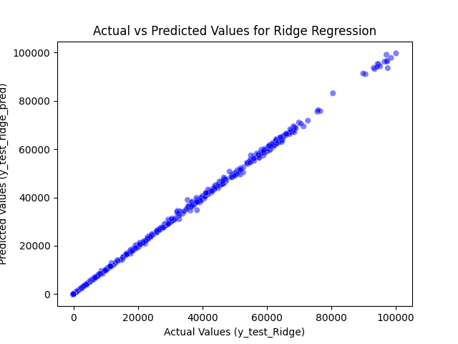
Actual vs Predicted Values for Testing Data Ridge Regression

Slide 41

Actual vs Predicted Values for Unseen Data Ridge Regression

Slide 42
Lasso Regression
Why
Result
Accuracy on Test Data
Performs feature selection, creates sparse models, improves interpretability, and highlights key predictors.
The model has an R² of 0.9996, indicating near-perfect accuracy on the test data.
Measures | Test Data | Unseen Data
MSE | 48114.2162 | 479434.5017
RMSE | 219.3495 | 692.4121
MAE | 45.2369 | 224.5735
R² | 0.9996 | 0.9997
CV R²-Mean | -
CV R²-Std Dev | -
How
Error on Unseen Data
Used GridSearchCV with 10-fold CV and R² scoring to find best alpha for Ridge
The high MSE (479,434.50) and RMSE (692.41) suggest significant error, showing the model struggles to generalize well on unseen data.

Slide 43

Actual vs Predicted Values for Testing Data Lasso Regression

Slide 44

Actual vs Predicted Values for Unseen Data Lasso Regression

Slide 45
Ensemble
Why
Result
Accuracy on Test Data
Combined Linear, Ridge, and Lasso Regression using a weighted average on RMSE to minimize overfitting /underfitting and calculate Ensemble RMSE's average and std dev.
Measures | Test Data | Unseen Data
MSE | - | -
RMSE | - | 652.9295
MAE | - | -
R² | - | -
CV R²-Mean | -
CV R²-Std Dev | -
No metrics (MSE, RMSE, MAE, R²) provided for test data, so accuracy cannot be determined.
How
Error on Unseen Data
RMSE of Linear, Ridge, and Lasso Regressions was used to calculate weights, ensuring they sum to 1, and ensemble RMSE was obtained using the sum product function.
The RMSE for unseen data is 652.93, indicating some error in predictions for unseen data. However, other error metrics are not available.

Slide 46
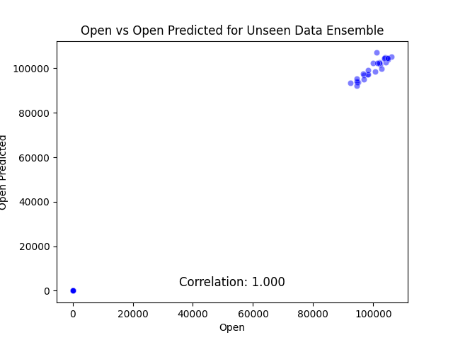
True vs Ensemble Prediction for Unseen Data

Slide 47
Random Forest Regression
Why
Result
Accuracy on Test Data
Helps with hyperparameter tuning, provides more robust and accurate predictions despite no non-linear relationships in the data.
The model has an R² of 0.9997, indicating near-perfect accuracy on the test data.
Measures | Test Data | Unseen Data
MSE | 46208.0115 | 573941.7709
RMSE | 214.9605 | 757.5894
MAE | 42.2924 | 259.8266
R² | 0.9997 | 0.9996
CV R²-Mean | 0.9996
CV R²-Std Dev | 0.0001
How
Error on Unseen Data
RF Regression was performed with varied parameters (n_estimators, max depth, sample splits/leaf) and 10-fold CV to select the best model with least errors.
The high MSE (573,941.77) and RMSE (757.59) suggest significant error on unseen data, indicating some difficulty in generalizing.

Slide 48
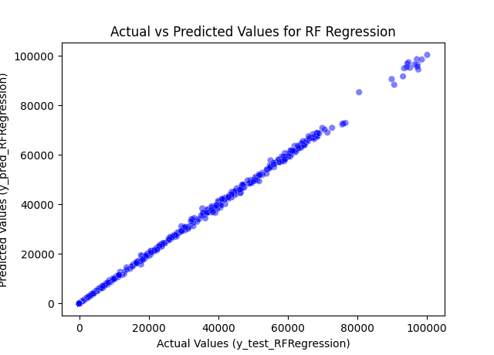
Actual vs Predicted Values for Testing Data RF Regression

Slide 49
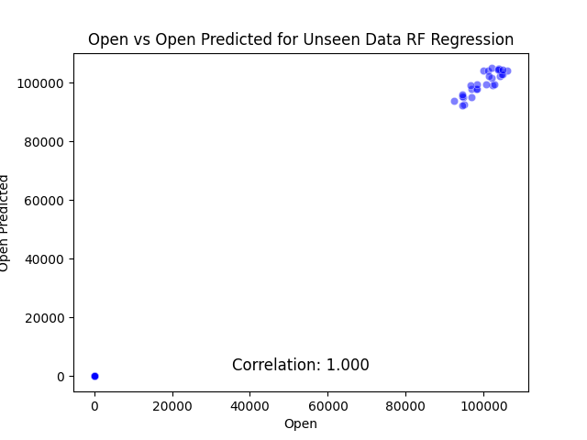
Actual vs Predicted Values for Unseen Data RF Regression

Slide 50
XG Boost Regression
Why
Result
Accuracy on Test Data
Accurate, robust, and efficient predictions with built-in handling of missing data and feature importance.
The model has an R² of 0.9968, indicating strong accuracy on test data.
Measures | Test Data | Unseen Data
MSE | 428862.9515 | 23992545.7233
RMSE | 654.8763 | 4898.2186
MAE | 98.1871 | 1881.2063
R² | 0.9968 | 0.9827
CV R²-Mean | 0.9955
CV R²-Std Dev | 0.0024
Error on Unseen Data
How
n_estimators=260, learning rate=0.03, max depth=6, subsample=0.8, gamma=2, reg_lambda=5, reg_alpha=2 for better performance.
The high MSE (23,992,545.72) and RMSE (4,898.22) suggest significant error on unseen data, indicating challenges in generalization.

Slide 51
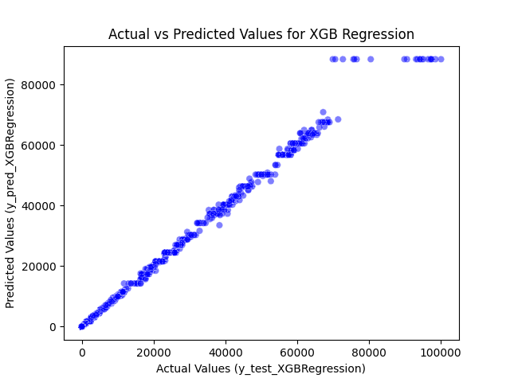
Actual vs Predicted Values for Testing Data XGB Regression

Slide 52
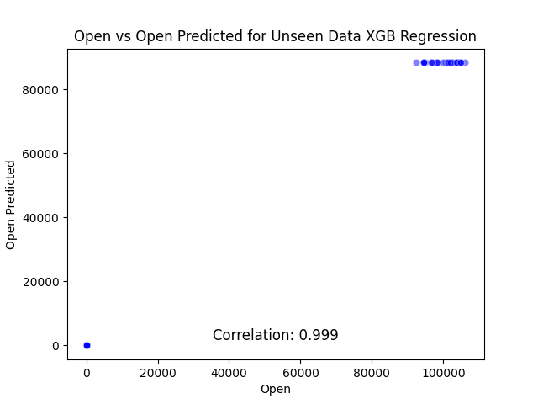
Actual vs Predicted Values for Unseen Data XGB Regression

Slide 53
Conclusion

Slide 54
Model Selected
Train Test
R² = 0.9997
RMSE = 184.2191
Linear Regression
Unseen
R² = 0.9997
RMSE = 651.0434
X = [["high", "low", "close"]] y = [[“open”]]
Train Test
R² = 0.9997
RMSE = 184.2191
Ridge Regression
Unseen
R² = 0.9997
RMSE = 651.0429

Slide 55
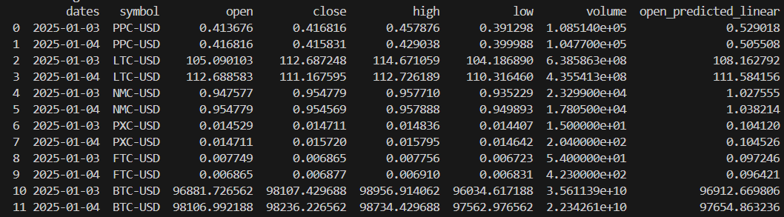
Result

Slide 56
Model Selected
X = [["high", "low", "close”, “volume”]] y = [[“open”]]
Ensemble
RMSE = 647.7303

Slide 57
Thank You!

