Slide 1
Spokes & Stats: Analysing Divvy’s Bike Share Data
</
} /> [
/>

Slide 2
01
Introduction
</>
} /> [

Slide 3


</ About Divvy Bikes
Divvy is a Chicago’s bike share system across Chicago and Evanston. It consists of a fleet of specially-designed, sturdy and durable bikes that are locked into a network of docking stations throughout the region.

Slide 4
</ Objective
The aim of this project is to gather insights and predict member behaviour (Casual vs. Member) in the Divvy bike-sharing system using machine learning models.
Overview
Data from Divvy bike trip logs (September 2024 to January 2025)
Analyse patterns in user behaviour based on ride data
Apply machine learning techniques to predict membership status
Evaluate model performance and feature importance

Slide 5

</ Data Description
ride_id
end_station_name
rideable_type
end_station_id
start_lat
started_at
start_lng
ended_at
End_lat
started_station_name
End_lng
started_station_id
member_casual

Slide 6
</ Data Preprocessing
Removed missing values
Extracted relevant time features
Removed unnecessary columns
Calculated ride duration in minutes
Handled outliers in trip duration
Created new features

Slide 7
02
Data Exploration
</>
} /> [

Slide 8
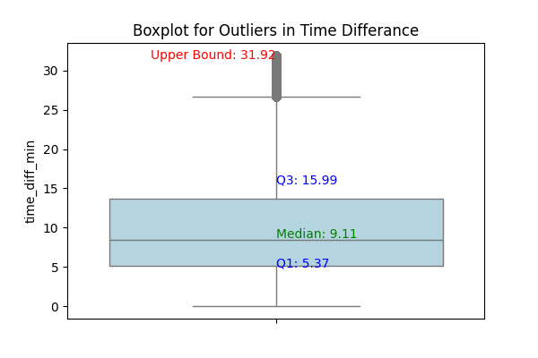
Notes:
Used Interquartile Range (IQR) to detect and remove outliers in ride durations
Visualized outliers using a boxplot
Removed rides with unrealistic durations (e.g., extremely short or long trips)
Most rides last about 5-15 mins
Upper bound is 31.92 meaning rides lasting more than 31 mins are considered outliers which could be possible may be because some technical error or if some has forgotten to end the ride has resulted in removal of these rides.

Slide 9
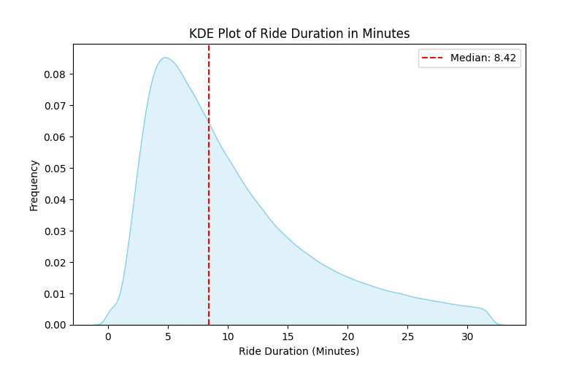
Notes:
Long Right Tail: The long right tail indicates the presence of some rides with significantly longer durations, pulling the mean to the right of the median. Peak Left of Median: The fact that the peak is to the left of the median is another strong indicator of positive skewness. This means that while the most common ride durations are around 5 minutes, there's a significant number of rides that last much longer, resulting in a right-skewed distribution.

Slide 10
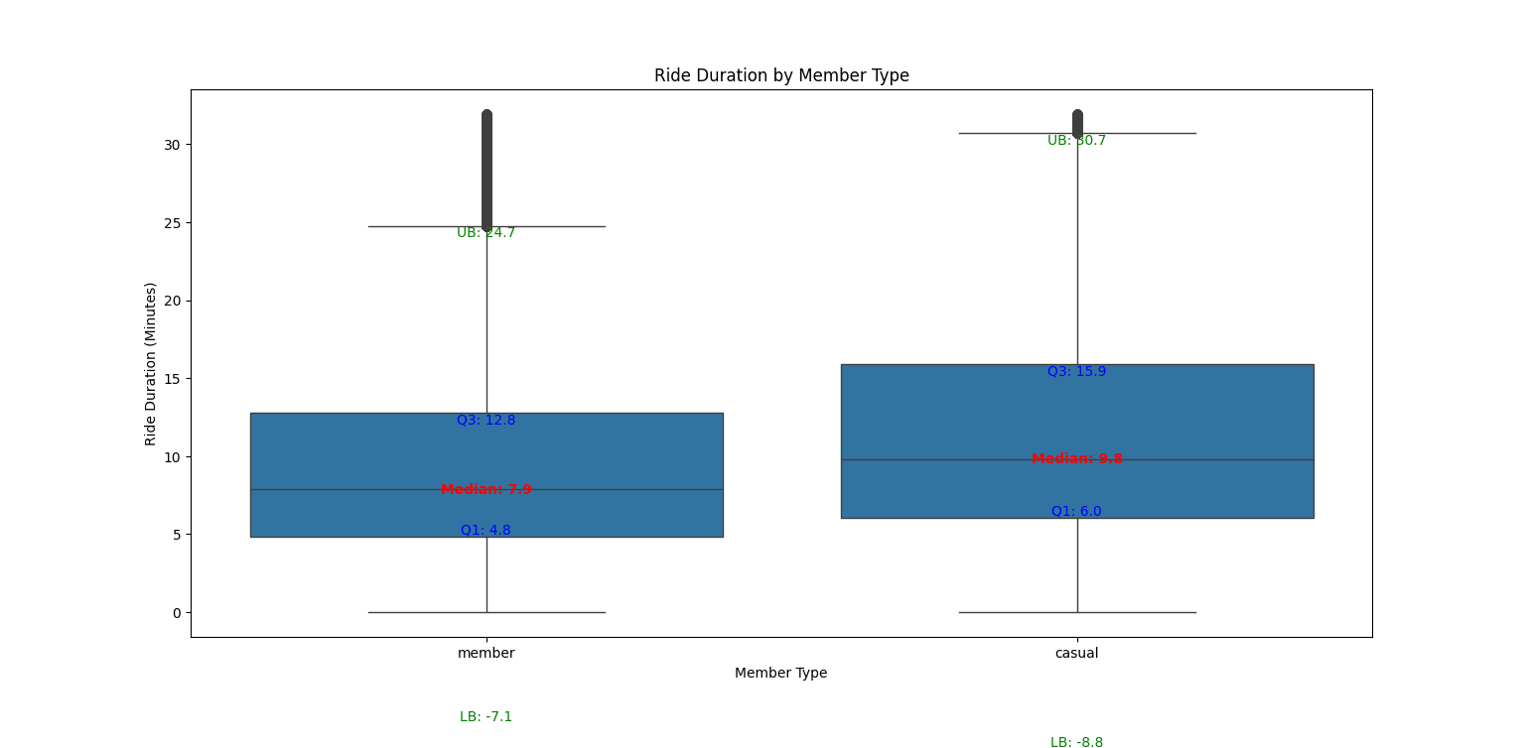
Notes:
Casual riders shows the broader variability of range durations compared to members. This states the casual riders are may be using it for diverse purposes ,however members shows more consistent and are clustered around the shorter duration, showing that they use it for daily or regular commutes.but we still can see the skewness in the data showing that we have negative skewd data where it is given that there are people few who are using it for longer duration as long as 24.7 mins in member and 30.7 min in casuals.

Slide 11
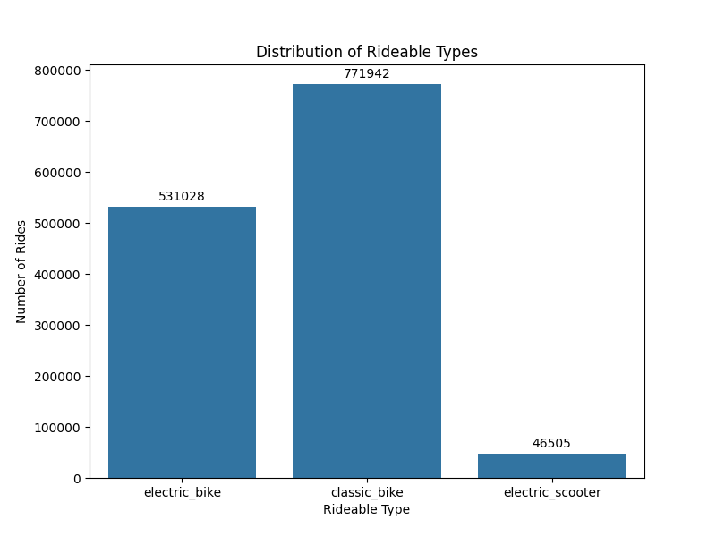
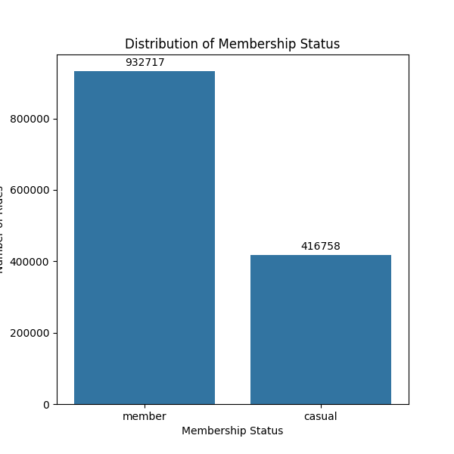
Notes:
This provides the clear picture of the preference of the user and demographics of the sharing system.
First graph depicts the dominance of classic bikes as compared to the electric bike and electric scooter suggesting most users prefer classic bikes as their mode of transfer and least preferred is electric scooter.
While on the other hand it emphasises the strong presence of the member, indicating that this system relies on the membership base.

Slide 12
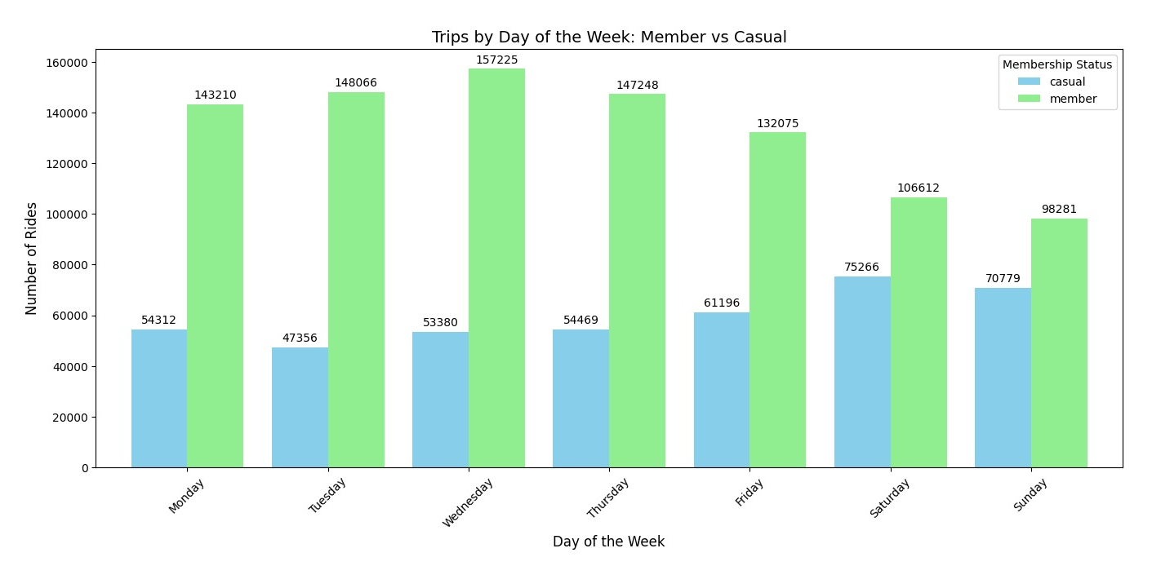
Notes:
There is clear dominance of members as we can see in graph all the days of the week, member has significantly higher no of rides as compared to casual riders. This states that this bike system is primarily worked for the rider who have subscription. The highest number of riders who are members are more active on the Wednesdays, followed by Tuesday and Thursday. Similarly highest casual rider are utilising most on the Saturdays and still is drastically low as compared to members on other weekdays. This shows the importance of membership programs in utilisation this bike sharing system. The casual peak usage on weekend shows that it is mostly used for leisure or weekend activities .

Slide 13
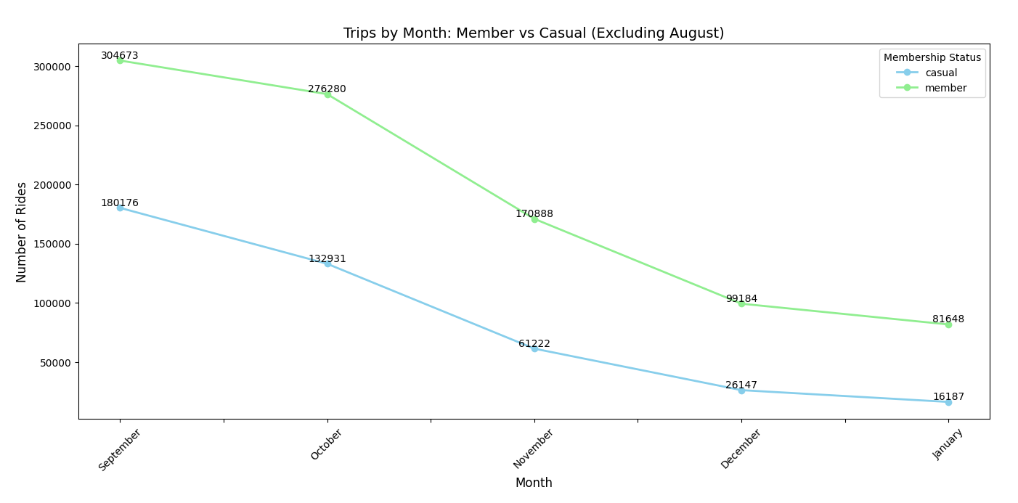
Notes:
Declining Trend: Both casual and member rides show a downward trend from September to January.
More Decline for Members: Members' rides decrease at a faster rate than casual users, especially after September. This suggests that fewer members are using the service as the months go on, whereas casual users' rides are still relatively high.
Seasonal Variation: The drop in rides could be seasonal, with fewer people using the service during the winter months (December and January), which could be influenced by factors like weather or holidays.

Slide 14
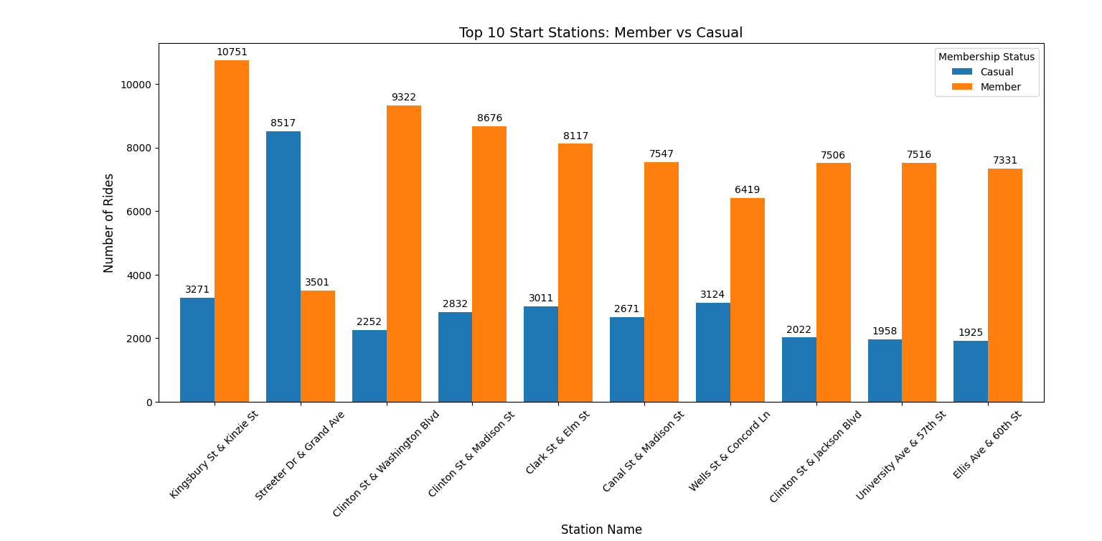
Notes:
The graph strongly emphasizes the reliance of the bicycle sharing system on its membership base. It identifies the most popular starting points for rides, which can be valuable for station management and resource allocation. The most popular stations are the kingsbury st & kinzie st which susbstantial numbert of member rides. There's only one station where the popularity is high among the casual which is the streeter drive and grand ave.

Slide 15
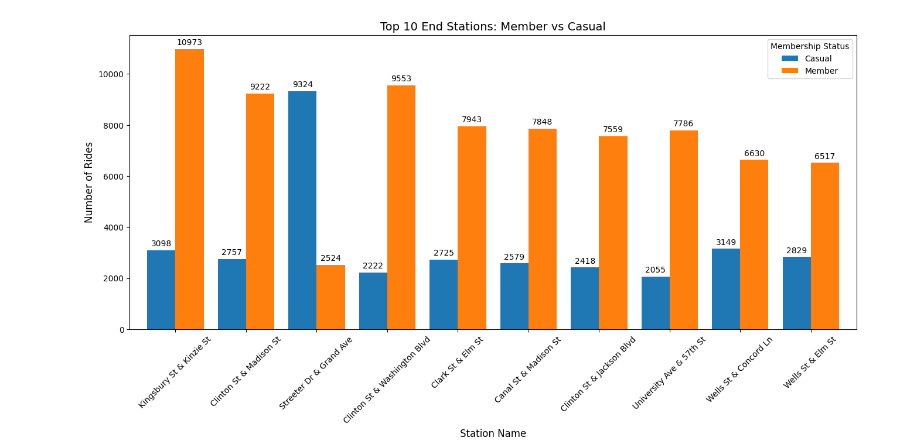
Notes:
The graph reinforces the observation that the bicycle sharing system is primarily utilized by members. It identifies the most popular ending points for rides. Similar to the start stations, the "Member" category consistently shows a significantly higher number of rides ending at these top 10 stations compared to "Casual" riders. Again the most popular stations kingsbury st & kinzie st with good number of members usage. And also the busiest end station for casuals is streeter drive & grand ave.

Slide 16
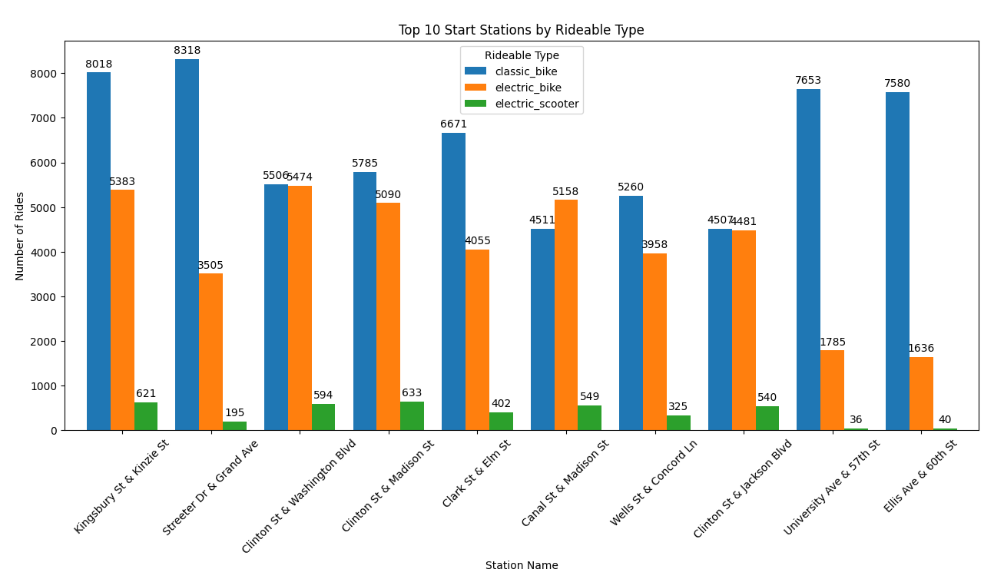
Notes:
This graph gives the company a good idea of what type of bikes are being used the most at each station.The graph highlights the strong preference for "classic bikes" among riders. It identifies the most popular starting points for rides, considering the different rideable types. It reveals the relatively low adoption of "electric scooters" compared to bikes.

Slide 17
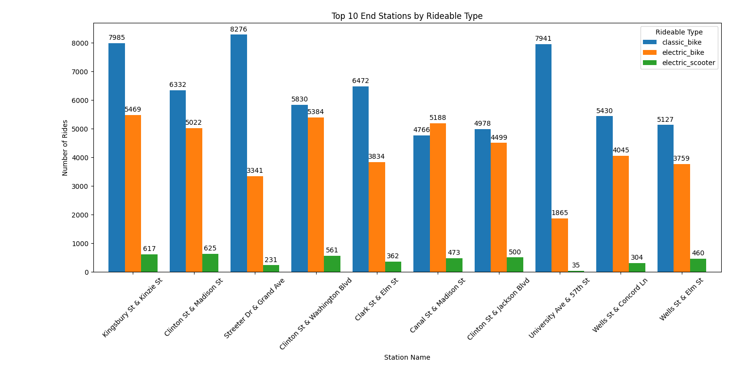
Notes:
Similar to the start stations, the "classic bike" type consistently shows a significantly higher number of rides ending at these top 10 stations compared to "electric bike" and "electric scooter."he usage patterns for each rideable type vary across stations. Some stations show a very large gap between classic bike usage and the other types, while others show a smaller difference.This graph provides valuable information for the company to understand the preferred rideable type ending at each station. This data can be used to optimize bike distribution and ensure that the most popular types are readily available at high-demand locations.

Slide 18
03
Models
</>
} /> [

Slide 19
</ Logistic Regression
Predict whether a user is a Casual or Member using logistic regression.
Features Used
ride_duration
date_week
Steps Taken
Encoded target variable (member_casual)
Split the dataset into training and testing sets (80/20 split)
Trained a logistic regression model and evaluated its performance
} /> [
/>
Notes:
Logistic Regression model. Overall, it's about 68% accurate, which sounds okay, right? But when we break it down, we see a big problem: it's really bad at predicting casual users. It only catches 6% of them! It's basically saying 'everyone's a member.' You can see that reflected in the confusion matrix – a ton of casual users are being misclassified. We need to fix this bias if we want a reliable model.

Slide 20
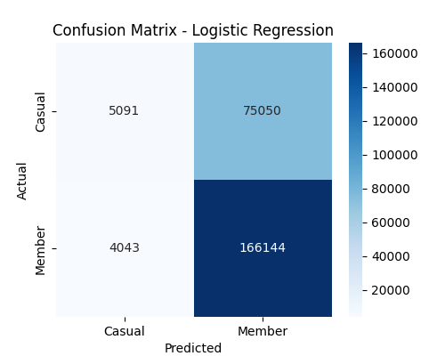
</ Results
0.684
Accuracy
Logistic Regression Report
 | Precision | Recall | F1-Score | Support
0 (Casual) | 0.56 | 0.06 | 0.11 | 80141
1 (Member) | 0.69 | 0.98 | 0.81 | 170187
Accuracy |  |  | 0.68 | 250328
Macro Avg | 0.62 | 0.52 | 0.46 | 250382
Weighted Avg | 0.65 | 0.68 | 0.59 | 250328

Slide 21
</ KNN Classifier
Predict member behaviour using KNN Classifier
Features Used
date_week
ride_duration
Steps Taken
Standardized features
Calculated best K using the Elbow Method.
Trained and evaluated the KNN model
} /> [
/>

Slide 22
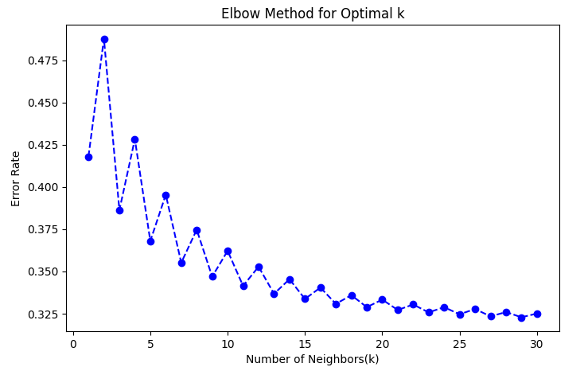
29
K Value

Slide 23
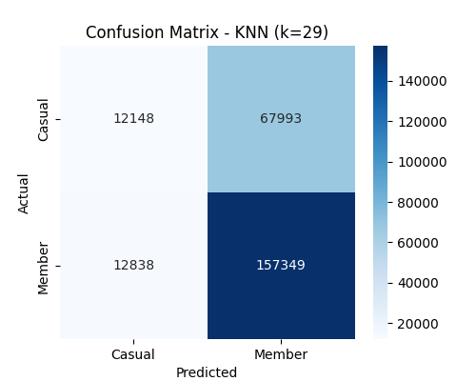
</ Results
0.677
Accuracy
KNN Classification Report
 | Precision | Recall | F1-Score | Support
0 (Casual) | 0.49 | 0.15 | 0.23 | 80141
1 (Member) | 0.70 | 0.92 | 0.80 | 170187
Accuracy |  |  | 0.68 | 250328
Macro Avg | 0.59 | 0.54 | 0.51 | 250382
Weighted Avg | 0.63 | 0.68 | 0.61 | 250328
Notes:
KNN Classification:
The KNN model achieved 67.7% accuracy, which is:
Better than Logistic Regression (68.4%) in some aspects but slightly worse in overall accuracy.
Key Observations:
Casual users (Class 0)
Recall is 15%, higher than 6% in Logistic Regression.
F1-score is 0.23, which is slightly better than 0.11 in Logistic Regression.
False negatives (Casual misclassified as Members): 67,993, slightly better than 75,050 in Logistic Regression.
Members (Class 1)
Recall is 92%, quite lower than 98% in Logistic Regression but still quite high.
F1-score is 0.80, almost same as Logistic Regression.
Confusion Matrix Insights:
Casual users correctly classified: 12,148 (Better than Logistic Regression).
Members correctly classified: 157,349 (Decent but lower than Logistic Regression).
Still biased towards predicting Members, similar to Logistic Regression.
Best Metric to Consider:
F1-score remains the most relevant to balance precision and recall.
KNN perform well in certain areas and managing bias at some level for casual classification effectively.
Conclusion:
KNN is not the best choice because:
It struggles with Casual users (low recall, low F1-score).
KNN might need feature scaling or tuning to perform better.

Slide 24
</ XGBoost Classifier
Predict member behaviour using Random Forest Classifier
Features Used
date_week
ride_duration
Steps Taken
Encoded target variable
Evaluated feature importance
Trained and evaluated the XGBoost model
} /> [
end_station_id
start_station_id
/>

Slide 25
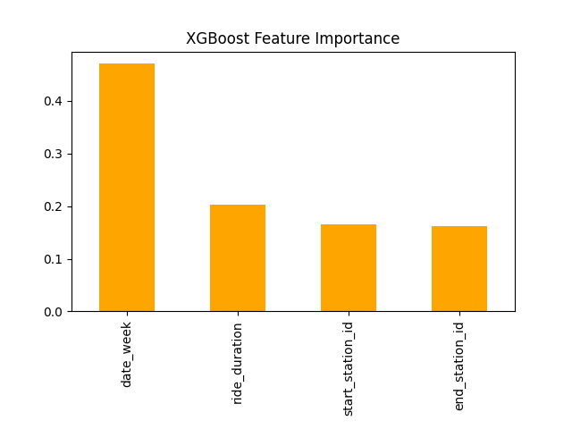
</ date_week
was the most important feature for XGBoost
</ Feature Importance Analysis

Slide 26

</ Results
0.686
Accuracy
XGBoost Classification Report
 | Precision | Recall | F1-Score | Support
0 (Casual) | 0.54 | 0.13 | 0.20 | 80141
1 (Member) | 0.70 | 0.95 | 0.80 | 170187
Accuracy |  |  | 0.69 | 250328
Macro Avg | 0.62 | 0.54 | 0.50 | 250382
Weighted Avg | 0.65 | 0.69 | 0.61 | 250328
Notes:
XGBoost Classification:
The XGBoost model achieved 68.6% accuracy, which is slightly better than Logistic Regression (68.4%) but slightly worse than Random Forest (69.5%).
Key Observations:
Casual users (Class 0)
Recall improved from 6% (Logistic Regression) to 13%, but it's still worse than 41% in Random Forest.
F1-score is 0.20, better than 0.11 in Logistic Regression but much worse than 0.46 in Random Forest.
False negatives (Casual misclassified as Members): 70,021 (Better than 75,050 in Logistic Regression, worse than 47,014 in Random Forest).
Members (Class 1)
Recall is 95%, higher than 83% in Random Forest, similar to 98% in Logistic Regression.
F1-score is 0.80, slightly better than 0.79 in Random Forest.
Confusion Matrix Insights:
Casual users correctly classified: 10,120 (Better than 5,091 in Logistic Regression, worse than 33,127 in Random Forest).
Members correctly classified: 161,534 (Better than Random Forest, worse than Logistic Regression).
The model is still biased toward predicting Members, though slightly better than Logistic Regression.
Best Metric to Consider:
F1-score remains the best metric for overall balance.
Recall for Class 0 is still low (13%), meaning it still struggles to classify casual users.
Conclusion:
XGBoost is not the best choice because:
It still struggles with Class 0 (Casual users), just like Logistic Regression.
Random Forest is more balanced in predicting both classes.
It only improves slightly on Logistic Regression but does not outperform Random Forest.

Slide 27
</ Random Forest Classifier
Predict member behaviour using Random Forest Classifier
Features Used
ride_duration
start_station_id
Steps Taken
Encoded categorical features (station IDs) and target variable
Evaluated feature importance
Trained and evaluated the Random Forest model
} /> [
end_station_id
date_week
/>

Slide 28
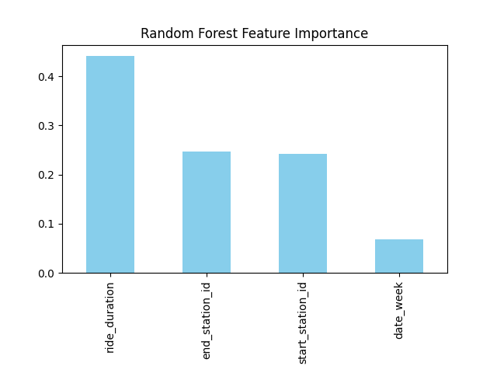
</ ride_duration
was the most important feature for Random Forest
</ Feature Importance Analysis

Slide 29
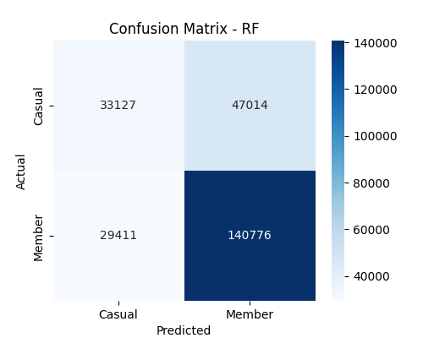
</ Results
0.695
Accuracy
Random Forest Classification Report
 | Precision | Recall | F1-Score | Support
0 (Casual) | 0.53 | 0.41 | 0.46 | 80141
1 (Member) | 0.75 | 0.83 | 0.79 | 170187
Accuracy |  |  | 0.69 | 250328
Macro Avg | 0.64 | 0.62 | 0.63 | 250382
Weighted Avg | 0.65 | 0.65 | 0.68 | 250328
Notes:
Random Forest:
The Random Forest model achieved 69.5% accuracy, which is slightly better than the Logistic Regression model (68.4%).
Key Observations:
Casual users (Class 0)
Recall improved (41% vs. 6% in Logistic Regression) → The model is better at identifying casual users.
F1-score is 0.46, much better than 0.11 in Logistic Regression.
False negatives (Casual misclassified as Members) reduced from 75,050 to 47,014.
Members (Class 1)
Recall decreased (83% vs. 98% in Logistic Regression) but is still high.
F1-score is 0.79, slightly lower than 0.81 in Logistic Regression.
Confusion Matrix Insights:
Casuals correctly classified: 33,127 (Much better than 5,091 in Logistic Regression).
Members correctly classified: 140,776 (Lower than 166,144 in Logistic Regression).
False negatives (Casuals misclassified as Members) dropped significantly.
Best Metric to Consider:
F1-score is still the best metric, as it balances precision and recall.
Improved Recall for Class 0 (Casual users) makes this model more balanced than Logistic Regression.
Conclusion:
Random Forest is a better model overall because:
It significantly improves recall for casual users (from 6% → 41%).
It still maintains good performance for members.
The trade-off in member classification is acceptable for better balance.

Slide 30
04
Results
</>
} /> [

Slide 31

</ Model Comparison
Accuracy Ranking
Class 0 (Casual)
Random Forest (69.5%) > XGBoost (68.6%) >
Logistic Regression (68.4%) >
KNN (67.7%)
Random Forest (41%) >
KNN (15%) >
XGBoost (13%) >
Logistic Regression (6%)
Class 1 (Member)
F1-Score
Logistic Regression (98%) >
XGBoost (95%) >
KNN (92%) >
Random Forest (83%)
 | Casual | Member
Random Forest | 46% | 79%
KNN | 23% | 80%
XGBoost | 20% | 80%
Logistic Regression | 11% | 81%
Notes:
Insights and Key Takeaways:
Accuracy Ranking:
Random Forest (69.5%) > XGBoost (68.6%) > Logistic Regression (68.4%) > KNN (67.7%).
Random Forest has the highest accuracy, meaning it makes the fewest total errors.
Class 0 (Casual users) - Performance Issues Across Models:
Logistic Regression performs the worst (Recall = 6%).
XGBoost & KNN slightly improve (Recall = 13-15%).
Random Forest does best (Recall = 41%), meaning it recognizes casual users better than others.
Class 1 (Members) - Best Recognition in All Models:
Logistic Regression has highest recall (98%), meaning almost all members are correctly classified.
XGBoost (95%) and KNN (92%) are slightly lower but still strong.
Random Forest is most balanced (83%), ensuring better recognition for both classes.
F1-Score Considerations:
The F1-score for Casual users (0) is worst in Logistic Regression (0.11), improving slightly in KNN (0.23) and XGBoost (0.20), but Random Forest is best (0.46).
The F1-score for Members (1) is highest across all models (~0.79-0.81).
Random Forest gives the most balanced F1-score across both classes.
Conclusion:
Random Forest is the best model overall.
It performs the best in balancing both Casual and Member users.
Higher Recall for Casual users (41%) compared to others (6%-15%).
While XGBoost & KNN have high recall for Members, they struggle with Casual users.
Logistic Regression is the worst model for this classification task.
Extremely poor at identifying Casual users (Recall = 6%).
It over-predicts Members (1), meaning Casuals are often misclassified.
XGBoost & KNN are similar, but Random Forest still wins.
Both models improve over Logistic Regression but still struggle with Class 0 (Casuals).
XGBoost is better than Logistic Regression, but not as strong as Random Forest.

Slide 32
{53% 75%}
{41% 83%}
</ Model Deployed: Random Forest
{46% 79%}
Precision
} /> [
Recall
F1-Score
{69%}
/>
Accuracy
Notes:
It is (casual, member)

Slide 33
05
Conclusion
</>
} /> [

Slide 34
</ Conclusions & Recommendations
Optimize Bike Availability & Station Planning
Improve Membership Conversion Strategy
Selected Random Forest Classifier
Personalise User Engagement & Retargeting
Notes:
Membership conversion strategies: from the box plot for the member and casual we have configure that casuals are usually tend to take longer rides, hence are good targets for the subscription promotions. So the strategy to promote membership could be offering discounted long term subscriptions, email marketing and pop-up notifications at popular casual user stations.
Optimize bike availability & station planning: the bar graph of start/end station and bike ride type shows there are station with high casual traffic so to not face the shortages at the station , can increase the bike availability and plan station accordingly. It also showed that electric scooters are used way less than classic bikes, we can promote them as tourist friendly option to promote the usage.
Personalise User Engagement & Retargeting: If causals users tend to take longer rides and from specific stations , station could be set up for personalized targeting and personalized app notification or target social media ads .
Random forest significantly outperforms other models in correctly identifying casual users,and has achived recall for 41% which very high as compared to other three models. Also RF maintains robust 83% recalls for member users. Random Forest yields the highest F1-score for both classes. his superior overall performance solidifies Random Forest as the optimal model for this classification task, demonstrating its ability to accurately and reliably distinguish between Casual and Member users.

Slide 35
Thank You!
</
} /> [
/>
Any Questions?

