Slide 1
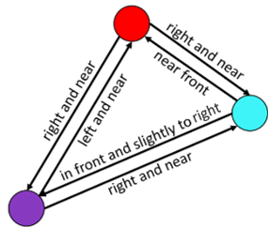
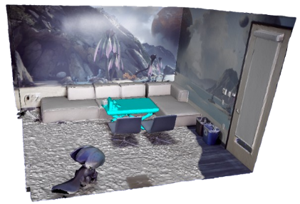
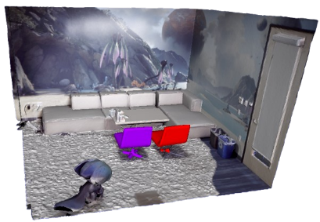
Pair of objects lying beside each other |  |  |  | Object 0 and Object 1 are chairs that are near each other with a distance of 0.74, indicating they are positioned beside each other.
Query | Partial Scene Graphs | ConceptGraphs | VIZOR | Explanation

Slide 2
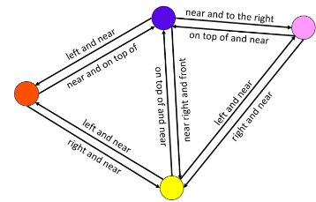
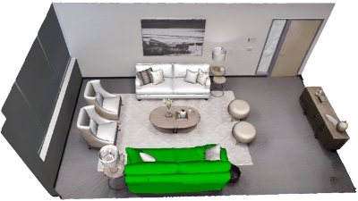
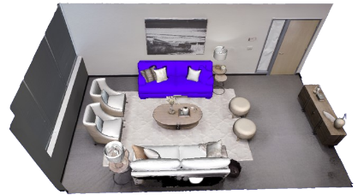
What is the object with the most pillows on it? |  |  |  | Object 17, which is a couch, has three pillows (objects 9, 15 and 22) near or on top of it. No other object in the scene has more than one pillow associated with it.
Query | Partial Scene Graphs | ConceptGraphs | VIZOR | Explanation

Slide 3
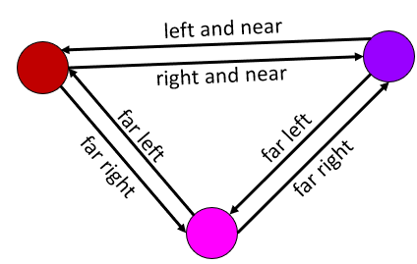
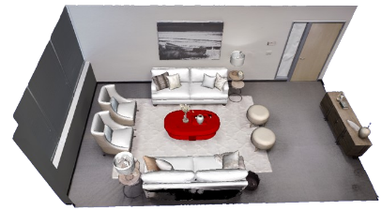
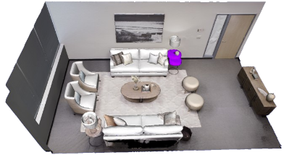
What is the nearest place where I can put down my coffee mug when I enter the room? |  |  |  | The nearest place to put down a coffee mug when entering the room is typically a table. In this scene, Object 2 is likely positioned near an entrance and provides a surface for placing items like a coffee mug.
Query | Partial Scene Graphs | ConceptGraphs | VIZOR | Explanation

Slide 4
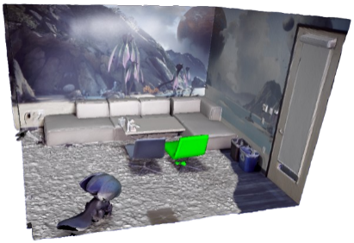
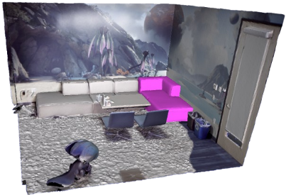
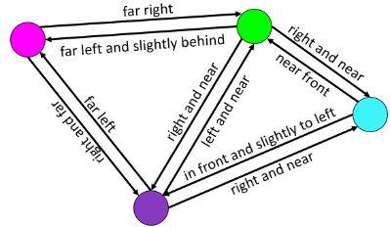
Something to sit on other than a chair |  |  |  | Object 11 is a couch, which provides seating for multiple people and can be used as an alternative to chairs for sitting.
Query | Partial Scene Graphs | ConceptGraphs | VIZOR | Explanation

Slide 5
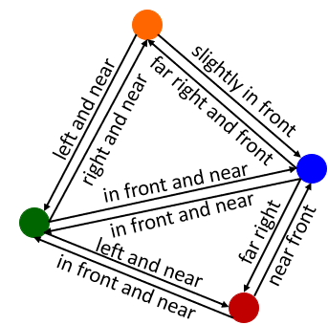
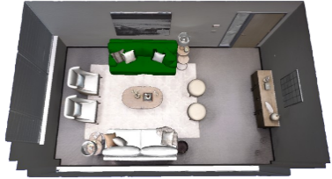
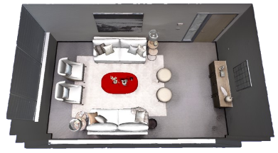
Which table is positioned closer to the sofa |  |  |  | The coffee table with object ID 5 is positioned closer to the sofa (object ID 14) at a distance of 1.59, compared to other tables.
Query | Partial Scene Graphs | ConceptGraphs | VIZOR | Explanation

Slide 6
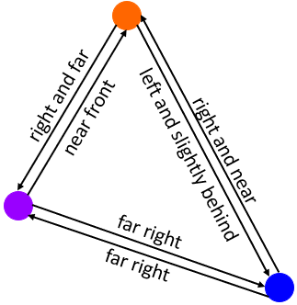
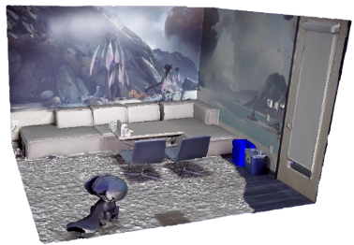
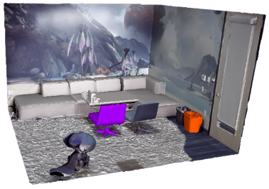
Select the farthest chair, trashcan pair |  |  |  | The farthest chair-trashcan pair is between Object 1 (a chair) and Object 3 (a recycling bin) with a distance of 2.022.
Query | Partial Scene Graphs | ConceptGraphs | VIZOR | Explanation

Slide 7
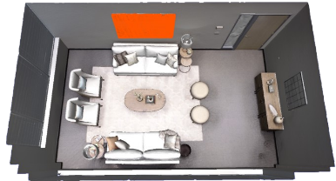
I need to find some object to gift. Which one will be best in this room? |  |  |  | The picture (Object 7) is a decorative art piece with black and white color, which makes it an elegant choice for gifting. Its aesthetic appeal as a decorative item makes it suitable for various settings.
Query | Partial Scene Graphs | ConceptGraphs | VIZOR | Explanation

Slide 8
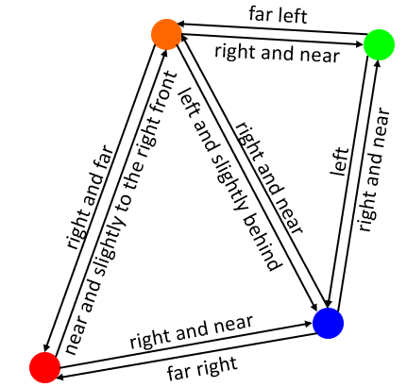
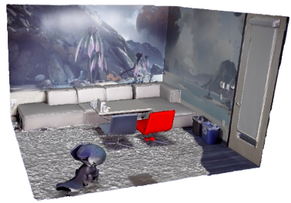
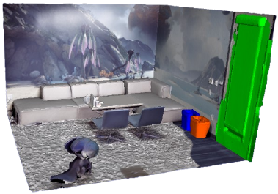
Which is the bad object for sitting on it? |  |  |  | Objects suitable for sitting are typically chairs and couches. The objects that are not designed or intended for sitting include recycling bins (Object 2 and 3), doors (Object 7).
Query | Partial Scene Graphs | ConceptGraphs | VIZOR | Explanation

Slide 9
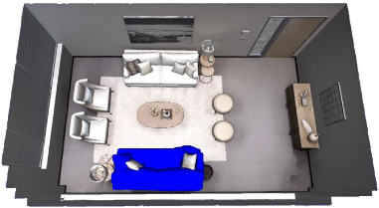
Where can I sit so that I have a clear view of picture in front of me |  |  |  | Objects 14 is a couch, which provide seating. It has picture (Object 7) positioned in front, allowing for a clear view.
Query | Partial Scene Graphs | ConceptGraphs | VIZOR | Explanation

Slide 10
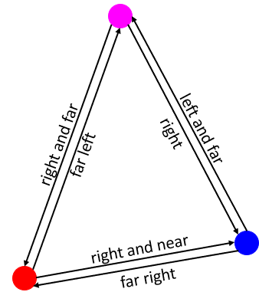
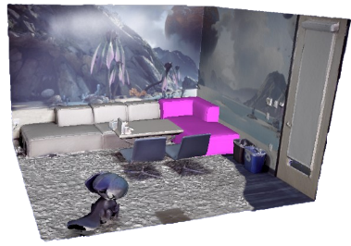
Where can I sit that is farthest from the trash can? |  |  |  | The objects used for seating are chairs (Object 0 and Object 1) and a couch (Object 11). Among the seating options, the couch is farthest from both recycling bins with distances of 1.094 and 1.4 respectively.
Query | Partial Scene Graphs | ConceptGraphs | VIZOR | Explanation

