Slide 1
InfraGuide AI
Cloud Migration Intelligence Platform
From application repository to practical cloud migration blueprint
Repository analysis ? Groq reasoning ? MCP cloud intelligence ? Regional pricing ? Word blueprint
Analyze
Scan repository
Recommend
Map cloud services
Price
Compare regions
Blueprint
Export plan
InfraGuide AI | 1

Slide 2
Contents
Page-wise presentation flow
Slide | Section
3 | Overview: Project Problem And Goal
4 | Why We Chose This Project
5 | Technologies, Frameworks, Dependencies And Methodology
6 | Technical Architecture
7 | Problem Solved And End-User Benefits
8 | AI Concepts Used
9 | Repository Analysis And Readiness
10 | Blueprint Output Sections
11 | Application Workflow
12 | Demo Walkthrough
13-18 | Screenshots To Paste
19 | Closing Summary
InfraGuide AI | 2

Slide 3
Overview: Project Problem And Goal
Problem
Cloud migration assessment usually needs manual code review, cloud service mapping, pricing checks, risk review, and a final migration document.
Goal
InfraGuide AI generates a first-pass cloud migration blueprint from a GitHub repository or uploaded project ZIP.
Output
Technology stack, readiness score, recommended services, cost and strategy, dependencies, security, roadmap, and Word export.
The product helps teams move from uncertain application discovery to a structured migration plan quickly.
InfraGuide AI | 3

Slide 4
Why We Chose This Project
Cloud migration planning is a real-world problem faced by developers, DevOps teams, architects, consultants, and modernization teams.
Most early migration assessments require separate tools for repository review, cloud service mapping, pricing, and documentation.
The project provides a practical use case for AI plus tools: Groq explains and reasons; MCP fetches pricing and validates cloud capabilities.
It demonstrates multi-cloud thinking across AWS, Azure, and GCP rather than being locked into one provider.
Why It Matters
A developer or migration team can submit an application and quickly understand what must change before moving to cloud.
Practical Outcome
The generated blueprint can be discussed with stakeholders before detailed migration execution begins.
InfraGuide AI | 4

Slide 5
Technologies, Frameworks, Dependencies And Methodology
Layer | Technology / Dependency | Purpose
Frontend | React, TypeScript, Vite, Tailwind CSS, Lucide React | Input modal, report UI, pricing modal, Word download
Backend | Python, FastAPI, Pydantic, HTTPX | Assessment APIs, validation, orchestration, MCP bridge calls
Repository Analysis | Git clone/subprocess, static file scanning, pattern matching | Detect stack, dependencies, CI/CD, containers, governance signals
AI Reasoning | Groq API, structured JSON prompts, fallback logic | Migration strategy, guidance, sizing, architect reasoning
MCP Layer | Python MCP FastMCP, Bridge API, provider clients | Pricing, service availability, runtime support, limits
Cache | Redis | Cache provider pricing and catalog responses
Deployment | Docker, Docker Compose | Run app services with Redis as separate cache container
Methodology: deterministic repository analysis first, AI refinement second, tool-backed cloud pricing and validation through MCP, then fallback-safe blueprint generation.
InfraGuide AI | 5

Slide 6
Technical Architecture
User
React UI
FastAPI
Analyzer
Recommendation
Blueprint
Groq LLM
MCP Bridge
MCP Server
Provider APIs
Redis Cache
The architecture separates repository analysis, AI reasoning, pricing tools, cloud validation, and final report rendering.
InfraGuide AI | 6

Slide 7
Problem Solved And End-User Benefits
For Developers
Quickly understand application stack, dependencies, missing containerization, cloud compatibility, and migration steps.
For DevOps Teams
See CI/CD, infrastructure, runtime, service, and observability gaps before migration planning starts.
For Architects
Compare provider services, readiness, risks, costs, and roadmap before selecting a target architecture.
Reduces manual discovery time for first-pass migration assessment.
Creates consistent assessment output across different application repositories.
Improves stakeholder communication using a downloadable migration blueprint.
Supports cloud cost visibility before detailed migration execution.
InfraGuide AI | 7

Slide 8
AI Concepts Used
Hybrid AI Approach
Deterministic repository analysis creates facts. Groq uses those facts to improve reasoning and explanation.
Fact-Grounded Prompting
Prompts instruct the model to use only repository facts and selected migration requirements.
Structured JSON Output
Where the app needs structured responses, prompts request JSON for parsing and validation.
Tool-Augmented Intelligence
MCP tools provide pricing, service availability, runtime support, limits, and health checks.
Fallback Logic
If Groq or provider data is unavailable, local analysis and rule-based recommendations still produce a usable blueprint.
Requirement-Aware Reasoning
Goal, traffic, budget, and timeline influence sizing, strategy, roadmap, governance, and cost assumptions.
InfraGuide AI | 8

Slide 9
Repository Analysis And Readiness
The analyzer scans project files and produces a structured repository profile before AI reasoning is applied.
Detected Area | Examples In Output
Technology stack | Languages, frameworks, runtimes, package managers, hosting model, deployment model
Dependencies | Databases, cloud dependencies, external dependencies, dependency graph
Cloud readiness | Score, complexity, runtime compatibility, database compatibility, container readiness, configuration readiness
Governance signals | Hardcoded secret patterns, missing CI/CD, missing IaC, missing containerization, database migration risk
Requirement profile | Traffic, budget, goal, timeline converted into sizing and roadmap assumptions
Readiness is explainable: each score is backed by detected signals and score breakdown lines.
InfraGuide AI | 9

Slide 10
Blueprint Output Sections
Section | What It Explains
Technology Stack | Detected stack, hosting, runtime, databases, containers
Cloud Readiness | Score, complexity, compatibility, score breakdown
Cloud Service Validation | MCP check for service availability by region
Recommended Services | Provider-specific runtime, storage, database, secrets, monitoring, etc.
Runtime Compatibility | MCP check for runtime support on selected service
Cost And Strategy | Monthly/annual estimate, region, line items, assumptions
Dependencies | Cloud, external, and application dependency graph
Security | Risk, passed checks, issues, recommendations
Modernization And Roadmap | Opportunities and phased migration steps
InfraGuide AI | 10

Slide 11
Application Workflow
Input Repo / ZIP
Validate Fields
Clone / Extract
Analyze Files
Groq Reasoning
MCP Pricing
Generate Report
Pricing And Validation Branch
Regional pricing, service availability, runtime support, service limits, and health checks are handled through MCP tools and Redis cache.
Fallback Branch
If Groq, MCP, provider API, or cache fails, the system keeps the blueprint usable with deterministic analysis and fallback estimates.
Final output: on-screen migration blueprint plus downloadable Word report.
InfraGuide AI | 11

Slide 12
Demo Walkthrough
Navigate to InfraGuide AI http://62.72.30.227:5174/ and click Analyze Project.
Choose either GitHub Repository URL or Upload ZIP File as the project source.
Select the target Cloud Provider, Migration Goal, Expected Traffic, Budget Preference, and Migration Timeline.
Click Generate Migration Blueprint to start the analysis.
Review the generated recommendations, including:
Technology Stack Analysis
Cloud Readiness Assessment
Recommended Cloud Services
Cost Estimation and Migration Strategy
Security Recommendations
Migration Roadmap
Navigate to the Compare section to view and compare regional pricing across cloud providers.
Verify the Cloud Service Validation results and Runtime Compatibility recommendations.
Download the generated Migration Blueprint in Microsoft Word (.docx) format.
InfraGuide AI | 12

Slide 13
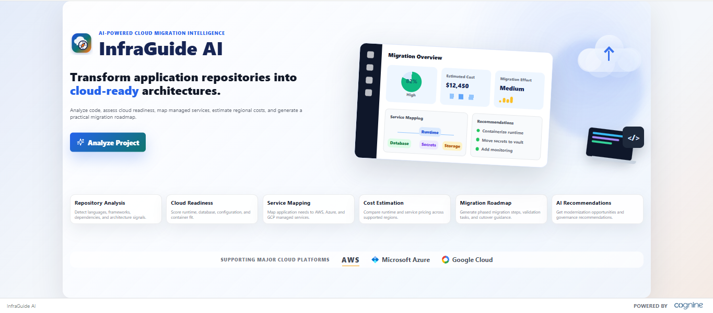
InfraGuide AI Dasboard
Paste Screenshot: Migration Input Modal
Show the redesigned modal with GitHub/ZIP tabs, provider logo cards, migration goal cards, traffic, budget, and timeline selections.
InfraGuide AI | 13

Slide 14
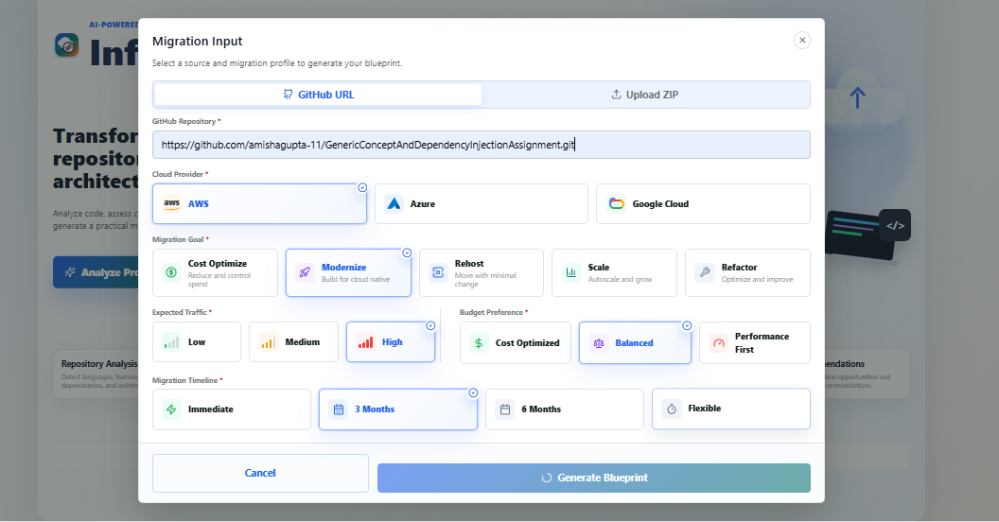
Migration Input
Paste Screenshot: Migration Input Modal
Show the redesigned modal with GitHub/ZIP tabs, provider logo cards, migration goal cards, traffic, budget, and timeline selections.
InfraGuide AI | 14

Slide 15
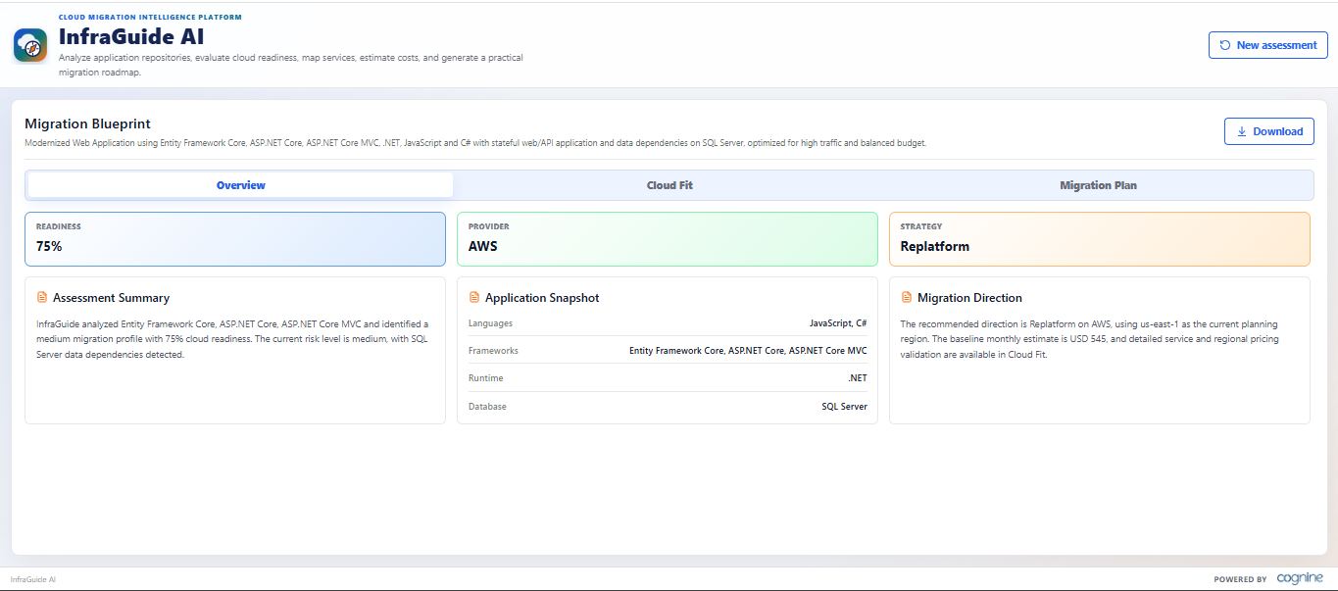
Generated Blueprint
Paste Screenshot: Generated Migration Blueprint
Show Technology Stack, Cloud Readiness, Recommended Services, Cost And Strategy, Dependencies, Security, Modernization, and Roadmap.
InfraGuide AI | 15

Slide 16
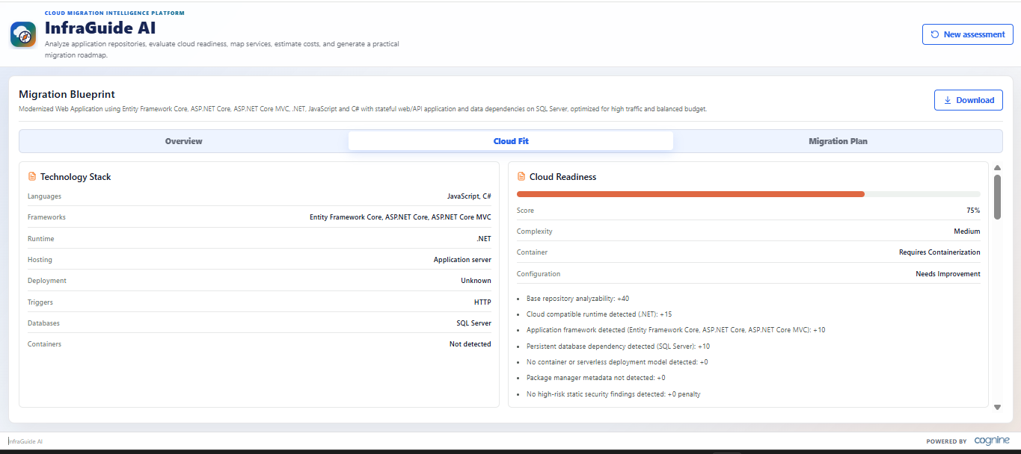
Generated Blueprint
Paste Screenshot: Generated Migration Blueprint
Show Technology Stack, Cloud Readiness, Recommended Services, Cost And Strategy, Dependencies, Security, Modernization, and Roadmap.
InfraGuide AI | 16

Slide 17
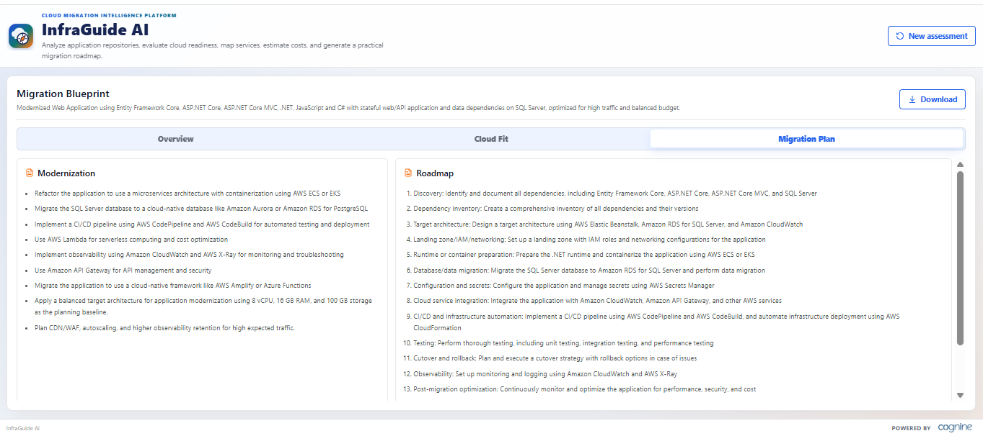
Generated Blueprint
Paste Screenshot: Generated Migration Blueprint
Show Technology Stack, Cloud Readiness, Recommended Services, Cost And Strategy, Dependencies, Security, Modernization, and Roadmap.
InfraGuide AI | 17

Slide 18
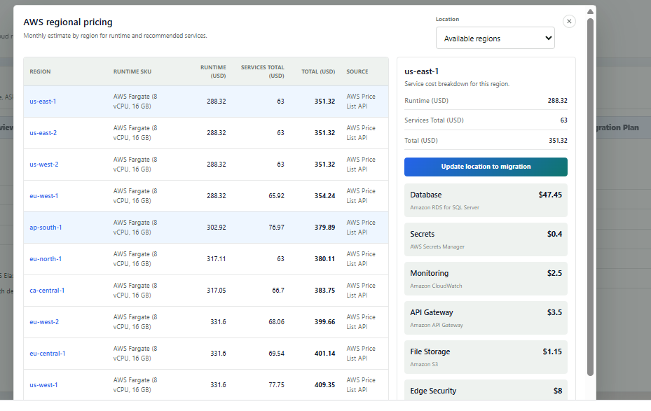
Regional Pricing
Paste Screenshot: Regional Pricing Modal / Word Export
Show Compare and select regional pricing rows, service cost breakdown, selected region update, or downloaded Word blueprint.
InfraGuide AI | 18

Slide 19
Closing Summary
InfraGuide AI turns repository evidence into a practical cloud migration blueprint.
Repository Analysis
Grounds the output in actual application files and dependencies.
Groq Reasoning
Improves migration strategy, guidance, roadmap, and architect explanation.
MCP Intelligence
Provides pricing, regional comparison, runtime support, service availability, and limits.
Result: faster discovery, better cost visibility, clearer cloud planning, and stakeholder-ready documentation.
InfraGuide AI | 19

