Slide 1
Selenium Test Automation of DemoBlaze Website
Wipro Capstone project
Made By: Vivek Mhetre (Selenium Java Batch 3)

Slide 2
Table of Content
Summary
Tools and Technologies
Test Automation Approach
Test Architecture Overview
Test Case Coverage Summary
Git repository snapshot
Jenkins snapshot
Jira & Zephyr Integration
Sprint Snapshot
Zephyr Test Cases & Report Snapshot

Slide 3
Summary
This project is a Selenium WebDriver automation framework developed using TestNG and Page Object Model (POM) design pattern, built within a Maven project structure.
The suite validates key user workflows such as registration, login, shopping cart operations, purchasing, logout, contact form, and category browsing to ensure that core business functionalities work reliably.
Each significant page and user action is modeled as a separate class for maintainability, and test assertions verify both positive and negative scenarios.

Slide 4
Tools and Technologies
Selenium WebDriver
TestNG
Maven
POM
GitHub
Jenkins
Jira + Zephyr

Slide 5
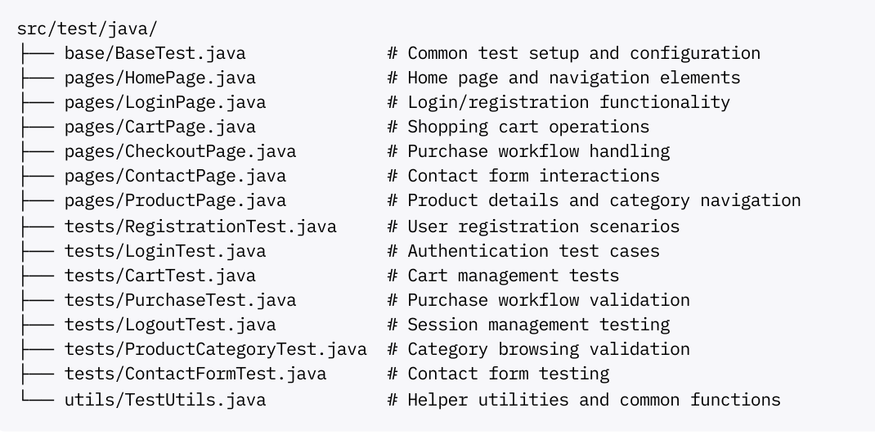
Test Automation Approach
Page Object Model Structure

Slide 6
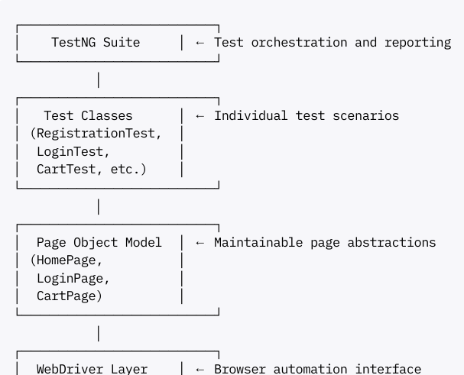
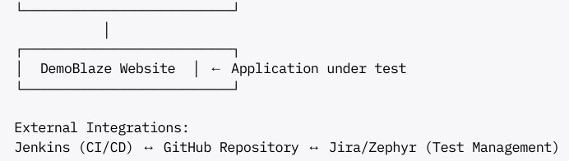
Test Architecture Overview

Slide 7
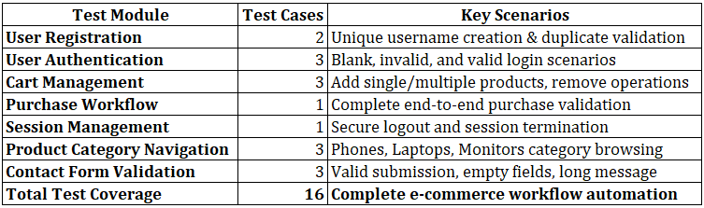
Test Case Coverage Summary

Slide 8
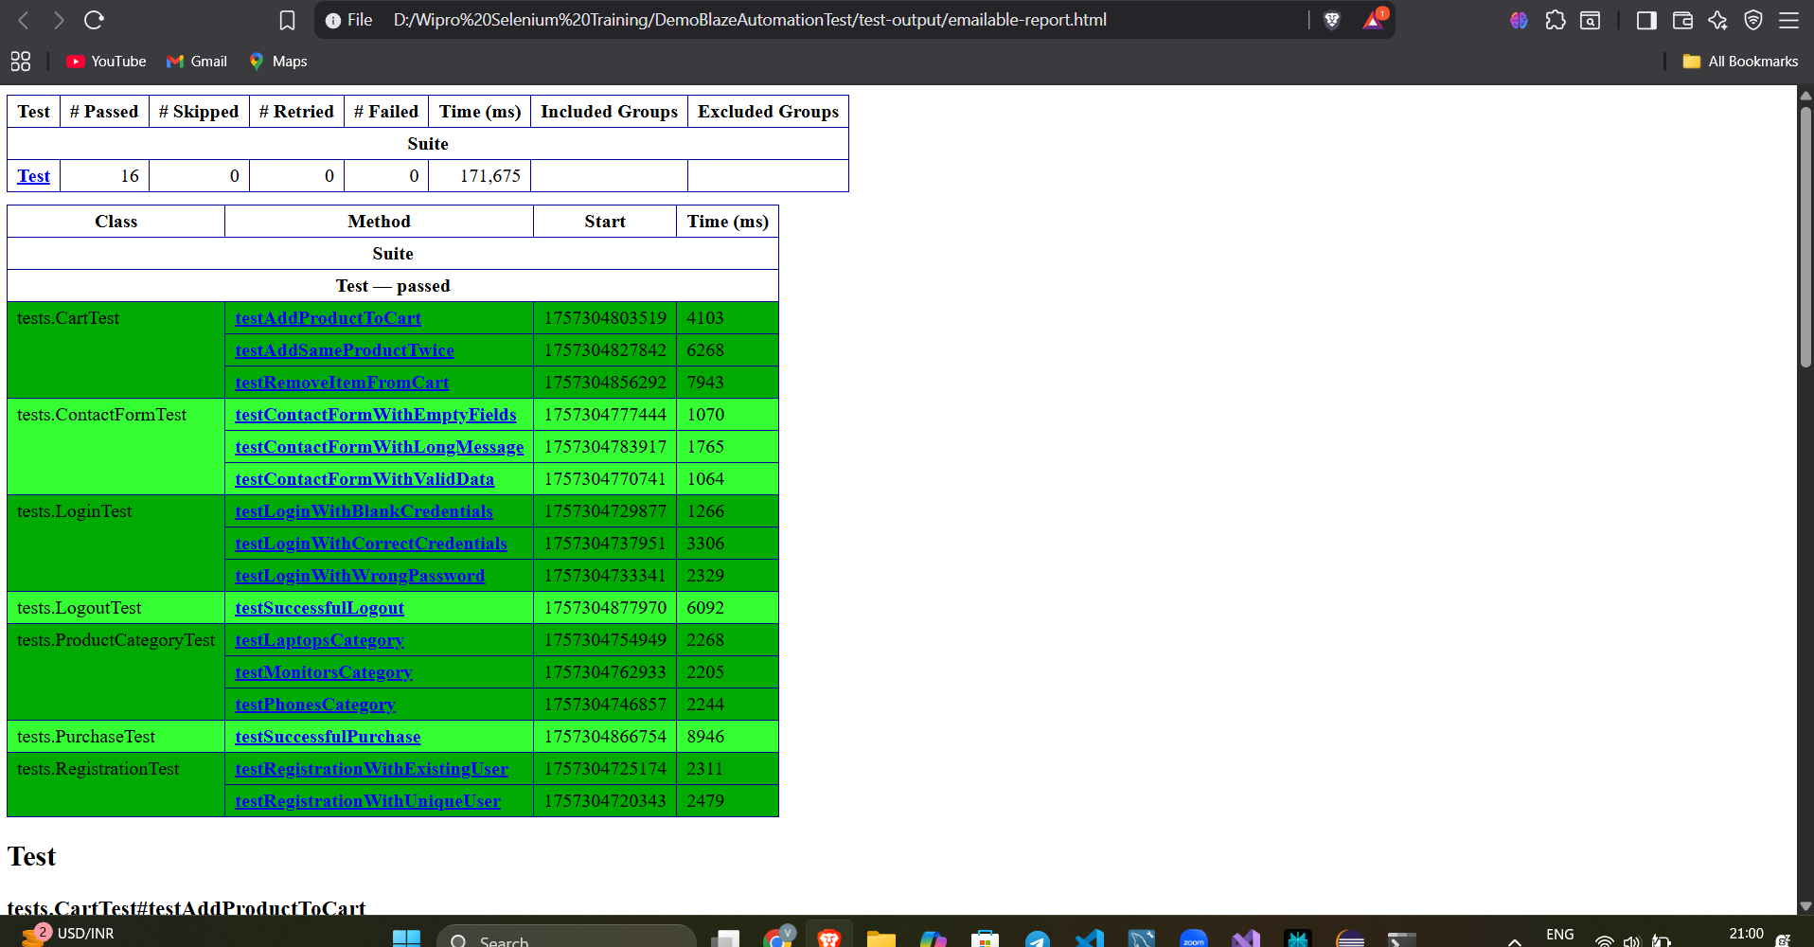
Test Case Report

Slide 9
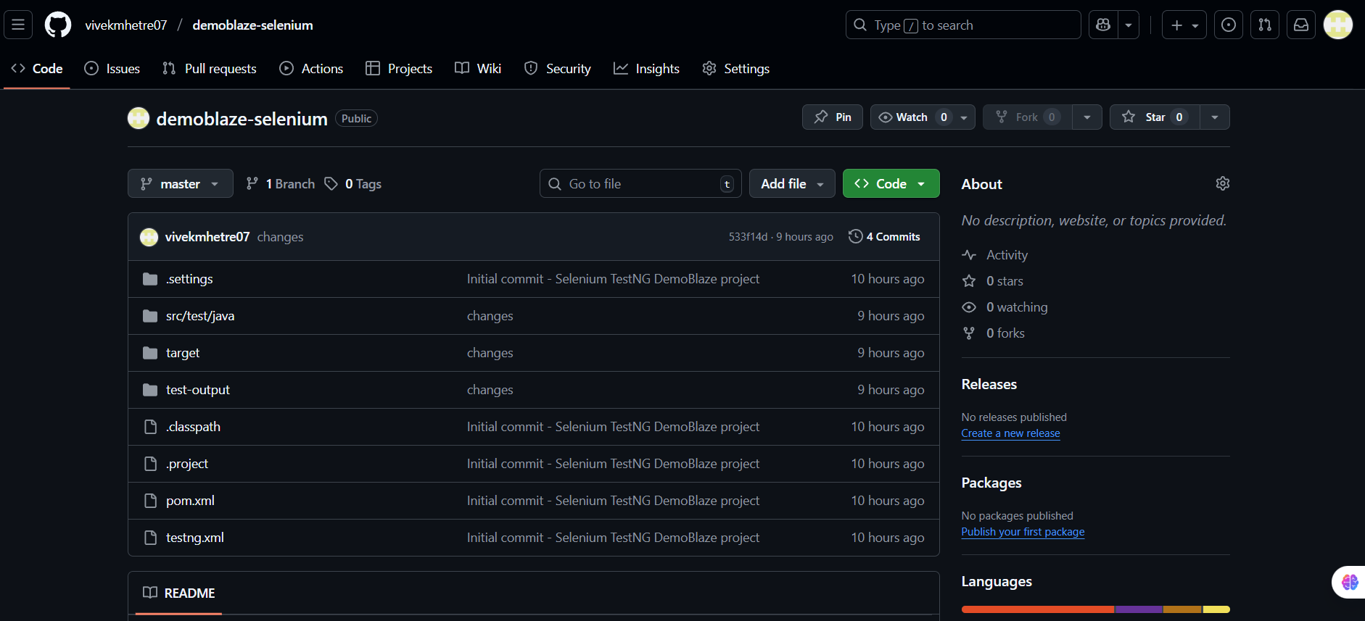
Git repository snapshot

Slide 10
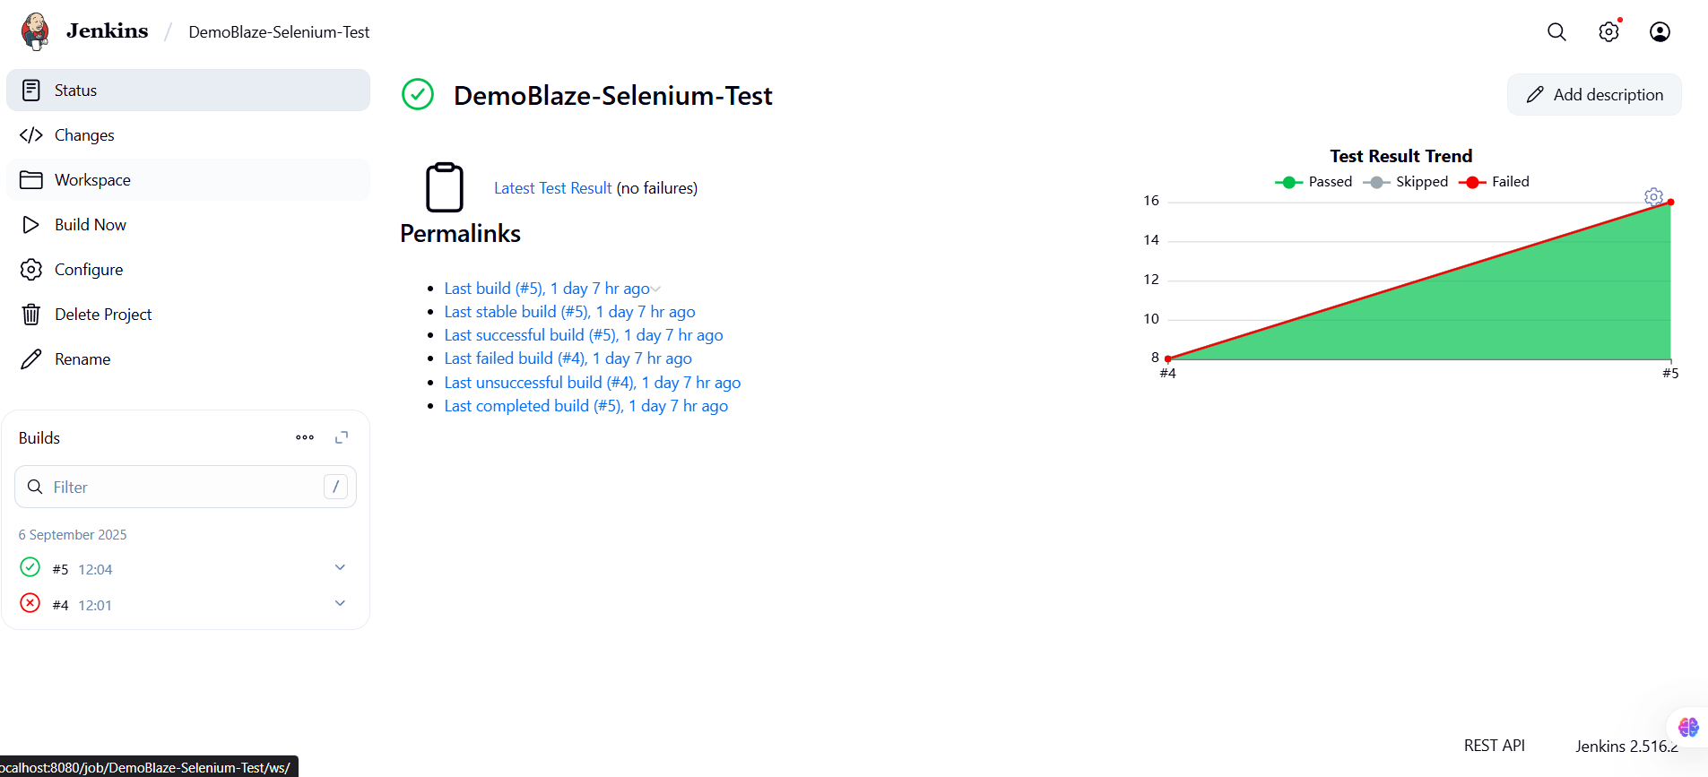
Jenkins snapshot

Slide 11
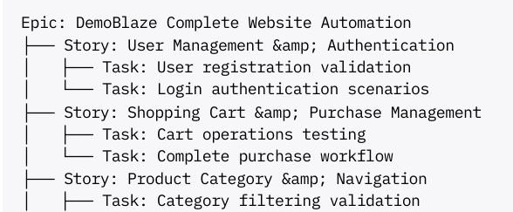

Jira & Zephyr Integration
Test Case Management: All 16 test cases documented as Zephyr Test issues
Execution Tracking: Real-time test results and execution status Requirements
Traceability: Direct linking between user stories and test cases
Sprint Integration: Test cases allocated to development sprints
Automated Reporting: Test execution summaries and coverage reports

Slide 12
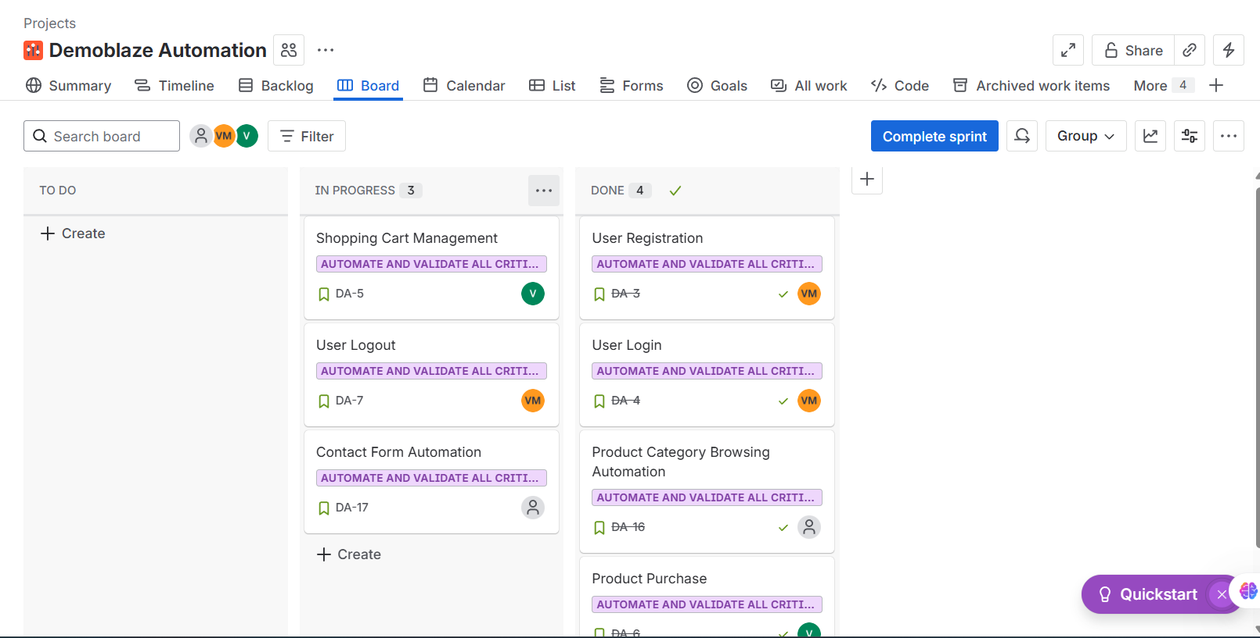
Sprint Snapshot

Slide 13
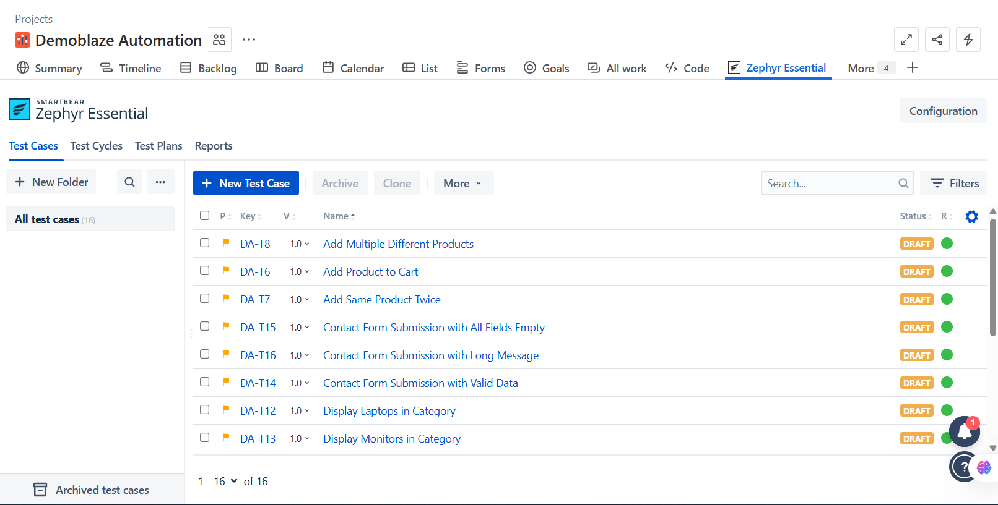
Zephyr Test Cases

Slide 14
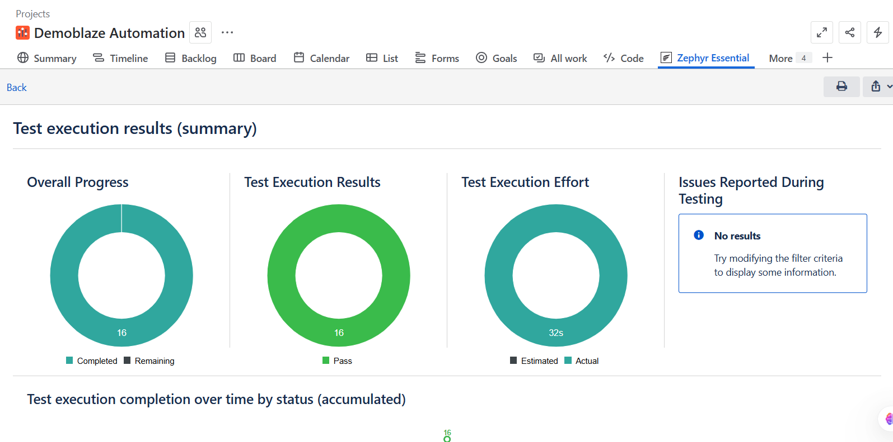
Zephyr Report

Slide 15
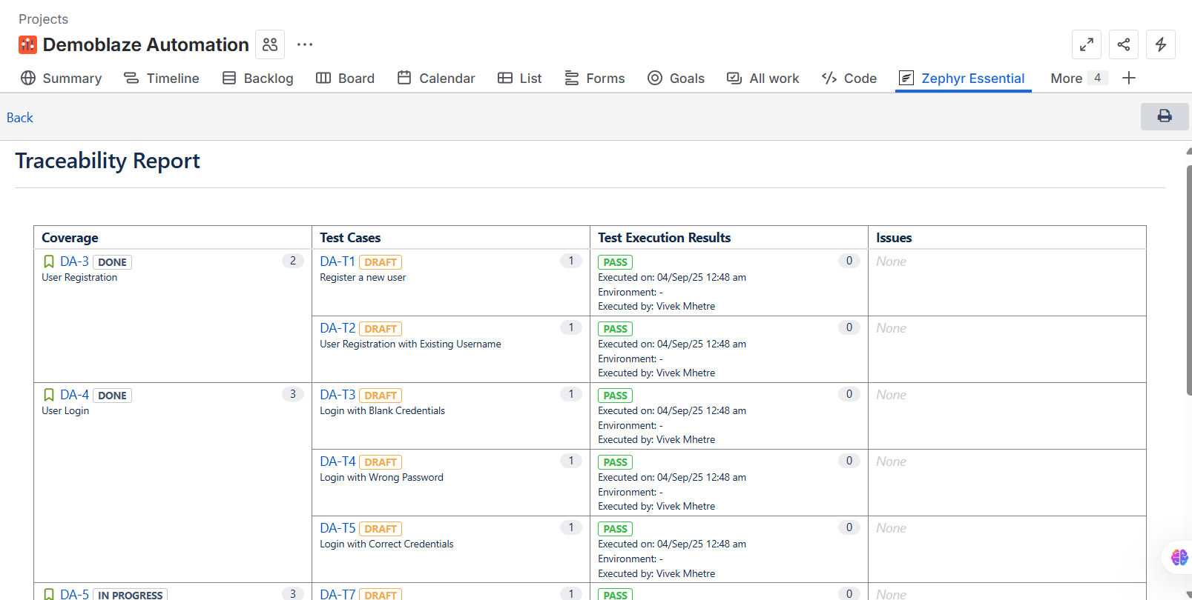
Zephyr Traceability Report

Slide 16
Thank You

