Slide 1
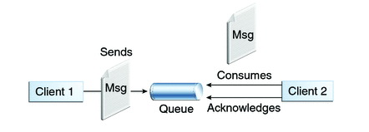

How to Send/Receive product object to/from Queue with Manual Acknowledgement
(Spring Boot + JMS + RabbitMQ Example with Annotations)?
Queues [point-to-point]: Queue’s are based on point-to-point messaging model where messages are sent to a queue. Each message has exactly one sender and one receiver. Message is guaranteed to be delivered to only one receiver.
SpringBootJMSProducer Application
SpringBootJMSReceiver Application

Slide 2
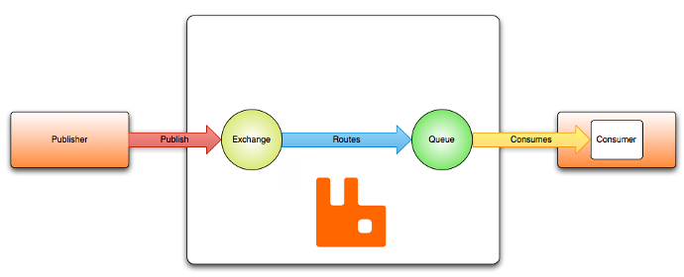
How to Send/Receive product object to/from Queue with Manual Acknowledgement
(Spring Boot + JMS + RabbitMQ Example with Annotations)?
Routes the message to a queue
This is container for the messages.
SpringBootJMSReceiver Application
SpringBootJMSProducer Application

Slide 3
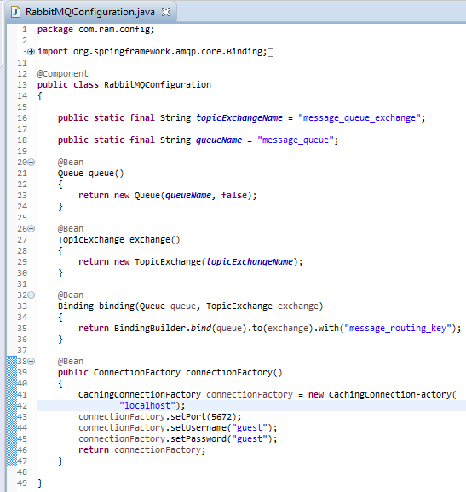
SpringBootJMSProducer Application
Binding: Binds the queue and topic exchange for a given queue name.

Slide 4
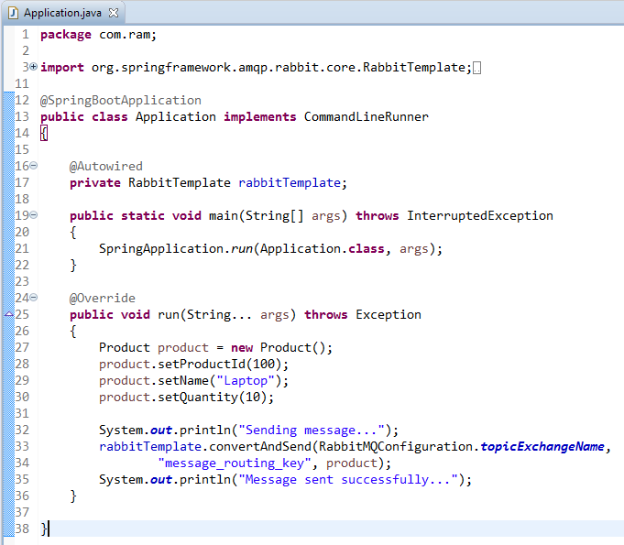
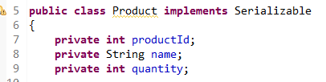
SpringBootJMSProducer Application
Spring Boot automatically creates a connection factory and a RabbitTemplate, reducing the amount of code you have to write.
RabbitTemplate.convertAndSend method converts java object to AMQP message and is sent to default topic exchange.

Slide 5
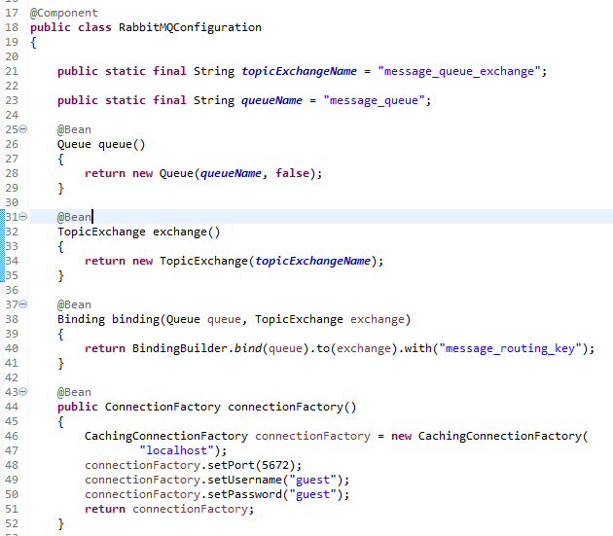
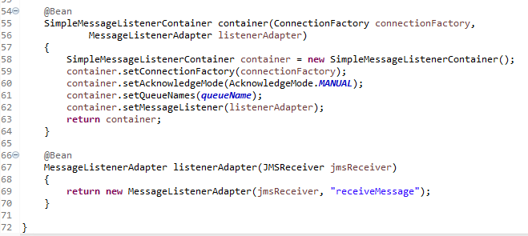
SpringBootJMSReceiver Application
Register a Receiver with the message listener container to receive messages.

Slide 6
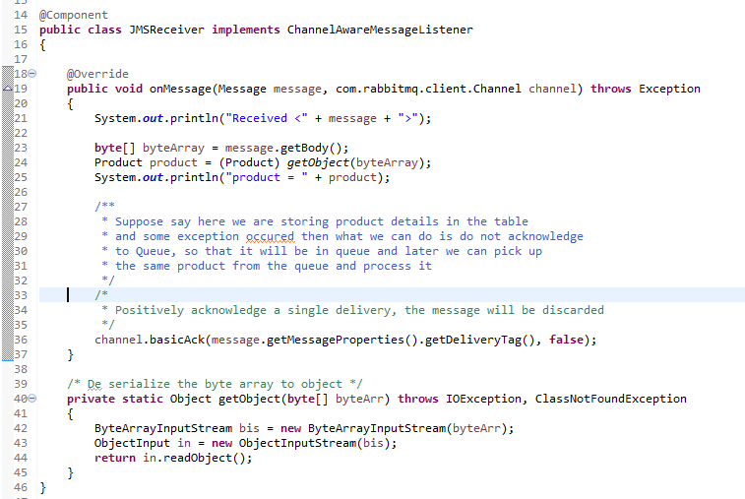
SpringBootJMSReceiver Application
JMSReceiver class that will receive the message.

Slide 7
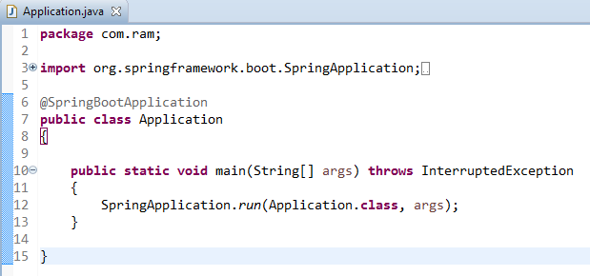
SpringBootJMSReceiver Application

