Slide 1
Landing Case Study
Group Members:-
Vivek Moningi (Group Facilitator)
Kuldeep

Slide 2
Purpose:-
Helping ”Consumer Finance Company” to find most suitable applicants to lend money by
performing “Risk Analytics”, and helping company to avoid financial Risks.
To Analyze the data set we are following below steps:
1:-Data Sourcing & Data Understanding
2:- Data Cleaning
3:- Handling Outliers
4:- Fixing Invalid Values
5:- Univariate Analysis
6:- Bivariate and Multivariate Analysis
7:- Risk And Recommendations

Slide 3
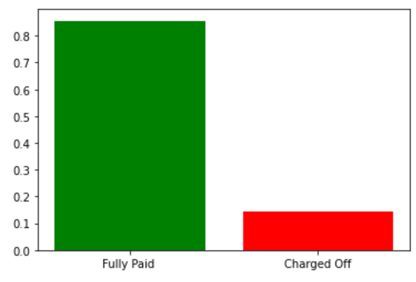
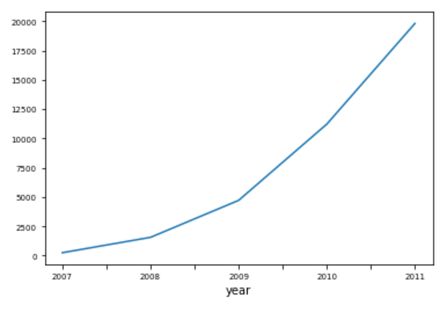

Analysis on Lending Case Study
There total 14% of people who have defaulted as per our analysis and the number of defaulters are increasing on yearly basis.
As we can see that no of people defaulting count is increasing every year linearly

Slide 4
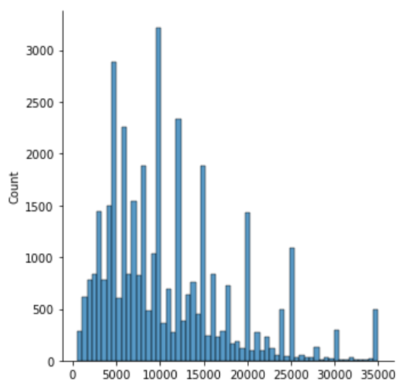
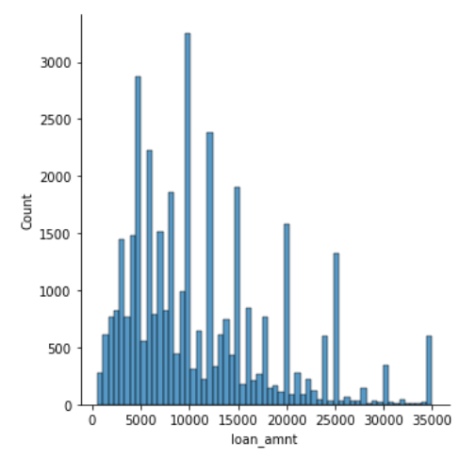
Analysis on Lending Case Study - Continued
As we can see the loan amount and Funded amount follow same distribution so all the borrowers requested amount is funded lets see further analysis to understand clearly about why it is loss to the investors.

Slide 5
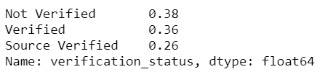
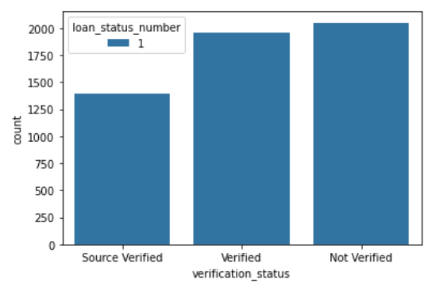
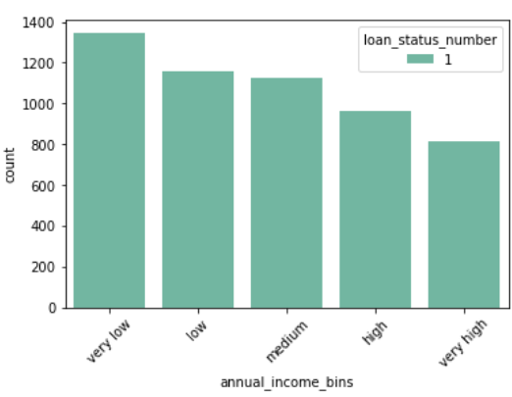
Analysis on Lending Case Study - Continued
Around 38% of defaulted population is due to no proper verification prior to giving the loan and 25% of defaulted population is due to very low income
Lets see for what purpose of the population take loans

Slide 6
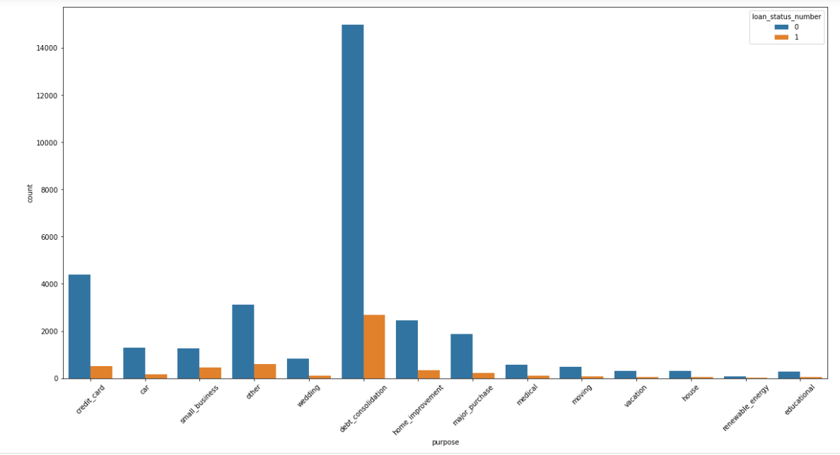
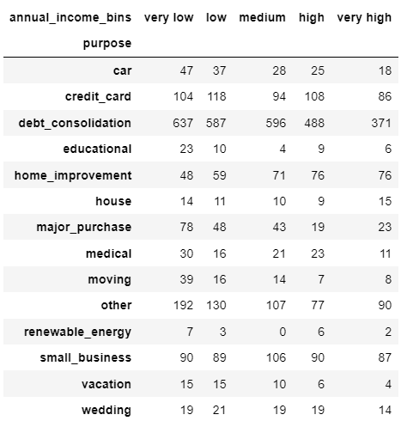
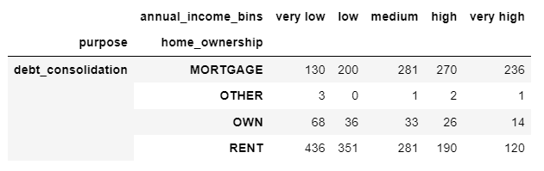
47% of the population takes loan for debt consolidation and 50% of defaulted borrowers also took for debt consolidation.
As per the graph 1227 people with low income who took loan for debt consolidation has defaulted out of which 787 people have rented properties and 330 people have mortgage

Slide 7
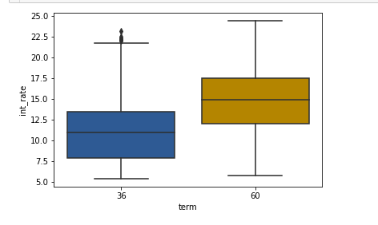
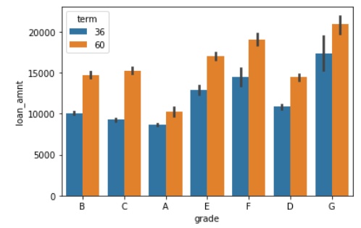
Few more observations :
It can be observed that the interest rates are based on terms means the longer the loan the higher the interest rates.
It can be observed by this analysis that the higher amount are approved in longer terms but has lower grade to because of it's high charged off frequencies

Slide 8
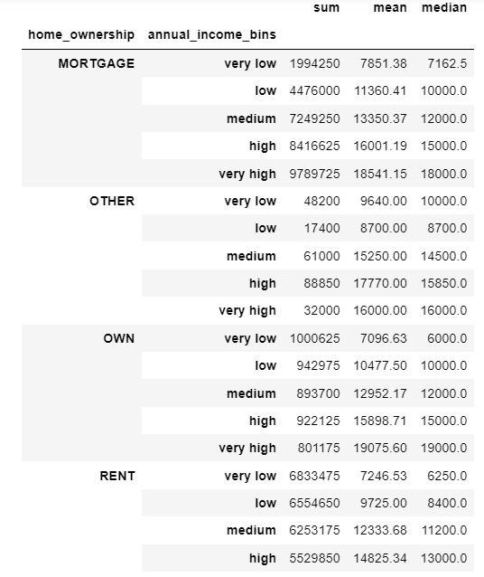
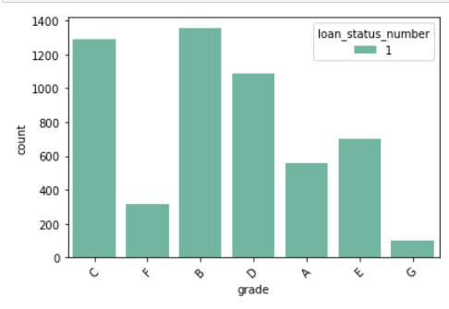
Rented and Mortgage people tend to take high amount of loans when compared to others
People with Grade B and in which sub grade B3,B4 and B5 tend to take high amount of loans and default

Slide 9
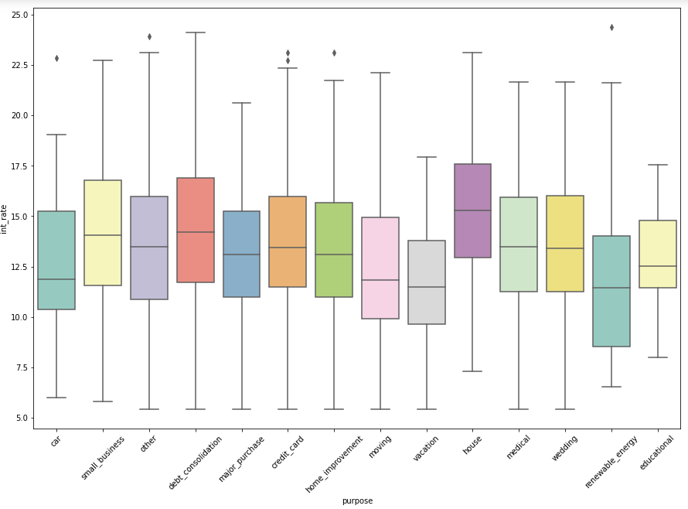
Housing have higher range of interest rate when compared to other purposes where as debt consolidation have highest interest rate

Slide 10
Recommendations:
Reduce approving the loans where purpose is debt consolidation
Stop approving loans with very low to low income range
Increase the verification process before approving the loan
Reduce the approval of loan with rented and mortgage houses
Reduce the interest rate for people with low income category.

