Slide 1


MOOC

Slide 2


M assive O pen O nline C ourse

Slide 3
MOOC
Massive : course followed by anyone
Open : open to all.
Online : located on web
Course : collection of Topics

Slide 4
Before MOOC
Correspondence Courses
Computer Based Training
YouTube videos

Slide 5
Advantages of MOOC
Enrolment open to anyone
No fee
Not constrained by time or geography.
Informal

Slide 6
MOOC providers
Coursera
edX
Udacity
and many more...

Slide 7


Slide 8
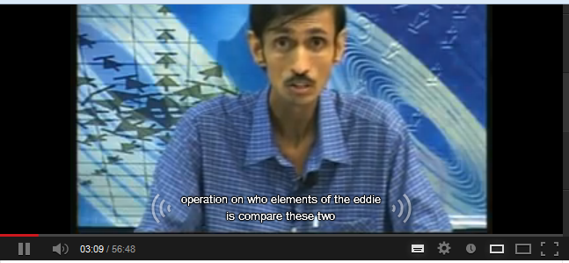
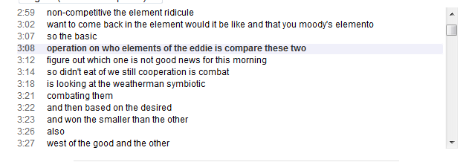
Features to be Implemented
Lecture Videos
Subtitles
Transcripts

Slide 9
Features to be Implemented
Interactive Video lectures
Text Readings - pdfs
Quizzes
Progress Evaluation
Peer Review
Discussion Forums

Slide 10
Thank You.

