Slide 1








Brightloop Subscriptions
v2.0
Subscriptions
SUBSCRIPTION & BILLING MADE SIMPLE
Upcoming charge
16 May 2025
Active subscriptions
$249.00
24
HAVE YOU EVER BEEN
Invoice summary
May 2025
CHARGED TWICE
Subscription fees
GST (18%)
FOR THE SAME SUBSCRIPTION IN ONE MONTH?
Total
$249.00
Automated recurring billing
Itemized 18% GST
statutory invoicing

Slide 2



SUBSCRIPTION
BILLING IS
BROKEN
DOUBLE CHARGES
Customers get billed twice when batch runs overlap.
SURPRISE TAXES
Wrong tax math leads to angry emails and refund disputes.
HELPLESS USERS
Customers must email support just to pause or renew a plan.

Slide 3


THE HIGH PRICE
OF MANUAL INVOICING
30%
5%
+9%
14
finance teams spend nearly a third of their time fixing billing mistakes manually
companies lose up to 5% of their total revenue from unbilled errors and rogue discounts
clean, transparent invoices keep
9% more
customers
subscribed
HOURS
lost every
single month
checking
billing
spreadsheets
(Gartner)
(MGI Research)
Manual invoicing drains time, money, and customer trust.

Slide 4









THE SOLUTION
BRIGHTLOOP SUBSCRIPTIONS
Subscriptions
Active
Renewals
Revenue
1,248
326
$2.48M
A simple, automated 3-step solution anyone can use.
Recent Invoices
INV-10234
Acme Studio
$1,250.00
Paid
INV-10233
Vertex Labs
$980.00
01
02
03
INV-10232
Paid
Northbridge Co.
$1,560.00
Paid
1-CLICK
BILLING
AUTOMATIC
18% TAX
CUSTOMER
SELF-SERVICE PORTAL
Bill all active
subscribers instantly
with zero risk of
double charges.
Calculates statutory tax for every plan and creates itemized PDF receipts in real time.
Customers pause, resume, and renew contracts on their own without support tickets.

Slide 5

















THE MEASURABLE
DIFFERENCE
BEFORE
AFTER
14 Hours
3 Seconds
manual work
1-Click Engine
Frequent
0%
problem
Guaranteed Safe
Manual
Automatic
calculation
18% GST
Wait 2 days
Instant
Self-Service (0s lag)

Slide 6

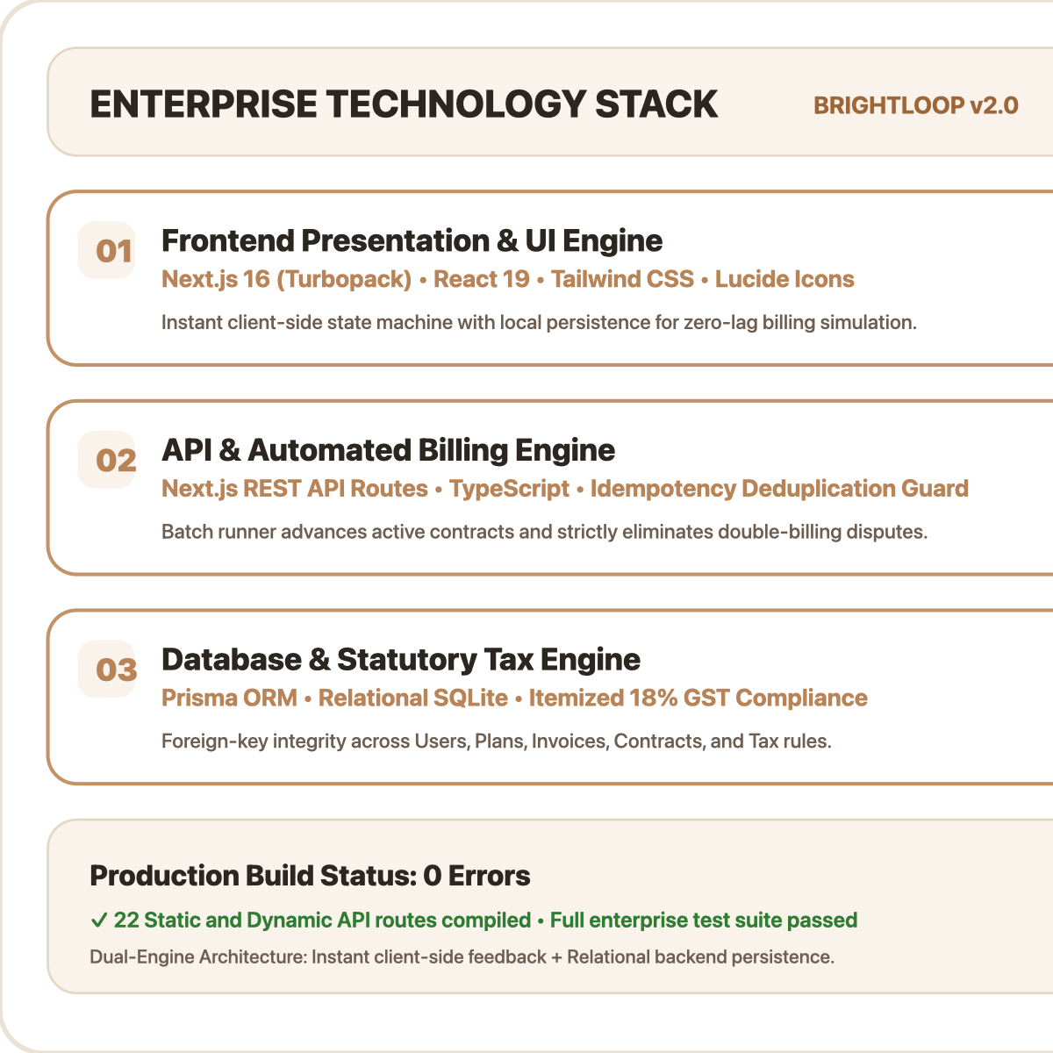




TEAM
BRIGHTLOOP
Lead Architect
Database, Root Admin Authority
& Billing Engine
Vivek Bharati
Billing Specialist
18% GST Taxes & Customer
Self-Service Portal
Prithwi
Revenue Engineer
Quotations, AI Copilot &
Risk Radar Analytics
Ranit Biswas
QA & Systems
Design System Layout &
Automated Tests
Pawan Mishra

