Slide 1

Investment
Portfolio Analysis
Presented by: GUO Yifei DANILKINA Valeriia MOUROUGAPPANE Soundarya PANDYA Vivek
23 January 2023
Notes:
Photo by Austin Distel on Unsplash

Slide 2
01
03
Dashboard
Code
02
04
Data Cleaning
Analysis & Insights
2
Notes:
Photo by Hannah Nicollet on Unsplash
Photo by Dan Cornilov on Unsplash
Photo by Olga Zabegina on Unsplash
Photo by Phạm Duy Quang on Unsplash

Slide 3
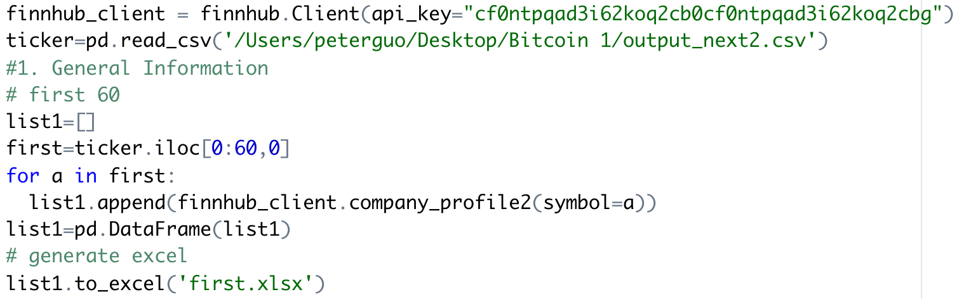
Code1: General Information
Code
*
Result
Highlight
* Divided into two parts due to Finnhub limitations
3

Slide 4
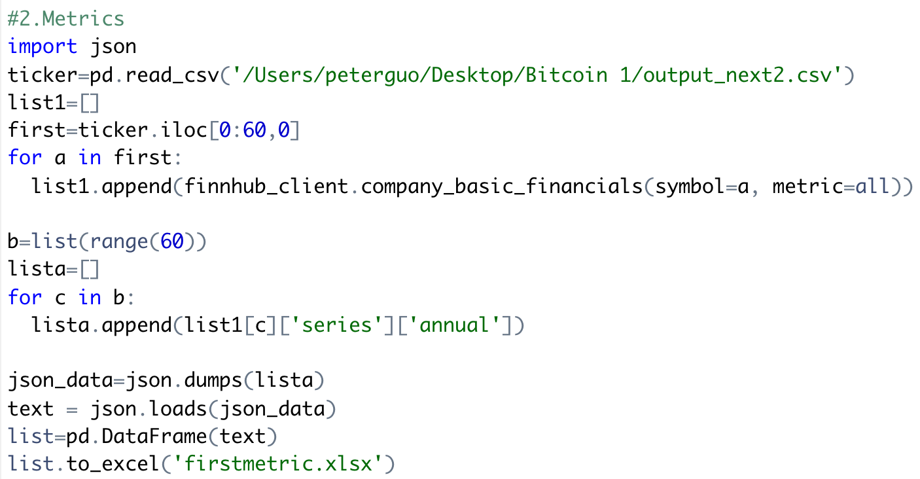
Code2: Metrics
Code
Result
*
Highlight
* Used Json function for converting to dataframe
4

Slide 5
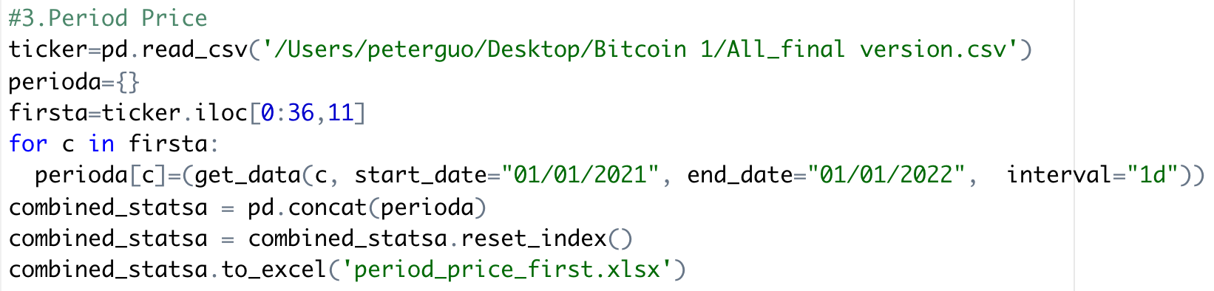
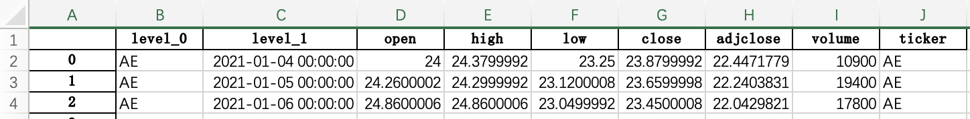
Code3: Period Price
Code
1
2
Result
Highlight
Used concat funcation combined dataframes
Added the serial number under column A
5

Slide 6
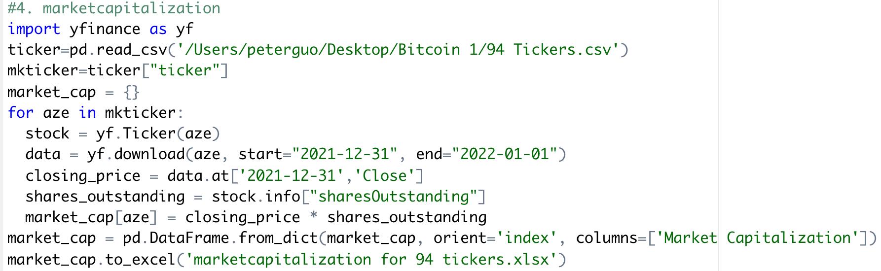
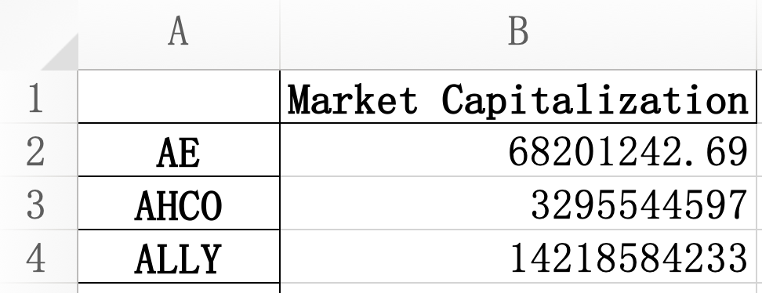
Code4: Market Capitalization
Code
Result
Highlight
Calculated market capitalization
6

Slide 7
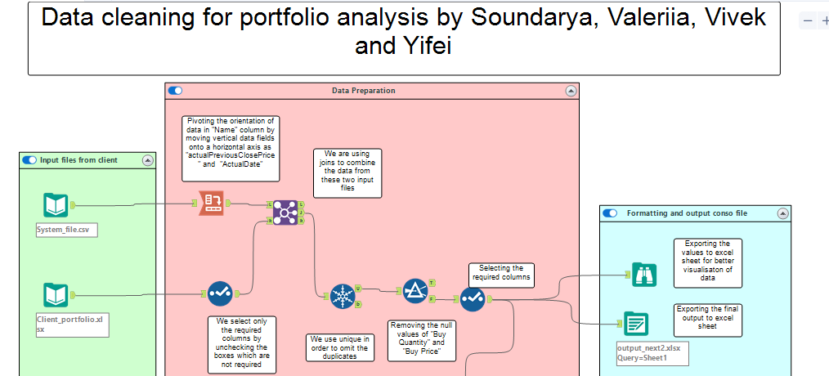
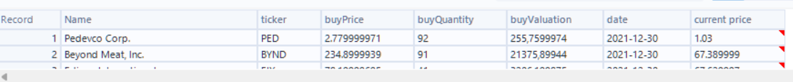
Alteryx for Data Cleaning

Slide 8
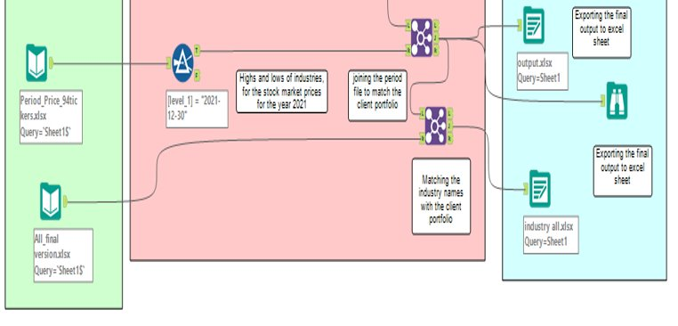
Alteryx for Data Cleaning
Sell: 1. SPPI 2. GTLS 3. ASTE 4. CTSH 5. RGNX
8
Notes:
Photo by Power Point asset

Slide 9

Portfolio Analysis
Most likely the given portfolio is Highly risky and short-term strategy
01
02
Consists of company shares only (no bonds, ETFs, currency, etc.)
High volatility of stock
7
Notes:
Photo by Hannah Nicollet on Unsplash
Photo by Dan Cornilov on Unsplash
Photo by Olga Zabegina on Unsplash
Photo by Phạm Duy Quang on Unsplash

Slide 10
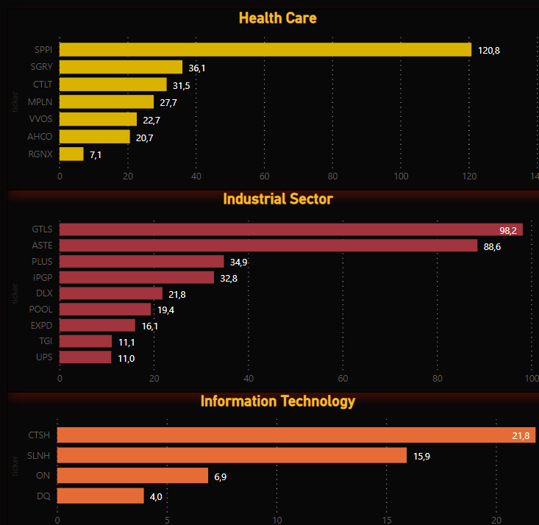


Top 5 companies to buy/sell from the portfolio.
Using P/E we decide to
To Assess if we have to buy or sell stocks we can rely on indicators such as: a) Earnings per share
b) Price to earnings (P/E) ratio
c) Price to earnings ratio to growth ratio (PEG)
d) Price to book value ratio (P/B)
e) Dividend payout ratio (DPR)
f) Dividend yield
Sell: 1. SPPI 2. GTLS 3. ASTE 4. CTSH 5. RGNX
Buy: 1. AHCO 2. TGI 3. ON 4. VVOS 5. EXPD
8
Notes:
Photo by Power Point asset

Slide 11
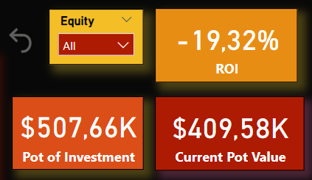
Portfolio Analysis
Performance
Diversification
When to sell entire portfolio?
Likely poor: negative ROI
Not well diversified: Only has company shares
1. Hits the portfolio value target
2. Decides to use money for something else
3. In case of unforeseen circumstances, such as a market crash.
Most/least valuable industry
Top 3 industries per total stock value in this portfolio are Industrial Sector, Healthcare, IT – 70,8% of stock together Bottom 3 industries: Energy, Materials, Utilities – 4% of stock
9

Slide 12

How to optimize the portfolio investment?
Sell extremely overvalued and undervalued stock
Diversify portfolio
Split portfolio into parts: % high-risk, % medium-risk, % low-risk.
1. Shares of funds, ETFs 2. Foreign currency 3. Bonds - a safe alternative and other financial instruments
10
Notes:
Photo by Power Point asset

Slide 13

Thank You
Questions?
Notes:
Photo by Dylan Gillis on Unsplash

