Slide 1
Customer Churn Prediction Application Architecture: Implementation using Docker & Kubernetes

Slide 2
Data Ingestion
Sources: The data can be ingested from various sources like databases, CSV files, APIs, or real-time streams.
Data Flow: Data is fed into a preprocessing pipeline.

Slide 3
Preprocessing
Data Cleaning: Handling missing values, normalizing data, and feature selection.
Transformation: Encoding categorical variables, scaling numeric features.
Output: Processed data is sent to the model training pipeline.

Slide 4
Model Training and Evaluation
Machine Learning Pipeline: Model is trained using algorithms like Logistic Regression, Decision Trees, or Neural Networks.
Evaluation: The model’s performance is evaluated using metrics such as accuracy, precision, recall, or F1-score.
Output: Trained model.

Slide 5
Need Of Containerization & Orchestration
One of the common problems is faced by the developers and operational team that the code is working successfully on a machine but doesn't work on other one due to the differences in computing environment, if any..
The Virtual Machine or Virtualization is not the suitable option to handle these challenges. To address such issues, the need of Containerization arises. Containerization facilitates to deploy various applications utilizing the same OS on a single VM/ Server. A Container uses operating system level virtualization for deploying applications instead of creating an entire VM.Output: Trained model.

Slide 6
Need Of Containerization & Orchestration
The applications are enveloped with all the required dependencies into a standardized format called as a Container. These Containers carry on running in an isolated manner on top of the host OS. Now several Microservices can run in the same VM by running various Containers for each Microservice. In this way, it supports the Microservices architecture as well as resolves the issue of differences in computing environment on VM/ Servers. The application will always work same way without any difference that on which Platform/ OS (Data Center, Cloud, Windows and Linux Distros) it runs. Containerization is in vogue with the rise of Microservices and Docker.The Virtual Machine or Virtualization is not the suitable option to handle these challenges. To address such issues, the need of Containerization arises. Containerization facilitates to deploy various applications utilizing the same OS on a single VM/ Server. A Container uses operating system level virtualization for deploying applications instead of creating an entire VM..

Slide 7
Dockerization
Docker Image: The trained model is packaged into a Docker image, along with dependencies (Python, libraries, model file, etc.).
Dockerfile: A Dockerfile is used to define the steps to create this image.
Docker Registry: The Docker image is pushed to a container registry (Docker Hub, private registry).

Slide 8
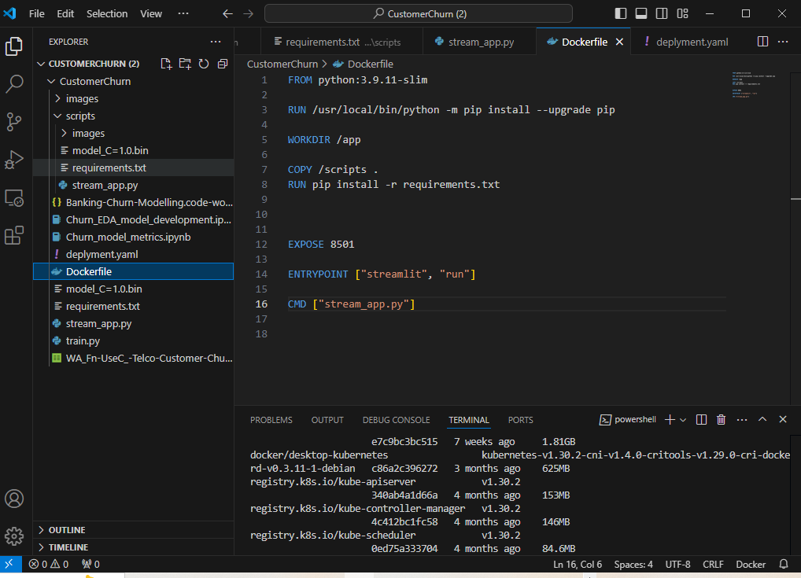
Docker File

Slide 9
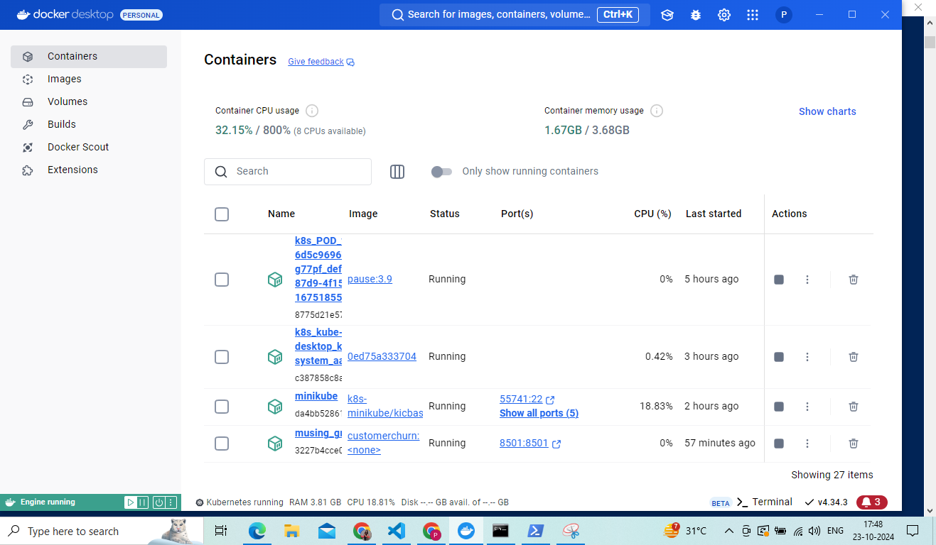
Docker Desktop Dashboard

Slide 10
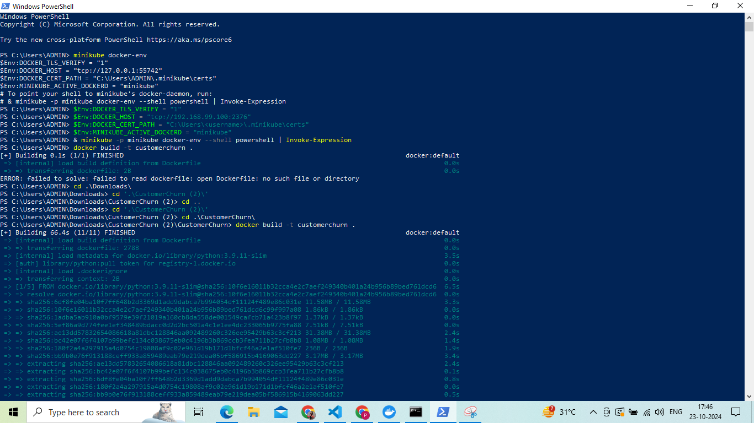
Docker Image Creation in Minikube

Slide 11
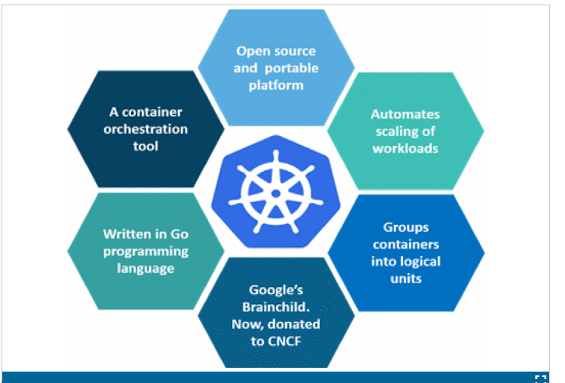
Kubernetes

Slide 12
Kubernetes
It is an open source project to automate deployment, scale, and to manage the
Containerized applications [11]. Without the Container orchestration the human cost of
running services was high, increased complexity of running something new in production,
scaling was difficult, manual service setup and manual node crash fixing was required.
Kubernetes (K8S) provides various significant features which allow running immutable
infrastructure.
The key K8S features are as below-
Horizontal scaling
Automated rollouts and rollbacks
Service discovery and load balancing
Storage orchestration
Secret and configuration management
Self-healing
Batch execution
Automatic bin packing

Slide 13
Kubernetes Orchestration
Kubernetes Cluster: The Docker image is deployed in a Kubernetes cluster.
Deployment: Manages replicas of the container running the model. Ensures scalability and fault tolerance.
Service: Exposes the container to external traffic. The service can be of type NodePort or LoadBalancer.

Slide 14
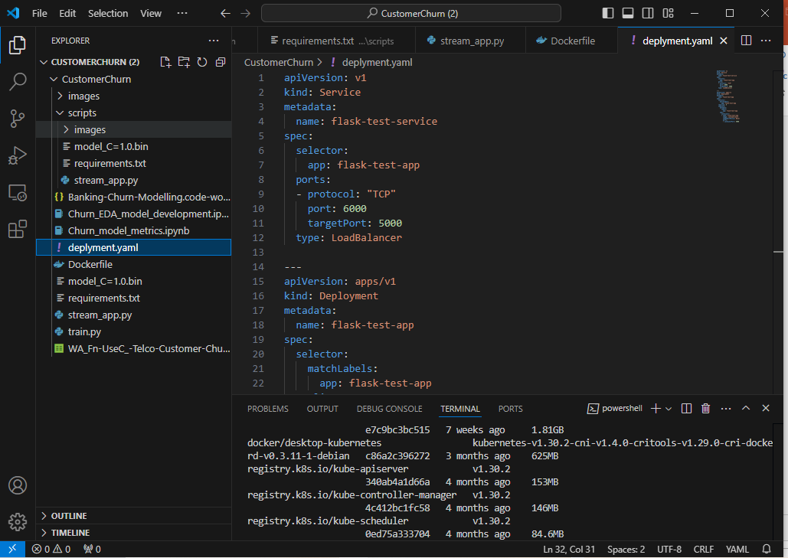
Yaml File

Slide 15
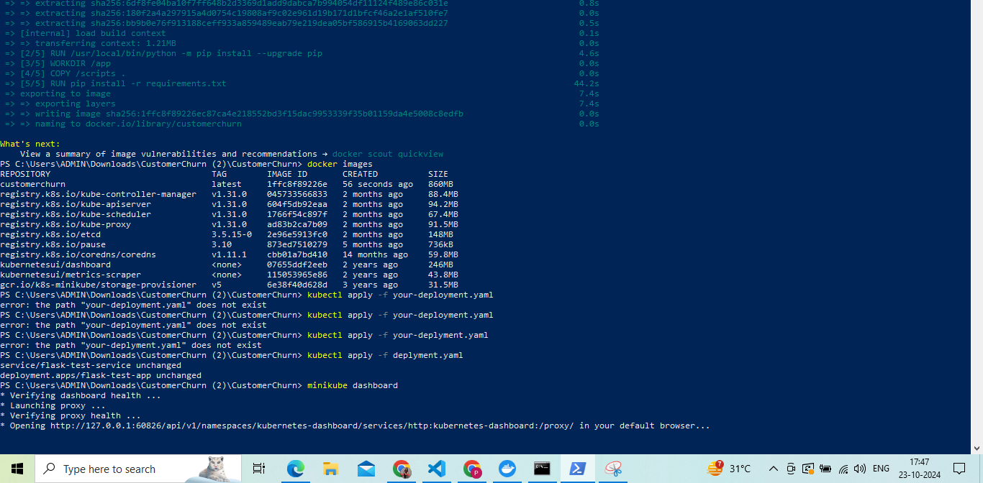
Deploying Service in Kubernetes

Slide 16
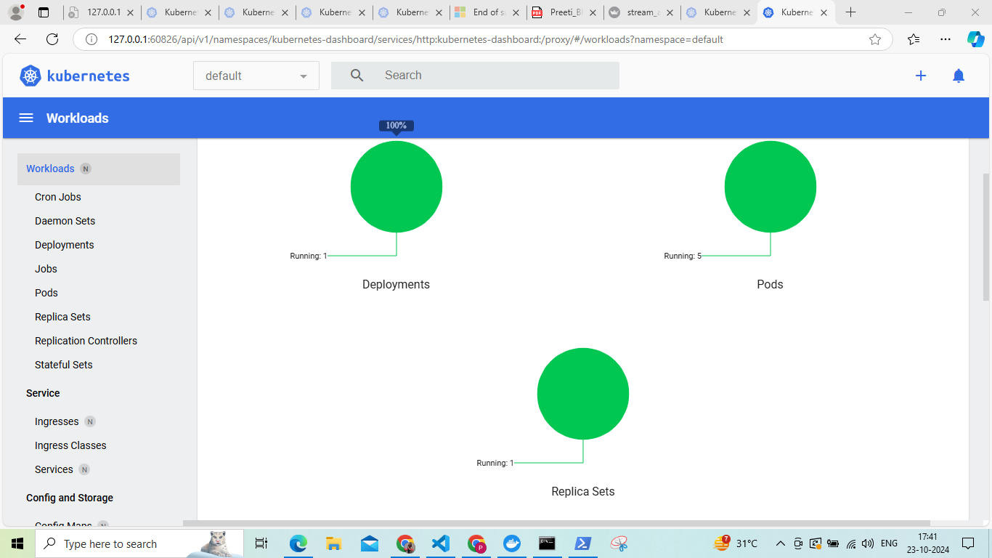
Minikube Dashboard

Slide 17
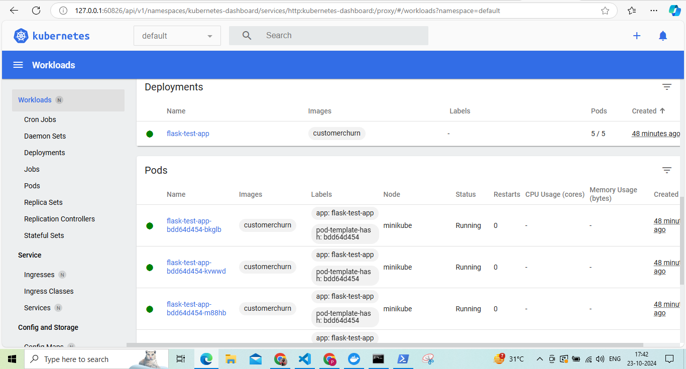
Minikube Dashboard Services & Pods

Slide 18
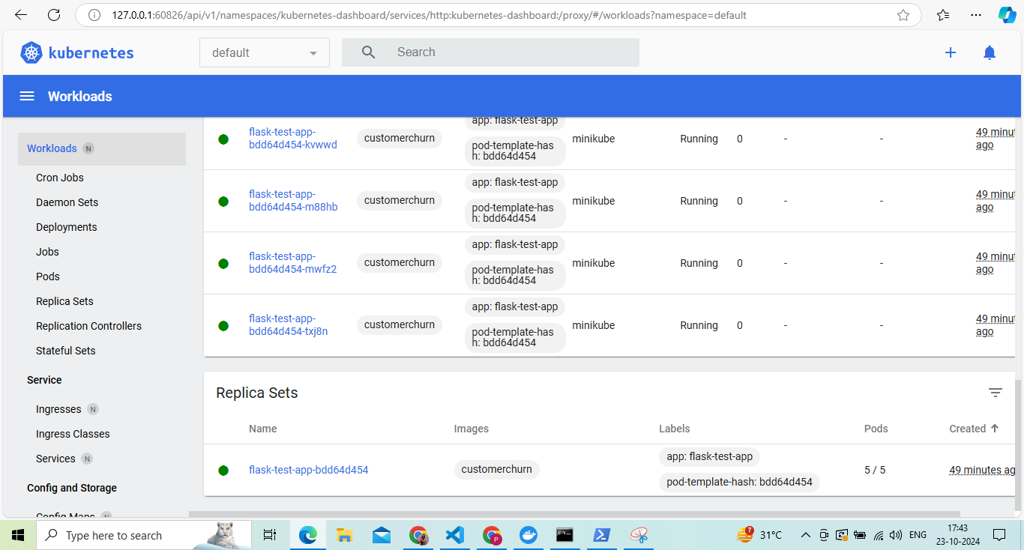
Minikube Replica Sets

Slide 19
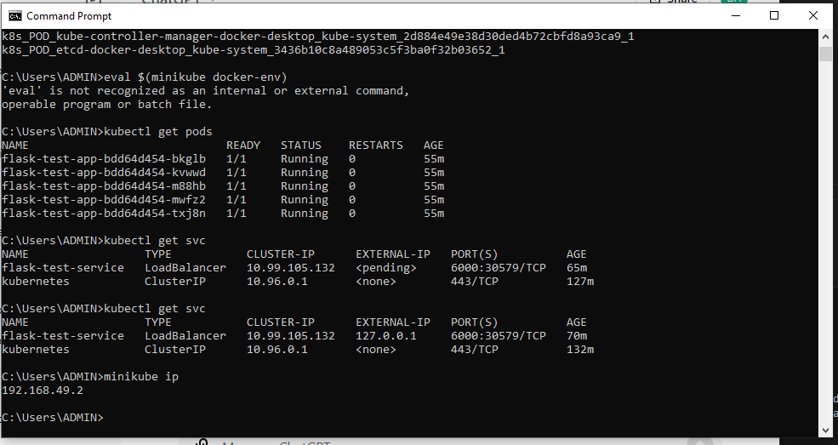
Minikube Pods & Services

Slide 20
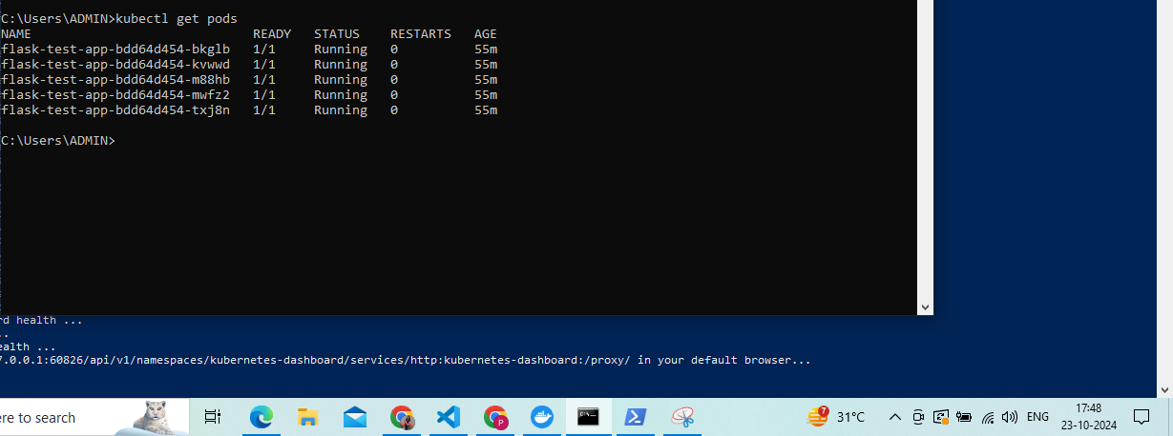
Minikube Pods & Services

Slide 21
API Exposure
Flask/FastAPI: The container running the model serves predictions via an API.
Endpoint: A /predict endpoint is exposed to handle user requests, typically returning churn predictions based on input features.

Slide 22
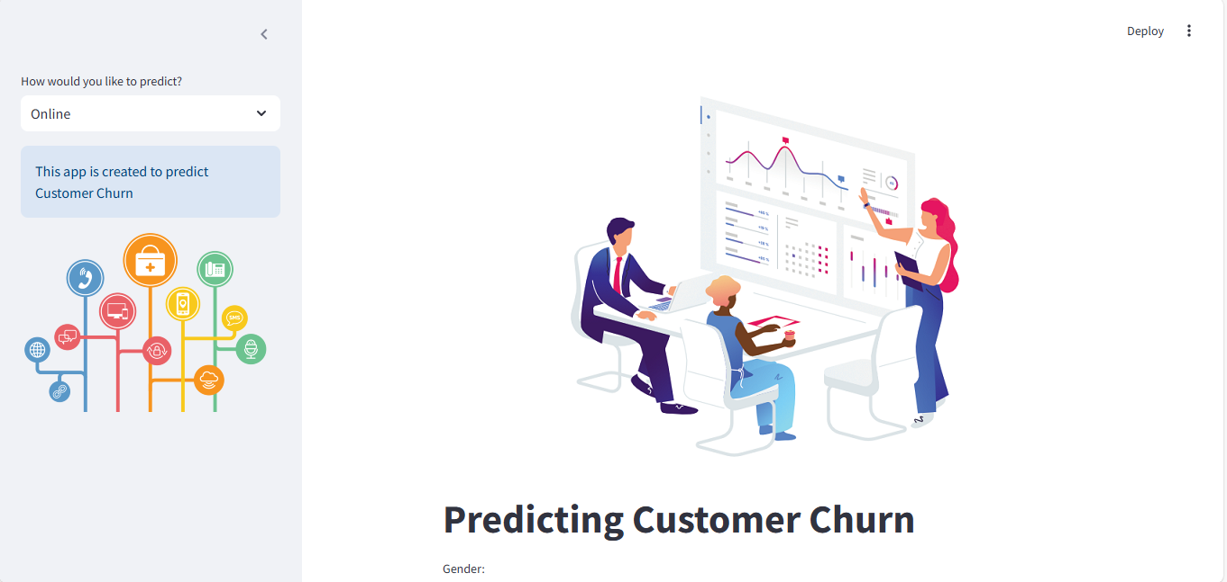
API Exposure

