Slide 1
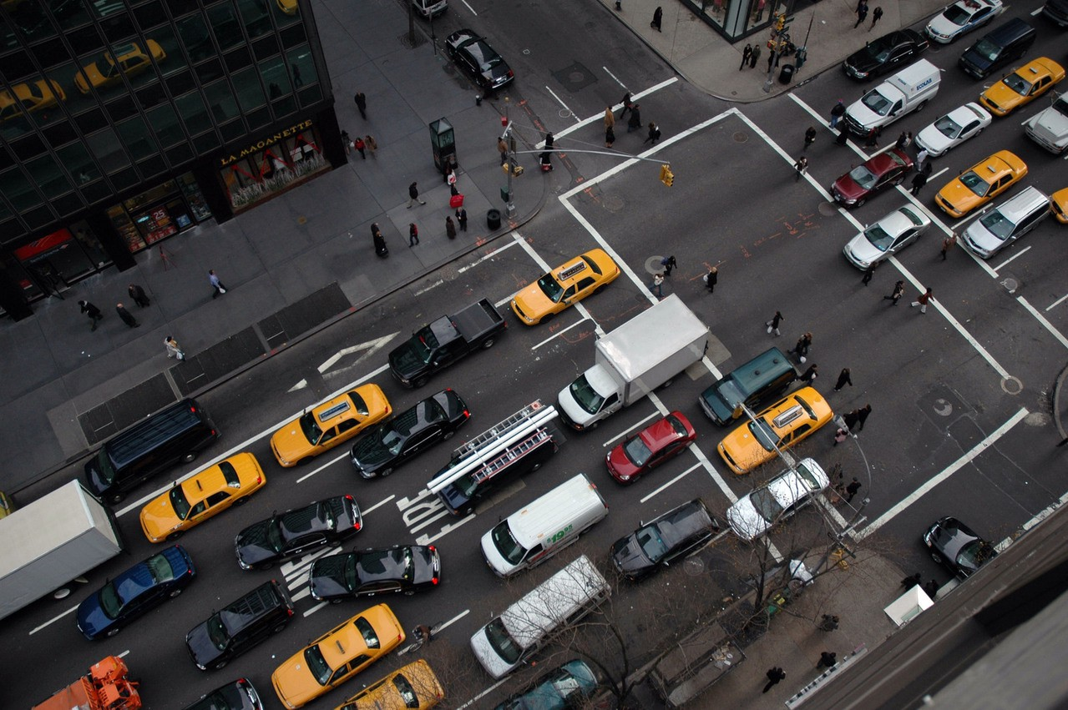
New York City Motor Vehicles Collisions - A statistical analysis
New York City Motor Vehicles Collisions - A statistical analysis

Slide 2
NYC Motor Vehicles Collisions : Data Overview
Questions
Data Processing
Preliminary EDA
Model Assumptions
Hypotheses Testing - Discussion
GLM Inference model - Discussion
Conclusion and Future work
Agenda

Slide 3




We would like to look into..
Whether the number of collisions resulting in injuries is the same across all the time segments of the day for all the boroughs of New York City
Whether seasons and weather have an effect on the number of collisions resulting in an injury
Whether Driving Under Influence (DUI) is a significant factor for collisions resulting in injury
Given a collision happened, what are the significant factors that explain if a collision results in injury?

Slide 4



Data for motor vehicle collisions and weather summaries were acquired to perform Hypotheses tests and study factors behind injuries during collisions
Motor Vehicle Collisions – Persons
Secondary data set
Source : NYC OpenData
Scope : Information on the attributes of victims involved in every collision. Each row represents details of a victim
Data considered: Jan 2019 to Dec 2019
Key Attributes:
Victim ID (Primary key)
Victim type (Occupant / Bicyclist / Pedestrian)
Collision ID
Motor Vehicle Collisions – Crashes
Primary data set
Source : NYC OpenData
Scope : Information on police reported motor vehicle collisions in NYC. Each row represents a crash event.
Data considered: Jan 2019 to Dec 2019
Key Attributes:
Collision ID (Primary key)
Crash Date
Crash Time
Borough (5 boroughs of NYC)
Zip Code
Lat-long coordinates
On-Street name
Off-Street name
Contributing factor vehicle
Vehicle type
# Persons killed
# Persons Injured
NOAA - Daily Weather Summary
Secondary data set
Source : National Oceanic and Atmospheric Administration
Scope : Information on daily weather summaries for NYC
Data considered : Jan 2019 to Dec 2019
Key Attributes:
Date (Primary Key)
Precipitation
Snowfall
Fog and smoke indicators

Slide 5



Missing value treatment was done to increase the coverage at Borough level and feature engineering was performed to increase the scope of factors
Raw Data
Treatment
Final Data (197,855 collisions)
Borough* has ~35% missing data
Reverse geo-coding using lat-long
Down to ~6% which were dropped
Feature Engineering
Crash date and crash time of the collision
Extract hour and month and tag them to a time segment and season
4 time segments for a day and 4 seasons for the year
Fog, smoke haze and blowing snow indicators
Visibility is low if any of the indicators are present
Low visibility indicator
Contributing vehicular factors and vehicle types involved in a collision
Derive the top N factors with the highest number of injury events
Top 15 vehicular factors and others. Top 10 vehicle types and others
On-street name and off-street name where a collision occurred
Combine on-street and off-street and group them into a road type
Top 5 major road types and others
197,855 Collisions
42,156 Injuries (21%)
*Borough: Bronx, Brooklyn, Manhattan, Queens, Staten Island
Time period: Jan 2019 – Dec 2019 Response variable: Is Injury(1/0)

Slide 6
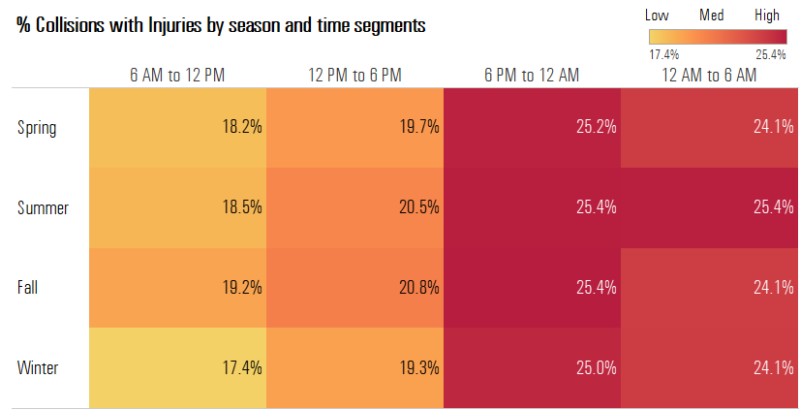
Exploratory Data Analysis (1/3)
Inference :
The above heatmap summarizes the % of collisions resulting in injuries by season and time segments
There is a clear pattern observed among the time segments as the % of collisions resulting in injuries is much higher during dark (6PM to 12 AM and 12 AM to 6 AM) compared to the morning and afternoon hours
While the trend is not very pronounced across seasons, the % of injury instances during 12AM to 6AM is the highest in Summer and Summer and Fall have higher chances of collisions resulting into injuries during the daytime

Slide 7
Exploratory Data Analysis (2/3)
Inference:
Low visibility index doesn’t seem to have any impact on proportion of injuries during summer months, However, shows increased trend during Autumn and Winter seasons
Inference:
Staten Island seem to have the highest proportion ~28% of injuries out of total collisions
Manhattan seem to have the lowest (17%) proportion of injuries

Slide 8
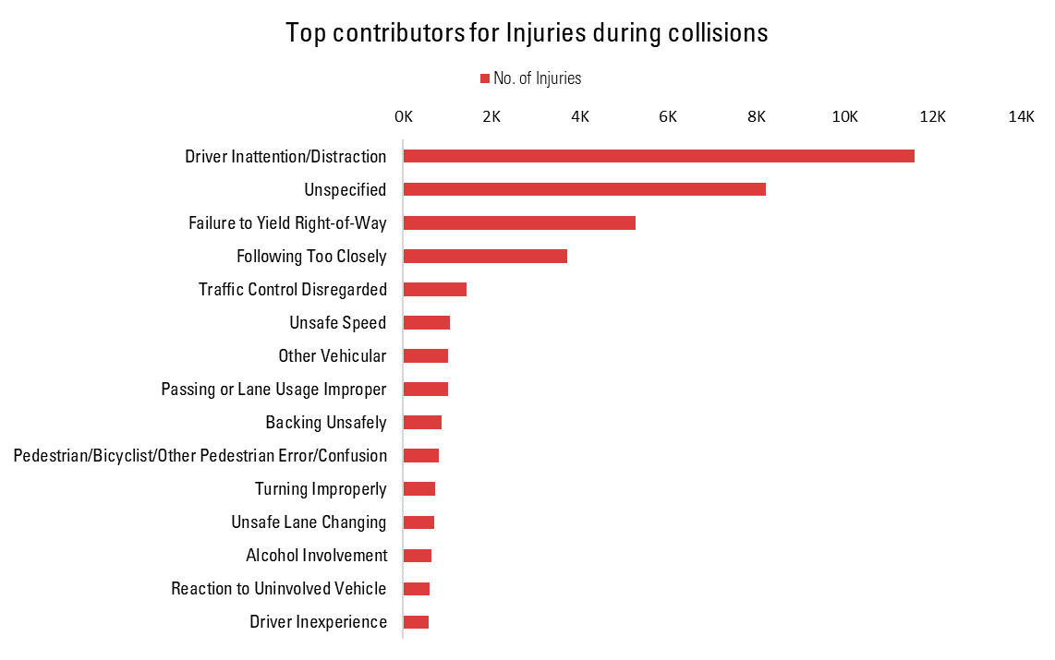
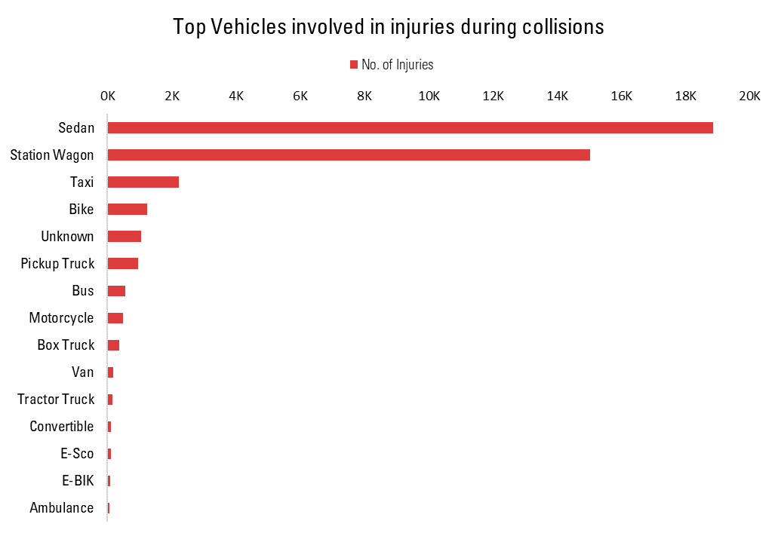
Exploratory Data Analysis (3/3)
Inference :
Leading among the contributing factors, nearly every 1 in 4 injuries are caused by Driver Inattention/Distraction - contributed to 27.52% of the overall collision in 2019
Sedans, station wagons are the two highest contributing vehicles to injury. Nearly 4 in 5 injuries are caused by them
Together Sedans, station wagons account for 79.13% of the overall injuries in 2019

Slide 9
Why Logistic Regression
The following are the assessment of the assumptions taken for logistic regression model:
Independence of Observation: Given the collision data for NYU motor vehicles, every vehicle is equally likely to face a collision at any of the roads in all of the five boroughs. It is also understood that occurrence of a collision influences the next collision happening at the same spot. But since our dataset is spread throughout the year, the overlap of such collisions is very less. Therefore, the condition for independence is satisfied.
Large Sample Size: For 2019, the dataset has 197,855 observations (# Collisions) which can be considered a large enough sample to satisfy the large sample size assumption
Mean-variance relationship​: For logistic regression, we do not need to assess the mean-variance relationship because it must be true due to the outcome variable being binary.

Slide 10
Hypotheses 1: Test the impact of Time of the day on collisions resulting in injury
Null Hypothesis:
Time of the day has no effect on a collision resulting into an injury across all the 5 boroughs.
Alternate Hypothesis:
Time of the day has an effect on a collision resulting into an injury across all the 5 boroughs.
Significance Test: We used Logistic regression for testing the effect of time of the day and borough on collisions resulting in injury. Response variable is column ‘Is_Injury’ in the dataset. As reference we have chosen time segment 6PM to 12AM and Manhattan borough.
Predictors | Estimated_Coeff | Std. Error | Z Statistic | p-value (>|z|) | Odds Ratio
(Intercept) | -1.343 | 0.016 | -83.645 | 0.000000e+00 | -
12AM to 6AM | -0.043 | 0.020 | -2.179 | 2.930180e-02 | 0.96
12PM to 6PM | -0.301 | 0.014 | -21.738 | 9.063571e-105 | 0.74
6AM to 12PM | -0.412 | 0.015 | -26.781 | 5.390582e-158 | 0.66
BRONX | 0.316 | 0.019 | 16.588 | 8.477598e-62 | 1.37
BROOKLYN | 0.349 | 0.017 | 21.020 | 4.317238e-98 | 1.42
QUEENS | 0.253 | 0.017 | 15.077 | 2.311439e-51 | 1.29
STATEN ISLAND | 0.633 | 0.030 | 20.985 | 9.062231e-98 | 1.88
Inference:
With reference to time segment 6PM to 12AM, the odds for a collision resulting in an injury are lower by 4.19% during 12AM to 6AM and by 34% during 6AM to 12PM.
With reference to Manhattan borough, the odds of for a collision resulting in an injury is 88% higher for Staten Island and 41% higher for Brooklyn.
The p-value across the 4 time segments and 5 boroughs are < 0.001 and hence we can reject the null hypothesis. We conclude that there is an impact of time of the day on a collision resulting in injury across all the 5 boroughs.

Slide 11
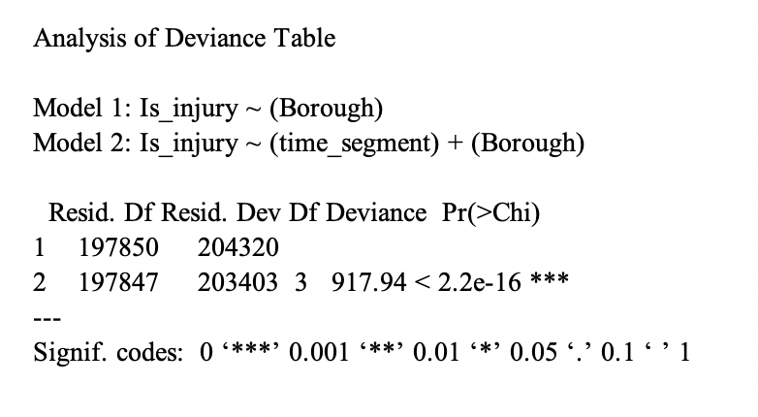
Time of the Day shows significant impact on collision resulting in injury across all the 5 boroughs
Deviance Test:
We performed a Likelihood-Ratio Test for composite hypothesis to test the significance of time of day as factor variable.
Inference:
The p-value is <0.001 so the model is significant
With the deviance value of 917, we can say that time segment has a significant effect on a collision resulting in an injury

Slide 12
Hypothesis 2: Test the impact of seasons and weather on collisions resulting in injury
Null Hypothesis:
Season and weather conditions have no effect on a collision resulting in an injury across all the 5 boroughs.
Alternate Hypothesis: Season and weather conditions have significant effect on a collision resulting in an injury across all the 5 boroughs.
Significance Test:
We used Logistic regression for testing the effect of season and weather conditions on collisions resulting in injury. Response variable is column ‘Is_Injury’ in the dataset. As reference we have chosen ‘Fall’ season.
Predictors | Estimated Coeff. | Std. Error | Z Statistic | p-value (>|z|) | Odds Ratio
(Intercept) | -1.286 | 0.012 | -110.828 | 2E-16 | -
Winter | -0.069 | 0.016 | -4.306 | 1.67E-05 | 0.93
Spring | -0.046 | 0.015 | -2.988 | 0.002808 | 0.95
Summer | 0.005 | 0.015 | 0.318 | 0.750298 | 1.00
Precipitation in inches | 0.047 | 0.020 | 2.385 | 0.017059 | 1.05
Snowfall in inches | -0.075 | 0.020 | -3.799 | 0.000145 | 0.93
Low Visibility | 0.006 | 0.014 | 0.432 | 0.665797 | 1.01
Inference:
Reference to Fall seasons, the odds of a collision resulting in an injury is lower by 6.7% in Winter and lower by 4.52% in Spring.
The odds of a collision resulting in injury are higher by 4.8% for each additional 1 inch of precipitation.
The odds of a collision resulting in injury are lower by 7.26% for each additional 1 inch of snowfall.
Summer with reference to fall season and ‘Low Visibility’ do not have a significant effect on collisions resulting in injury.

Slide 13
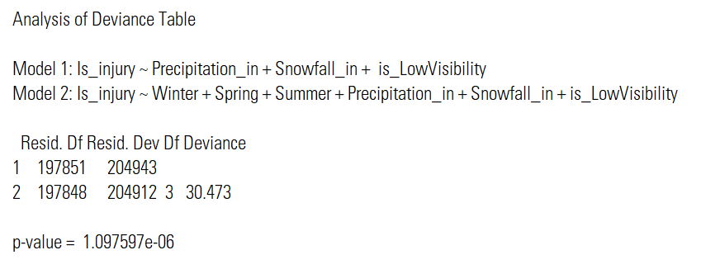
Seasonality and weather conditions have a significant effect on collisions resulting in injury across NYC
Deviance Test:
We performed a Likelihood-Ratio Test for composite hypothesis to test the significance of Seasons as factor variable.
Inference:
The p-value is <0.05 so the model is significant.
We also observe a significant deviance of 30.473 indicating that the seasons have a significant effect on collisions resulting in injury.

Slide 14
Hypothesis 3: Impact of Driving Under Influence on collision resulting in injury
Null Hypothesis:
'Driving under the Influence’ has no impact on the injuries caused during collisions.
Alternate Hypothesis:
'Driving under the Influence’ has impact on the injuries caused during collisions.
Significance Test
We used Logistic regression method to test DUI impact on the Injuries at overall level and then at Borough level. Response Variable is Is_Injury column in the dataset.
Predictor Variable: DUI_Ind (Collision due to Driving Under Influence)
Predictors | Estimated Coefficient | Std. Error | Z Statistic | p-value (>|z|) | Odds ratio
(Intercept) | -1.308 | 0.006 | -236.900 | <2e-16 *** | -
DUI Indicator | 0.579 | 0.047 | 12.440 | <2e-16 *** | 1.78
Predictor Variable: DUI_Ind, Borough (Collision due to Driving Under Influence)
Predictors | Estimated Coefficient | Std. Error | Z Statistic | p-value (>|z|) | Odds of Injury
(Intercept) | -1.560 | 0.013 | -116.490 | <2e-16 | 1.78
DUI indicator | 0.543 | 0.047 | 11.640 | <2e-16 | 1.72
BRONX | 0.302 | 0.019 | 15.890 | <2e-16 | 1.35
BROOKLYN | 0.340 | 0.017 | 20.560 | <2e-16 | 1.40
QUEENS | 0.242 | 0.017 | 14.500 | <2e-16 | 1.27
STATEN | 0.610 | 0.030 | 20.290 | <2e-16 | 1.84
Inference:
Driving Under the Influence increases odds of injuries or death by 78% during motor vehicle collisions
Staten Island collisions has increased odds ratio 84% compared to Manhattan under DUI presence; whereas Brooklyn has 40% increased odds of injuries compared to Manhattan
Under the presence of Boroughs and keeping the boroughs constant, DUI indicator impacts still stays high with increased odd of 72% injuries

Slide 15
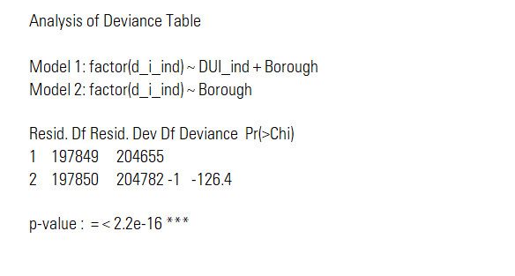
Driving Under the Influence has significant impact on the number of Collisions resulting in Injuries
Deviance Test:
We performed a Likelihood-Ratio Test for composite hypothesis to test the significance of DUI as factor variable
Inference:
The p-value is <0.05 so the model is significant.
We also observe a high deviance indicating that the DUI have a significant effect on collisions resulting in injury

Slide 16
Overall model to understand the association between various features and the odds of a collision resulting in an injury
Objective: Given a collision occurred in New York City, build a GLM model to check if there an association between the following factors and the outcome of the collision (Response variable : Is_Injury )
•Borough Time segment
•Season of the year Weekend
•Victim type Precipitation, snow and visibility
•Contributing vehicular factors Vehicle types involved
•Road type (i.e. Highway/Avenue/Boulevard etc.)
Null hypothesis: There is no effect of the aforementioned factors on a collision resulting in an injury
Alternate hypothesis: There is an effect of the aforementioned factors on a collision resulting in an injury
Model summary
Key Inferences:
The odds of a collision resulting in injury is higher by ~140% in Staten Island compared to Manhattan
Given the victim in a collision is a pedestrian, the odds of getting injured is 72 times higher than the other victim types
Factors like traffic control disregarded and unsafe speeds have the highest odds of injuries among vehicular factors
Similarly, among the vehicles, motorcycles have an odds of 5.5 times compared to other vehicles in a collision resulting in an injury
Among road types, the odds ratio of a collision resulting in an injury is the highest for Highways (higher by 68%) as compared to the other types
* The variables highlighted in red are not significant in the model

Slide 17
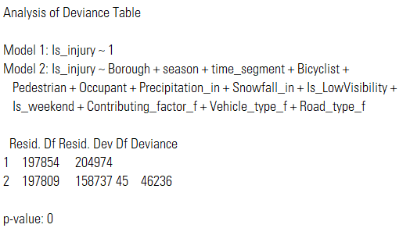
Deviance test and multicollinearity check for the overall GLM model
Deviance Test:
We performed a Likelihood-Ratio Test to access the overall significance of all the model terms by comparing the full vs null model.
Test for Multicollinearity:
In order to ensure there is no multicollinearity, we calculated the variance inflation factor.
Predictors | GVIF | Df | GVIF^(1/(2*Df))
Borough | 1.389 | 4 | 1.042
Season | 1.043 | 3 | 1.007
Time segment | 1.070 | 3 | 1.011
Bicyclist | 1.359 | 1 | 1.166
Pedestrian | 1.188 | 1 | 1.090
Occupant | 1.623 | 1 | 1.274
Precipitation | 1.425 | 1 | 1.194
Snowfall | 1.064 | 1 | 1.031
Low visibility | 1.477 | 1 | 1.215
Weekend | 1.022 | 1 | 1.011
Contributing_factor | 1.295 | 14 | 1.009
Vehicle type | 2.097 | 9 | 1.042
Road type | 1.357 | 5 | 1.031
Inference:
Since none of the variables in the model have a high VIF (>5), the test for multicollinearity is satisfied
The large deviance value and the p-value being equal to 0 suggests that the overall model is highly significant

Slide 18
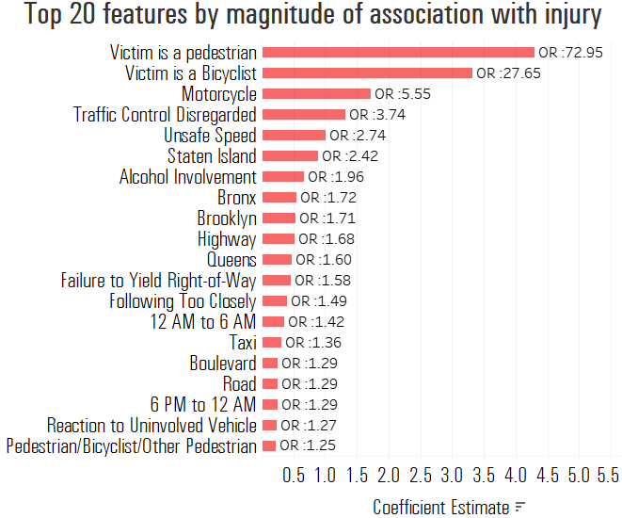
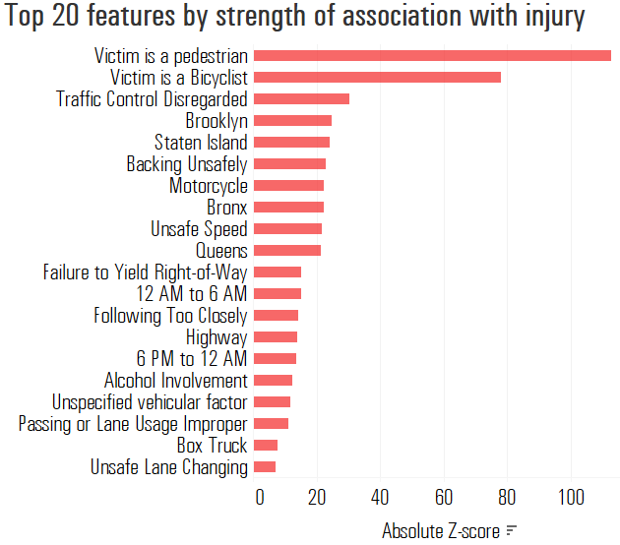
Variable ranking by top features based on the strength and magnitude of the association with the response variable
Inference:
Being a pedestrian or bicyclist has the highest odds of resulting in injury, when all other features are held constant
Disregarding traffic control, Unsafe speed and Alcohol Involvement have the highest importance among vehicular features
All the boroughs feature in the top 20 with Staten Island having the largest magnitude of association in the event of an injury

Slide 19







Conclusions
Traffic disregard
Staten Island
DUI
Highways
Factors such as ‘Traffic disregard and ‘Unsafe Speed’ are the most common contributors of injuries during motor vehicle collisions in NYC. According to findings, these factors each increase odds of injury by 200%
Staten Island has the highest odds of injuries ~142% , among all 5 Boroughs of NYC. Proportion of injuries are highest here and can be attributed to the maximum motor vehicles engaged in driver inattention, road rash and DUI as compared to other Boroughs
Odds of injuries increase by 96% when ‘Driving under the Influence’ and involved in a motor vehicle collision.
DUI incidences are highest in Staten island, with 273% odds as compared to any other Borough
Highways have the highest odds of 68% injuries among any other road types, which can be attributed to vehicles moving at faster pace than any other road ways and hence increasing the impact of collision resulting in injury
Other Significant factors:
Motorcycle vehicle type has 455% odds of getting injury when involved in an accident, whereas Pedestrians and Bicyclists have ~700% and ~260% respectively
Time period 12 AM – 6 AM has 42% higher odds of collision resulting in injury, highest among all other time segments
Summer month has 7% higher odds of collisions resulting in injuries, compared to all other Spring as reference season
20

Slide 20
Limitations – Next Steps - References
Limitations
For categorical predictors, estimated coefficients are always calculated against a reference category and hence interpretability of variable importance becomes difficult when modelling in the presence of multiple predictors
With regards to Interpretation of odds ratio, magnitude of association between the variables may be misunderstood because of the presence of a reference level, leading to unrealistic estimates of intervention benefit
Next steps / Further research
Use of methods such as pseudo partial correlation metric, adequacy metric, c-statistics and information values for ranking feature importance
Use of Generalized Linear Mixed models to capture the cyclical nature of seasons and time of the day features for enhanced inference and prediction on a wider time frame
References
[1] Motor Vehicle Collisions – Crashes (NYC OpenData) - Online https://data.cityofnewyork.us/Public-Safety/Motor-Vehicle-Collisions-Crashes/h9gi-nx95
[2] Motor Vehicle Collisions – Persons (NYC OpenData) - Online
https://data.cityofnewyork.us/Public-Safety/Motor-Vehicle-Collisions-Person/f55k-p6yu
[3] Daily Weather Summaries – NYC Laguardia station (NOAA) - Online
https://www.ncdc.noaa.gov/cdo-web/datasets/GHCND/stations/GHCND:USW00014732/detail
[4] Ranking predictors in logistic regression – Paper
http://www.mwsug.org/proceedings/2009/stats/MWSUG-2009-D10.pdf
21

Slide 21
New York City Motor Vehicles Collisions - A statistical analysis
Thank You!
Questions?

Slide 22
Model summary (1/2)
Predictors | Coefficient Estimate | Standard Error | z value | Pr (>|z|) | Significance | Odds Ratio
(Intercept) | -2.503 | 0.100 | -24.942 | < 2e-16 | *** | 0.08
Bronx | 0.543 | 0.024 | 22.183 | < 2e-16 | *** | 1.72
Brooklyn | 0.534 | 0.022 | 24.681 | < 2e-16 | *** | 1.71
Queens | 0.472 | 0.022 | 21.257 | < 2e-16 | *** | 1.6
Staten Island | 0.883 | 0.036 | 24.286 | < 2e-16 | *** | 2.42
Fall | 0.035 | 0.018 | 1.886 | 0.059262 | . | 1.04
Summer | 0.070 | 0.018 | 3.872 | 0.000108 | *** | 1.07
Winter | -0.047 | 0.019 | -2.536 | 0.011206 | * | 0.95
12 AM to 6 AM | 0.353 | 0.023 | 15.179 | < 2e-16 | *** | 1.42
12 PM to 6 PM | 0.065 | 0.017 | 3.897 | 9.72E-05 | *** | 1.07
6 PM to 12 AM | 0.251 | 0.018 | 13.764 | < 2e-16 | *** | 1.29
Victim is a Bicyclist | 3.320 | 0.043 | 78.046 | < 2e-16 | *** | 27.65
Victim is a pedestrian | 4.290 | 0.038 | 112.687 | < 2e-16 | *** | 72.95
Victim is a motor vehicle occupant | -0.084 | 0.085 | -0.995 | 0.319686 |  | 0.92
Precipitation in inches | 0.027 | 0.023 | 1.137 | 0.255603 |  | 1.03
Snowfall in inches | -0.061 | 0.023 | -2.630 | 0.008533 | ** | 0.94
Low Visibility | -0.034 | 0.016 | -2.045 | 0.040825 | * | 0.97
Weekend | 0.030 | 0.015 | 2.044 | 0.041 | * | 1.03
* The variables highlighted in red are not significant in the model

Slide 23
Model summary (2/2)
Predictors | Coefficient estimate | Standard Error | z value | Pr(>|z|) | Significance | Odds Ratio
Alcohol Involvement | 0.674 | 0.055 | 12.258 | < 2e-16 | *** | 1.96
Backing Unsafely | -1.115 | 0.049 | -22.896 | < 2e-16 | *** | 0.33
Driver Inattention/Distraction | 0.123 | 0.023 | 5.328 | 9.94E-08 | *** | 1.13
Failure to Yield Right-of-Way | 0.455 | 0.030 | 15.242 | < 2e-16 | *** | 1.58
Following Too Closely | 0.400 | 0.028 | 14.378 | < 2e-16 | *** | 1.49
Other Vehicular | 0.113 | 0.041 | 2.730 | 0.006329 | ** | 1.12
Passing or Lane Usage Improper | -0.462 | 0.042 | -11.054 | < 2e-16 | *** | 0.63
Pedestrian/Bicyclist/Other Pedestrian | 0.227 | 0.094 | 2.410 | 0.015953 | * | 1.25
Reaction to Uninvolved Vehicle | 0.241 | 0.052 | 4.613 | 0.00000396 | *** | 1.27
Traffic Control Disregarded | 1.320 | 0.044 | 30.345 | < 2e-16 | *** | 3.74
Turning Improperly | 0.018 | 0.048 | 0.369 | 0.712475 |  | 1.02
Unsafe Lane Changing | -0.334 | 0.046 | -7.215 | 5.38E-13 | *** | 0.72
Unsafe Speed | 1.009 | 0.047 | 21.662 | < 2e-16 | *** | 2.74
Unspecified vehicular factor | -0.286 | 0.024 | -11.682 | < 2e-16 | *** | 0.75
Bike | 0.226 | 0.097 | 2.320 | 0.02032 | * | 1.25
Box Truck | -0.538 | 0.070 | -7.710 | 1.26E-14 | *** | 0.58
Bus | -0.019 | 0.064 | -0.295 | 0.768178 |  | 0.98
Motorcycle | 1.713 | 0.076 | 22.413 | < 2e-16 | *** | 5.55
Pickup Truck | -0.176 | 0.053 | -3.305 | 0.000951 | *** | 0.84
Sedan | 0.178 | 0.035 | 5.091 | 0.000000356 | *** | 1.2
Station Wagon/Sport Utility Vehicle | 0.057 | 0.035 | 1.617 | 0.105939 |  | 1.06
Taxi | 0.306 | 0.045 | 6.768 | 1.31E-11 | *** | 1.36
Unknown vehicle | -0.060 | 0.113 | -0.530 | 0.59645 |  | 0.94
Avenue | 0.124 | 0.035 | 3.554 | 0.000379 | *** | 1.13
Boulevard | 0.256 | 0.040 | 6.322 | 2.59E-10 | *** | 1.29
Highway | 0.517 | 0.037 | 13.984 | < 2e-16 | *** | 1.68
Road | 0.255 | 0.046 | 5.601 | 2.13E-08 | *** | 1.29
Street | -0.171 | 0.036 | -4.777 | 0.00000178 | *** | 0.84
* The variables highlighted in red are not significant in the model

Slide 24
DUI vs Boroughs – Interaction model summary
Predictors | Coefficient Estimate | Standard Error | z value | Pr (>|z|) | Odds Ratio
(Intercept) | -5.00247 | 0.06234 | -80.25 | 2E-16 | -0.99
Bronx | 0.60324 | 0.08055 | 7.489 | 6.93E-14 | 0.82
Brooklyn | 0.55835 | 0.07307 | 7.641 | 2.15E-14 | 0.74
Queens | 0.44612 | 0.07416 | 6.016 | 1.79E-09 | 0.56
Staten Island | 1.31659 | 0.10012 | 13.15 | 2E-16 | 2.73

