Slide 1
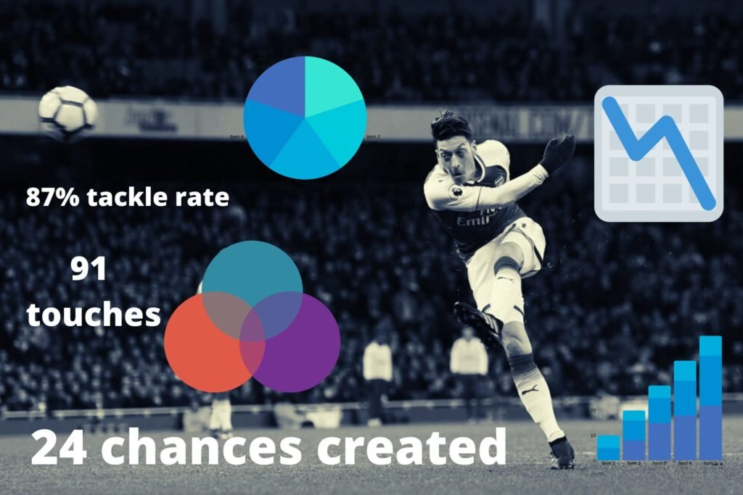
Data Analytics Competition
Team Name : “Stataholics”
Vivekpandian Veerapandain
Image - theathletic.com

Slide 2
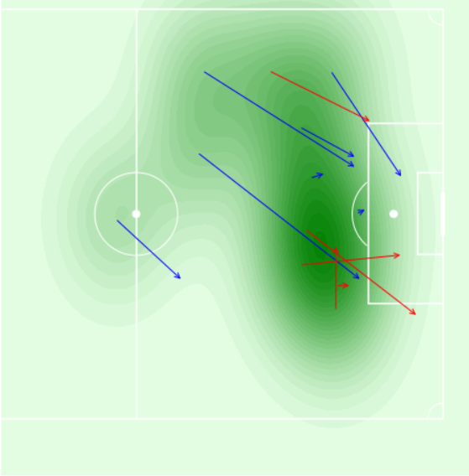
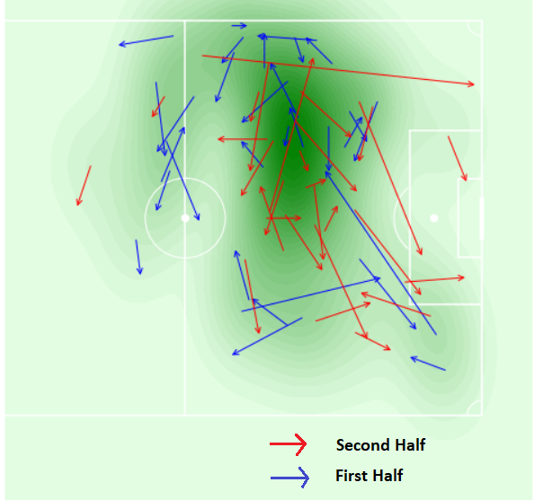
LIONEL MESSI PASS STATS AGAINST GIRONA
Number of Passes :70
Accurate passes :58
Average Length :14.30 yards
Average Angle :-0.30 radians
Wrong passes :12
Average length :18.60 yards
Average Angle :-0.17 radians
WRONG PASSES
ACCURATE PASSES

Slide 3
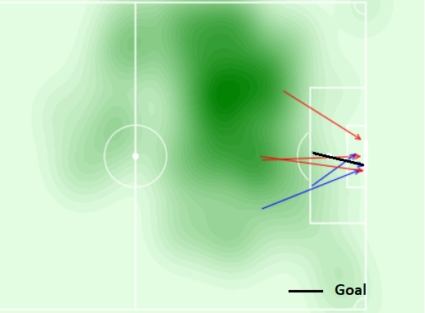
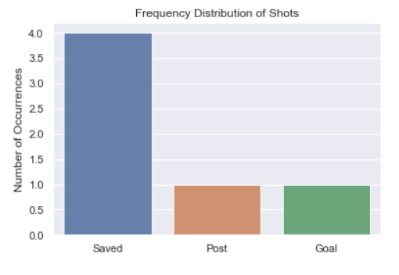
LIONEL MESSI SHOT STATS AGAINST GIRONA
Number of Shots :6
Shots On Target :58
Shots Off Target :12
Goals Scored :1
Shots Outside the Box :4

Slide 4
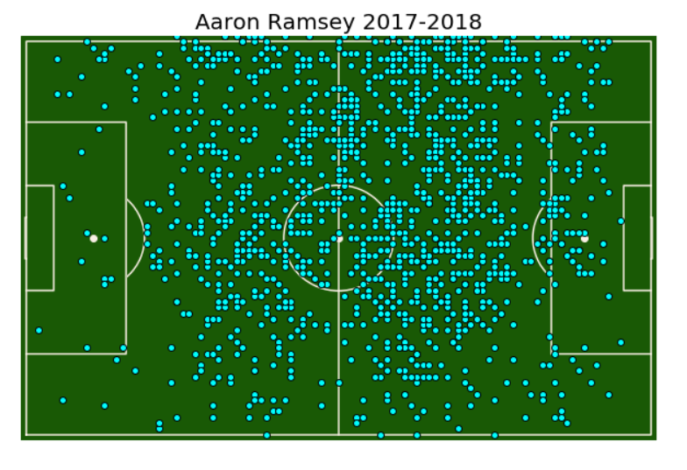
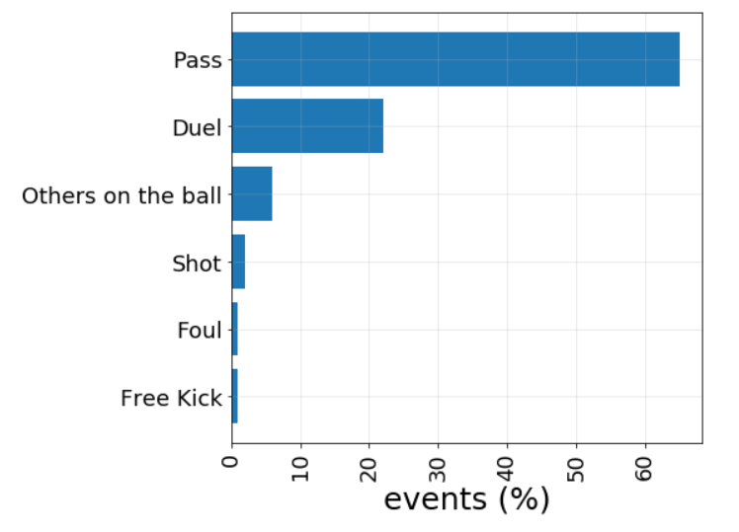
AARON RAMSEY 2017-18

Slide 5
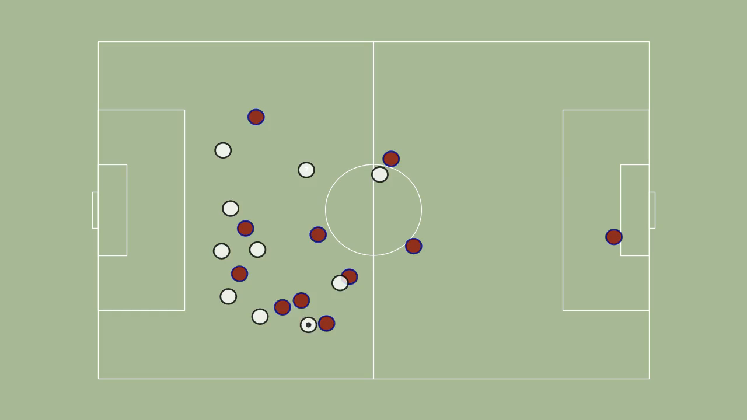
CRITIANO RONALDO’S GOAL AGAINST BARCELONA
*video

Slide 6
DATASET:
STATSBOMB
LAST ROW
WYSCOUT
REFERENCE:
Friends-of-Tracking-Data-FoTD/LaurieOnTracking
https://dl.acm.org/doi/10.1145/3343172

