Slide 1
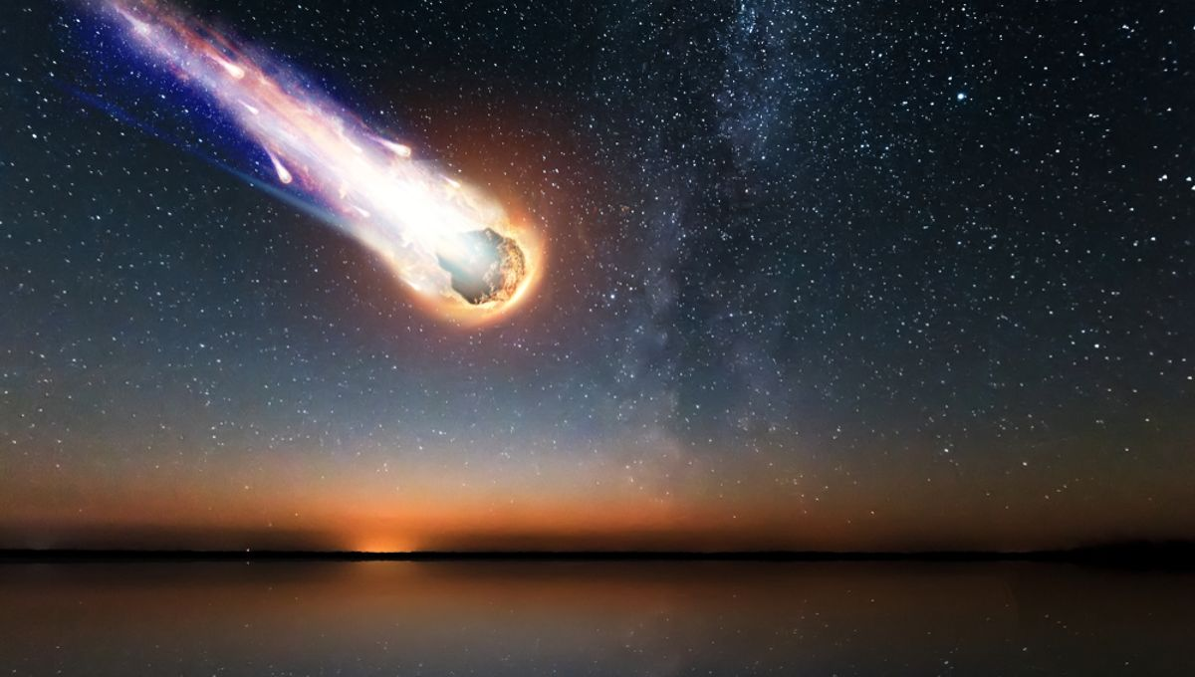
Meteorite landing: MIS 6382 Group 6:Python Gen Z
Members: Vivek Pani
Ashish Yadav
Kannupriya
Hemanth Kella

Slide 2

Lyrid meteor shower is one of the oldest known meteor showers, with records dating back to 687 BC. It occurs annually between April 16 and 25, and peaks around April 22.
In April 2023, the Lyrid meteor shower was particularly spectacular, with many people reporting seeing hundreds of meteors per hour. This event inspired us to learn more are about the history of meteorites, and to explore the data that has been collected about them.
Introduction
The dataset that we are using for this project contains information on over 40000 meteorites.
The Recclass column tells us what type of class the meteorite falls into. It is based on various factors:
H class : high on iron L class : Low on iron C class : high on carbon (most primitive know) E class: rich in mineral enstatite

Slide 3
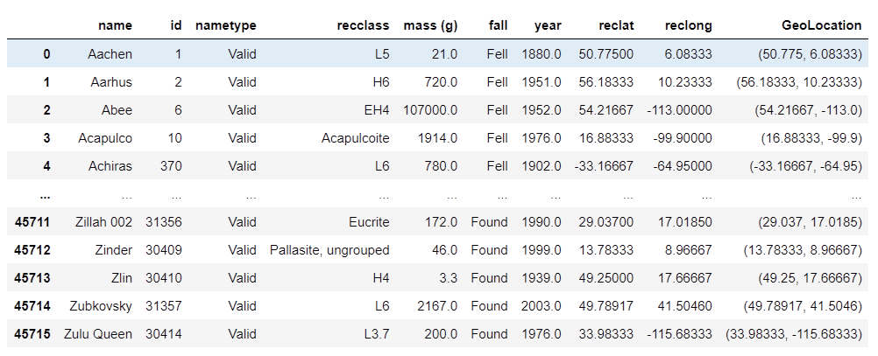
DATASET:
Notes:
“Observed” usually means that a meteor was seen or heard and the stone or stones causing the effects was recovered shortly thereafter, usually within a few days. Such meteorites are called “falls” by meteoriticists. The other are called “finds” – someone found the meteorite but the meteor was not observed.

Slide 4

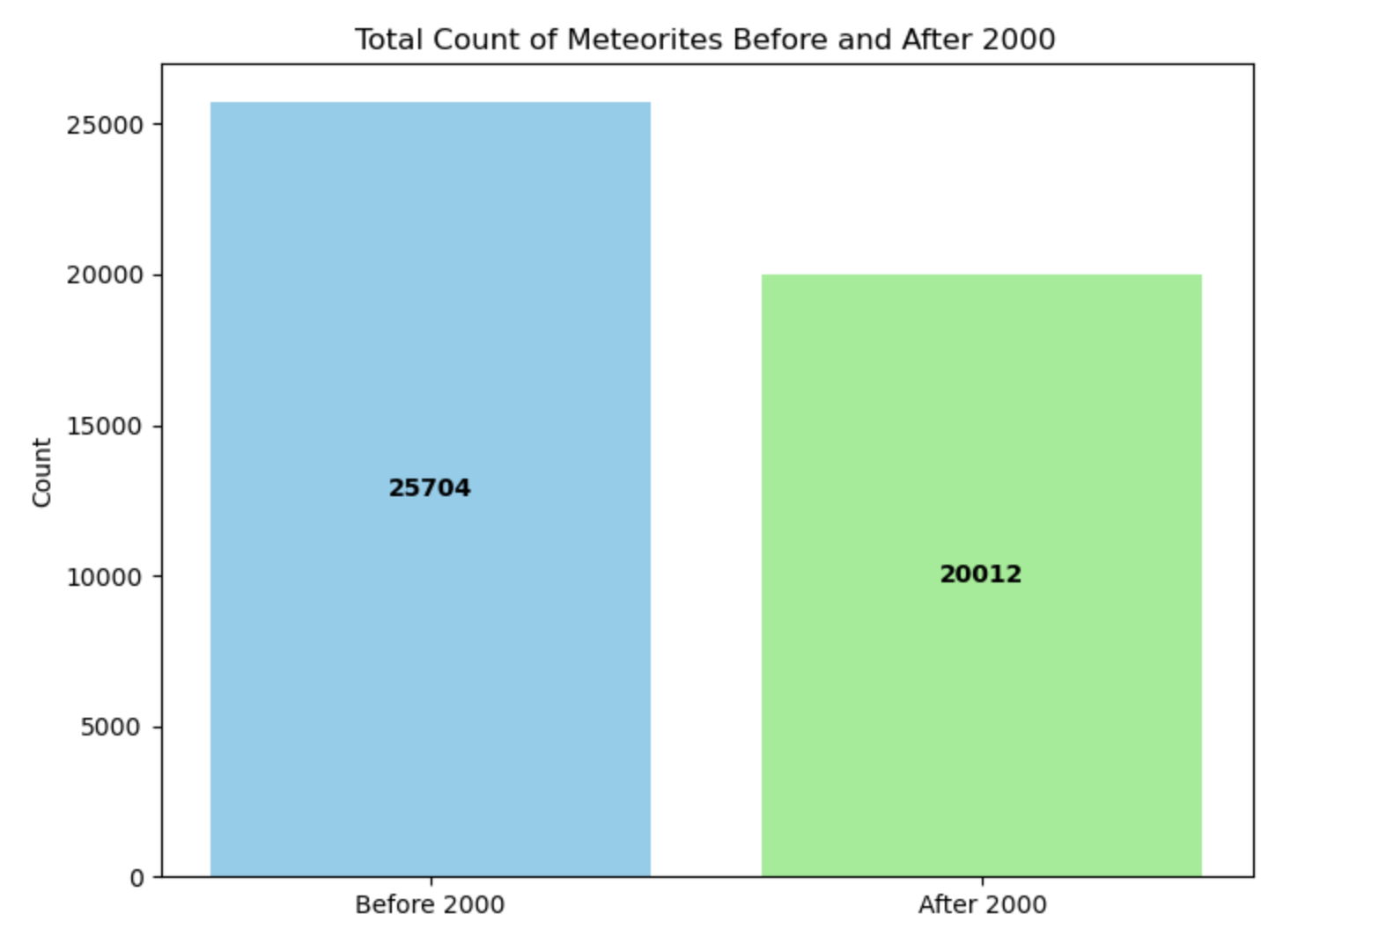
BAR CHART:
No. of meteorite observed before 2000 are 25704 which is 23% more than meteorite observed after 2000
However, the time period for the before 2000 data is 30 years (1970-2000), while the time period for the after 2000 data is only 10 years (2000-2010).
Therefore, the average number of meteorites observed per year is higher for the after 2000 data (1972.1) than the before 2000 data (856.8) and this trend can be observed in the Line chart.

Slide 5
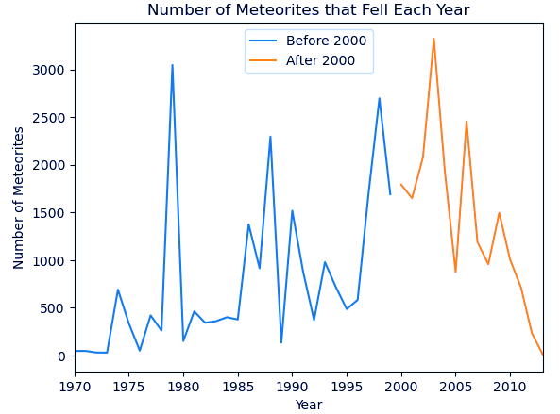
line CHART:
Highest no. of meteorite observed was 3323 in year 2003
No. of meteorite observed ranges very low from 1970-1977 but drastic increase can be seen towards year 1980
After 1985, the number of meteorites observed fluctuated, but there was an overall increase from 1985 to 2010.

Slide 6
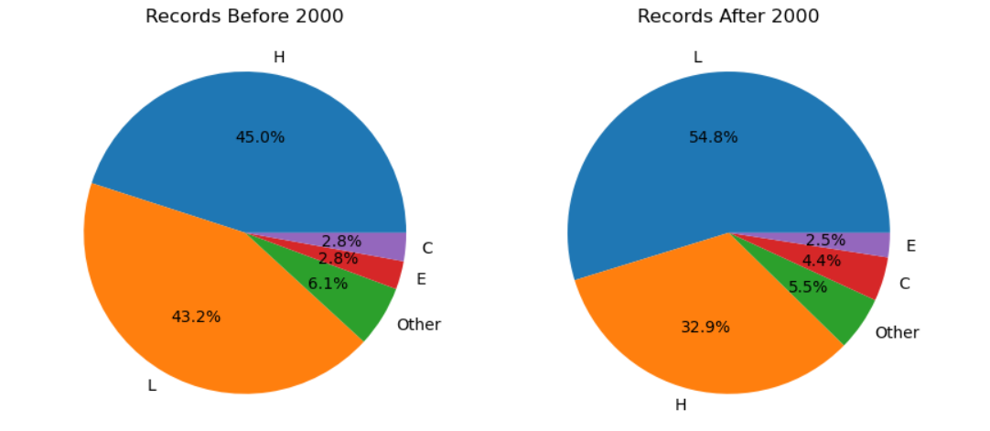
Type of Meteorite before 2000 vs after 2000:
Through out the years observed, more than 80% of meteorite falls were in L and H class.
However, the percentage of L class meteorites increased by 11.6%, while the percentage of H class meteorites decreased by 12.1%
This suggests that the composition of meteorites may be changing over time, with a relative increase in L class meteorites and a relative decrease in H class meteorites.

Slide 7
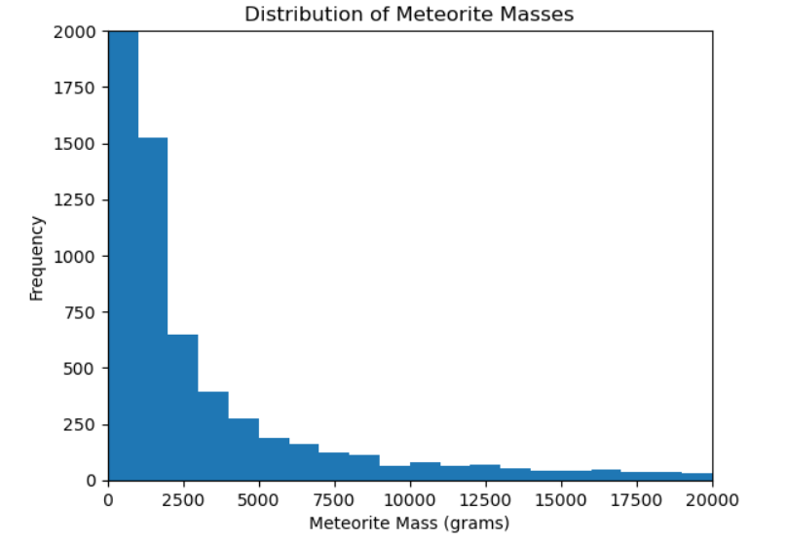
HISTOGRAM:
The histogram shows there were a lot of meteorites found within 1 kgs in mass.
As the mass increased after 7.5 kgs, the number of meteorites found have exponentially decreased and very heavy meteorites found were rare.

Slide 8
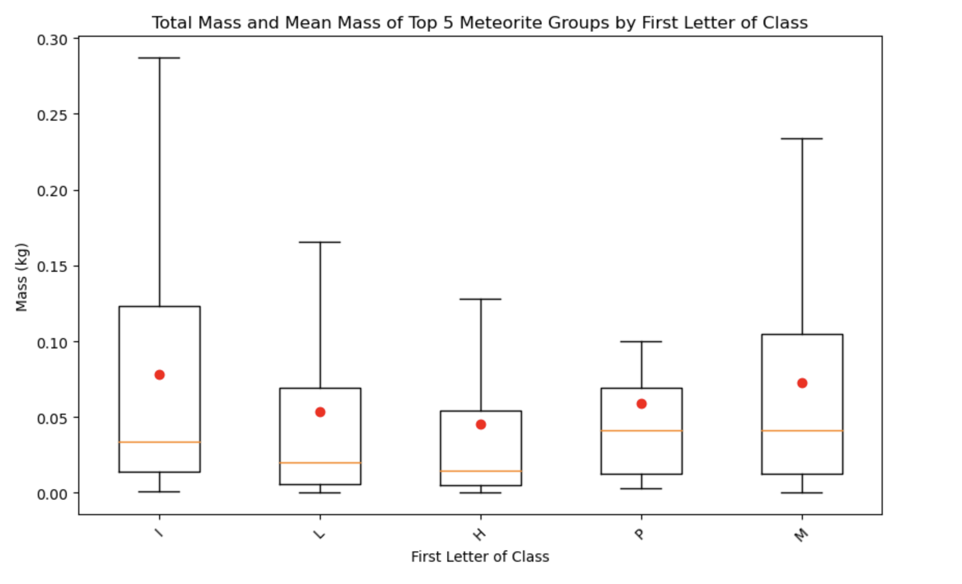
BOX PLOT:
Box plots of the top classes of meteorites found shows their distribution against their mass.
We can conclude that, the mean masses for the top 5 classes is less than 0.1 kg, indicating very small pieces of meteorites were found in large numbers.

Slide 9
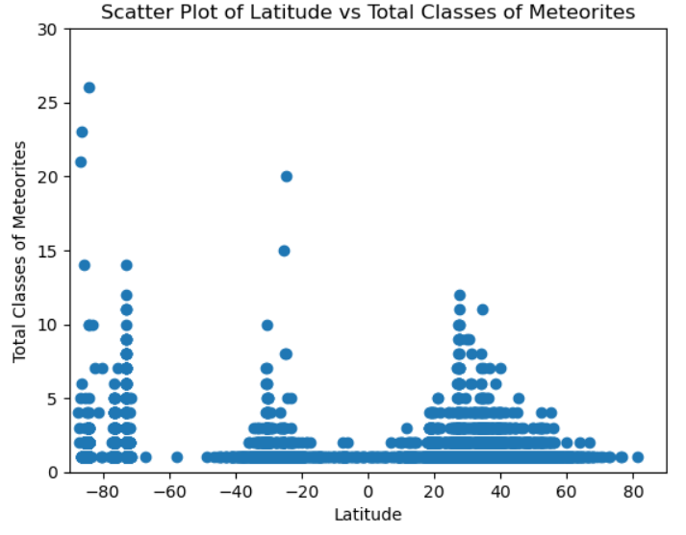
Scatter plot:
Most meteorite falls occur between 30 degrees north and south latitude. This is likely because the Earth's magnetic field is weakest at the poles, making it more likely for meteorites to survive entry into the atmosphere.
Additionally, the Earth's atmosphere is denser at the equator, making it more likely for meteorites to burn up before they reach the surface.
Highest no. of classes are observed near 30-degree latitude.

Slide 10
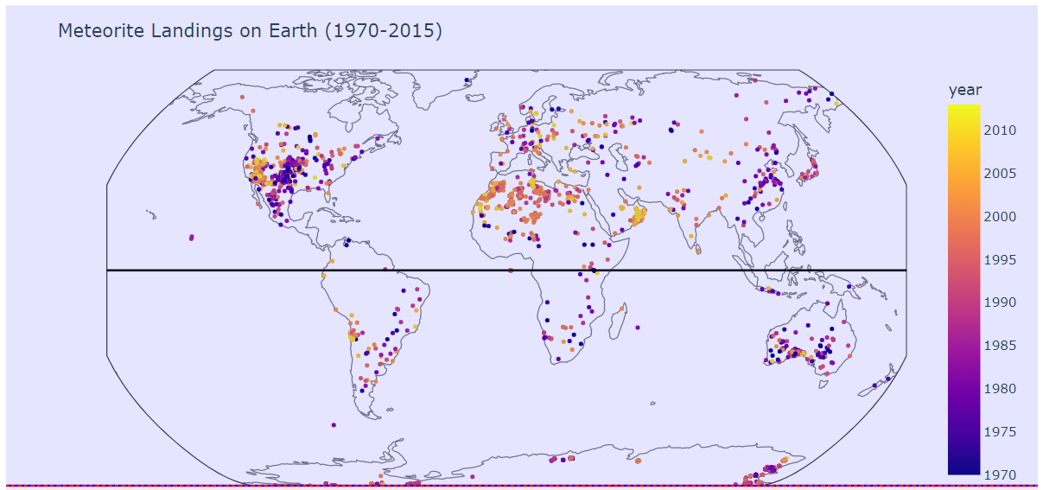
HEAT MAP:
Percentage of meteorites above equator: 15.48%
Percentage of meteorites below equator: 69.70%
Percentage of meteorites on equator: 14.82%
Meteors found near equator are quite less because the Earth’s atmosphere is thicker and meteors enter at a shallow angle near the equator, so chances of meteors burning up or leaving the atmosphere are high.

Slide 11
Highest no. of meteors recorded were after 2000 and this could be because of advancement in technology. Most meteors are found away from equator because of atmospheric factors.
Conclusion:
Meteorites in Antarctica are more visible because the environmental conditions are favorable for the preservation and retrieval of these space rocks. The arid and cold Antarctic environment helps to preserve these rocks
As technology and exploration methods continue to improve, it is likely that we will discover new sources of meteorites, and potentially even new types of meteorites.
Changes in the Earth's atmosphere: These changes could make it more likely for H-type meteors to survive their passage through the atmosphere and reach the ground
Overall, this project has demonstrated the value of open data sources such as the NASA meteorite dataset for scientific research and public outreach.

Slide 12
Recommendation:
Impact site: Information about the impact site characteristics, such as the size of the impact crater and environment factors like seasons, would help researchers to better understand the geological and atmospheric processes that have affected the meteorites.
Chemical composition: A column indicating the chemical composition of the meteorite, including the percentage of major and minor elements, would provide a more detailed insight into the mineralogy and geochemistry of the meteorites.
Statistically, meteorites can land anywhere on Earth. Most fall into the ocean due to the fact that the world’s ocean covers 70% of the world’s surface. With advancement in technology new ways should be invented to retrieve meteorites from large water bodies.

Slide 13
Thanks ☺
Keep an eye for Eta Aquarid meteor shower on May 5 & 6th 2023.

