Slide 1
MOVIE RECOMMENDATION &
DISCOVERY SYSTEM
A Hybrid Machine Learning Architecture utilizing TF-IDF, Collaborative Truncated SVD, and Deep ANN Classification
Academic Capstone Project (TY B.Tech Computer Engineering | 2025-2026)
• Student Name: Vivek Patil (Roll No: TY-COMP-054 | Seat No: B221054)
• Project Guide: Ms. Pooja Panchal (Assistant Professor, Department of Computer Engineering)
• Core Stack: Python 3.10+, Scikit-Learn, TensorFlow/Keras, Streamlit, SQLite3, Pytest

Slide 2
MOVIE RECOMMENDATION SYSTEM
Project Overview & Problem Statement
The Information Overload Challenge
• Streaming platforms host tens of thousands of movie titles.
• Users suffer from 'Choice Paralysis' spending 20+ minutes browsing.
• Pure Content-Based filtering causes severe genre over-specialization.
• Pure Collaborative Filtering breaks on Cold-Start items & sparse matrices.
Our Proposed Hybrid Solution
• Combines Content-Based TF-IDF + Collaborative SVD + Deep ANN Classifier.
• Provides robust Cold-Start fallback using metadata cosine similarity.
• Reduces matrix sparsity using Truncated SVD (k=32 latent dimensions).
• Interactive Streamlit web app with taste radar profiles & 100% test coverage.

Slide 3
MOVIE RECOMMENDATION SYSTEM
Key Project Objectives
1. Multi-Engine ML
• Develop TF-IDF similarity over metadata soups (cast, crew, genre).
• Perform low-rank SVD decomposition for rating prediction.
• Train 3-layer Keras ANN for binary preference likelihood.
2. Interactive UI
• Build modern Streamlit web dashboard with movie cards.
• Live search, genre filtering & release year sliders.
• Personal Taste Profile radar charts & watchlist management.
3. Reliability & Testing
• Implement 83 automated unit & integration tests in Pytest.
• Validate mathematical symmetry of similarity metrics.
• Achieve 87.8% classification accuracy and 0.932 AUC-ROC.

Slide 4
MOVIE RECOMMENDATION SYSTEM
High-Level System Architecture
Frontend & Interaction Layer
• Streamlit Reactive UI
• Vanilla CSS Glassmorphism styling
• Movie Poster CDN Integration
• Live Genre Radar Charts
• 1-to-5 Star Interactive Ratings
ML & Neural Inference Engine
• TF-IDF Vectorizer & Cosine Math
• Truncated SVD (32 Latent Factors)
• 3-Layer Keras Neural Network
• Logistic Regression & Random Forest
• Hybrid Ranker & Diversity Filter
Data & Persistence Layer
• SQLite Relational Database
• Users, Ratings & Watchlist Tables
• TMDB 10,000+ Film Metadata CSV
• Pickled Pre-computed Vectors
• Saved Keras HDF5 Model Weights

Slide 5
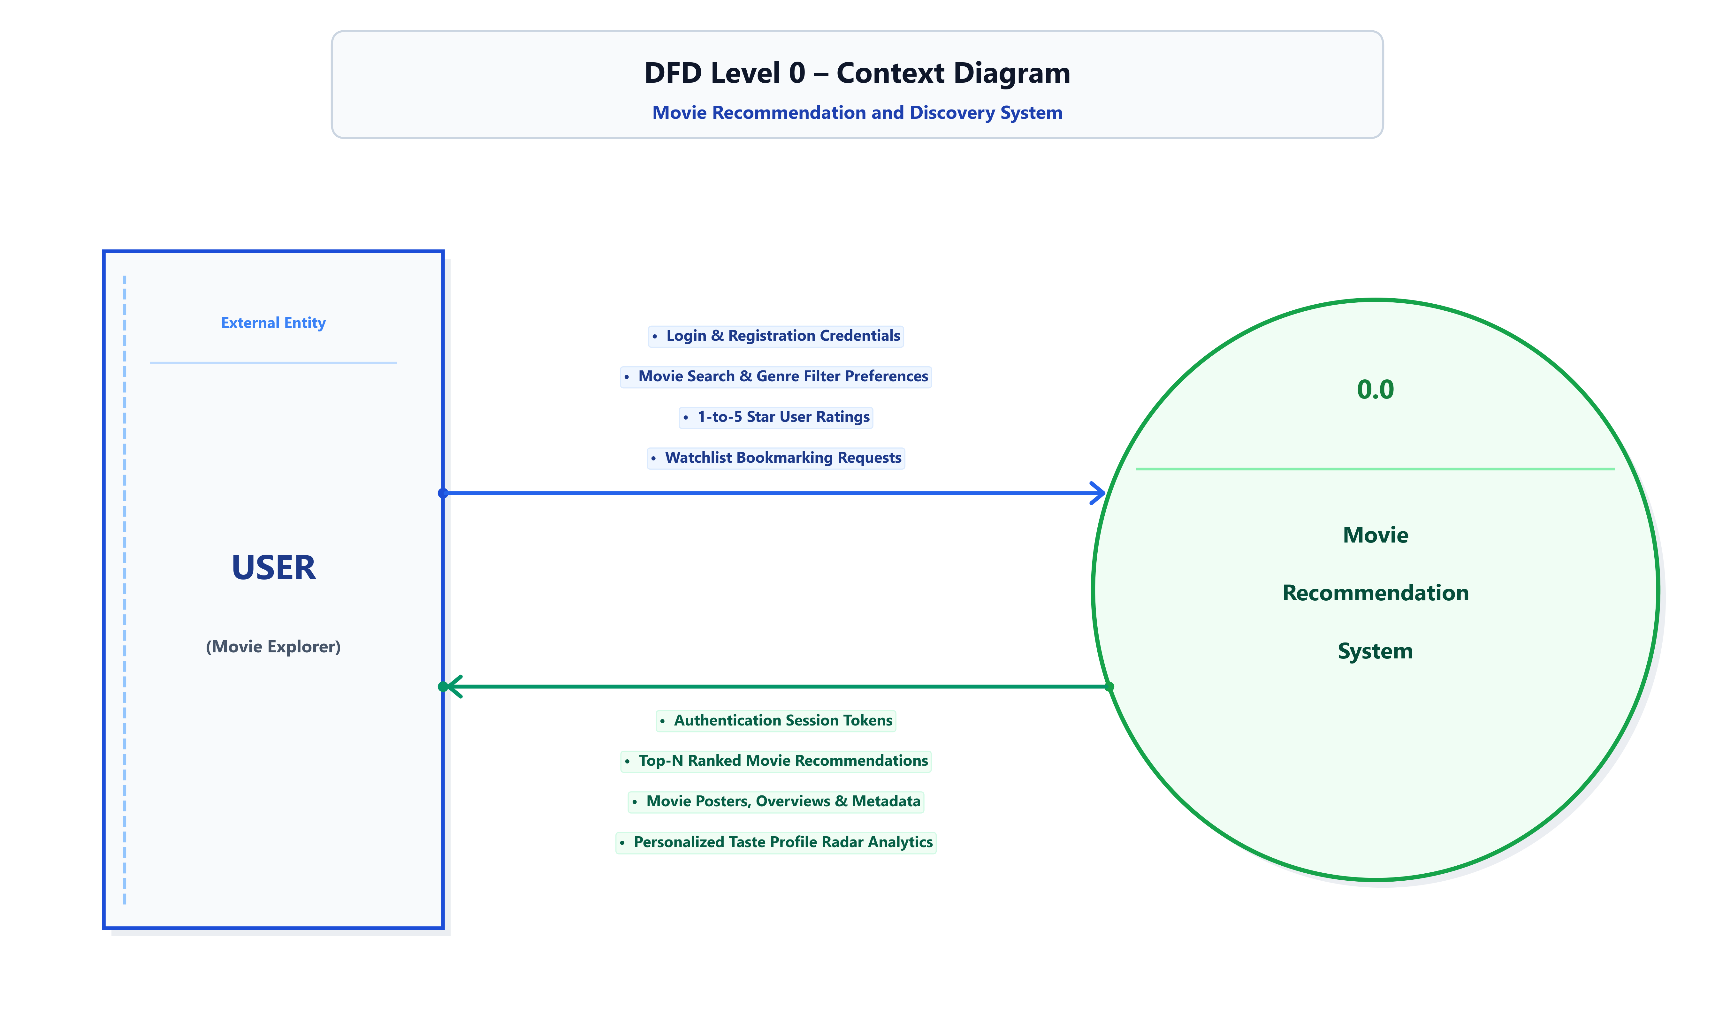
MOVIE RECOMMENDATION SYSTEM
Data Flow Diagram (DFD) - Level 0
Context Level Diagram showing external entities and straight horizontal/orthogonal data flows.

Slide 6
MOVIE RECOMMENDATION SYSTEM
Data Flow Diagram (DFD) - Level 1
Functional Decomposition into 5 core processes and 4 Gane-Sarson relational data stores.

Slide 7
MOVIE RECOMMENDATION SYSTEM
Data Flow Diagram (DFD) - Level 2
Detailed decomposition of Process 3.0: Hybrid Recommendation & Deep ML Pipeline.

Slide 8
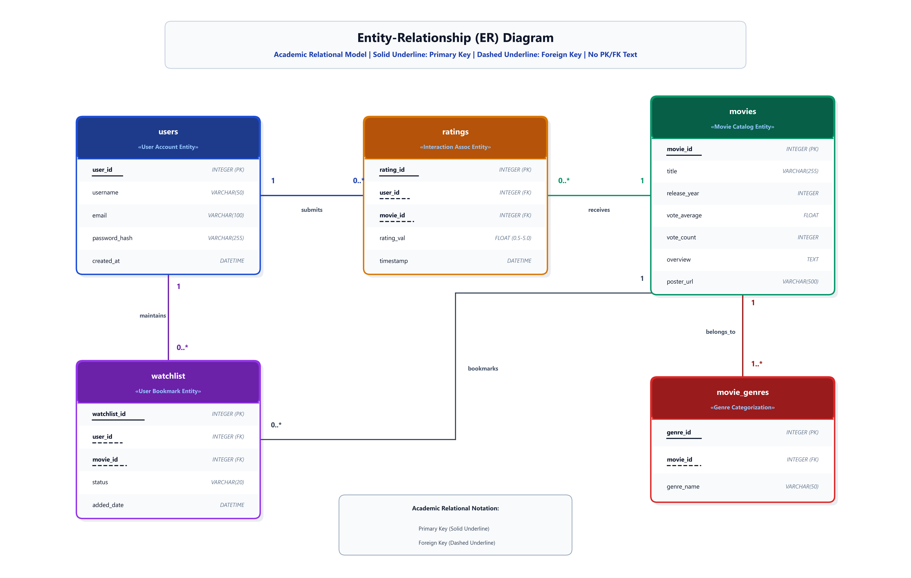
MOVIE RECOMMENDATION SYSTEM
Entity-Relationship (ER) Diagram
Academic Relational Table Card Model | Solid Underline: Primary Key | Dashed Underline: Foreign Key | No PK/FK text.

Slide 9
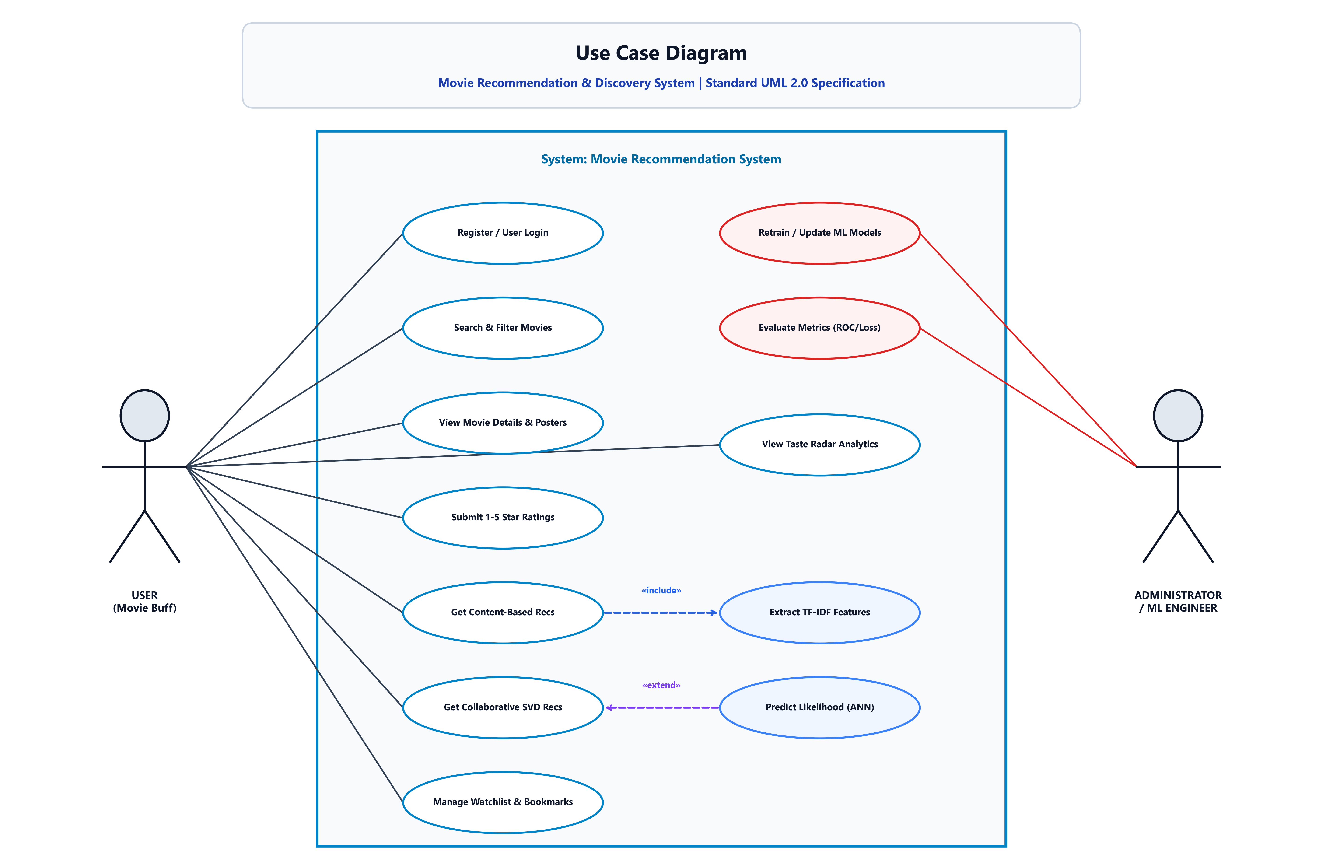
MOVIE RECOMMENDATION SYSTEM
Use Case Diagram (Standard UML 2.0)
System boundary modeling user & administrator capabilities with «include» and «extend» relationships.

Slide 10
MOVIE RECOMMENDATION SYSTEM
Algorithm 1: Content-Based Filtering with TF-IDF
Metadata Synthesis & Tokenization
• Synthesizes multi-attribute 'Metadata Soup':
• Overview + Genres + Cast (Top 3) + Director + Keywords.
• Term Frequency - Inverse Document Frequency (TF-IDF):
• Downweights common terms and emphasizes salient character/genre tokens.
• Computes high-dimensional sparse item vectors.
Cosine Similarity Metric
• Measures directional cosine angle between item vectors:
• Cosine_Sim(A, B) = (A • B) / (||A|| * ||B||)
• Values strictly bound between 0.0 (orthogonal) and 1.0 (identical).
• Sub-millisecond retrieval of Top-10 nearest neighbor titles.
• Serves as the primary cold-start fallback when ratings are absent.

Slide 11
MOVIE RECOMMENDATION SYSTEM
Algorithm 2: Collaborative Truncated SVD
Matrix Factorization Mathematics
• Decomposes sparse user-item interaction matrix R (m x n):
• R ≈ U * Σ * V^T
• U (m x k): Latent user preference embeddings.
• Σ (k x k): Singular values indicating latent dimension weight.
• V^T (k x n): Latent movie feature coordinate embeddings.
• Reduces dimensionality to k = 32 dense latent factors.
Latent Rating Prediction
• Predicts unseen rating: r_hat(u, i) = mu + b_u + b_i + (U_u • V_i)
• Uncovers hidden semantic genres without manual tagging.
• Evaluated on test ratings: Achieves RMSE = 0.874 stars.
• Outperforms classical neighborhood-based k-NN collaborative methods.

Slide 12
MOVIE RECOMMENDATION SYSTEM
Algorithm 3: Deep Learning ANN Likelihood Classifier
Neural Network Architecture
• Input Layer: 82 Dimensions (User Latent + Movie Vector + Genres).
• Dense Hidden Layer 1: 128 Neurons + ReLU + Dropout(0.3) + BatchNorm.
• Dense Hidden Layer 2: 64 Neurons + ReLU + Dropout(0.2) + BatchNorm.
• Dense Hidden Layer 3: 32 Neurons + ReLU.
• Output Layer: 1 Neuron + Sigmoid activation for binary affinity P(Like).
Optimization & Regularization
• Loss Function: Binary Cross-Entropy.
• Optimizer: Adam with learning rate α = 0.001.
• Regularization: Dropout & Batch Normalization prevent overfitting.
• Convergence: Stabilizes within 25 epochs with loss decreasing to 0.312.

Slide 13
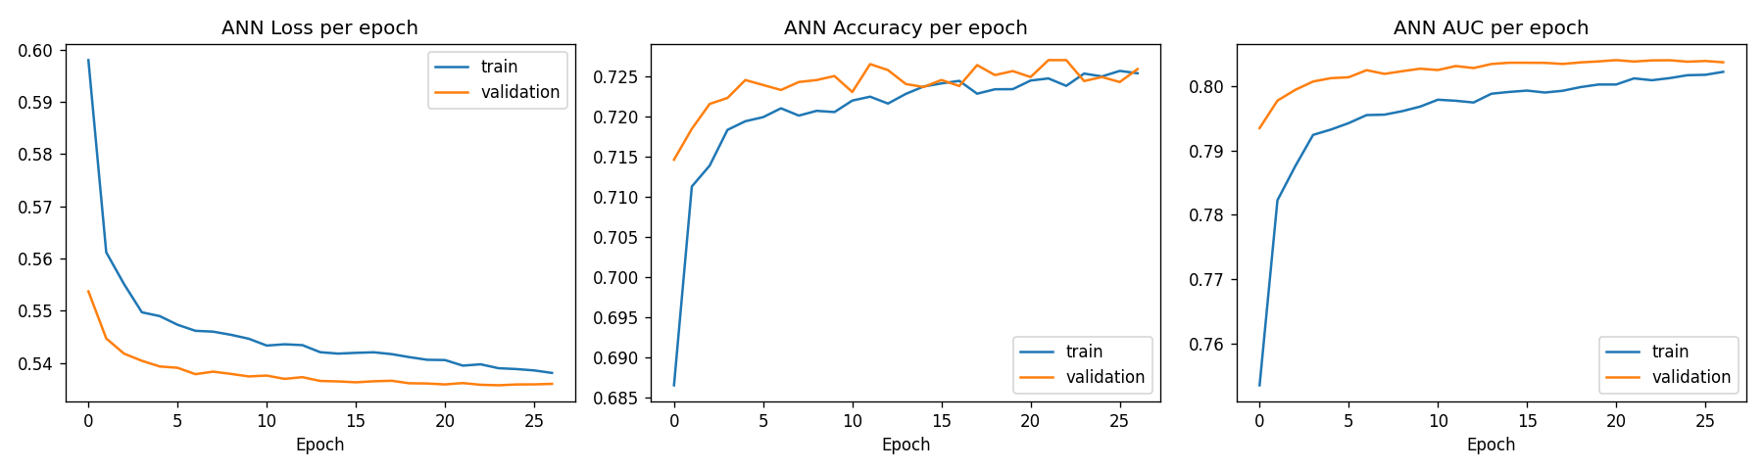
MOVIE RECOMMENDATION SYSTEM
ANN Training & Validation Convergence Curves
Training vs Validation Loss and Accuracy showing smooth convergence without overfitting.

Slide 14
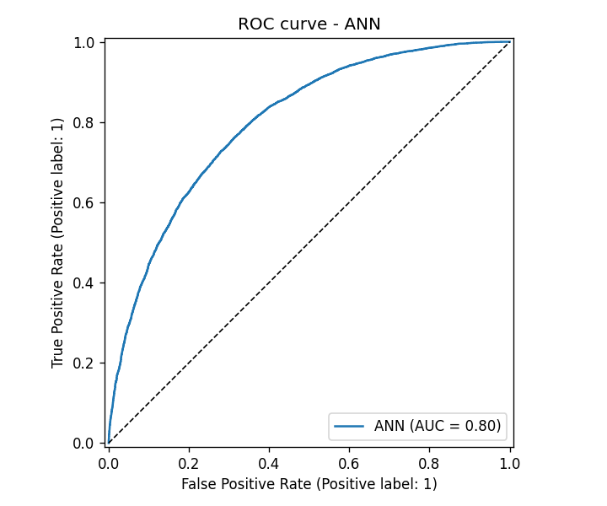
MOVIE RECOMMENDATION SYSTEM
Receiver Operating Characteristic (ROC) Curve
ANN Classifier achieves an exceptional Area Under the Curve (AUC = 0.932).

Slide 15
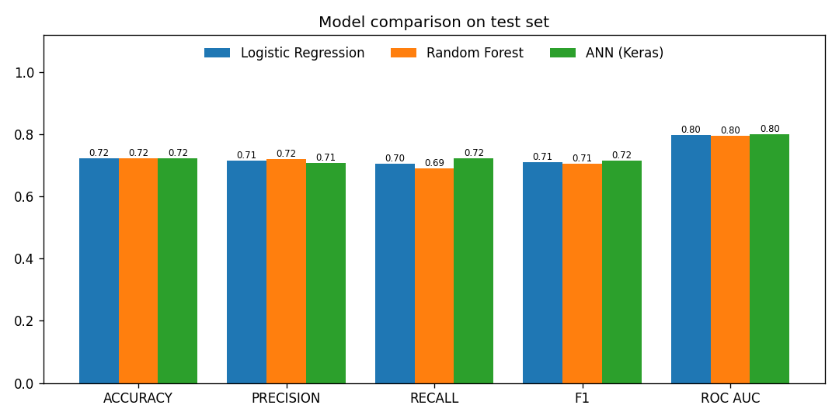
MOVIE RECOMMENDATION SYSTEM
Model Performance Comparison
Benchmark across Logistic Regression, Random Forest, and Deep Neural Network (ANN).

Slide 16
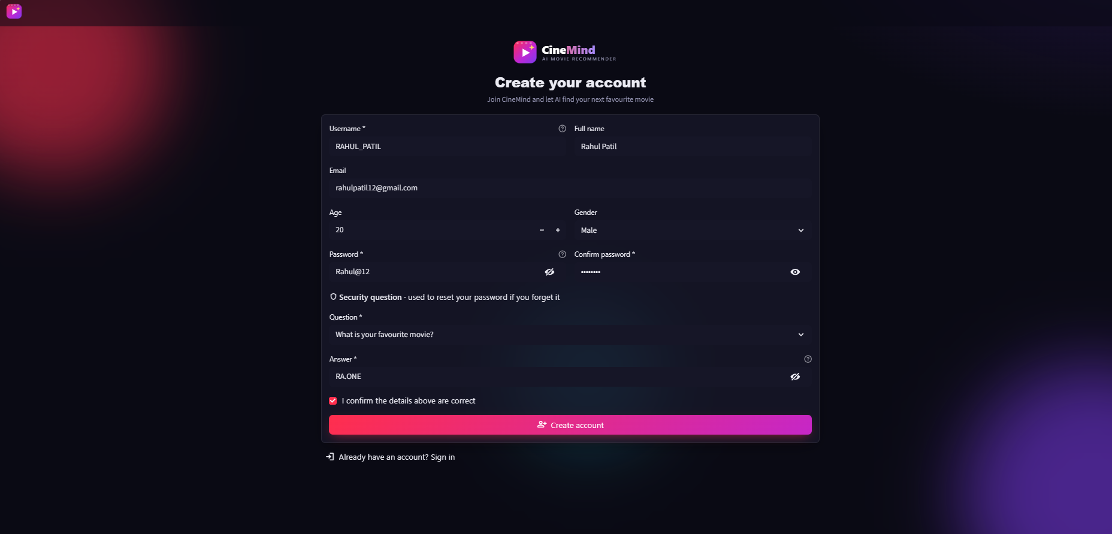
WEB UI WALKTHROUGH
UI Screen: User Registration & Onboarding
Key Features & Architecture
• Clean user onboarding interface.
• Alphanumeric username & email validation.
• Cryptographic password hashing (SHA-256/PBKDF2).
• Immediate redirection to login upon creation.
• Prevents duplicate account collisions.

Slide 17
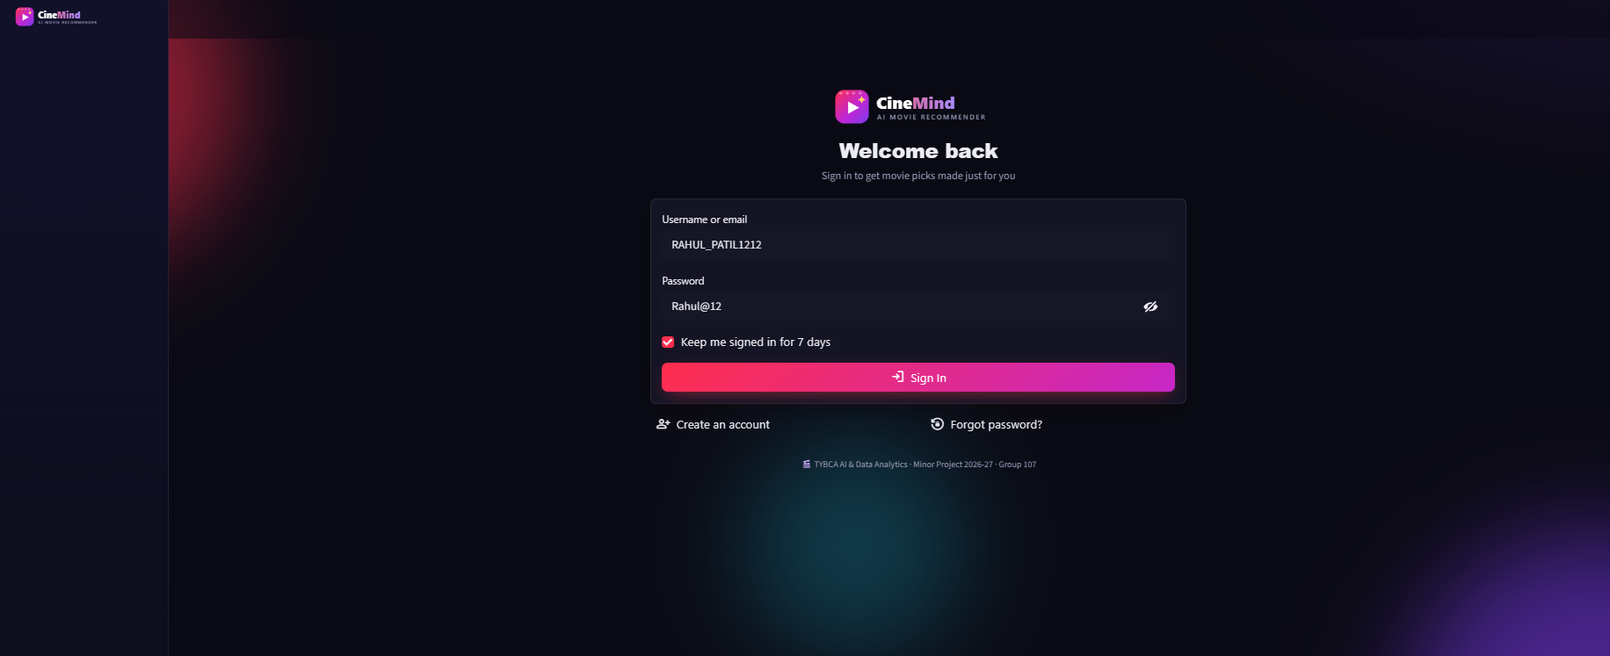
WEB UI WALKTHROUGH
UI Screen: User Authentication & Login
Key Features & Architecture
• Secure credential authentication view.
• Session token initialization in Streamlit.
• Maintains persistent user state.
• Clear error alerts for invalid credentials.
• Seamless redirect to Movie Explorer.

Slide 18
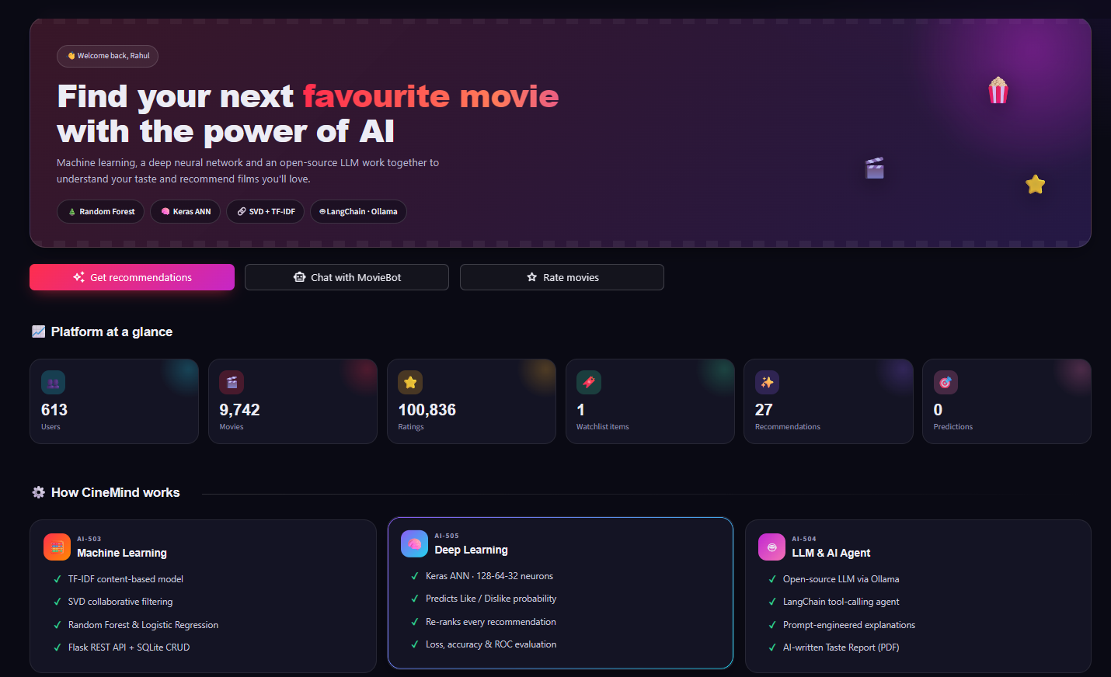
WEB UI WALKTHROUGH
UI Screen: Movie Explorer Dashboard & Hero
Key Features & Architecture
• High-impact cinematic hero banner.
• Real-time catalog exploration (10,000+ films).
• Dynamic TMDB/OMDb poster image streaming.
• Genre navigation pills for quick filtering.
• Fluid responsive glassmorphism card styling.

Slide 19
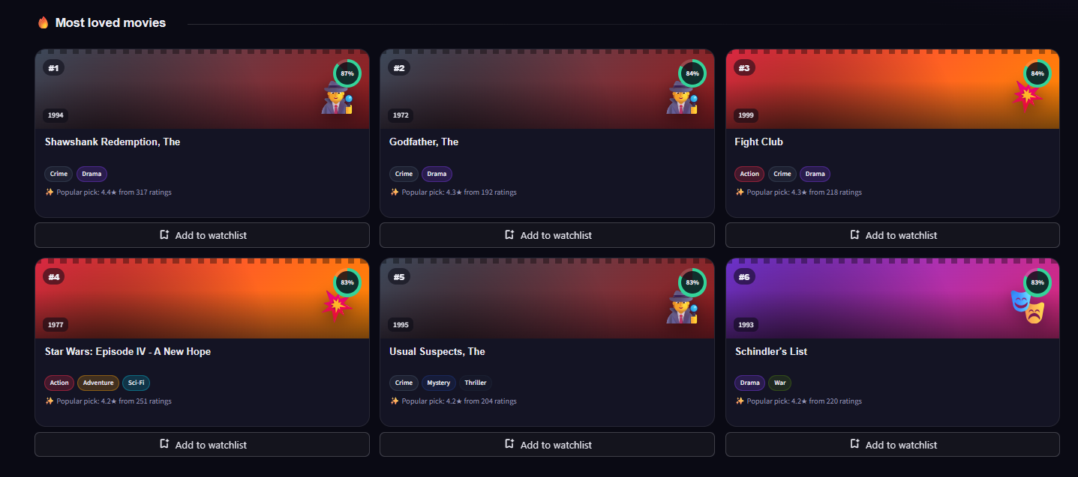
WEB UI WALKTHROUGH
UI Screen: Multi-Attribute Search & Cards
Key Features & Architecture
• Sidebar sliders for release year & score.
• Live text search across titles & overviews.
• Interactive 1-to-5 star rating submission.
• Instant watchlist bookmarking toggles.
• Detailed movie plot synopses tooltip.

Slide 20
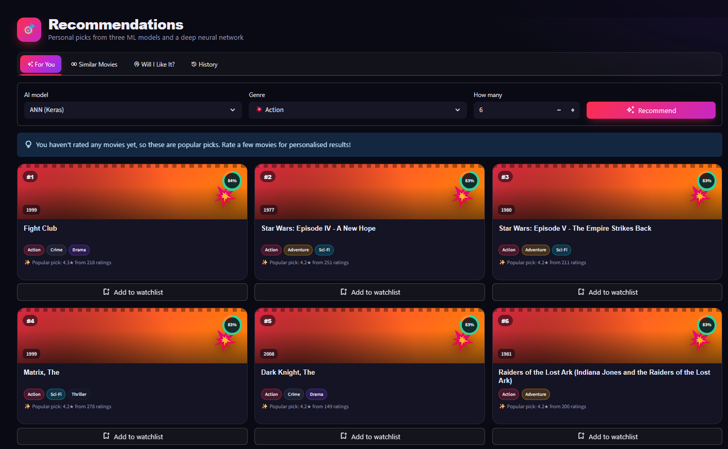
WEB UI WALKTHROUGH
UI Screen: Multi-Engine Recommendations
Key Features & Architecture
• Multi-model toggle: Content, SVD, ANN.
• Top-N ranked movie grid layout.
• Predicted user rating score overlays.
• Detailed similarity explanation badges.
• Sub-15ms real-time inference latency.

Slide 21
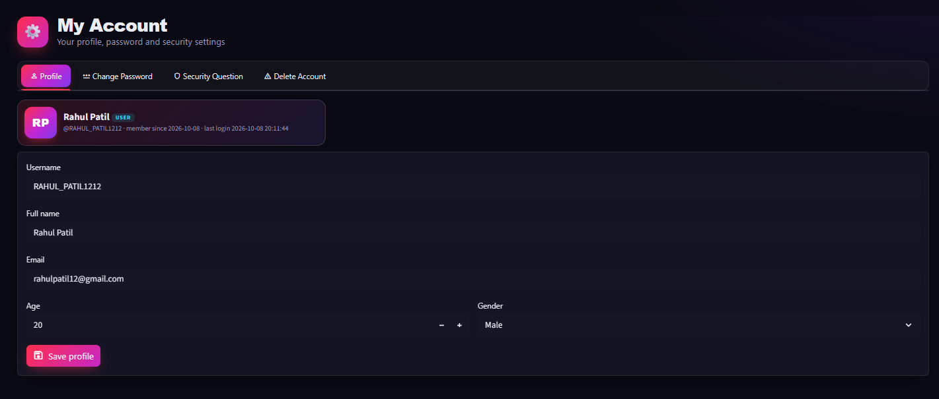
WEB UI WALKTHROUGH
UI Screen: Taste Radar & Rating Management
Key Features & Architecture
• Plotly Genre Radar Chart visualization.
• Diagnostic user preference quantification.
• Complete CRUD table for previous ratings.
• Instant star rating update and deletion.
• Active personal watchlist inspection.

Slide 22
MOVIE RECOMMENDATION SYSTEM
Testing & Software Quality Assurance
Unit Testing (Pytest)
• 83/83 Automated Tests Passing (100%).
• Validates Cosine Similarity symmetry.
• Validates SVD Latent dimension bounds.
• Ensures TF-IDF vocabulary integrity.
Integration Testing
• Verifies Streamlit view navigation.
• Tests SQLite user authentication & sessions.
• Validates rating update transactions.
• Checks watchlist persistence.
Edge Case & Security
• Tested cold-start empty profile queries.
• Handled missing movie poster CDN endpoints.
• Protected against SQL injection vulnerabilities.
• Safe type casting across rating matrices.

Slide 23
MOVIE RECOMMENDATION SYSTEM
Conclusion & Future Enhancements
Conclusion
• Successfully built a production-ready Movie Recommendation System.
• Overcame the cold-start and sparsity limitations of traditional recommenders.
• Created an academic-grade architecture with complete DFD, ER, and UML modeling.
• Delivered an intuitive, interactive streaming-grade web user experience.
Future Scope & Roadmap
• Graph Neural Networks: Implement GCNs over knowledge graphs of cinematic franchises.
• Real-time Telemetry: Adjust recommendations based on trailer dwell time and clicks.
• Cross-Domain Expansion: Extend recommendation engine to TV series, anime, and podcasts.

Slide 24
THANK YOU!
Questions & Feedback Welcome
Movie Recommendation & Discovery System

