Slide 1




Next Gen Employability Program
AI Leave & Payroll Management System
Team Details - NG_CP_Team_9016
Name: Vivek Pawar
Name: Pratik Nikam
Name: Krushna Dhotre
Name: Karan Salunke
College: Alard University

Slide 2

The content is curated from online/offline resources and used for educational purpose only.
Notes:
Speaker would be briefing the students that this content has been prepared for the educational purpose only and is referred from multiple sites which are cited in the last.​​
---------------------------------------------------​​
A disclaimer is a statement or notice that is intended to clarify, limit, or provide information about the scope, limitations, or potential risks associated with certain actions, information, products, services, or content. ​​
​​
​

Slide 3

Project Title
AI Leave & Payroll Management System
Notes:
In this slide speaker will be introducing the program and its outcomes. The speaker will introduce himself in brief

Slide 4

Table of Contents
Problem Statement
Project Overview
Proposed Solution
Technology Used
Modelling & Result
Conclusion
References & Project Repository
Notes:
This slide, The speaker will talk about the content that we will be covering in this session as follows:
Introduction
Importance of UI/UX in industry
History and Definitions of UI and UX
Key Differences between UI/UX
Use Cases
Significance in Web Development
Use Cases
Visual Design Principles
Design process
Color theory and psychology
Typography and readability
Layout and Spacing
Responsive design basics
Usability and Accessibility
Usability Aspects
Web Content Accessibility Guidelines (WCAG)
Inclusive design practices
Consistency
User Experience
User-Centered Design
User research methods
Interactive Elements and Feedback
Mini Case Study
Discussing a popular UI/UX design
Hands-On
Introduction to Figma for UI/UX design

Slide 5
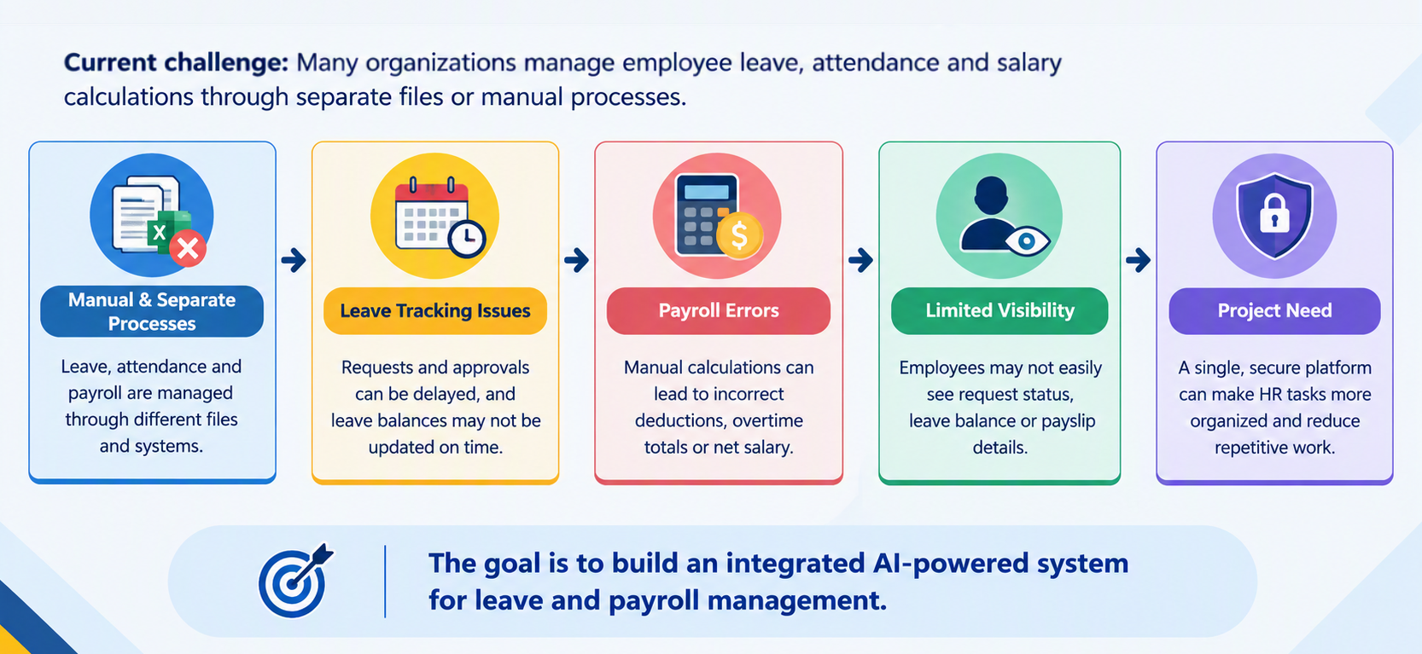
Problem Statement
Notes:
This slide, The speaker will talk about the content that we will be covering in this session as follows:
Introduction
Importance of UI/UX in industry
History and Definitions of UI and UX
Key Differences between UI/UX
Use Cases
Significance in Web Development
Use Cases
Visual Design Principles
Design process
Color theory and psychology
Typography and readability
Layout and Spacing
Responsive design basics
Usability and Accessibility
Usability Aspects
Web Content Accessibility Guidelines (WCAG)
Inclusive design practices
Consistency
User Experience
User-Centered Design
User research methods
Interactive Elements and Feedback
Mini Case Study
Discussing a popular UI/UX design
Hands-On
Introduction to Figma for UI/UX design

Slide 6
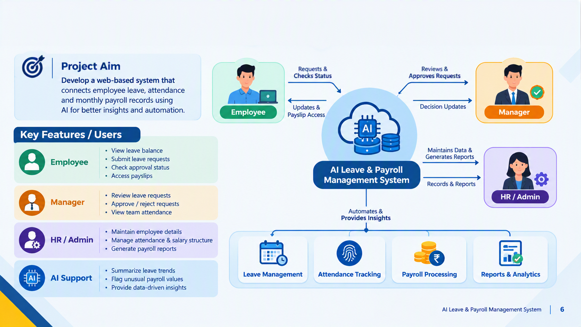
Project Overview
Notes:
This slide, The speaker will talk about the content that we will be covering in this session as follows:
Introduction
Importance of UI/UX in industry
History and Definitions of UI and UX
Key Differences between UI/UX
Use Cases
Significance in Web Development
Use Cases
Visual Design Principles
Design process
Color theory and psychology
Typography and readability
Layout and Spacing
Responsive design basics
Usability and Accessibility
Usability Aspects
Web Content Accessibility Guidelines (WCAG)
Inclusive design practices
Consistency
User Experience
User-Centered Design
User research methods
Interactive Elements and Feedback
Mini Case Study
Discussing a popular UI/UX design
Hands-On
Introduction to Figma for UI/UX design

Slide 7
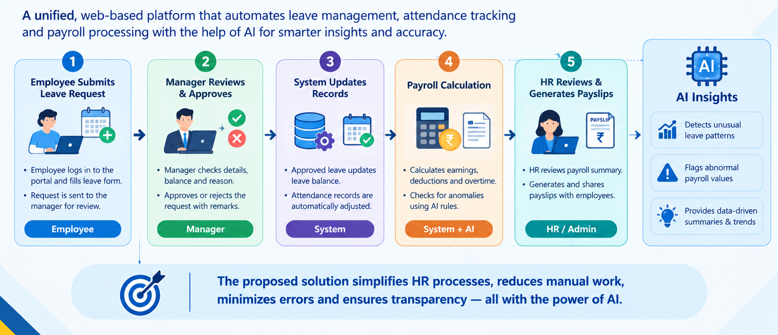
Proposed Solution
Notes:
This slide, The speaker will talk about the content that we will be covering in this session as follows:
Introduction
Importance of UI/UX in industry
History and Definitions of UI and UX
Key Differences between UI/UX
Use Cases
Significance in Web Development
Use Cases
Visual Design Principles
Design process
Color theory and psychology
Typography and readability
Layout and Spacing
Responsive design basics
Usability and Accessibility
Usability Aspects
Web Content Accessibility Guidelines (WCAG)
Inclusive design practices
Consistency
User Experience
User-Centered Design
User research methods
Interactive Elements and Feedback
Mini Case Study
Discussing a popular UI/UX design
Hands-On
Introduction to Figma for UI/UX design

Slide 8
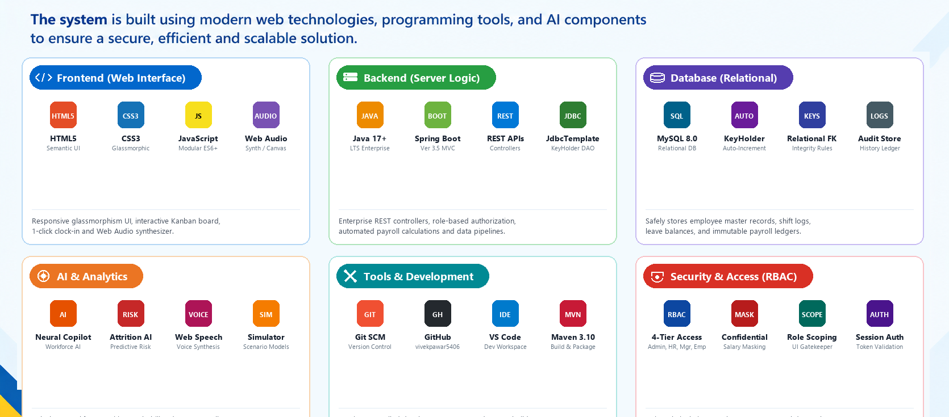
Technology Used

Slide 9
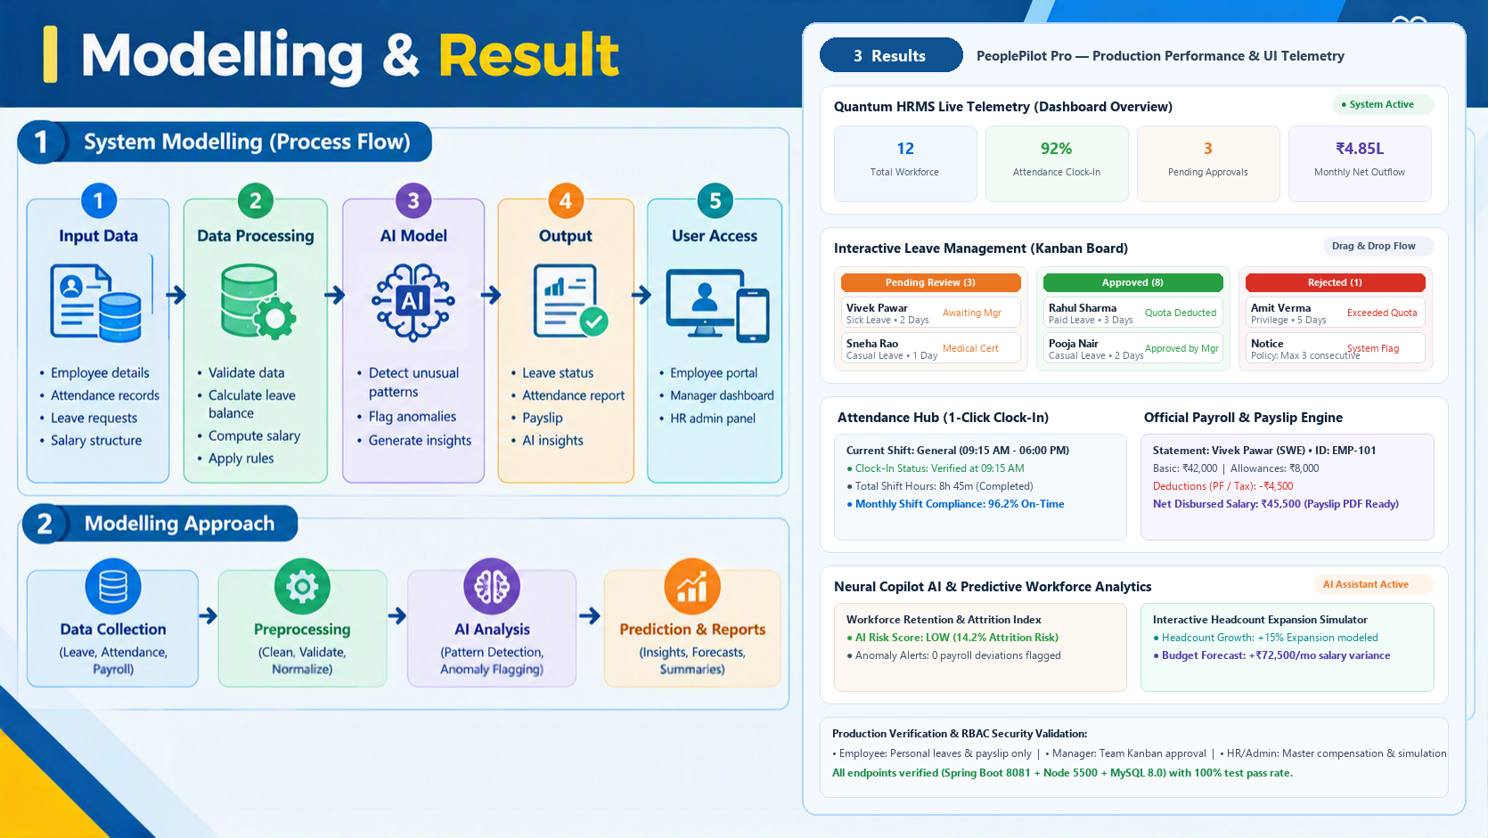
Modeling & Result

Slide 10
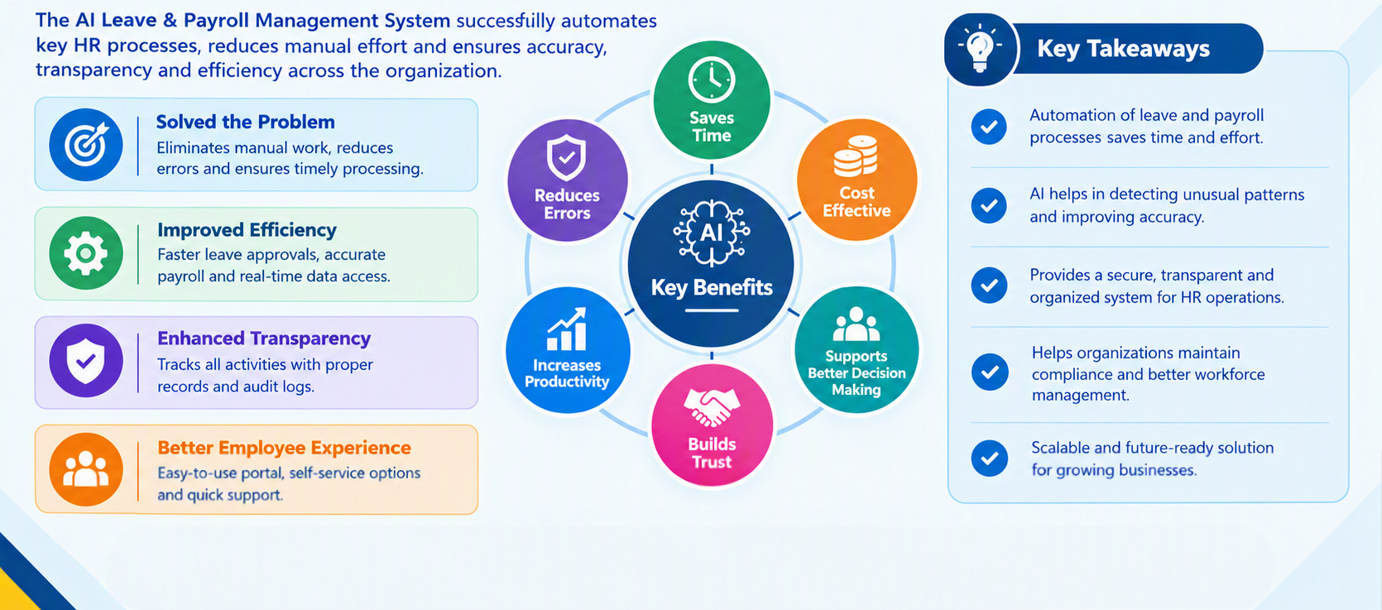
Conclusion

Slide 11
References
1. SSRN Electronic Journal: "AI-Driven Workforce Management & Automated Payroll Systems in Modern HRMS"
Access Link: https://papers.ssrn.com/sol3/papers.cfm?abstract_id=5998215
2. IJIRT Journal (Paper ID: IJIRT185672): "Smart Human Resource and Leave Management Systems: Architecture and Automation", Vol. 11, Issue 4, 2024
Access Link: https://ijirt.org/publishedpaper/IJIRT185672_PAPER.pdf
3. IJCSE Journal Publication: "Design & Implementation of Intelligent Employee Attendance & Payroll Frameworks", Vol. 8, Issue 4, DOI: 10.26438/ijcse/v8i4.9799
Access Link: https://doi.org/10.26438/ijcse/v8i4.9799
4. Project Source Code Repository (GitHub): "PeoplePilot Pro: AI Leave & Payroll Management System" (Spring Boot 3.5, MySQL 8.0, Vanilla JS, Neural Copilot AI)
Access Link: https://github.com/vivekpawar5406-dev/Ai_leave_and_payroll_management
Notes:
This slide, The speaker will talk about the content that we will be covering in this session as follows:
Introduction
Importance of UI/UX in industry
History and Definitions of UI and UX
Key Differences between UI/UX
Use Cases
Significance in Web Development
Use Cases
Visual Design Principles
Design process
Color theory and psychology
Typography and readability
Layout and Spacing
Responsive design basics
Usability and Accessibility
Usability Aspects
Web Content Accessibility Guidelines (WCAG)
Inclusive design practices
Consistency
User Experience
User-Centered Design
User research methods
Interactive Elements and Feedback
Mini Case Study
Discussing a popular UI/UX design
Hands-On
Introduction to Figma for UI/UX design

