Slide 1

Snakes (AI)
Ankit Suman
Vivek Raj
(Software Trainee, NathCorp)

Slide 2
Contents
Introduction to the project.
Game.
Introduction to Snake Game.
Rules to Play.
Requirements.
Software Required.
Packages Used.
Game Logic.
Data Set.
ANN
Building an ANN model.
Using the ANN model for prediction.

Slide 3

Introduction to the project.

Slide 4
Game.
Introduction to Snake Game.
Rules to Play.

Slide 5
Introduction To snake game.

Slide 6

Rules
Can move forward only.
Can turn left or right.
If the head touches the boundaries or its body itself the snake dies.
Grows in size after eating food.
Gets points for every food it eats.
Eat as much food as it needs.

Slide 7
Requirements.
Software Required.
Packages Used.

Slide 8
Software Required.
Python 3.5.2
PyCharm.

Slide 9
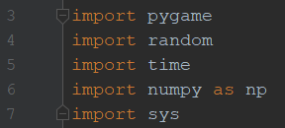
Packages Used.

Slide 10

Game logic

Slide 11
Game Logic.
Snake Class.
Food Class.
Initializing the pygame window.
Working of game in every frame.

Slide 12
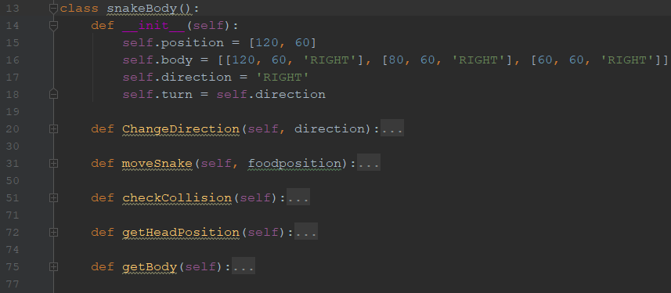
Snake class.

Slide 13
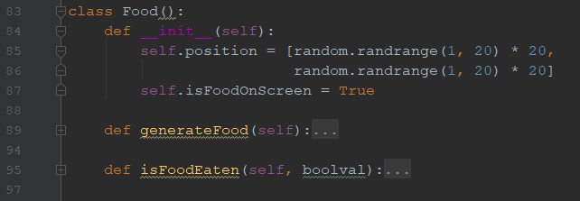
food class.

Slide 14
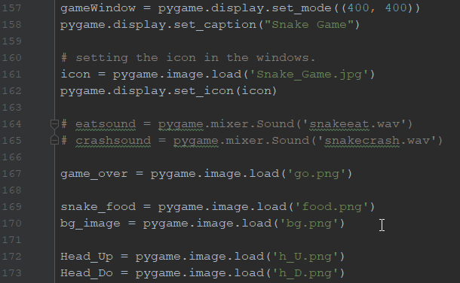
Initializing the pygame window.

Slide 15
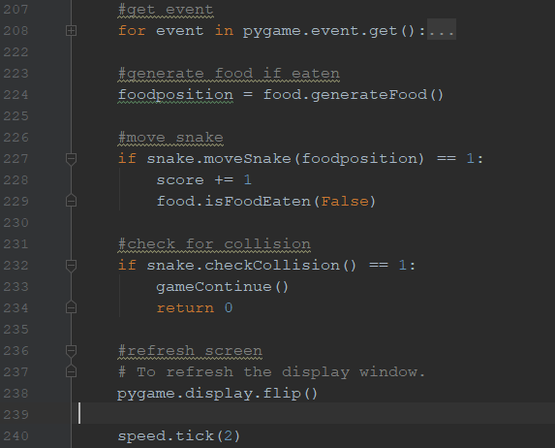
working of Game in every frame.

Slide 16

Check for certain Situations.

Slide 17
Check for certain Situations.
Check Obstacles.
Check Angle.
Status.
Co-ordinates.

Slide 18
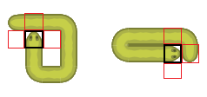
Check Obstacles.
Check Left, Right, Front –
If( blocked ) : Set value to 0.
else : Set value to 1.

Slide 19
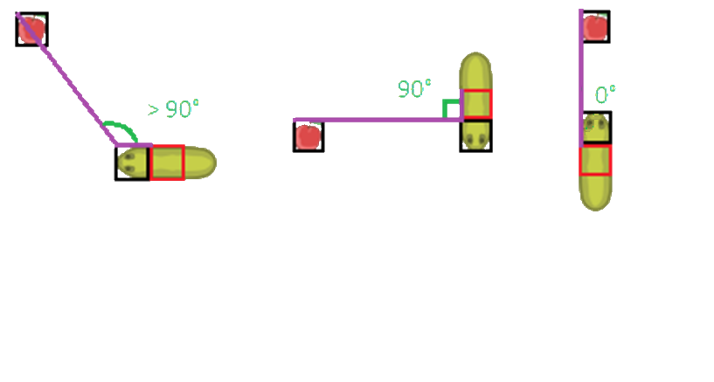
Check Angle.
Angle between snake and food.

Slide 20
Status.
Towards the food. ( 1 )
Away from the food. ( 0 )
Collision. ( -1 )

Slide 21
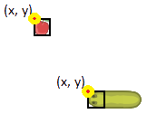
Co-ordinates.
Food Co-ordinates.
Snake Head Co-ordinates

Slide 22

Data Set

Slide 23
Data Set.
Left_B
Right_B
Front_B
Cosine_Angle
Status
Food_x
Food_y
Snake_x
Snake_y
Suggested_Direction

Slide 24

Artificial Neural Network

Slide 25

What is Ann ?

Slide 26
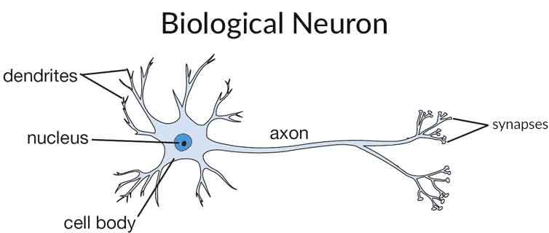

Slide 27
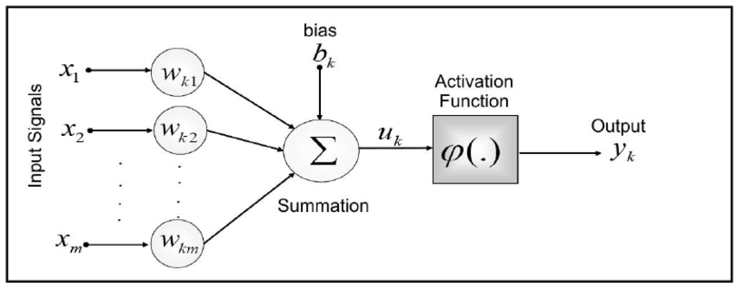

Slide 28
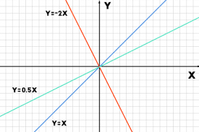
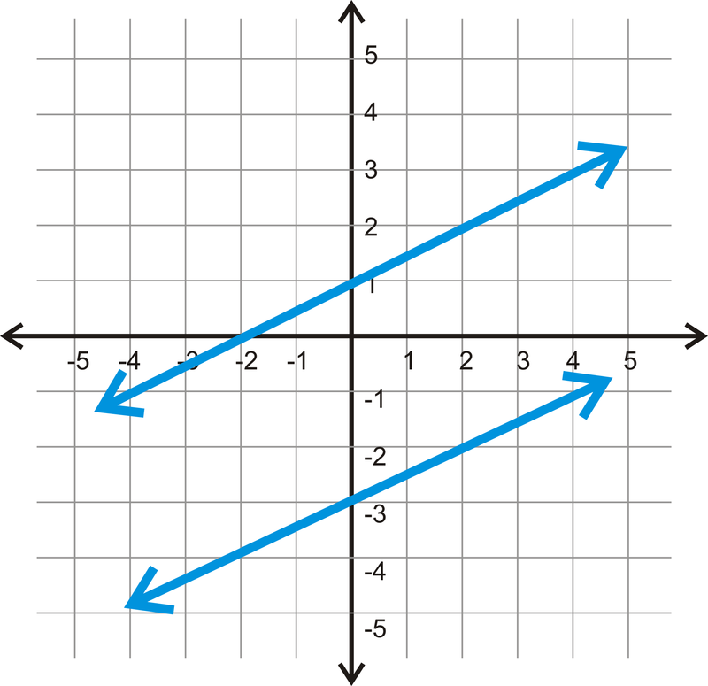
BIAS
Y = mX
Y =mX + c

Slide 29
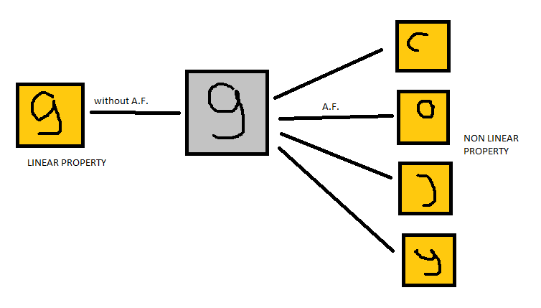
ACTIVATION FUNCTION

Slide 30
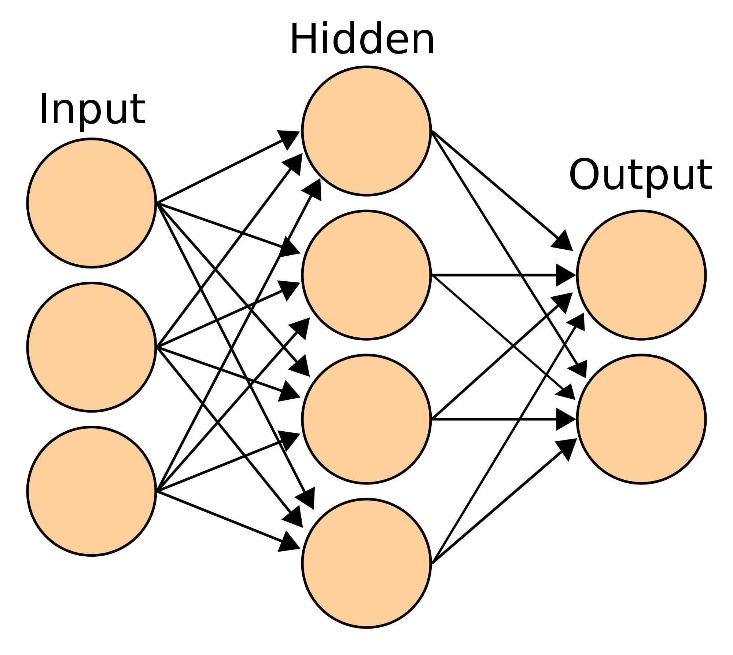

Slide 31

Building an ANN model

Slide 32
Importing data
# Importing the dataset
dataset = pd.read_csv('SNAKE_A.csv') dataset = dataset.dropna() X = dataset.iloc[:, 0:9].values y = dataset.iloc[:, 9].values

Slide 33
Categorical feature
# making prediction column as categorical.
ohe = OneHotEncoder(sparse=False)
y = y.reshape(-1, 1) y = ohe.fit_transform(y)

Slide 34
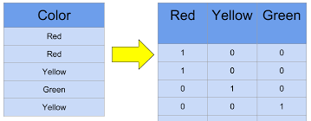
One hot encoder

Slide 35
Splitting data
# spliting data for training and testing.
X_train, X_test, y_train, y_test =/
train_test_split(X, y, test_size = 0.2)

Slide 36
Initializing neural network
#Initializing Neural Network
model = Sequential()

Slide 37
1ST hidden layer
# Adding the input layer and the first hidden
layer.
model.add(Dense(output_dim = 80, init = /
'uniform', activation = 'relu', input_dim = 9))

Slide 38
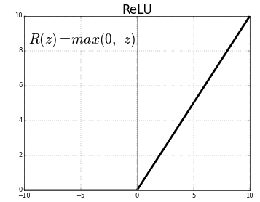
relu

Slide 39
2nd hidden layer
# Adding the input layer and the second hidden
layer.
model.add(Dense(output_dim = 50, /
init = 'uniform', activation = 'relu’))

Slide 40
OUT-put layer
# Adding the output layer
model.add(Dense(output_dim = 3, init = /
'uniform’, activation = 'softmax’))

Slide 41
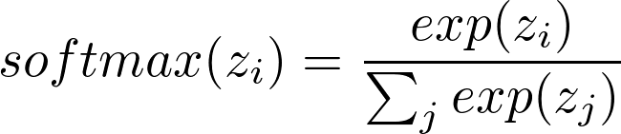
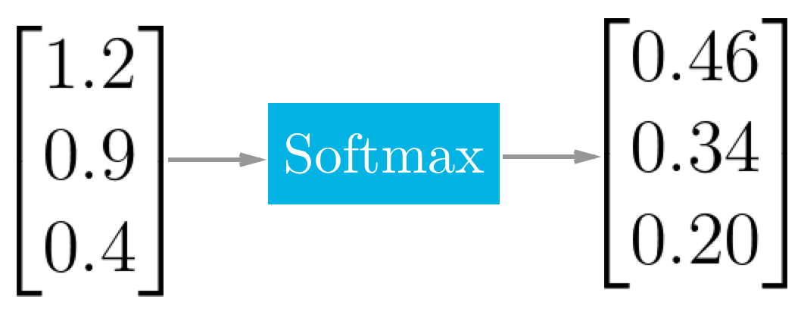
Soft-max

Slide 42
Creating optimizer
# optimizer creation.
Adam_opt = optimizers.Adam(lr=0.001, beta_1=/
0.9, beta_2=0.999, epsilon=10E-8, decay=0.0 )

Slide 43
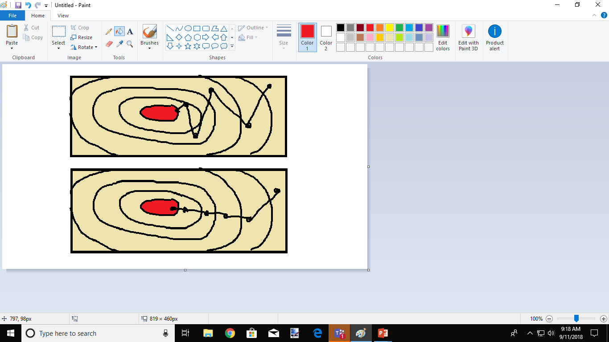
MOMENT

Slide 44
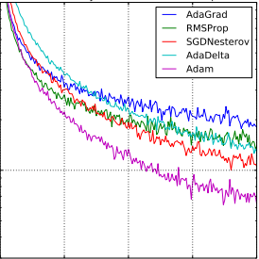
Adam optimizer

Slide 45
compilation
# Compiling Neural Network.
model.compile(optimizer = Adam_opt , /
loss = 'categorical_crossentropy’,/
metrics = ['accuracy’])

Slide 46
Fitting and compilation
# Fitting our model
model.fit(X_train, y_train, batch_size = 40,/
epochs = 1200) # Evaluate the model
scores = model.evaluate(X_test, y_test) print("\nAccuracy: %.2f%%" % (scores[1]*100))

Slide 47
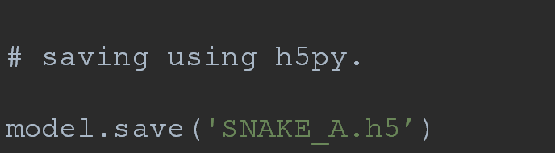
Saving the model

Slide 48
Playing game using our model

Slide 49
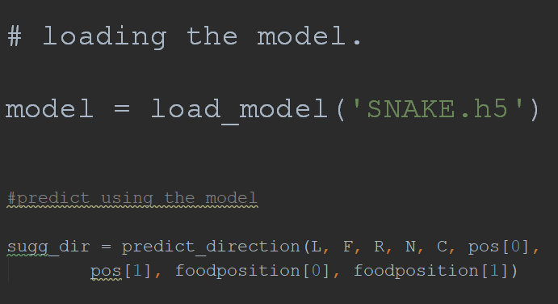
predicting directions

Slide 50

Thank you

