Slide 1



BIT TO BYTE ROBOTICS
presents
TECHKAMERA
THE TECH COMPANION OF FARMER

Slide 2

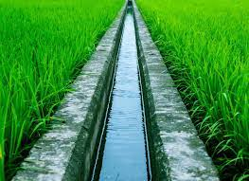
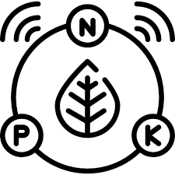



PROBLEM STATEMENT
INEFFICIENT FARM OPERATIONS
NO PRECISE METHOD FOR
IRRIGATION MANAGEMENT
NO MEAUSERMENT OF NPK VALUES
WESTAGE OF WATER DUE
TO OVER IRRIGATION
LOW YIELD DUE TO ALL ABOVE REASON
FARMING OPERATIONS ARE DANGEROUS

Slide 3
SOLUTION
“TECH KAMERA” is a complete end to end solutions for farmers to increase the productivity and safety of farmers. It is an
integrated system of different tech enabled devices for different operations in farm. These devices are based on latest
technologies like – embedded robotics , ai and IoT and very user-friendly for farmers. The main components of the integrated
system of TECH KAMERA are-
GSM BASED AUTOMATED SWITCH
DIGITAL WATER METER
IRRIGATION MANAGEMENT SYSTEM
NPK SENSORS
NUTRITION MANAGEMENT SYSTEM
Local Farmer Help Centre
CROP MAPING
SECURE CENTRE
DIGITAL MANDI

Slide 4
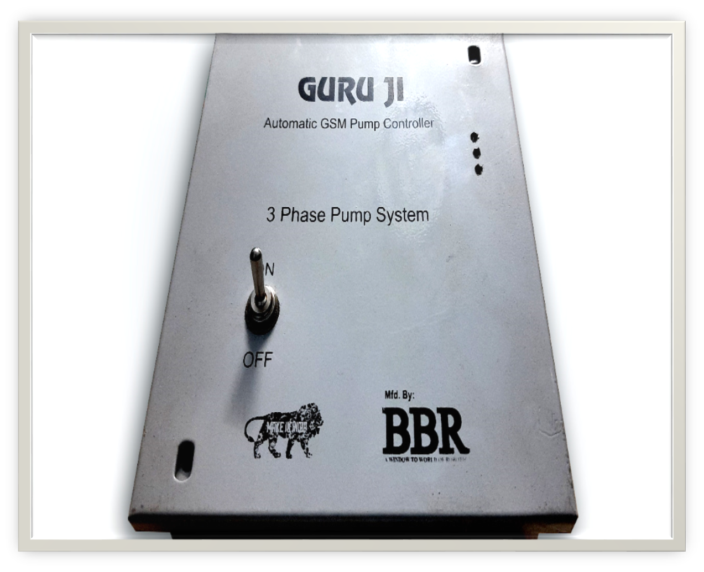
SOLUTION
GSM BASED AUTOMATED SWITCH
A GSM Based switch to control the motor in field through simple mobile call; no need of smartphone and internet connection.
It is also used as controller and communicator for other components.

Slide 5
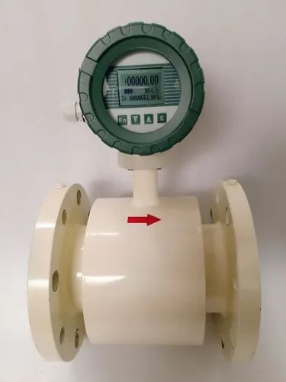
SOLUTION
DIGITAL WATER METER
DIGITAL WATER METER measures the water running through the motor and communicate with GSM based automated switch.

Slide 6
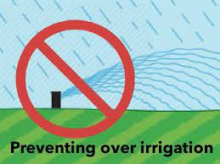

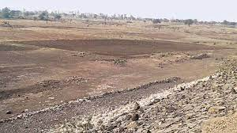
SOLUTION
IRRIGATION MANAGEMENT SYSTEM
It is the combination of both GSM BASED AUTOMATED SWITCH and DIGITAL WATER METER with assistance of local Farmer
Help Centre. Farmer can control and measure the water for irrigation and can avoid under irrigation and/or over irrigation and also can irrigate the crop at right time through the help of local Farmer Help Centre.

Slide 7
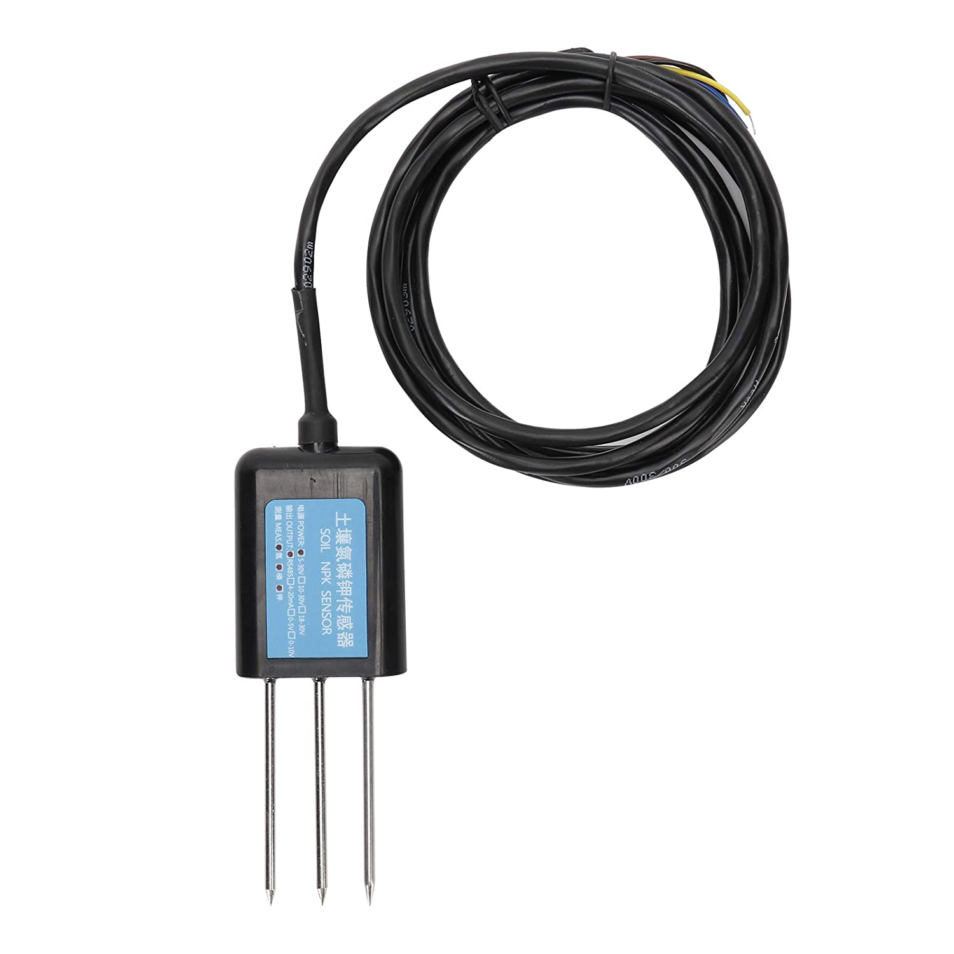
SOLUTION
NPK SENSORS
NPK SENSORS measures the value of Nitrogen , Phosphorus and Potassium and the crop root zone and communicate with GSM based automated switch .It will be used once in a month for measurement in field and can be used at multiple field in one crop season .

Slide 8

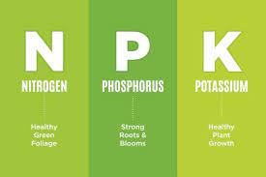
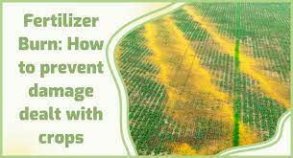
SOLUTION
NUTRITION MANAGEMENT SYSTEM
It is the combination of both NPK SENSORS and GSM BASED AUTOMATED SWITCH along with local Farmer Help Centre. Based on the NPK values from the sensor and crop type Local Farmer Help Centre suggests farmer to provide nutrition needed for the crop. It avoids excessive use of fertilizers.

Slide 9


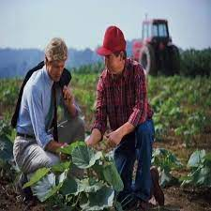
SOLUTION
LOCAL FARMER HELP CENTRE
Local Farmer Help Centre will be a joint venture of Government Organization for farmer welfare like-Kisan Sahayta Kendra ,Agriculture University, Kisan Seva Kendra etc and TECH KAMERA. TECH KAMERA will collect the real time data of important attributes from field and these organization will advise farmer to do needful action for the betterment of the crop yield. Farmer will be served to increase the productivity and safety along with more earning by the “Local Farmer Help Centre”.

Slide 10
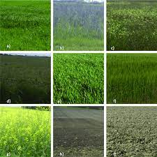
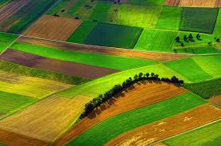

SOLUTION
CROP MAPING
It is a complete consultancy to the farmer about which all crops and in which proportion should be farmed as per water available , soil type and NPK values to get the optimum financial benefits. It will available after two years of installation of GSM Based Switch ,Digital Water Meter and NPK Sensors.

Slide 11



SOLUTION
SECURE CENTRE
Crop yield decrease due to insects attack and/or disease and also due to fluid , drought and many other climatic conditions. Secure Centre provide treatment and prevention suggested by agronomist against insects attack and/or disease through local Farmer Help Centre and also provide insurance to the crop through government and/or non-government organization.

Slide 12

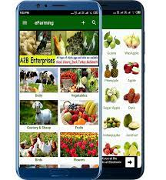

SOLUTION
DIGITAL MANDI
A direct connection between farmers and end users ;farmers have a very simple interface and will get the order simply by call and text SMS.

Slide 13
HOW IT WORKS
Device Combo | Features | Remarks
GSM Based Automated Switch(GURU JI) COMBO A | Mobile control of motor, Voice response, Wide range, Notification of electricity, Notification on over running, Water Limit setup ,Timer Setup | Introductory Product
GURU JI + Digital Water Meter COMBO B | COMBO A + Water Measurement +Irrigation Management System (All features on call through IVR and test SMS) | Avoid under irrigation and Over Irrigation
GURU JI + NPK SENSORS COMBO C | COMBO A +NPK Measurement +Nutrition Management System (All features on call through IVR and test SMS) | Optimum Yield
GURU JI + Digital Water Meter + NPK SENSORS | COMBO B+COMBO +Crop Mapping
Digital Mandi | Any farmer can register and get direct buyers.

Slide 14
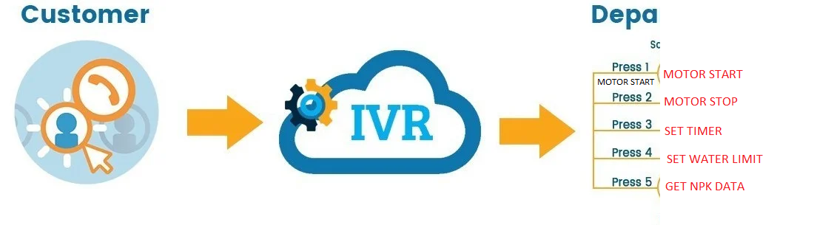

USER INTERFACE
Farmer UI-
Farmer will have all the control of motor , water limit through Digital Water Meter on call through simple IVR in their local language and/or text SMS. Also Farmer will get all the relevant data ,notification through call and/or text SMS.

Slide 15
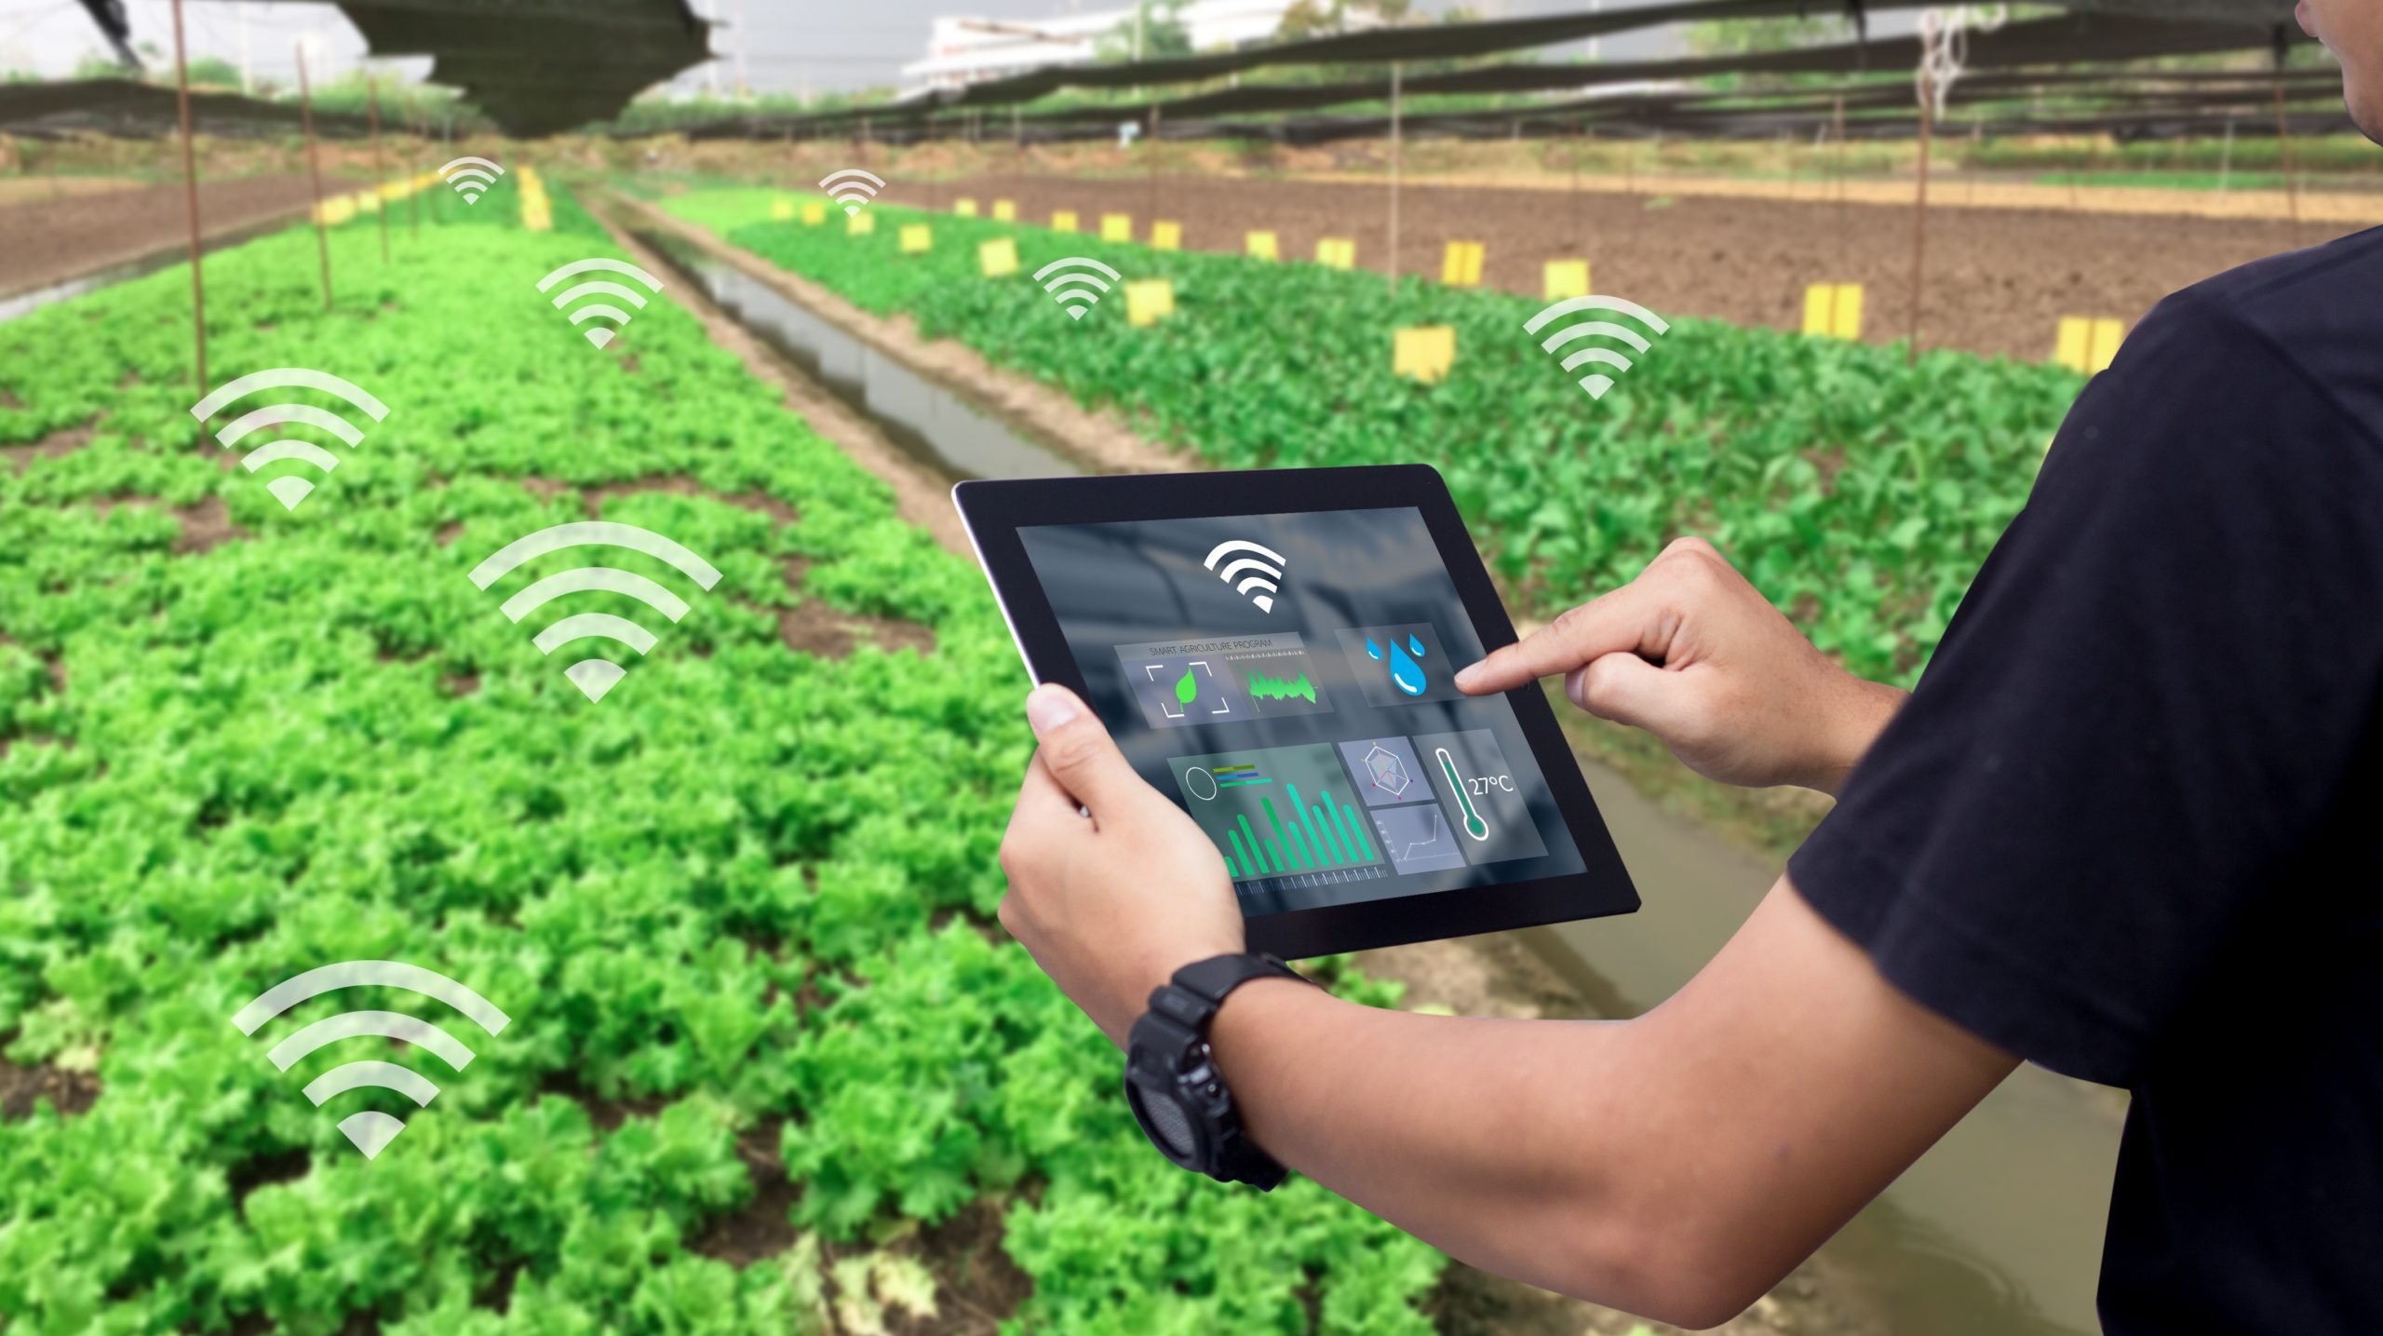

USER INTERFACE
Website UI-
All the control and data will be also available on website for advanced usage. It can be used by agronomist , Local Farmer Help Centre and for other tech beneficiary purpose.

Slide 16
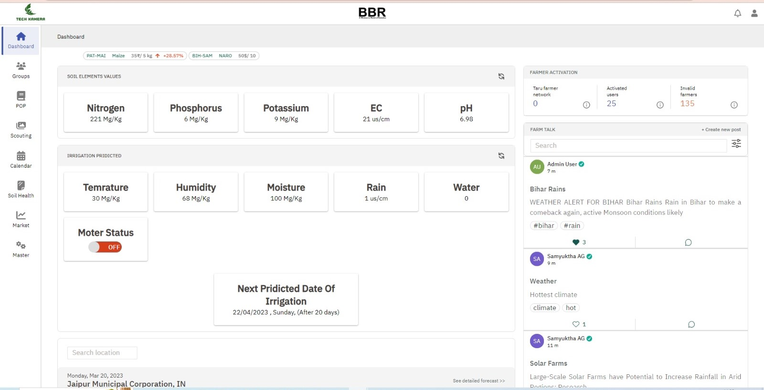
DASHBOARD WITH IRIGATION AND NUTRITION MANAGEMENT

Slide 17
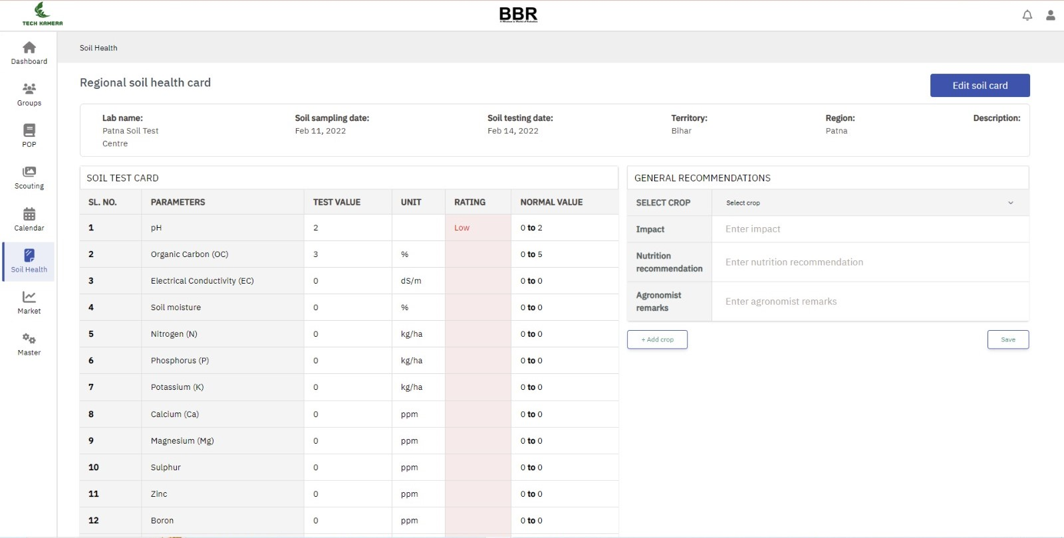
SOIL TESTING DATA

Slide 18
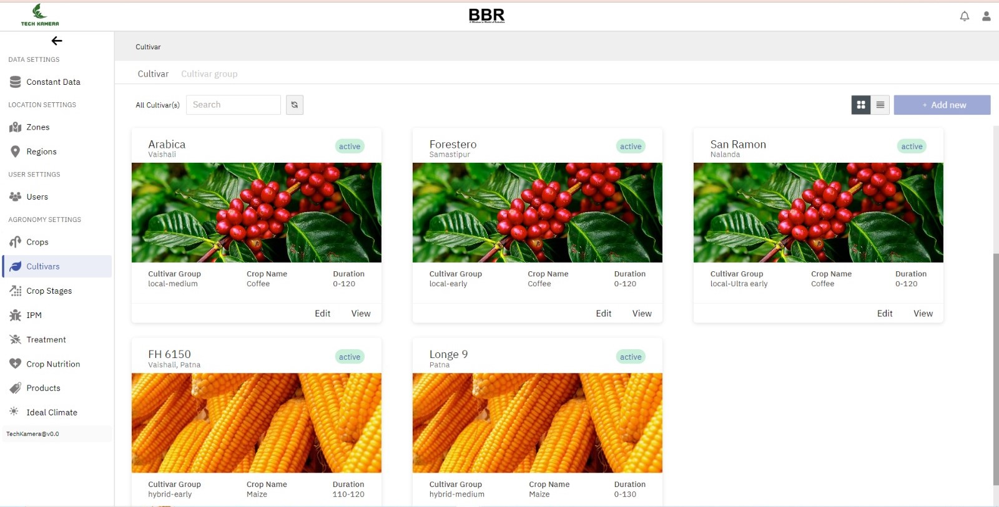
AGRONOMIST/LOCAL FARMER HELP CENTER DATA UI

Slide 19
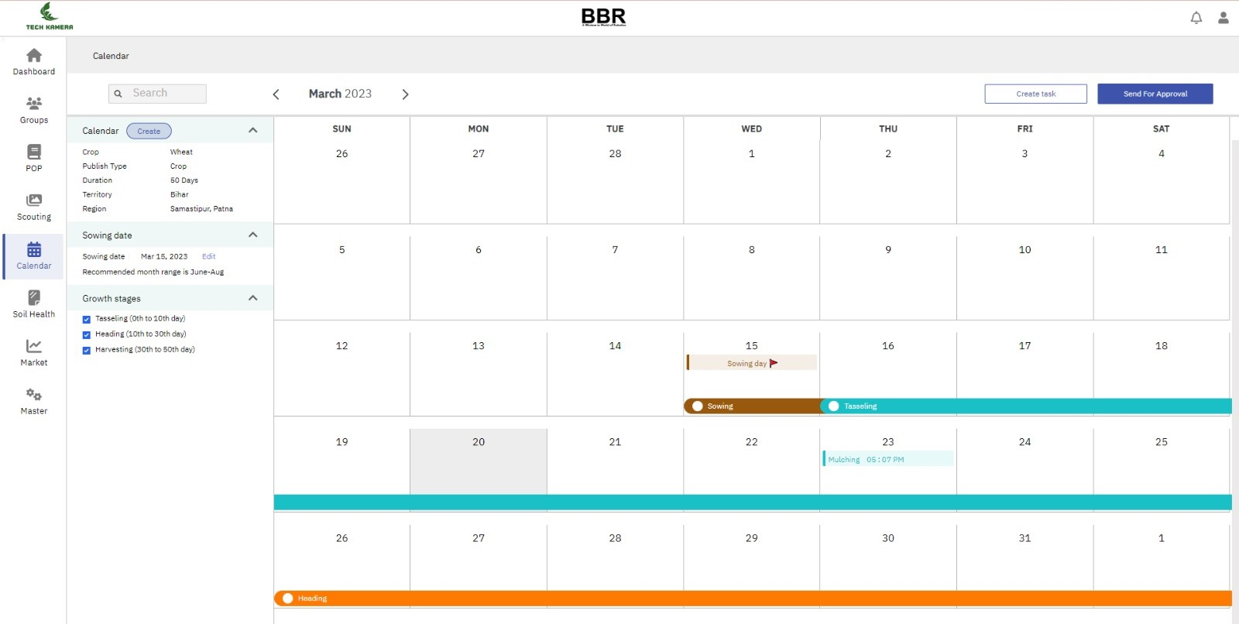
CROP IRRIGATION AND OTHER OPERATION SCEDULE

Slide 20
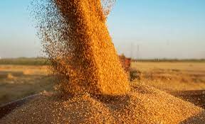





IMPACT
Water Conservation
Optimum Yield
Less use of fertilizers
Risk free farming
Time saving
Better management of large fields
Danger free control
Optimum use of electricity
Less visits
Water usage data/depository for farmers to regulate
water bodies.

Slide 21
TRACTION
Developed MVP for GURU JI , Protect , Protect + and GURU JI Secure technology and developed prototype for GURU JI Mech , Mech + , and digital water meter.
Reached at POC Level of NPK Sensors.
Applied patent for the irrigation regulate and monitoring system
Established Distribution and sales Channel in 15 States of India.
Got PO for 80000 Units in 75 Districts in Uttar Pradesh.
Successfully running at five locations in Rajasthan for 18 months and each product turned on/off the motor 6000 times and completed a growth period of crop.
Received feedback and suggestions from five pilot product user and currently working on some improvements based on their suggestions.
Received feedback and suggestions from five pilot product user and currently working on some improvements based on their suggestions.
Completed a market survey with more than 10000 Farmers.

Slide 22
FINANCIAL
Sr. No. | Item | Price | Quantity | Total Price
1. | GURU JI | 7000 | 250 | 1750000
2. | Digital Water Meter | 4000 | 125 | 500000
3. | NPK SENSORS | 25000 | 10 | 250000
 | Total | 16000 | 425 | 2500000

Slide 23
IMPLIMENTATION PLAN
Stage-C | Timeline | Milestone | Action Plan
Stage-A | 0-1 Months | Installing 250 GURU JI | Manufacturing 250 devices and installing at different location through local channel support
Stage-B | 1-2 Months | Installing 125 Digital Water Meter | Manufacturing 125 devices and selection of farmers doing over irrigation and installing digital water meter.
Stage-C | 2-4 Months | Availing 10 NPK Sensors | Manufacturing 10 devices and selection of farmers using excess fertilizer and installing NPK Sensors. The sensor will be available at 10 different locations.

Slide 24
EXPECTED OUTCOMES
Stopping Over Irrigation
Reducing Water Wastage
Awareness in farmers towards safer and more productive devices
Safety of farmers
Optimum Yield
Motivation to farmers to shift towards modern techniques
No excessive use of fertilizers
More earning

Slide 25
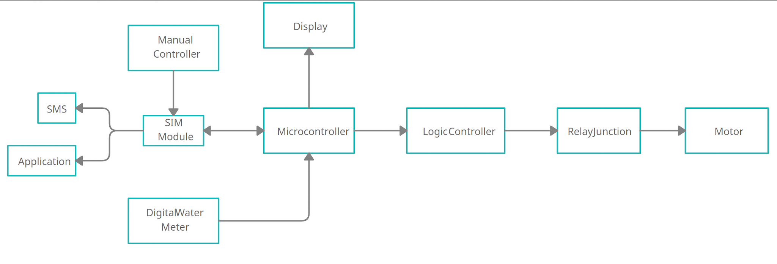
R&D and Technologies
SMART IRRIGATION SYSTEM
Farm Automation
Soil Treatment
Irrigation water Treatment

Slide 26
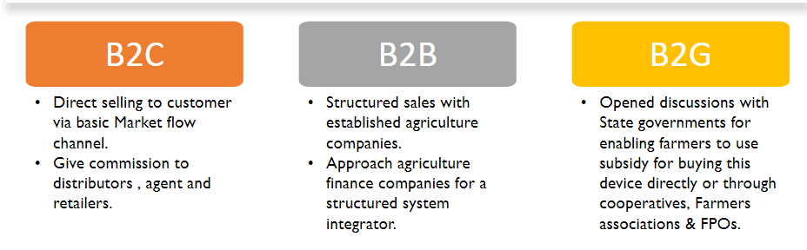
GO TO MARKET STRATEGY

Slide 27
THANK YOU

