Slide 1
Chapter 10: Data Abstraction and Object Orientation
Aaron Bloomfield
CS 415
Fall 2005

Slide 2
Fundamental OO Concepts
Encapsulation
Inheritance
Dynamic Method Binding

Slide 3
Encapsulation
Encapsulation
  Encapsulation allows the programmer to group data and the subroutines that operate on them together in one place, and to hide irrelevant details from the user.
Information Hiding
  Making objects and algorithms invisible to portions of the system that do not need them.

Slide 4
Modules
If a module M exports a type T, the rest of the program can only pass T to subroutines exported from M.
  T is said to be an opaque type.
var Database : module
exports (tuple with (:=, name))
…
type tuple = record
var name : packed array 1..80 of char
…
end tuple
…
What can the code outside the Database module do?
Notes:
This sort of module-based scoping was introduced by Clu, Euclid, and Modula in the 1970’s
Here we are seeing more recent aspects of modern programming languages

Slide 5
Module Changing
Body is Changed
Private Part of Header is Changed
Public Part of Header is Changed
Will never require a change or recompile of the user code
  May require user recompile, but never requires a change in user code.
It is a change to the interface which will often require a user code change

Slide 6
Classes can limit visibility
Private
Protected
Public
Package (in some languages, e.g. Java)
Visible inside the class’s methods
  Visible inside the methods of the class and its descendants.
Visible anywhere the class declaration is in scope

Slide 7
Derived class can restrict visibility
Private
  Protected and public members of base class are private in derived class.
Protected
  Protected and public members of base class are protected in derived class.
Public
  Protected and public members of base class are protected and public in derived class.
Private members of base class aren’t visible in derived class.

Slide 8
Initialization and Finalization

Slide 9
Four Important Issues
Choosing a Constructor
References and Values
Execution Order
Garbage Collection
  We’ve seen that already

Slide 10
Choosing a Constructor
Object-Oriented Languages allow classes to have zero, one or more different constructors.
Two ways to distinguish between constructors
  Different Names
  Different Number and Types of Arguements

Slide 11
Constructors
Eiffel code:
class COMPLEX
creation
new_cartesian, new_polar
…
new_cartesian(x_val, y_va; : REAL) is
…
new_polar(rho, theta : REAL) is
…
class mydata {
public:
mydata(string data);
mydata(int data);
mydata();
};

Slide 12
References and Values
C++ vs. Java
  Java uses reference, C++ you can specify
Reference
  Every object is created explicitly so it is easy to make sure the correct constructor is called.
  More elegant, but requires allocation from heap and extra indirections on every access of the object.
Value
  More efficient but harder to control initialization

Slide 13
Execution Order
If class B is derived from class A, A constructor is called before B constructor
  To get arguments to the A constructor, you must use an intializer list
class foo : bar {
...
}
foo::foo (foo_params) : bar(bar_params) {
…
  The part after the colon is a call to bar’s constructor

Slide 14
Destructors and Garbage Collection
When an object is destroyed, the destructor is called for the derived class first, then the destructors of the base classes are called.
  Reverse order of derivation
Destructors purpose is to return allocated space back to the heap
Many languages provide automatic garbage collection
  Java, Smalltalk, Eiffel, etc.

Slide 15
Java’s finalize() method
In Java, you can override the finalize() method
This allows code to be executed when the object is about to be deleted
  But you shouldn’t extend the object’s lifetime by doing this
  As the finalize() method is only called once per object

Slide 16
Dynamic Method Binding

Slide 17
Polymorphism
A derived class (D) has all the members of its base class (C)
  Class D can be used anytime class C is expected.
  If class D does not hide any publicly visible members of C then D is a subtype of C.
If class D is used in place of class C, this is a form of polymorphism.

Slide 18
Polymorphism Example
class person { …
class student : public person { …
class professor : public person { …
student s;
professor p;
…
person *x = &s;
person *y = &p;

Slide 19
Dynamic vs. Static binding
Static method binding uses the type of the reference:
    s.print_mailing_label();
    p.print_mailing_label();
Dynamic method binding uses the class of the object that is referred/pointed to:
    x->print_mailing_label();
    y->print_mailing_label();

Slide 20
Which one does Java use?
public class Foo {
public String toString() {
return "Foo's toString()";
}
public static void main (String args[]) {
Object bar = new Foo();
System.out.println (bar);
}
}
Java uses dynamic binding

Slide 21
Dynamic method binding
Dynamic method binding: calls to virtual methods are dispatched to the appropriate implementation at run time based on the class of the object
  Simula: virtual methods listed at beginning of class declaration
    CLASS Person;
      VIRTUAL: PROCEDURE PrintMailingLabel;
    BEGIN
      …
    END Person;

Slide 22
Dynamic method binding
  C++: keyword “virtual” prefixes function declaration
    class person {
    public:
      virtual void print_mailing_label ();
      …
    }
This requires keeping a virtual method table along with each object
  More on this in a bit…

Slide 23
Abstract Methods
Bodyless virtual methods
  In C++: called pure virtual method, created by following a procedure declaration with an assignment to zero.
    class person {
      …
    public:
      virtual void print_mailing_label() = 0;

Slide 24
Abstract Classes
Class that contains one or more abstract methods
  Java: called an interface (which has only abstract methods)
Generally not possible to declare object of an abstract class b/c it would be missing at least one member
  But you can do so in C++
Serves as a base for concrete classes.
  Concrete class must provide a definition for every abstract method it inherits
Application to dynamic method binding: allows code that calls methods of objects of a base class, assuming that the concrete methods will be invoked at run time.

Slide 25
Member Lookup: vtable
In dynamic binding each object is represented with a record whose first field contains the address of a virtual method table (vtable) for that object’s class
Our objects are being more complicated for the compiler to manage
  Virtual method tables
  Reference counts
  Etc…

Slide 26
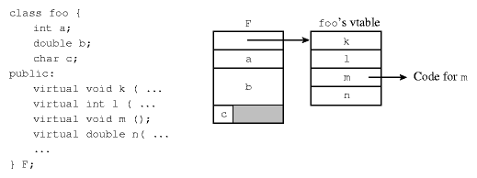
Member Lookup- vtable

Slide 27
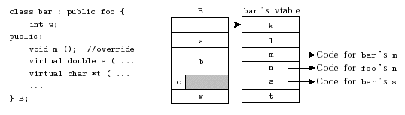
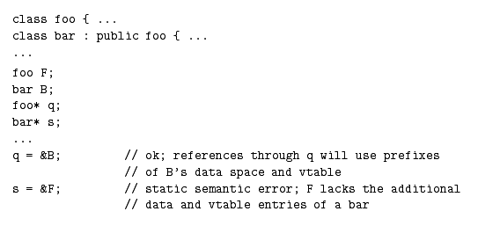
Single Inheritance

Slide 28
Multiple Inheritance

Slide 29
Multiple Inheritance
Derived class with two or more base classes
E.g. - Student class
C++:
class student : public person, public gp_list_node
  { … }
Notes:
elaborate

Slide 30
Multiple Inheritance
Supported in C++, Eiffel, CLOS
Single Inheritance only in Simula, Smalltalk, Modula-3, Ada 95 & Oberon
Java provides limited support – more on this later

Slide 31
Why use MI?
Involves a number of tradeoffs
  Complexity vs. Simplicity
  Efficiency vs. Scalability
How do you decide?
  Does it satisfy the “is a” relationship?
  Is object creation speed a constraint?

Slide 32
Multiple inheritance types
Normal (non-repeated)
Repeated
Shared
Mix-in

Slide 33
Normal (non-repeated) MI
Recall “views” of objects
  data members
  vtables
Compile-time constant offset d

Slide 34
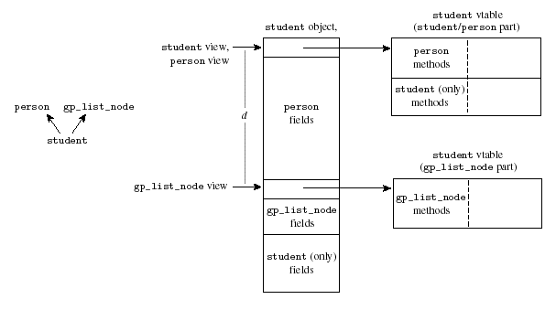

Slide 35
Efficiency (or lack thereof)
May have to determine view dynamically
Results in less time-efficient code
An example implementation may have:
  3 extra cycles, 1 extra memory access over single inheritance
  5 extra cycles, 3 extra memory accesses over static methods

Slide 36
Semantic Ambiguities
What if two base classes have implementations of a shared method?
  Won’t work in Eiffel or C++
  In other languages, you must call methods explicitly, i.e. class::method()

Slide 37
Semantic Ambiguities
What if the relationship below occurs?
This is repeated multiple inheritance
  As one of the ancestors is repeated in the parent class of one of the descendents
gp_list_node
person
gp_list_node
student
professor
student_prof

Slide 38
Replicated Multiple Inheritance
Default in C++
Ex. gp_list_node
Can only directly access one level deep
  To access a student view of gp_list_node, you must first assign a student_prof pointer into a student or professor pointer

Slide 39
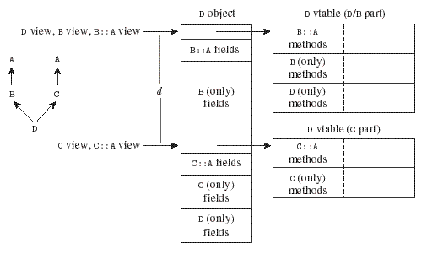

Slide 40
Shared Multiple Inheritance
Default in Eiffel
Ex. Person
Still have problem when inheriting overridden methods

Slide 41
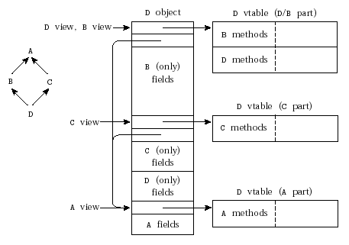

Slide 42
Mix-in Inheritance
Only one base class can contain method definitions
  The other base class(es) contain only abstract methods
Only type of MI supported in Java, but not necessarily MI
Traditional Java inheritance uses keyword extends
Mix-in (interface) inheritance in Java uses keyword implements
  Done via interfaces

Slide 43
Java Interfaces
public class String extends Object implements Serializable, CharSequence, Comparable;
Java interfaces can contain definition prototypes and static variables

