Slide 1
Building Java Programs
Chapter 8
Lecture 8-3: Encapsulation, this
reading: 8.5 - 8.6
self-checks: #13-17
exercises: #5

Slide 2

Abstraction
Don't need to know this
Can focus on this!!

Slide 3
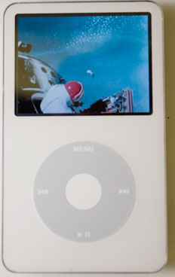
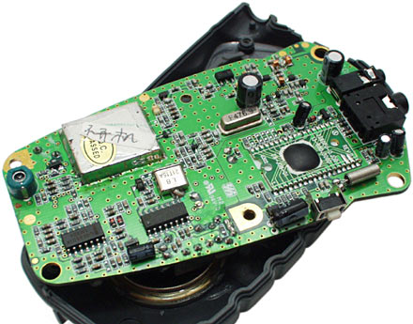
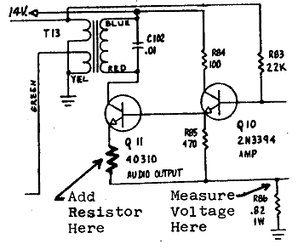
Encapsulation
encapsulation: Hiding implementation details of an
object from its clients.
  Encapsulation provides abstraction.
    separates external view (behavior) from internal view (state)
  Encapsulation protects the integrity of an object's data.

Slide 4
Private fields
A field can be declared private.
  No code outside the class can access or change it.
  private type name;
  Examples:
  private int id;
  private String name;
Client code sees an error when accessing private fields:
  PointMain.java:11: x has private access in Point
  System.out.println("p1 is (" + p1.x + ", " + p1.y + ")");
  ^

Slide 5
Accessing private state
We can provide methods to get and/or set a field's value:
  // A "read-only" access to the x field ("accessor")
  public int getX() {
  return x;
  }
  // Allows clients to change the x field ("mutator")
  public void setX(int newX) {
  x = newX;
  }
  Client code will look more like this:
  System.out.println("p1: (" + p1.getX() + ", " + p1.getY() + ")");
  p1.setX(14);

Slide 6
Point class, version 4
  // A Point object represents an (x, y) location.
  public class Point {
  private int x;
  private int y;
  public Point(int initialX, int initialY) {
  x = initialX;
  y = initialY;
  }
  public double distanceFromOrigin() {
  return Math.sqrt(x * x + y * y);
  }
  public int getX() {
  return x;
  }
  public int getY() {
  return y;
  }
  public void setLocation(int newX, int newY) {
  x = newX;
  y = newY;
  }
  public void translate(int dx, int dy) {
  x = x + dx;
  y = y + dy;
  }
  }

Slide 7
Client code, version 4
public class PointMain4 {
public static void main(String[] args) {
// create two Point objects
Point p1 = new Point(5, 2);
Point p2 = new Point(4, 3);
// print each point
System.out.println("p1: (" + p1.getX() + ", " + p1.getY() + ")");
System.out.println("p2: (" + p2.getX() + ", " + p2.getY() + ")");
// move p2 and then print it again
p2.translate(2, 4);
System.out.println("p2: (" + p2.getX() + ", " + p2.getY() + ")");
}
}
OUTPUT:
p1 is (5, 2)
p2 is (4, 3)
p2 is (6, 7)

Slide 8
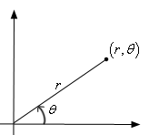
Benefits of encapsulation
Provides abstraction between an object and its clients.
Protects an object from unwanted access by clients.
  A bank app forbids a client to change an Account's balance.
Allows you to change the class implementation.
  Point could be rewritten to use polar coordinates
  (radius r, angle θ), but with the same methods.
Allows you to constrain objects' state (invariants).
  Example: Only allow Points with non-negative coordinates.

Slide 9
The keyword this
  reading: 8.7

Slide 10
this
this : A reference to the implicit parameter.
  implicit parameter: object on which a method is called
Syntax for using this:
  To refer to a field:
  this.field
  To call a method:
  this.method(parameters);
  To call a constructor from another constructor:
  this(parameters);

Slide 11
Variable names and scope
Usually it is illegal to have two variables in the same scope with the same name.
  public class Point {
  int x;
  int y;
  ...
  public void setLocation(int newX, int newY) {
  x = newX;
  y = newY;
  }
  }
  The parameters to setLocation are named newX and newY to be distinct from the object's fields x and y.

Slide 12
Variable shadowing
An instance method parameter can have the same name as one of the object's fields:
  // this is legal
  public void setLocation(int x, int y) {
  ...
  }
  Fields x and y are shadowed by parameters with same names.
  Any setLocation code that refers to x or y will use the parameter, not the field.

Slide 13
Avoiding shadowing w/ this
  public class Point {
  private int x;
  private int y;
  ...
  public void setLocation(int x, int y) {
  this.x = x;
  this.y = y;
  }
  }
Inside the setLocation method,
  When this.x is seen, the field x is used.
  When x is seen, the parameter x is used.

Slide 14
Multiple constructors
It is legal to have more than one constructor in a class.
  The constructors must accept different parameters.
  public class Point {
  private int x;
  private int y;
  public Point() {
  x = 0;
  y = 0;
  }
  public Point(int initialX, int initialY) {
  x = initialX;
  y = initialY;
  }
  ...
  }

Slide 15
Constructors and this
One constructor can call another using this:
  public class Point {
  private int x;
  private int y;
  public Point() {
  this(0, 0); // calls the (x, y) constructor
  }
  public Point(int x, int y) {
  this.x = x;
  this.y = y;
  }
  ...
  }

