Slide 1
ChatApp
Team-Eniacs Coders
TeamMates :-
Vivek Rathi
Gaurav katare
anuj modi

Slide 2
Key Features
Registering of User – Signup Facility
Fast Log in Facility
One to One person Chatting
Group Chatting
File Sharing
Works on your own Network.

Slide 3
Concepts and Tools Used
Sockets Programming using Java
Multithreading
JDBC for Database Connection
MySQL DataBase is used
Java NetBeans GUI

Slide 4
Utility of This Software
You Can use this ChatApp in your own Local Network Connection
You can create any type of connection using Mobile Hotspot or wired Connection among users.
You can use this for your project preparation among your team and send messages to each other .
Internet is not always needed for communication.

Slide 5
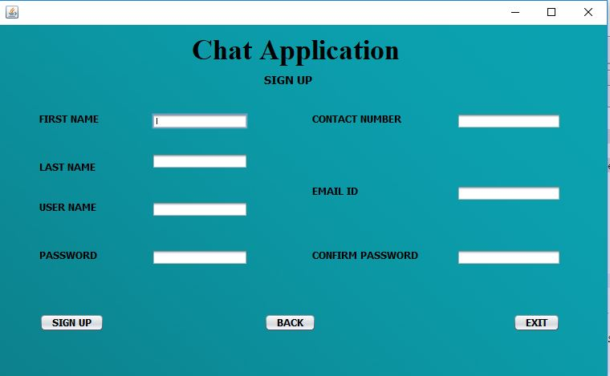
Working of Our Project

Slide 6
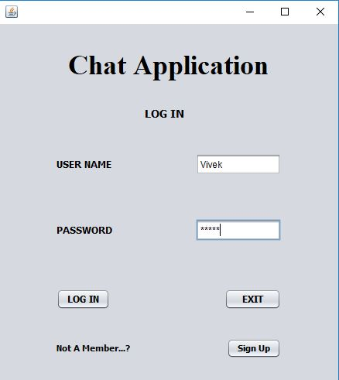
Login of user

Slide 7
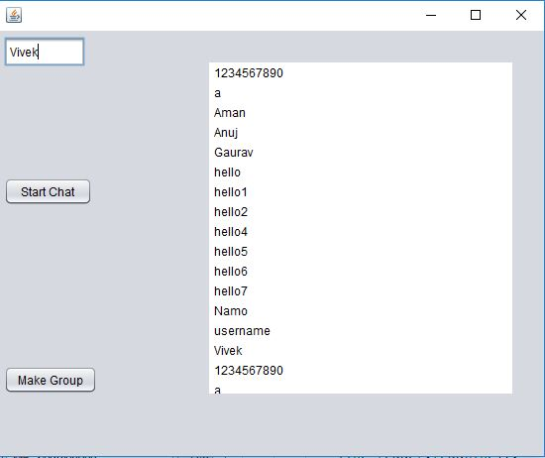
Startup Window

Slide 8
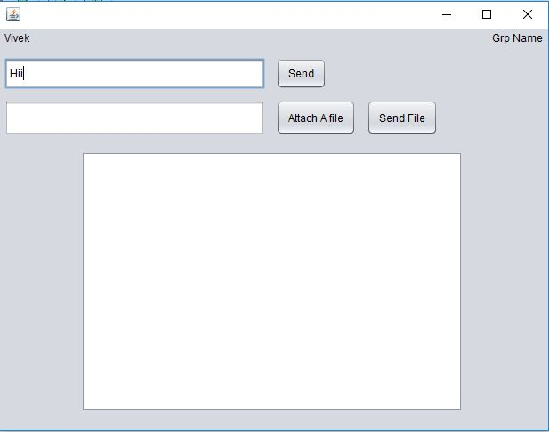
Chatting Window

Slide 9
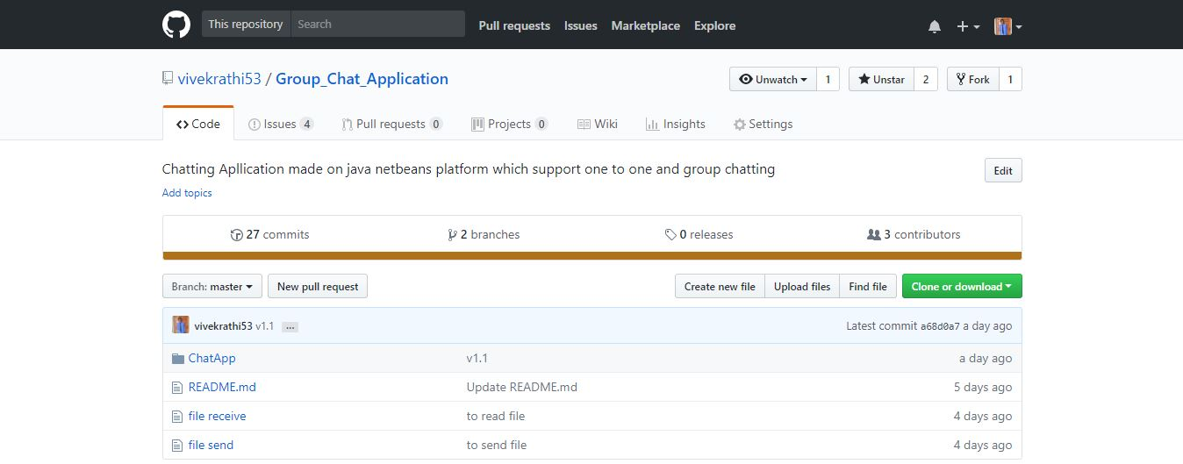
How do we made it?
LEARNING NEW STUFFS
COLLABORATING ON GITHUB – www.github.com/vivekrathi53/Group_Chat_Application

Slide 10
Thank You

