Slide 1
Analyzing trends in ACT composite scores across USA states from 2017 - 2019

Slide 2
PROBLEM STATEMENT
Analyze trends in ACT composite scores across all states from 2017 to 2019 in order to give suggestions / feedbacks on ways to improve the scores in some specific states.
Identify states with low participation rates and suggest ways to improve them

Slide 3
WHAT IS ACT?
An Entrance exam used by most colleges and universities to make admissions decisions
It is a multiple-choice, pencil-and-paper test administered by ACT
Its ”rival” is the SAT which is probably more popular outside of the United States

Slide 4
WHAT IS ACT?
It has 4 sections:
Reading
Math
Science Reasoning
English
Essay Writing (Optional for extra fee)
Cost of the test ranges from USD 50 to 70.
Some states even offer it for free for students doing it for the 1st time
For some states, it is a mandatory requirement (10 states)

Slide 5
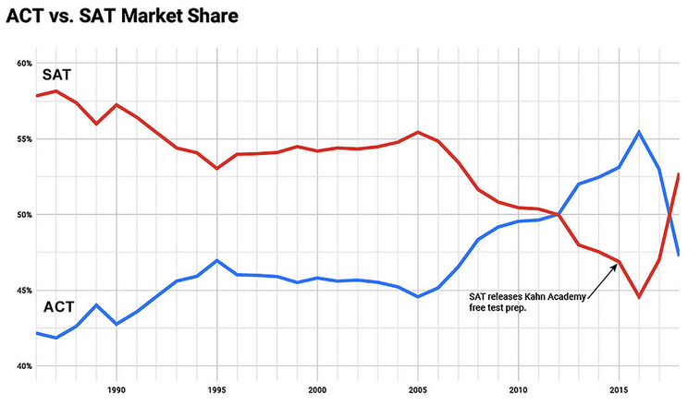
ACT vs SAT

Slide 6
DATASETS USED
act_2017.csv
act_2018.csv
act_2019.csv
These datasets have the following information:
State
Participation Rate
Composite Score (Average for that state)

Slide 7
WORKFLOW FOR DATASETS
Participation 2017
Participation 2018
Participation 2019
Average Participation

Slide 8
WORKFLOW FOR DATASETS
Composite 2017
Composite 2018
Composite 2019
Average Composite

Slide 9
WORKFLOW FOR DATASETS
Composite 2017
Composite 2019
Rate of Change of composite scores

Slide 10
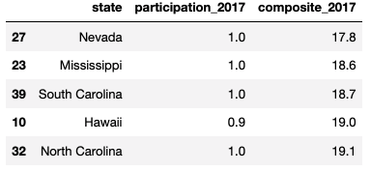
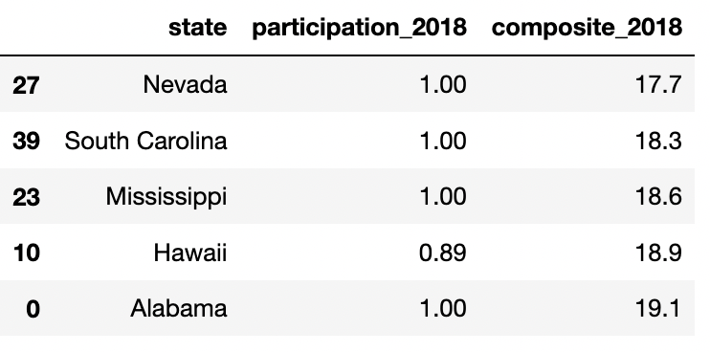
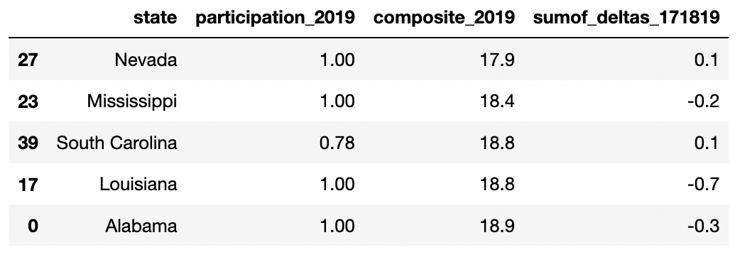
LOWEST COMPOSITE SCORES
Composite 2017
Composite 2018
Composite 2019

Slide 11
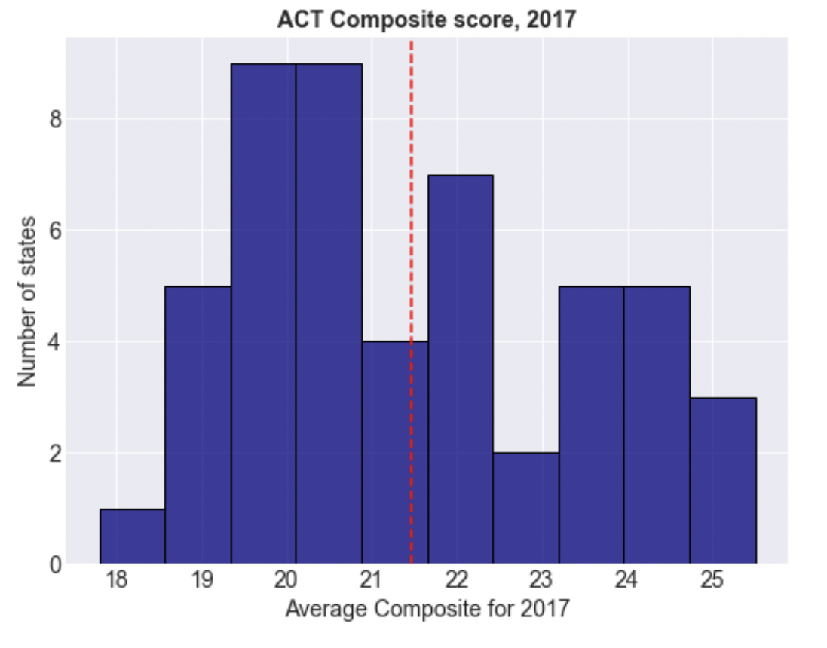
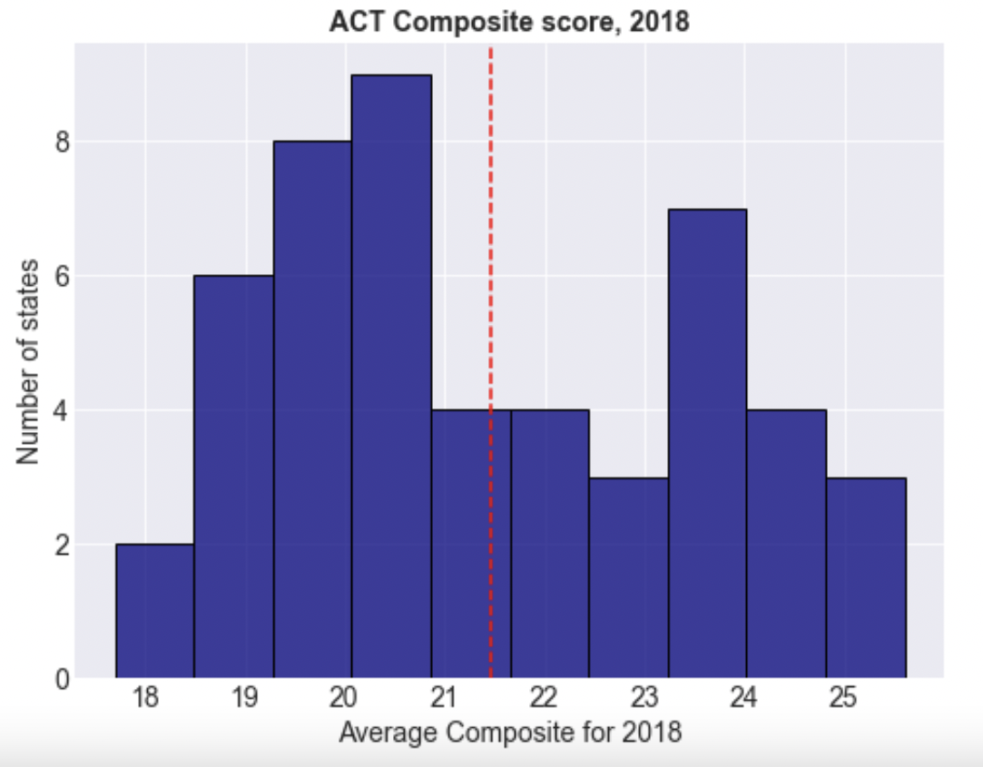
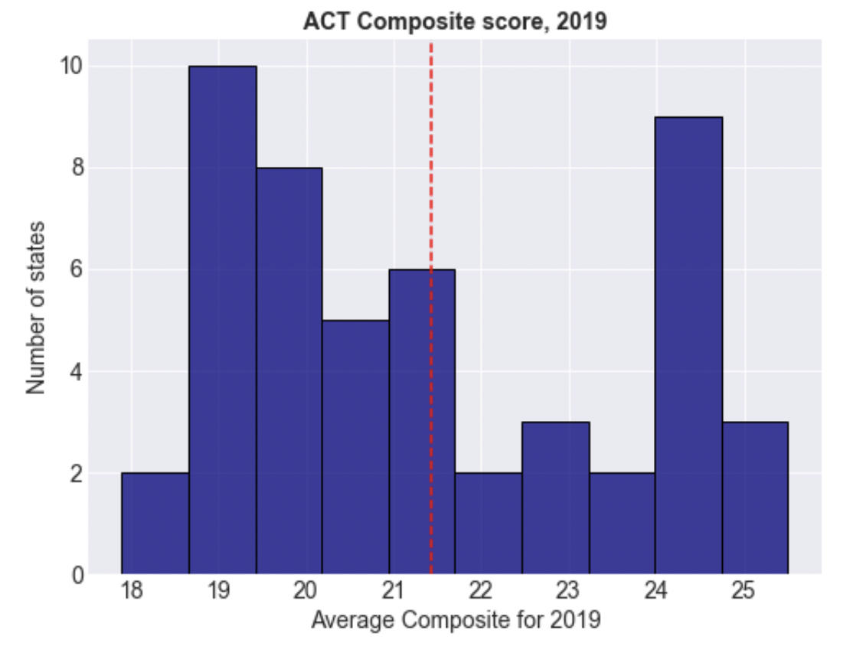
COMPOSITE SCORES HISTOGRAMS

Slide 12
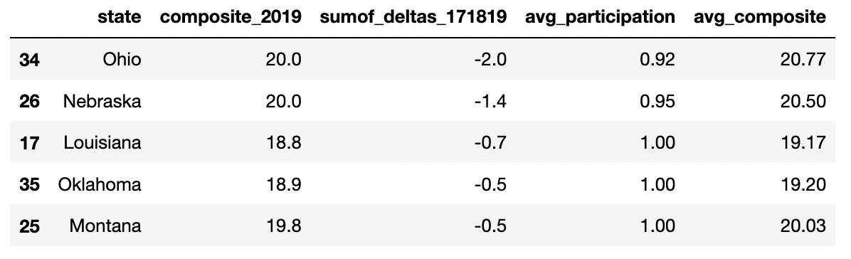
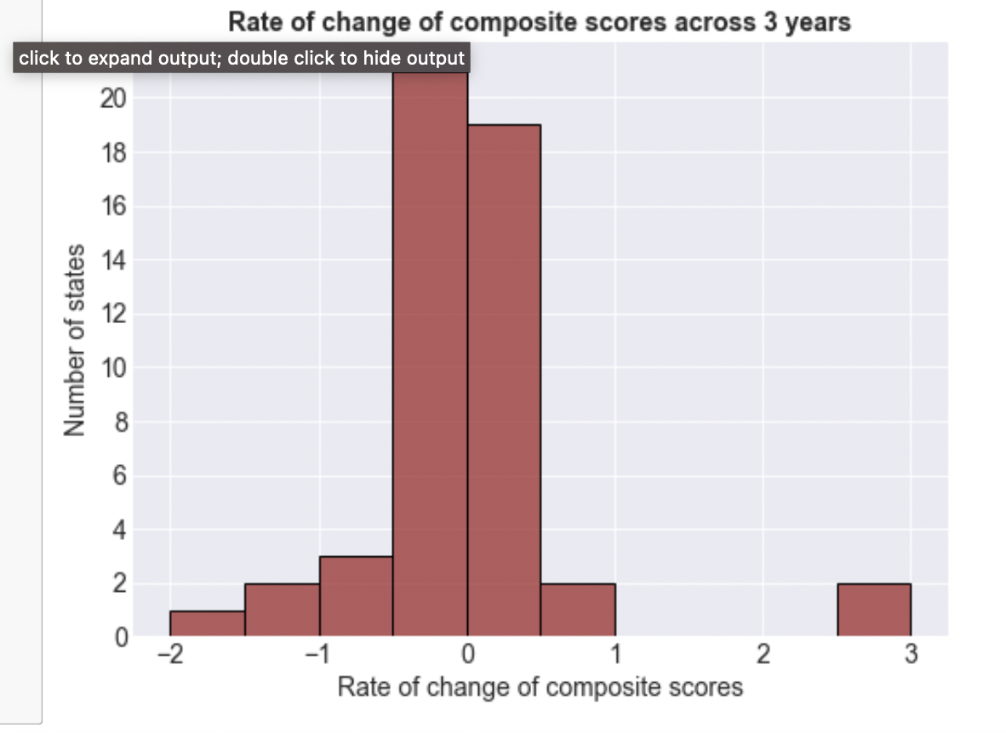
MOST DETERIORATED STATES

Slide 13
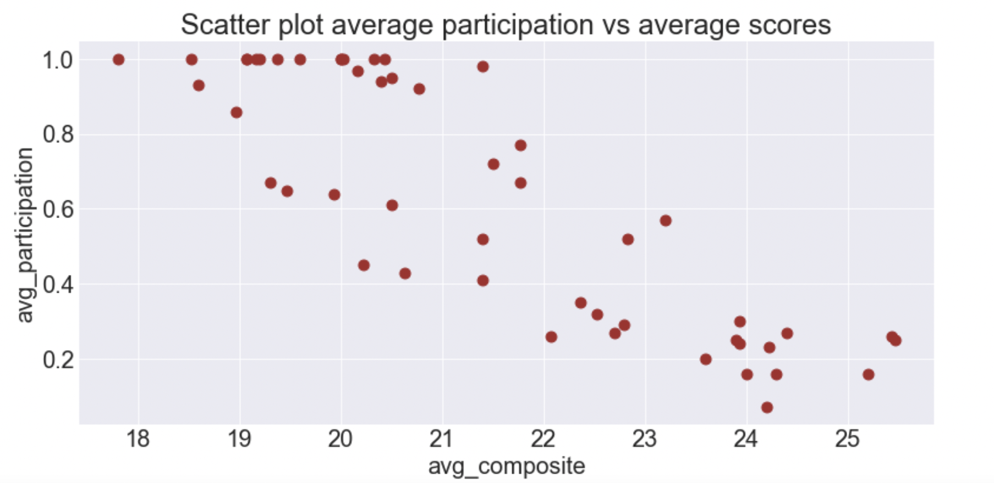
INVERSION RELATIONSHIP BETWEEN PARTICIPATION AND SCORES

Slide 14
CONCLUSIONS
The number of states that have been doing well have continued to improve while those that have been performing mediocre have become slightly worse.
The worse performing states in terms of average ACT scores are Nevada, Mississippi, South Carolina, Louisiana, Hawaii, Alabama and North Carolina.
In terms of highest rate of deterioration, its Ohio, Nebraska, Louisiana, Oklahoma and Montana.
There is an inverse relationship between ACT scores and participation rates. This could be because as more students write the exam, they bring the average down. In the states that have higher scores and lower participation rates, they could be having stiff competition from students writing SATs.

Slide 15
RECOMMENDATIONS
1. The amount of funding needs to increase in states with lower ACT scores that is mentioned above. The following can be done:
- There needs to be a re-evaluation of the ACT coaching classes and how its run.
- More students should be encouraged to attend coaching sessions
- As participation rates are high anyways, the ACT test rates can be subsidized. Some states already give a free test for the first time. For these cases, they can provide subsidies for the 2nd test.
- ACT is known for being more straightforward than other tests. This could be used as a key marketing point
2. There should be an in-depth analysis done on the states that are performing well in terms of ACT scores and use those findings and techniques to implement in the less performing states.
3. For the states with the lower participation rates (Maine, Rhode Island, New Hampshire, Delaware and Pennsylvania), more awareness and reach about ACT should be created to tap into students, especially those who are stronger in English and weaker in Math.

