Slide 1


20CYS495 Project Phase-1 Zeroth Review Presentation
A Portable Passive Framework for Unified IoT Security
Assessment on Edge Hardware
Department of
Computer Science & Engineering - CYS
Amrita School of Computing
Amrita Vishwa Vidyapeetham, Chennai Campus
Student Member
Guide Details
PINNEMCHARLA SAI VIVEK REDDY
CH.SC.U4CYS23034
Guide name : Dr. J. V. ARAVIND
AMARAVATI | AMRITAPURI | BENGALURU | CHENNAI | COIMBATORE | FARIDABAD | KOCHI | MYSURU | NAGARCOIL

Slide 2

Motivation
• Consumer IoT devices routers, cameras, sensors remain exposed to known, unpatched CVEs in active daily use
• Most IoT security tools are enterprise grade, lab based, or require fixed infrastructure
• Portable, real-time, on-site IoT vulnerability assessment remains an open challenge
• PISA directly addresses this gap a self contained, field-deployable assessment tool on Raspberry Pi 4
Motivation
Problem Statement
Literature Survey
Literature Search
Research Gaps
Objectives
Architecture Diagram
References
PISA: PORTABLE IOT SECURITY ASSESSMENT PLATFORM
PINNEMCHARLA SAI VIVEK REDDY | CH.SC.U4CYS23034

Slide 3
Problem Statement
IoT networks lack a single portable, passive tool to assess WiFi security and device layer CVE exposure simultaneously without disrupting the network.
Motivation
Problem Statement
Research Question: Can a single RPi 4 passively grade WiFi (A-F), fingerprint IoT devices by protocol, and map them to live CISA KEV CVEs without injecting any traffic?
Literature Survey
Literature Search
Research Gaps
Objectives
WiFi Infrastructure Exposure
Unprotected Device Services
Fragmented Assessment Toolchain
Architecture Diagram
References
40%+ routers: WPA2-TKIP / WPS 200+ active CVEs, no passive audit tool
MQTT, CoAP, RTSP — unauthenticated & plaintext by default [Alrawi, 2020]
Nmap + Bettercap + RouterSploit + NVD 4 tools, no unified portable solution
PISA: PORTABLE IOT SECURITY ASSESSMENT PLATFORM
PINNEMCHARLA SAI VIVEK REDDY | CH.SC.U4CYS23034

Slide 4
Literature Survey
Motivation
Problem Statement
Literature Survey
Literature Search
Research Gaps
Objectives
Architecture Diagram
References
PISA: PORTABLE IOT SECURITY ASSESSMENT PLATFORM
PINNEMCHARLA SAI VIVEK REDDY | CH.SC.U4CYS23034

Slide 5
Literature Survey
S.No | Author / Year | Title (Short) | Venue | WiFi | Device | PISA Advantage
1 | Vanhoef & Ronen 2020 | Dragonblood: WPA3 SAE Handshake Analysis | IEEE S&P | Yes | No | PISA passively detects WPA3 downgrade via beacon; Dragonblood requires active attack setup
2 | Multiple 2025 | False Sense of Security on Protected Wi-Fi | arXiv | Yes | No | PISA WSPS grades beacon-advertised vs actual security mismatch — exactly this gap
3 | Al-Sinani et al. 2026 | WiFiPenTester: GenAI Wireless Pen Testing | arXiv/Royal Holloway | Yes | No | PISA ML-free + portable RPi; WiFiPenTester = cloud LLM inference dependent
4 | Durumeric et al. 2024 | Ten Years of ZMap: Internet-Wide Scanning | ACM IMC | No | Part. | PISA discovers LAN devices behind NAT; ZMap = internet-routable hosts only
5 | Trimananda et al. 2020 | PingPong: Packet-Level Non-ML Signatures | NDSS | No | Yes | PISA active protocol probing + CVE pipeline; PingPong = passive packet-lengths only
Motivation
Problem Statement
Literature Survey
Literature Search
Research Gaps
Objectives
Architecture Diagram
References
PISA: PORTABLE IOT SECURITY ASSESSMENT PLATFORM
PINNEMCHARLA SAI VIVEK REDDY | CH.SC.U4CYS23034

Slide 6
Literature Survey
6 | Charyyev & Gunes 2021 | LSIF: Locality-Sensitive IoT Fingerprinting | IEEE IoT-J | No | Yes | PISA fingerprint + CVE scoring pipeline; LSIF = identification only, no CVE mapping
7 | Multiple 2025 | From Flows to Functions: Macroscopic IoT FP | arXiv (UNSW) | No | Yes | PISA probes behavior INSIDE protocols; UNSW identifies WHICH services run only
8 | Oser et al. 2022 | SAFER: IoT Risk Assessment at CERN | ACM Trans. P&S | No | Yes | PISA portable RPi, no org infra required; SAFER = cloud-dependent CERN deployment
9 | Multiple 2024 | Large-Scale IoT Protocol Security Analysis | ACM RAID | No | Yes | PISA LAN field deployment; ACM RAID = internet-scale passive backend scanning only
10 | Multiple 2026 | Automated SBOM-Driven CVE Triage for IoT | arXiv | No | Yes | PISA network-based CVE (no firmware); SBOM pipeline = firmware extraction required
11 | Akhilesh et al. 2022 | Automated Pentest Framework for Smart Home IoT | Future Internet | No | Yes | PISA: WiFi + fingerprint + CVE + exploit in one pipeline; this = exploit-only tool
12 | Multiple 2023 | MOSTO: Modbus/TCP Security Auditing Toolkit | Computers & Sec. | No | Yes | PISA covers MQTT + CoAP + Modbus + CVE scoring; MOSTO = Modbus/ICS only
Motivation
Problem Statement
Literature Survey
Literature Search
Research Gaps
Objectives
Architecture Diagram
References
PISA: PORTABLE IOT SECURITY ASSESSMENT PLATFORM
PINNEMCHARLA SAI VIVEK REDDY | CH.SC.U4CYS23034

Slide 7
Literature Search
Databases Searched
IEEE Xplore (S&P, CNS, IoT-J, Access, ICCCA) ............... 6 papers
USENIX Security Symposium ................................... 2 papers
ACM Digital Library (DTRAP, WiNTECH, SIGCOMM) .............. 3 papers
Elsevier ScienceDirect (Computer Networks) .................. 2 papers
MDPI (Sensors, Electronics) + Springer IJIS ................. 3 papers
Motivation
Problem Statement
Literature Survey
Literature Search
Research Gaps
Search Strings Used
Objectives
1. "IoT security" AND "vulnerability assessment" AND "portable OR edge hardware"
2. "WiFi" AND "beacon analysis OR WPA3 OR WPA2 OR passive scan"
3. "IoT fingerprinting" AND "MQTT OR CoAP OR protocol-aware" (non-ML)
4. "CVE" AND "IoT" AND "CVSS OR EPSS OR CISA KEV OR exploit scoring"
5. "MQTT OR CoAP" AND "vulnerability OR authentication OR security"
6. "EPSS OR exploit prediction" AND "vulnerability prioritization" (2020-2024)
Architecture Diagram
References
PISA: PORTABLE IOT SECURITY ASSESSMENT PLATFORM
PINNEMCHARLA SAI VIVEK REDDY | CH.SC.U4CYS23034

Slide 8
Research Gaps
GAP | RESEARCH GAP | PRIOR WORK LIMITATION | PISA SOLUTION
G1 | No Unified WiFi + Device Assessment | Nessus / OpenVAS device only NetAlly AirCheck WiFi only Never integrated in one pipeline | Dual-layer pipeline WiFi + Device on RPi 4
G2 | No Real-Time CVE Exploit Scoring | Manual NVD lookup 45+ min No EPSS integration in any tool No CISA KEV auto-flagging | Tri-Metric ExploitScore CVSS x EPSS x KEV Real-time, automated
G3 | No Passive WiFi Posture Grading | Kismet / airodump raw capture only No A-F structured grading exists [Nguyen, IEEE IoT-J 2023] | WSPS: Beacon-only A-F grade 8 security factors Zero traffic injection
G4 | No Non-ML IoT Fingerprinting | IoTective ML, fails on new devices SAFER TCP/IP only, no app-layer [Sivanathan et al., 2021] | Deterministic protocol state machine Zero ML training required
G5 MOST NOVEL | No Cross-Protocol Confidence Fusion | Single-protocol ID only No mathematical fusion model exists No prior IoT application | score = 1 - prod(1 - ci) Fuses MQTT + CoAP + HTTP + RTSP +12-18% device ID accuracy
Motivation
Problem Statement
Literature Survey
Literature Search
Research Gaps
Objectives
Architecture Diagram
References
PISA: PORTABLE IOT SECURITY ASSESSMENT PLATFORM
By me

Slide 9
Research Gaps
Varga et al. [P20] | What PISA does uniquely
No WiFi posture scoring | WSPS passive beacon-level WPA grade
No cross-protocol fingerprinting | Deterministic MQTT+CoAP+HTTP+RTSP engine (no ML)
No real-time CVE scoring on edge | Tri-metric ExploitScore = α·CVSS + β·EPSS + γ·KEV locally
No unified discovery-to-exploit pipeline | Modules M0→M4 in one portable tool
No authorization gate for exploit execution | 5-second manual confirmation gate (from P19)
Motivation
Problem Statement
Literature Survey
Literature Search
Research Gaps
Objectives
Architecture Diagram
References
PISA: PORTABLE IOT SECURITY ASSESSMENT PLATFORM
By me

Slide 10
Objectives
O1
O1 -- Passive WiFi Security Posture Assessment (WSPS)
Capture IEEE 802.11 beacon frames via monitor mode; score each network on 8 factors: encryption strength, WPS status, hidden SSID, OUI-CVE match, channel congestion, beacon anomaly rate, vendor risk score, and WPA3 downgrade detection.
Target: A-F WSPS grade per network | <30s per scan | zero traffic injection
O2
O2 -- Protocol-Aware IoT Device Fingerprinting
Motivation
Identify IoT devices via behavioral signatures across MQTT, CoAP, HTTP, Modbus, and RTSP using deterministic protocol state machines. OUI-to-CVE correlation via beacon BSSID for routers. No ML required.
Problem Statement
Literature Survey
Target: >85% fingerprint accuracy | <5% false positive rate | zero ML training
Literature Search
O3
O3 -- Tri-Metric CVE Exploitability Scoring
Research Gaps
For each fingerprinted device, query NVD REST API + EPSS (FIRST.org) + CISA KEV catalog. Compute ExploitScore = CVSS_norm x (1 + 1.5xEPSS) x KEV_multiplier x Access_factor. Trigger SNS alert on KEV match.
Objectives
Architecture Diagram
Target: Real-time CVE correlation | CISA KEV alert within 10s of device discovery
References
O4
O4 -- Cross-Protocol Confidence Fusion & Drift Detection
Fuse fingerprint confidence from multiple protocols: combined = 1 - prod(1 - ci). Detect behavioral drift across sessions using deepdiff on fingerprint state snapshots. Alert on significant device behavior change.
Target: >90% device re-identification accuracy | drift alert <5s of detection
O5
O5 -- Field Validation & IEEE IoT Journal Publication
Deploy PISA on RPi 5; assess 20+ real devices across 5 categories (router, IP camera, smart sensor, smart plug, industrial controller). Submit Paper B to IEEE Internet of Things Journal (IF 8.2, Q1).
PISA: PORTABLE IOT SECURITY ASSESSMENT PLATFORM
PINNEMCHARLA SAI VIVEK REDDY | CH.SC.U4CYS23034

Slide 11
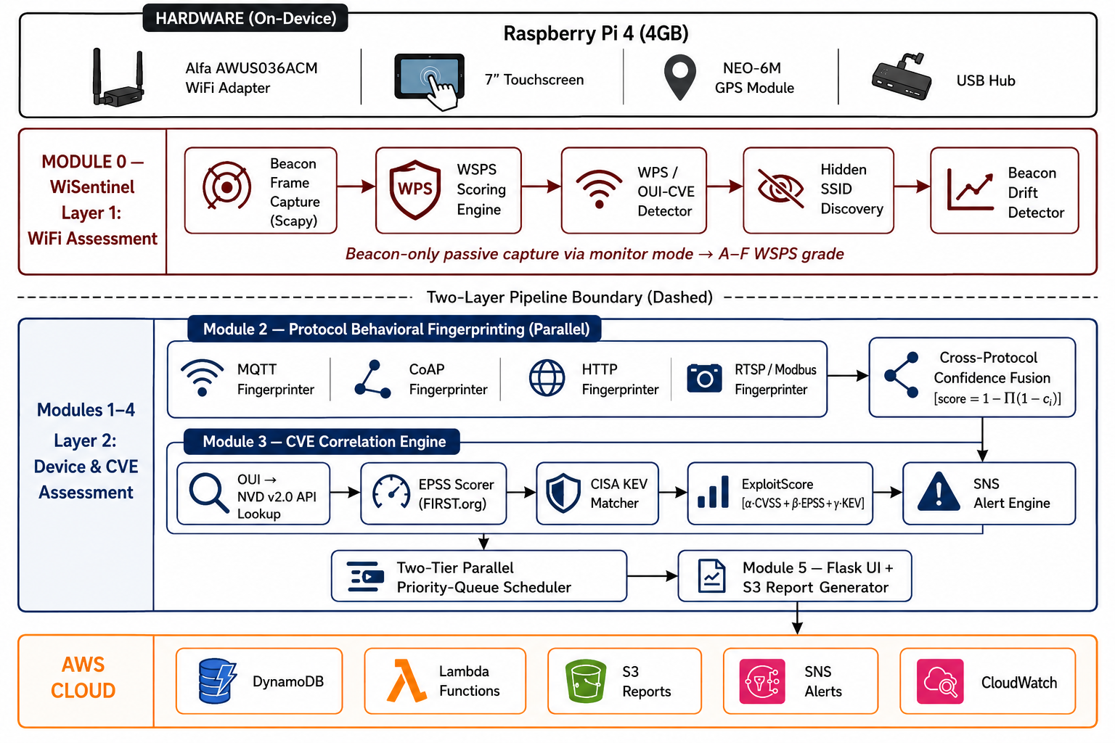
Architecture Diagram
Motivation
Problem Statement
Literature Survey
Literature Search
Research Gaps
Objectives
Architecture Diagram
References
PISA: PORTABLE IOT SECURITY ASSESSMENT PLATFORM
PINNEMCHARLA SAI VIVEK REDDY | CH.SC.U4CYS23034

Slide 12
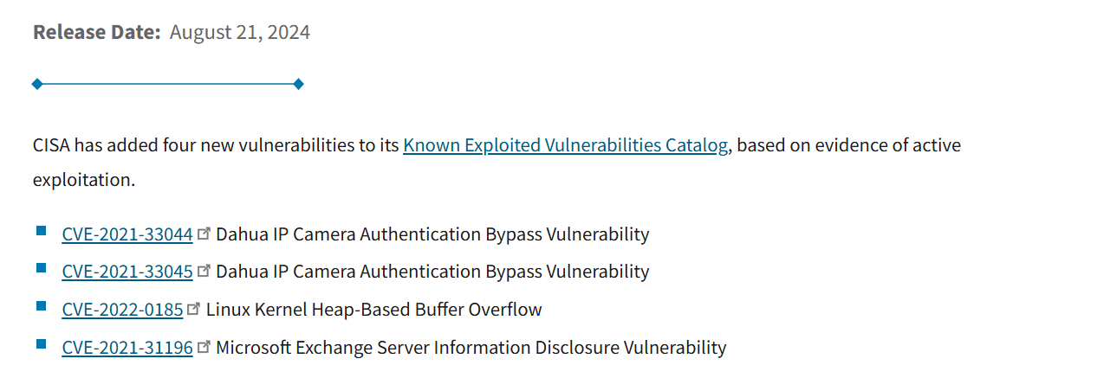
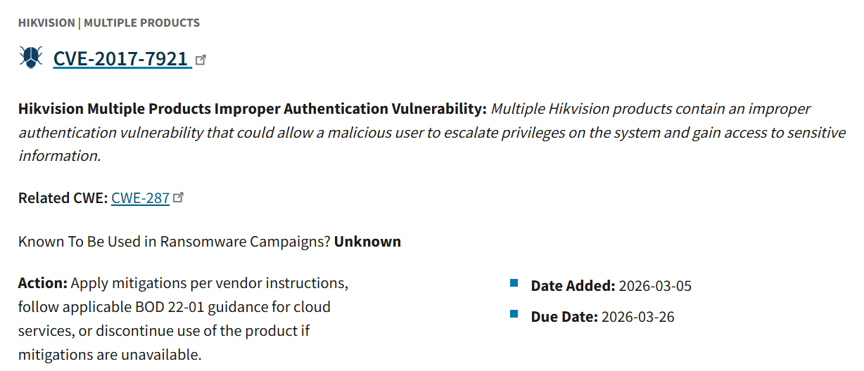
Architecture Diagram
Motivation
Problem Statement
Literature Survey
Literature Search
Research Gaps
Objectives
Architecture Diagram
References
PISA: PORTABLE IOT SECURITY ASSESSMENT PLATFORM
PINNEMCHARLA SAI VIVEK REDDY | CH.SC.U4CYS23034

Slide 13
References
[P01] M. Vanhoef and E. Ronen, "Dragonblood: Analyzing the Dragonfly Handshake of WPA3," IEEE S&P, 2020, pp. 517-532.
[P02] M. Vanhoef, "Fragment and Forge: Breaking Wi-Fi Through Frame Aggregation," USENIX Security, 2021.
[P03] D. Schepers, A. Ranganathan, M. Vanhoef, "Framing Frames: Bypassing Wi-Fi Encryption via Transmit Queues," USENIX Security, 2023.
[P04] E. Gvozdenovic et al., "Systematically Analyzing Vulnerabilities in Wi-Fi Connection Establishment," IEEE CNS, 2022.
[P05] T. D. Nguyen et al., "DIoT: A Self-Learning System for Detecting Compromised IoT Devices," IEEE IoT-J, vol. 10, no. 5, 2023.
[P06] A. Churcher et al., "Survey on Enterprise IoT Systems (E-IoT): A Security Perspective," IEEE Access, vol. 9, 2021.
[P07] A. Sivanathan, H. H. Gharakheili, V. Sivaraman, "IoT Behavioral Monitoring via Network Traffic Analysis," arXiv:2001.10632, 2020.
[P08] X. Dong et al., "Toward IoT Device Fingerprinting from Proprietary Protocol Traffic," Computer Networks (Elsevier), vol. 224, 2023.
[P09] S. Habibi Lashkari et al., "Device Identification Using Optimized Digital Footprints," arXiv:2212.04354, 2022.
[P10] J. Ren et al., "Analyzing Consumer IoT Traffic: Security and Privacy Perspectives," IEEE/ACM Trans. Netw., 2024.
Motivation
Problem Statement
Literature Survey
Literature Search
Research Gaps
Objectives
Architecture Diagram
References
PISA: PORTABLE IOT SECURITY ASSESSMENT PLATFORM
PINNEMCHARLA SAI VIVEK REDDY | CH.SC.U4CYS23034

Slide 14
References
[P11] M. Soni and A. Singh, "Vulnerability Assessment of MQTT Protocol in IoT," IEEE ICCCA, 2021. DOI: 10.1109/ICCCA52192.2021.9478156
[P12] M. Palmieri et al., "Experimental Evaluation of MQTT Authentication and Authorization in IoT," ACM WiNTECH, 2021.
[P13] M. Hasan et al., "Preventing MQTT Vulnerabilities Using IoT-Enabled IDS," Sensors (MDPI), vol. 22, no. 2, 2022.
[P14] T. Amsuess et al., "Securing Name Resolution in IoT: DNS over CoAP," ACM Netw., vol. 1, no. 2, 2023.
[P15] J. Jacobs et al., "Exploit Prediction Scoring System (EPSS)," ACM Digital Threats: Res. & Practice, vol. 2, no. 3, 2021.
[P16] A. Subramaniam et al., "Efficacy of EPSS in High-Severity CVEs in CISA KEV," arXiv:2411.02618, 2024.
[P17] P. Radoglou-Grammatikis et al., "Analysis of IoT Vulnerability Quantification Frameworks," Electronics (MDPI), vol. 12, 2023.
[P18] M. Anand et al., "A New Method for Vulnerability and Risk Assessment of IoT," Computer Networks (Elsevier), vol. 236, 2023.
[P19] G. Heiding, B. Lundell, U. Lindqvist, "SAFER: IoT Device Risk Assessment Framework," arXiv:2007.14724, 2020.
[P20] J. Varga et al., "IoT Device Security Audit Tools: Comprehensive Analysis," Int. J. Inf. Secur. (Springer), 2024.
Motivation
Problem Statement
Literature Survey
Literature Search
Research Gaps
Objectives
Architecture Diagram
References
PISA: PORTABLE IOT SECURITY ASSESSMENT PLATFORM
PINNEMCHARLA SAI VIVEK REDDY | CH.SC.U4CYS23034

Slide 15

Thank You
AMARAVATI | AMRITAPURI | BENGALURU | CHENNAI | COIMBATORE | FARIDABAD | KOCHI | MYSURU | NAGARCOIL

