Slide 1
AI Resume Shortlisting Agent
AI-Powered Recruiter Workflow Automation System
Submitted by: Vivek Sagar Arora B.Tech CSE (AI/ML)
TCI AI Enablement Internship Assignment

Slide 2
Problem Statement
Traditional resume screening is:
Manual
Time-consuming
Difficult to scale
Prone to human bias
Recruiters often receive hundreds of resumes for a single role, making shortlisting inefficient.
Goal
Build an AI-powered system to automate:
Resume parsing
Candidate evaluation
Resume ranking
Shortlisting workflow

Slide 3
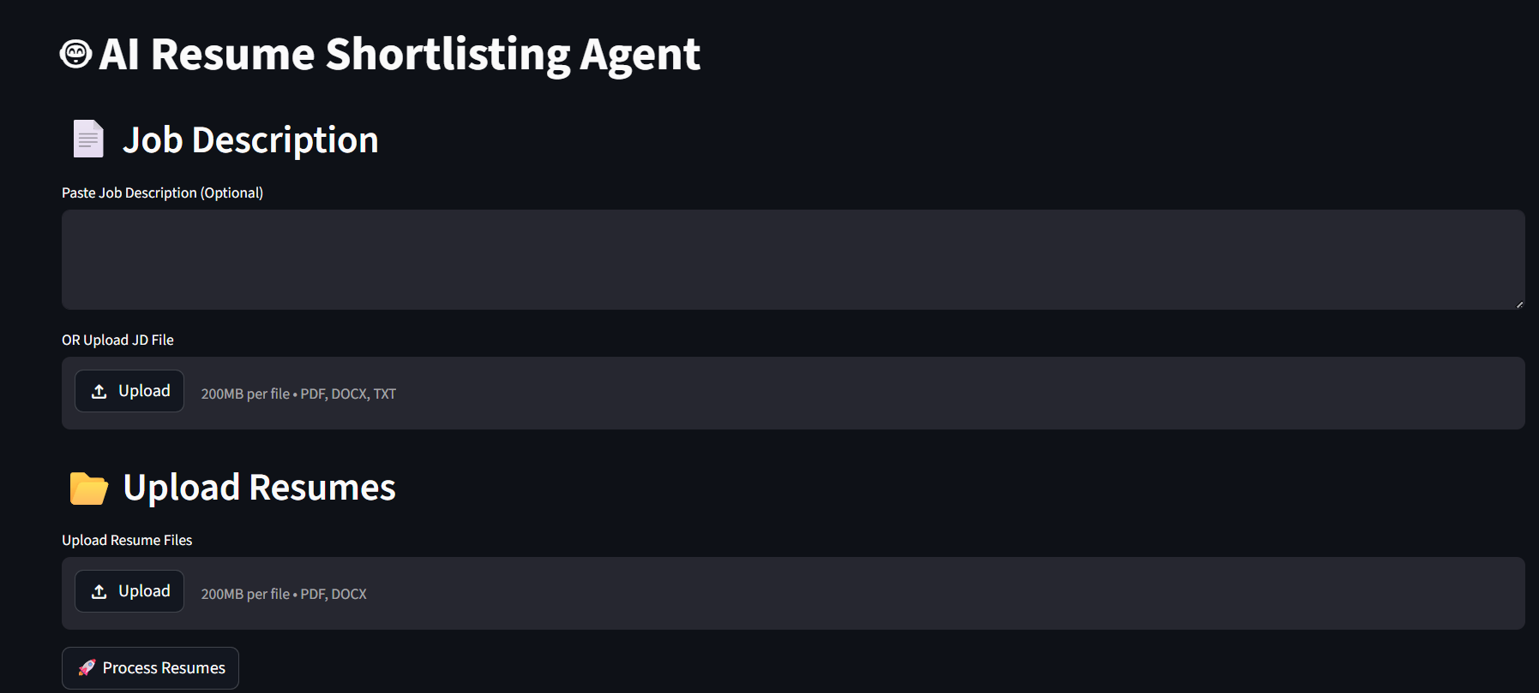
Proposed Solution
The AI Resume Shortlisting Agent:
Accepts Job Descriptions
Parses resumes automatically
Performs semantic similarity matching
Generates rubric-based AI scores
Ranks candidates automatically
Supports HR override decisions
Exports shortlist reports
Generates downloadable CSV and PDF shortlist reports
main_ui

Slide 4
System Architecture
Agent Workflow
Job Description Upload ↓ Resume Upload ↓ Resume Parsing ↓ Embedding Generation ↓ Semantic Similarity Matching ↓ Rubric-Based AI Scoring ↓ Candidate Ranking ↓ HR Override ↓ CSV/PDF Report Export

Slide 5
Technology stack
Tech Stack
Component | Technology
Frontend | Streamlit
Language | Python
NLP Framework | Sentence Transformers
Embedding Model | all-MiniLM-L6-v2
Resume Parsing | PyMuPDF, python-docx
Similarity Metric | Cosine Similarity
Data Handling | Pandas
PDF Generation | ReportLab
Why These Technologies?
Fast and lightweight semantic matching
Easy AI workflow development
Efficient text embedding generation
Simple interactive recruiter interface

Slide 6
Scoring & Ranking System
Candidate Evaluation Rubric
Dimension | Rubric
Skills Match | 30%
Experience Relevance | 25%
Education & Certifications | 15%
Projects / Portfolio | 20%
Communication Quality | 10%
Recommendation Categories
Hire
Maybe
Reject
Recommendations generated using semantic similarity thresholds and weighted rubric scoring.

Slide 7
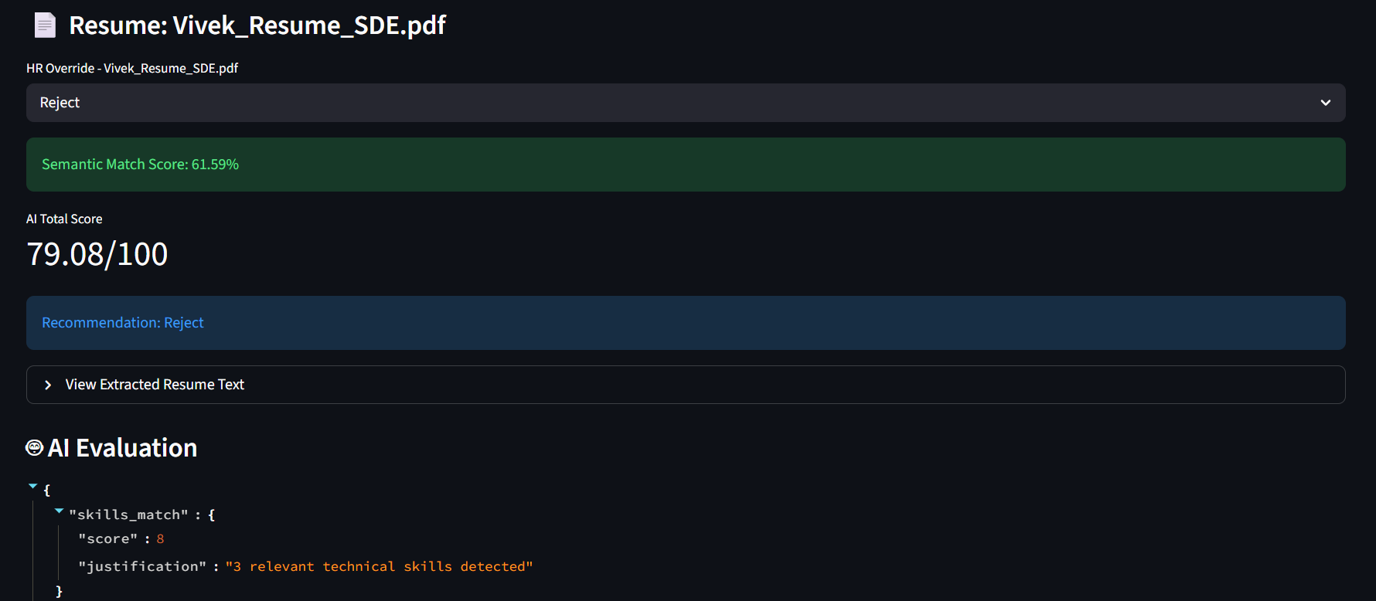

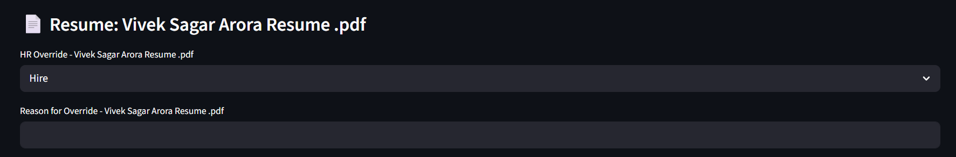
Results & Output
The system successfully:
Semantic Match Scores
AI Evaluation Scores
Candidate Rankings
HR Override Decisions
CSV Report Export
PDF Report Export
ai_evaluation
hr_override
PDF/CSV_export

Slide 8
Security Mitigations
Security Risk Mitigation
Risk | Mitigation
API Key Exposure | Stored using .env
Prompt Injection | Structured evaluation flow
PII Exposure | Local processing
Hallucination Risk | Rule-based scoring
Unauthorized Access | Localhost deployment

Slide 9
Learnings
Key Learnings
Understanding semantic similarity matching
Resume parsing using NLP pipelines
Embedding-based candidate evaluation
Human-in-the-loop AI workflows
Building interactive AI applications using Streamlit
Importance of structured scoring systems

Slide 10
Future Scope
Future Improvements
LLM-powered evaluation
LinkedIn profile integration
Cloud deployment
Authentication system
Recruiter analytics dashboard
Vector database integration

