Slide 1

AIONOS Customer Resolution Agent
Agentic AI Factory – Assignment 3
Submitted By: Vivek Sagar Arora | Program: B.Tech CSE (AI/ML), Bennett University

Slide 2
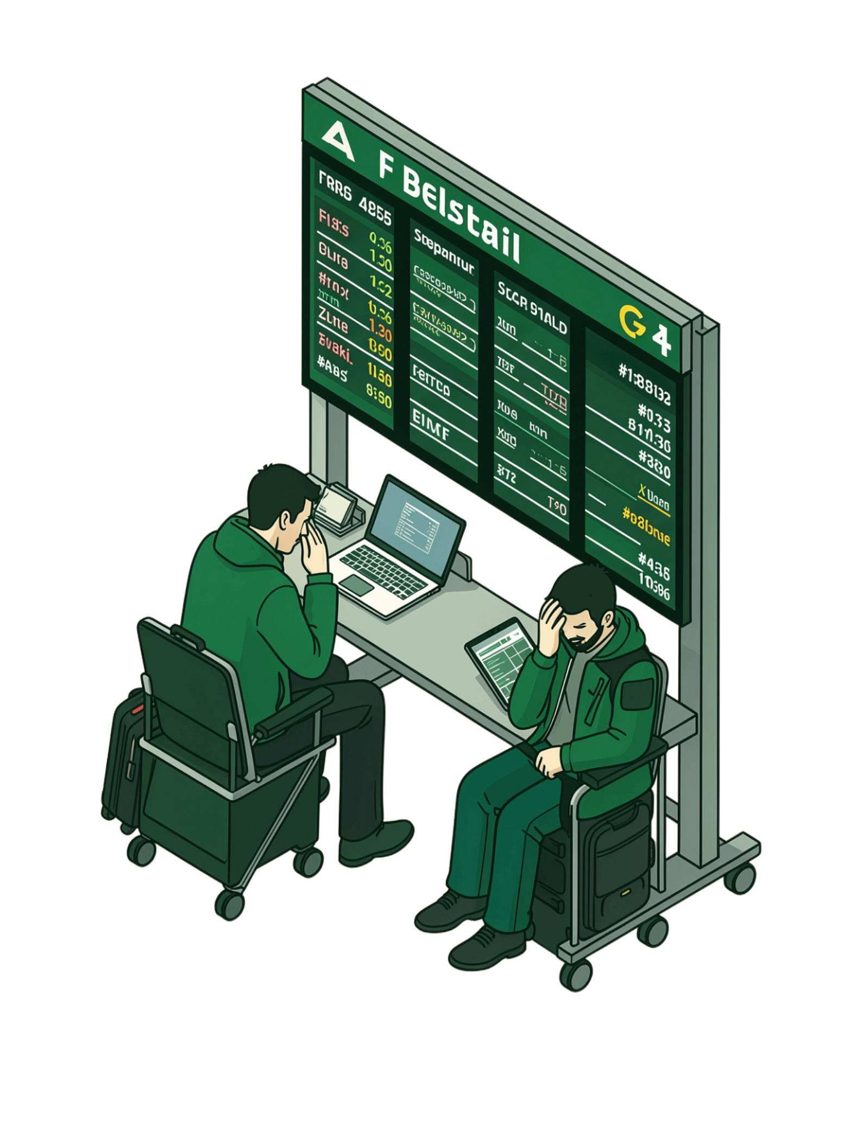
Airline Disruption Customer Support
The Problem
The Challenge
Flight cancellations, delays, refund requests, rebooking requests, and compensation disputes create high-pressure support scenarios.
Support agents must follow company policies, avoid unauthorized compensation, handle frustrated customers professionally, and escalate special cases appropriately.
The Objective
Build a customer-facing resolution agent that provides policy-compliant resolutions for airline disruption scenarios.

Slide 3


Agent Goals
Understand Requests Accurately
Parse and interpret customer queries with precision, using only provided customer and policy data.
Recommend Correct Actions
Apply policy rules to recommend the right resolution — rebooking, refund, or compensation.
Handle & Escalate Professionally
Manage angry customers with empathy, escalate when authority is insufficient, and maintain a transparent decision process.
Generate Customer Responses
Produce clear, policy-compliant, customer-facing resolution messages.

Slide 4




Solution Architecture
Technology Stack
Policy Evaluation
Key Features
Customer Query
Cancellation handling
Delay compensation handling
Refund processing
Escalation detection
Loyalty-tier support
Decision Engine
Response Generation
Python
Streamlit
Rule-Based Engine

Slide 5

System Architecture
End-to-end data flow from customer input to resolution output:
Customer Query
Data Layer
Policy Engine
Decision Layer

Slide 6
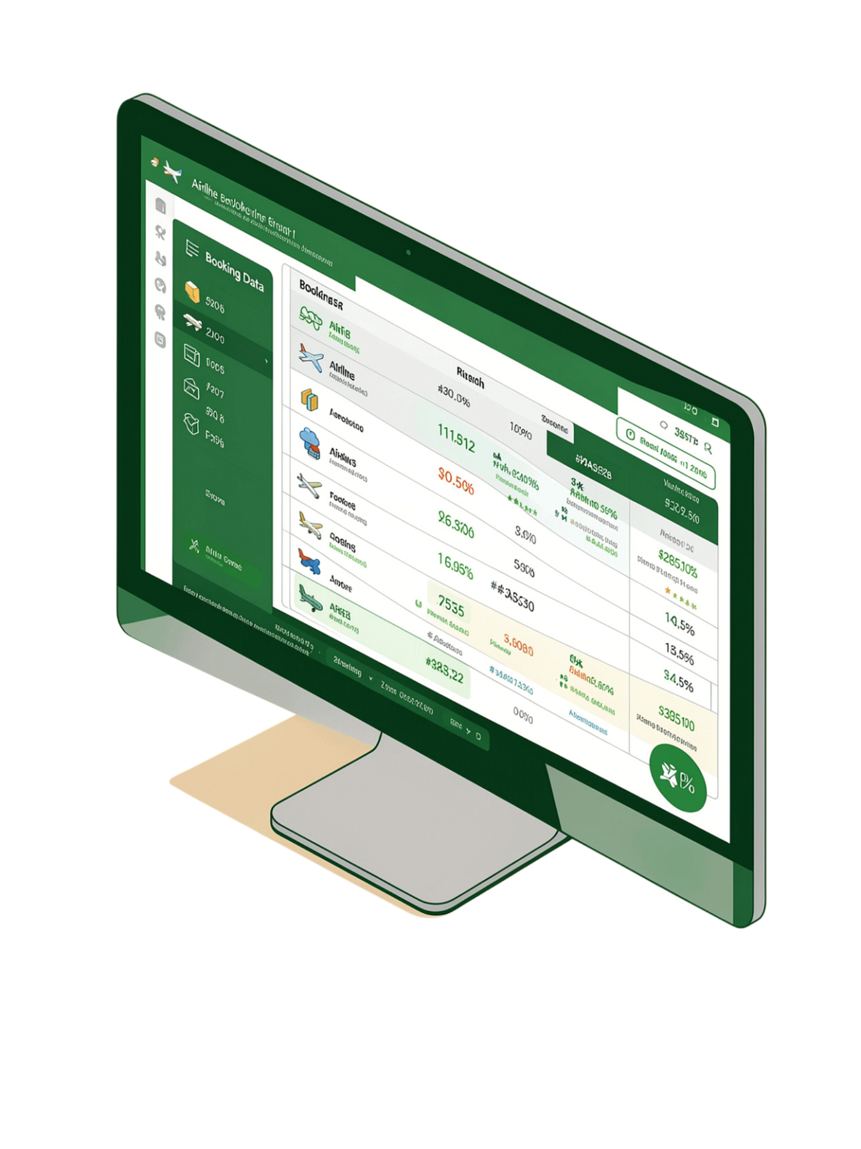

Data Sources & Business Rules
Customer Profiles
Policy Data
Priya Nair
Arvind Kulkarni
Meher Kaur
Rebooking policy
Refund policy
Compensation rules
Escalation rules
Loyalty-tier rules
Booking Data
Flight status & route
Delay duration
Fare difference
Constraint: Only assignment-provided data was used.

Slide 7
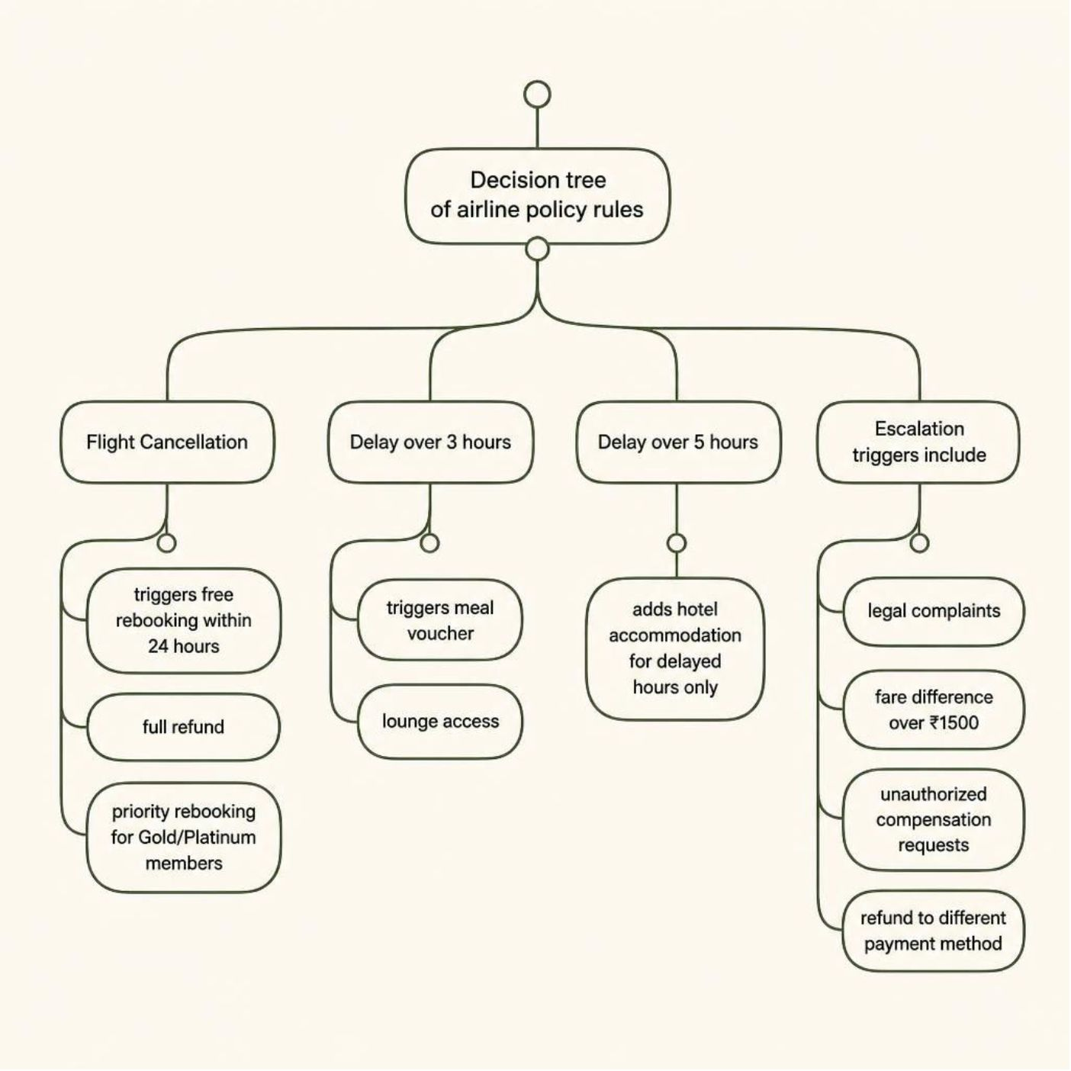
Policy Engine Decision Logic
Flight Cancellation
Free rebooking within 24 hours
Full refund
Priority rebooking for Gold/Platinum members
Delay > 3 Hours
Meal voucher
Lounge access
Delay > 5 Hours
Hotel accommodation for delayed hours only
Escalation Triggers
Legal complaints
Fare difference > ₹1500
Unauthorized compensation requests
Refund to different payment method

Slide 8
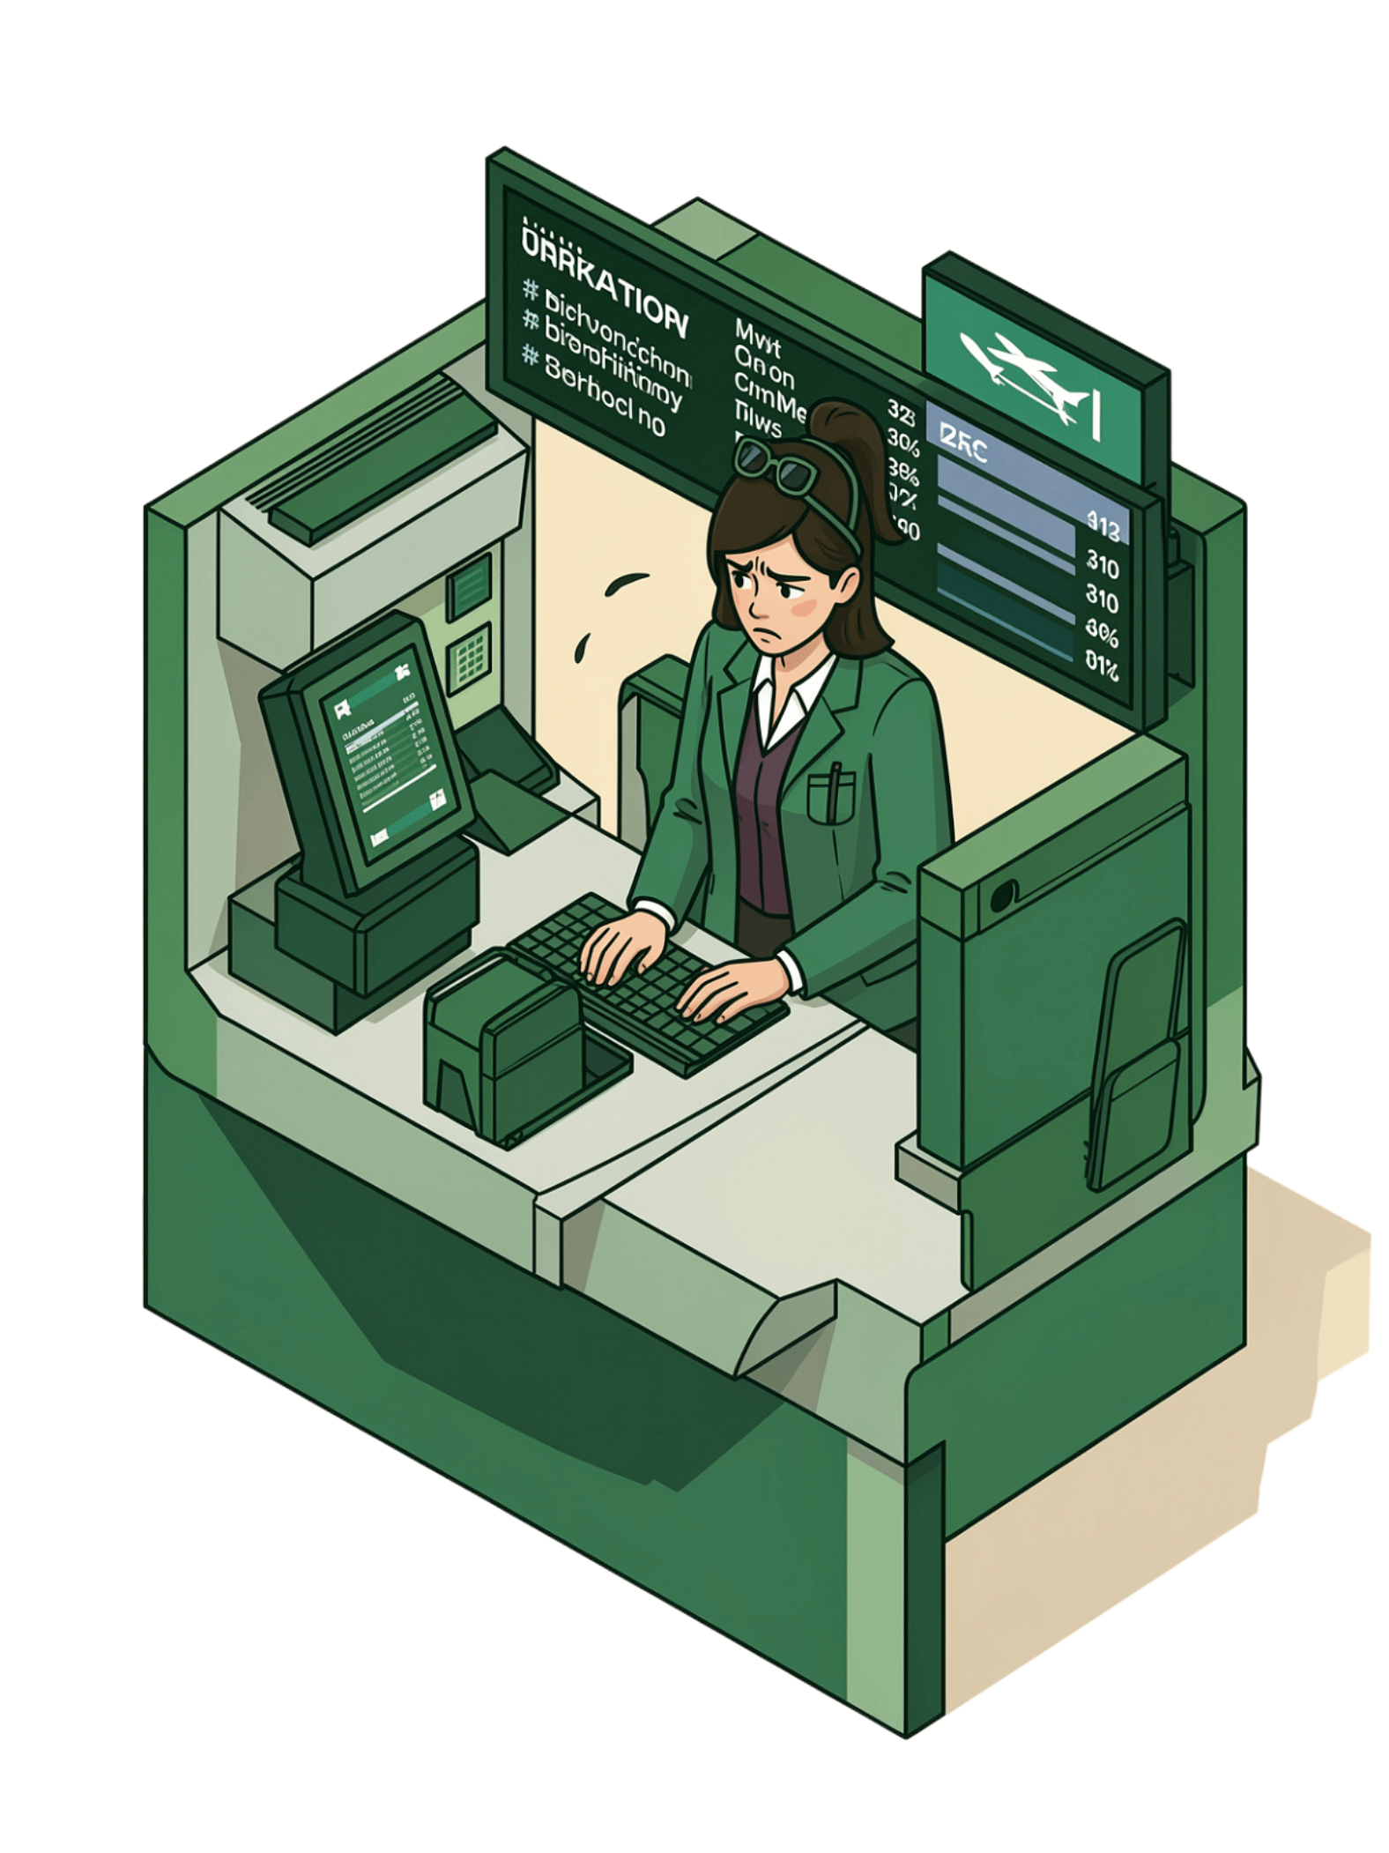
Scenario 1: Priya Nair
Customer Request
Agent Decision
Refund
Free business-class upgrade
✅ Full refund approved
✅ Free rebooking approved
✅ Priority rebooking (loyalty tier)
❌ Business-class upgrade denied — not covered by policy

Slide 9
Scenario 2: Arvind Kulkarni
Customer Request
Live Deployment
Hotel accommodation
Explore the working implementation of the AIONOS Customer Resolution Agent:
GitHub Repository:
github.com/viveksagararora/AIONOS-Customer-Resolution-Agent
Streamlit Demo:
Live App on Streamlit
Agent Decision
✅ Meal voucher approved
✅ Lounge access approved
❌ Hotel denied — delay was under 5 hours

Slide 10

Scenario 3: Meher Kaur
Customer Request
Key Learnings
Full-night hotel
Higher-fare flight
Translating business policies into executable logic
Building explainable decision systems
Designing escalation workflows
Developing customer-facing AI solutions
Agent Decision
✅ Meal voucher approved
✅ Lounge access approved
✅ Hotel for delayed hours only
⚠️ Escalation required — ₹2000 fare difference exceeds ₹1500 threshold
Future Enhancements
LLM-powered conversational interface
Multi-turn memory
Real-time database & CRM integration
Ticket generation & analytics dashboard
Thank You — Questions & Discussion

