Slide 1
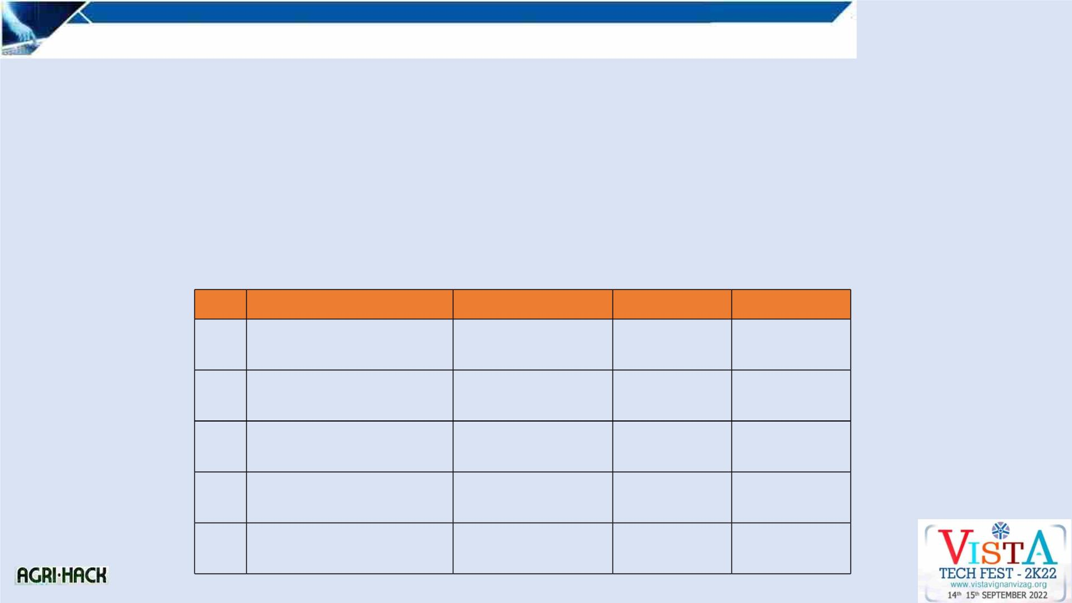
Idea/Approach Details
Problem Statement
: Agriculture Metrics And Residue Management
Title of the Project/Idea. : Agriculture Metrics And Residue Management
Team Name
: Kamikaze
College Name
: Vignan Institute of Information and Technology
SNO
Name of the Candidate
Studying Year
Course
Role
1
K.JITIN JNANA
PRABHATH
3RD YEAR
CSE
Team Lead
2
3
4
5
G.SAI KIRAN
3RD YEAR
3RD YEAR
3RD YEAR
3RD YEAR
CSE
CSE
CSE
CSE
Team
Member
L.NYNEESH KUMAR
Team
Member
G. RAMA PAVAN
SRIVATSA
Team
Member
B.KARTHIK
Team
Member

Slide 2
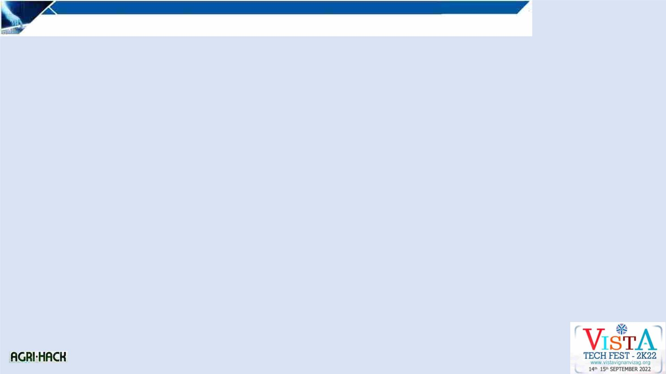
ABSTRACT : Problem statement
There are certain influencing variables that helped farmers during the cultivation phase. The farmer needs to be aware of all the
information that they need. Any other source, including the government, could be the source. It should be simple to access this
information, but the government has not done a good job of organizing it, employing many websites to display various
information, which is burdensome for the farmers. Additionally, farmers today were unaware of how to manage and profit from
agricultural waste. The primary risk of burning agricultural waste is pollution, which farmers in North India have been blamed
for creating. About 15–20 million tones of crop residue are produced annually.
In this case, a practical way to safely dispose of this garbage is urgently required. Due to this necessity, innovators are working
on technology to deal with agricultural waste in a more sustainable way. They also hope to provide farmers with financial
incentives to sell their crop waste, which may persuade them to stop burning stubble.
However, there are numerous uses for this agricultural waste, some of which the farmer might utilize to supplement his or her
income. We can employ waste to create biodegradable plates, and textiles, and lastly, many residues can be used as fossil fuel
substitutes.

Slide 3
Describe your idea / Solution / Prototype here :
To solve this issue, we were creating a web-based portal that contains data on cold storage, soil testing facilities, soil health cards,
weather reports using Microsoft weather maps, government initiatives, budget information, crop insurance, management of
agricultural residues, dealers of fertilizers from the official government website, and significance of DD Kisan.
EXPLAINED IN DETAIL:
COLD STORAGES: Following harvest, the crop needs to be kept cold. We'll include more than a thousand cold storage facilities,
organized by state. Additionally, the position of the farmer can be displayed on maps, allowing him to learn more about the cold
storage facilities that are close by. Additionally, he can acquire directions to his desired cold storage.
We are listing the locations of the soil testing facilities, the KCC, and the help line. We also detail every aspect of government
programes and spending.Using Microsoft's weather maps, we can provide a detailed weather map. We also incorporate crop
insurance, fertilizer suppliers from official websites, and all other websites that the farmer may need.
Regarding residue management, we ask farmers to fill out a form with the type of residue they have, their address, and their
phone number. From there, we mark the location of the farmer with their contact information so that the businesses collecting the
residue will be aware of the farmer's location and can get in touch with him or her to talk about deal. By this the farmer can have
secondary income.

Slide 4
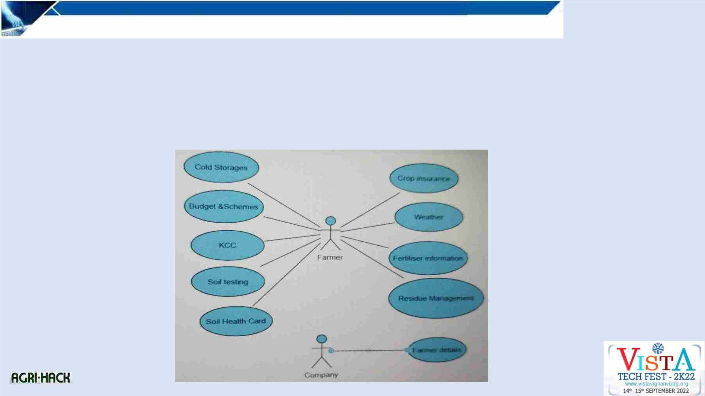
Describe your Technology stack here:
• We use HTML,CSS and javascript to create
• We use AIRtable to store the data of the farmer.
• Automations using Zapier.
• Google Maps API.
Describe your Use Case here

Slide 5
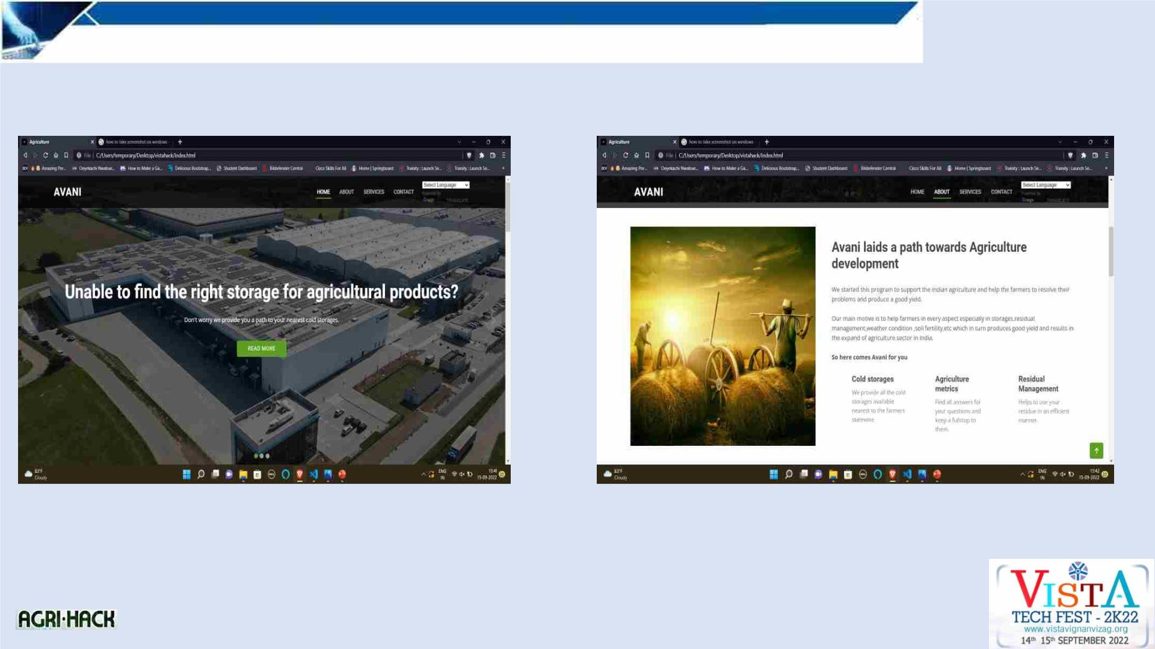
OUTPUT:

Slide 6
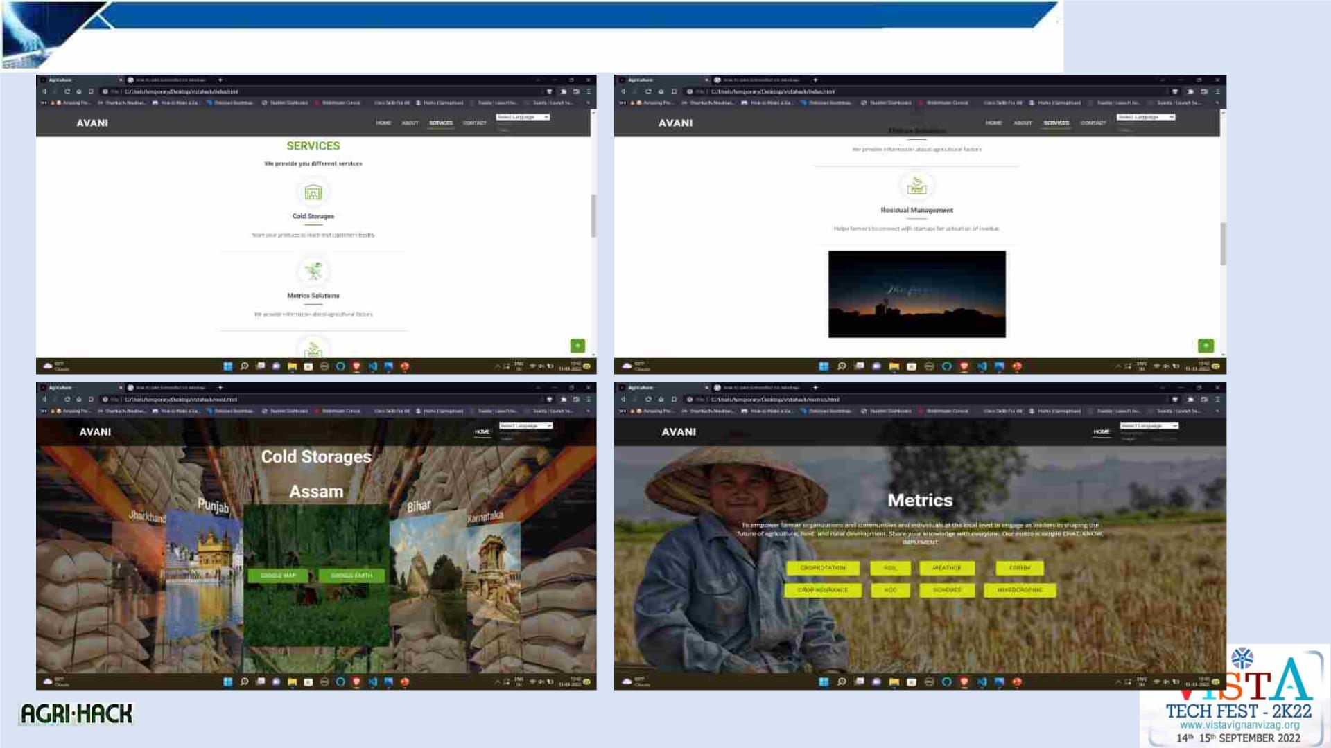

Slide 7
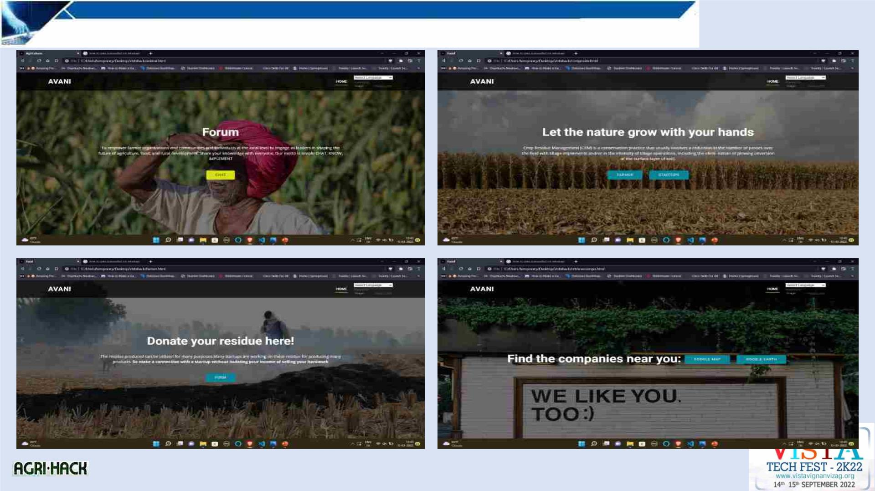

Slide 8
