Slide 2
Subject
SElinux
Server
Policy granted?
Object
Action
Request
yes
no
SElinux
Policy
Data-
base
AVC:
Denied
Message

Slide 3
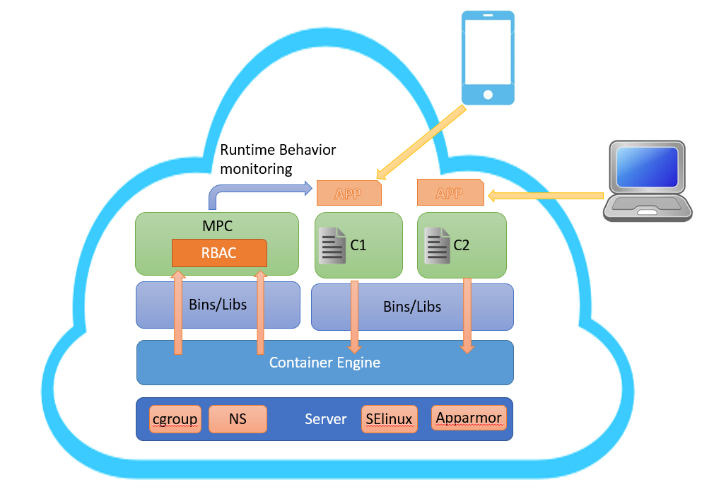

Slide 4
APP
APP
MPC
Conatiner1
Conatiner2
Bins/Libs
Bins/Libs
Container Engine
Server
cgroup
Names-paces
SElinux
Appar-mor

