Slide 1
RCS Template Analysis
AXIS BANK
September 2026

Slide 2
WHAT WE ANALYSED
9 sends of 4 templates
Year | Template | Date | GoogleID | Messages Submitted | DeliveryRate | ReadRate | P2AResponseRate (click rate)
2026 | axis_rcs_24mar_2 | 3 Sep | yvyv0sd7 | 1,737,800 | 94.42% | 33.20% | 0.33%
2026 | axisbank_1sept | 3 Sep | yvyv0sd7 | 1,366,206 | 90.58% | 33.14% | 1.84%
2026 | axisbank_1sept | 10 Sep | yvyv0sd7 | 1,364,199 | 90.06% | 31.65% | 1.57%
2026 | phonepe_offers_8sep | 11 Sep | yvyv0sd7 | 1,605,325 | 94.41% | 37.72% | 1.04%
2026 | axis_rcs_campaign_16 | 23 Sep | yvyv0sd7 | 3,130,979 | 90.62% | 38.82% | 0.78%
2026 | phonepe_offers_8sep | 23 Sep | yvyv0sd7 | 1,604,771 | 94.15% | 38.94% | 0.83%
2026 | axisbank_1sept | 24 Sep | yvyv0sd7 | 1,368,233 | 89.71% | 33.35% | 1.49%
2026 | axis_rcs_campaign_16 | 24 Sep | yvyv0sd7 | 966,811 | 93.12% | 37.88% | 0.63%
2026 | axis_rcs_campaign_16 | 30 Sep | yvyv0sd7 | 2,360,286 | 92.66% | 36.77% | 0.53%
Column names are the sheet's own. DeliveryRate = delivered ÷ sent. ReadRate = read ÷ delivered. P2AResponseRate = click rate (responses ÷ read).
Each send has its own audience and timing. Audience, day of week and frequency cannot be separated from the creative, so findings are directional.
Source: partner portal template export. * = our calculation from the sheet counts.

Slide 3
THE FUNNEL
Where messages are lost along the way
Share of Messages Submitted
Lost before sending
31.0% of Messages Submitted failed before sending in September 2026. This happens before the platform sends, so it is separate from template content.
After sending
DeliveryRate is 92.07% of Messages Sent and the expiry rate* is 7.7%.
Ask
Failure reason codes by GoogleID and template.
Source: partner portal template export. * = our calculation from the sheet counts.

Slide 4
EVERY TEMPLATE
Click rate by template
Click rate (P2AResponseRate)
Highest click rates
axisbank_1sept (1.64%), phonepe_offers_8sep (0.94%). Text strengths: A concrete number, One clear action.
Lowest click rates
axis_rcs_campaign_16 (0.67%), axis_rcs_24mar_2 (0.33%). Text flags: Long description.
Text score vs result
Scored from the text alone, the content score ordered 2 of 4 comparable template pairs the same way as click rate (2 the other way, 2 tied).
Source: partner portal template export. * = our calculation from the sheet counts.

Slide 5
ROOT CAUSE
Where each hypothesis stands
Hypothesis | What the data shows | Status
H1 Delivery or read differs between templates | DeliveryRate 89.71–94.42% and ReadRate 31.65–38.94% across the templates. | Plausible, needs data
H2 Offer specificity and content | Scored from the text alone, the content score ordered 2 of 4 comparable template pairs the same way as click rate (2 the other way, 2 tied). Visits and orders after the click are not visible in the sheet. | Plausible, needs data
H3 Scale dilution and audience mix | The sheet holds no audience data. | Unknown
H4 Pre-send failures | 31.0% of Messages Submitted failed before sending in September 2026. | Open, high priority
H5 Send time and offer timing | Expiry rate* is 7.7% of Messages Sent. | Plausible, needs data
Audience, send time and post-click data (visits, orders) are not available, so findings are directional.
Source: partner portal template export. * = our calculation from the sheet counts.

Slide 6
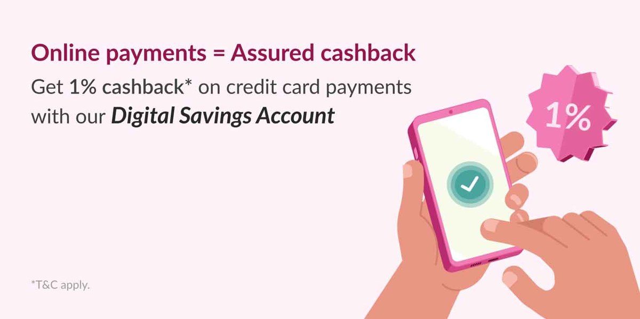
TEMPLATE 01
Template in Focus | axis_rcs_24mar_2
Template name: axis_rcs_24mar_2 | Sent 3 Sep 2026 | GoogleID yvyv0sd7
CURRENT LIVE TEXT
Card Title
Open Axis Bank Digital Savings Account in just 2 clicks.
Card Description
Dear Customer,
Thousands have already upgraded to smarter banking! What are you waiting for?
Open an Axis Bank Digital Savings Account in 7 minutes and enjoy these exclusive perks:
[icon] 1% cashback* on Axis Bank’s credit card bill payment
[icon] Flat 25% cashback* on Flipkart & AJIO via 𝐆𝐑𝐀𝐁 𝐃𝐄𝐀𝐋𝐒
[icon] Complimentary BookMyShow ticket* every month
… (full text in the report)
94.42%
33.20%
0.33%
CTA
DeliveryRate
ReadRate
P2AResponseRate (click rate)
Open Online
Source: partner portal template export; creative as supplied. Emojis may appear as placeholders.
Notes:
Content risk Low is scored from the text alone (Checks fired: long_description (score 1.0).). Click rate 0.33% is shown for comparison.

Slide 7
TEMPLATE 01 · axis_rcs_24mar_2
What Works and What to Watch
1. A concrete number
1. Long description
A price, amount, percentage or quantity appears in the text itself.
The description runs past the point where a reader will finish it.
2. One clear action
The text asks for one thing, the button.
Click rate 0.33%: rank 4 of 4 in September 2026; ReadRate 33.20%

Slide 8

TEMPLATE 02
Template in Focus | axisbank_1sept
Template name: axisbank_1sept | 3 sends, 3 Sep to 24 Sep | GoogleID yvyv0sd7
CURRENT LIVE TEXT
Card Title
Open Axis Bank Digital Savings Account in just 2 clicks.
Card Description
Dear Customer,
Complete your Axis Bank Digital Savings Account application now and enjoy exclusive benefits:
[icon] Flat 25% cashback* [icon] on Flipkart & Ajio every time you shop
[icon] Buy one get one offer* on BookMyShow every month
[icon] 1% cashback* on online spends
[icon] Instant e-debit card
[icon] Access to 250+ banking services
*T&C apply. Offers applicable via 𝙂𝙍𝘼𝘽 𝘿𝙀𝘼𝙇𝙎.
… (full text in the report)
90.12%
32.72%
1.64%
CTA
DeliveryRate
ReadRate
P2AResponseRate (click rate)
Open Online
Source: partner portal template export; creative as supplied. Emojis may appear as placeholders.
Notes:
Content risk Low is scored from the text alone (Checks fired: long_description (score 1.0).). Click rate 1.64% over 3 sends is shown for comparison.

Slide 9
TEMPLATE 02 · axisbank_1sept
What Works and What to Watch
1. A concrete number
1. Long description
A price, amount, percentage or quantity appears in the text itself.
The description runs past the point where a reader will finish it.
2. One clear action
The text asks for one thing, the button.
Click rate 1.64% over 3 sends: rank 1 of 4 in September 2026; ReadRate 32.72%

Slide 10

TEMPLATE 03
Template in Focus | phonepe_offers_8sep
Template name: phonepe_offers_8sep | 2 sends, 11 Sep to 23 Sep | GoogleID yvyv0sd7
CURRENT LIVE TEXT
Card Title
Grab 𝐈𝐍𝐑 𝟏𝟎𝟎 𝐜𝐚𝐬𝐡𝐛𝐚𝐜𝐤 on UPI payments!
Card Description
Make your first two UPI payments via PhonePe with Axis Bank RuPay Credit Cards and earn flat INR 50 cashback per transaction.
Offer valid till: 30th Sep 2026.
*T&C apply.
94.28%
38.34%
0.94%
CTA
DeliveryRate
ReadRate
P2AResponseRate (click rate)
Know more
Source: partner portal template export; creative as supplied. Emojis may appear as placeholders.
Notes:
Content risk Low is scored from the text alone (No text check fired (score 0.0).). Click rate 0.94% over 2 sends is shown for comparison.

Slide 11
TEMPLATE 03 · phonepe_offers_8sep
What Works and What to Watch
1. A concrete number
1. No text flags
A price, amount, percentage or quantity appears in the text itself.
None of the text checks fired for this template.
2. One clear action
The text asks for one thing, the button.
Click rate 0.94% over 2 sends: rank 2 of 4 in September 2026; ReadRate 38.34%

Slide 12

TEMPLATE 04
Template in Focus | axis_rcs_campaign_16
Template name: axis_rcs_campaign_16 | 3 sends, 23 Sep to 30 Sep | GoogleID yvyv0sd7
CURRENT LIVE TEXT
Card Title
Unlimited Health Protection at [icon]
Card Description
Unlock Unlimited Health cover with ReAssure 3.0 by Niva Bupa Health Insurance for a worry-free tomorrow. Get insured today!
91.74%
37.93%
0.67%
CTA
DeliveryRate
ReadRate
P2AResponseRate (click rate)
Buy Now
Source: partner portal template export; creative as supplied. Emojis may appear as placeholders.
Notes:
Content risk Low is scored from the text alone (No text check fired (score 0.0).). Click rate 0.67% over 3 sends is shown for comparison.

Slide 13
TEMPLATE 04 · axis_rcs_campaign_16
What Works and What to Watch
1. A concrete number
1. No text flags
A price, amount, percentage or quantity appears in the text itself.
None of the text checks fired for this template.
2. Short text
The whole card text is brief enough to read in one glance.
3. One clear action
The text asks for one thing, the button.
Click rate 0.67% over 3 sends: rank 3 of 4 in September 2026; ReadRate 37.93%

Slide 14
RECOMMENDATIONS
Changes to make in the next sends
1
Add a per-template tracking tag to the button URL
2
Diagnose pre-send failures
3
Use a formal, reassuring tone and a low-commitment CTA
The sheet shows clicks but not what happens after; tags tie each template to visits and orders.
31.0% of Messages Submitted failed before sending.
Vi guardrails G2 and G5 for BFSI; check the current CTAs against them.
4
Cap frequency, rotate creatives and scale in tiers
Vi guardrail G6; frequency and audience data are needed to see whether it applies.
Source: template review; partner portal template export.

Slide 15
NEXT STEPS
One test and 3 data asks
Test in the next window
Axis Bank
Visits and orders per template (tagged URLs)
A specific offer against the current text, same audience and send time for both arms
A tracking tag on every button URL so visits and orders are reported per template
Vi reviews the next templates at least a week before launch
Google / Platform partner
Audience tier or demographics, send time and frequency per campaign
Platform partner
Failure reason codes by GoogleID and template
Source: template review.

