Slide 1
Card creation process & output

Slide 2
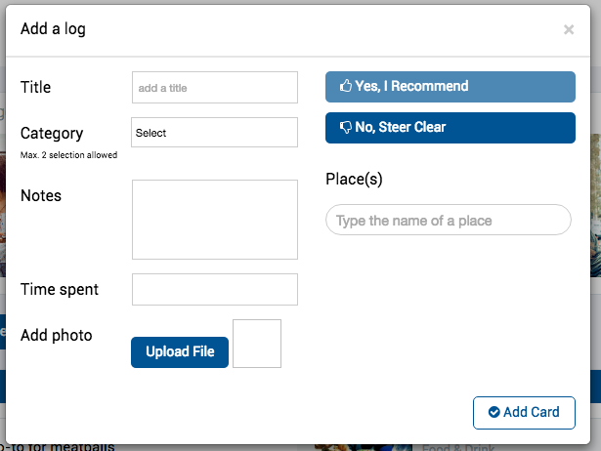


At onset of card creation, user indicates whether this is a recommendation or somewhere they hope to go.
This will dictate the form they must complete.
Add a place you are hoping to visit
Add a recommendation
If first option selected:
only Place, Category and Protips are active. Others are gray/unselectable
Card is not published to homepage. Only saved in user account
Recommended if you have ____ in this location
Begin typing address or location name….
Absolute must-do recommendation
Half a day
A weekend
1 week +
Worth doing
“Best comfort food in town. I come here at least once a week. Don’t overlook the $20 / bottle wine list”
(e.g. My Go-to Date Spot)
Perfect for:
Good for Groups
Doable in Rain
Solid Workout
No Bike Path
Pro tips:
e.g. “Plan on a long wait. Get the bloody Mary”
e.g. “1.5 hours”
(Optional)
☑
Finalize later
I don’t have a photo
You can come back and add one later if you’d like, we will sub one in for you in the mean time

Slide 3
At onset of card creation, user indicates whether this is a recommendation or somewhere they hope to go.
This will dictate the form they must complete.
Add a place you are hoping to visit
Add a recommendation
Recommended if you have ____ in this location
Begin typing address or location name….
Absolute must-do recommendation
Half a day
A weekend
1 week +
Worth doing
“Best comfort food in town. I come here at least once a week. Don’t overlook the $20 / bottle wine list”
(e.g. My Go-to Date Spot)
Perfect for:
Good for Groups
Doable in Rain
Solid Workout
No Bike Path
Pro tips:
e.g. “Plan on a long wait. Get the bloody Mary”
Best tags are selected by user during card creation process. Options are based on category.
e.g. “1.5 hours”
Pro tip is open-ended form, limited to 100 characters
(Optional)
☑
Finalize later
I don’t have a photo
You can come back and add one later if you’d like, we will sub one in for you in the mean time

Slide 4
Card detail

Slide 5
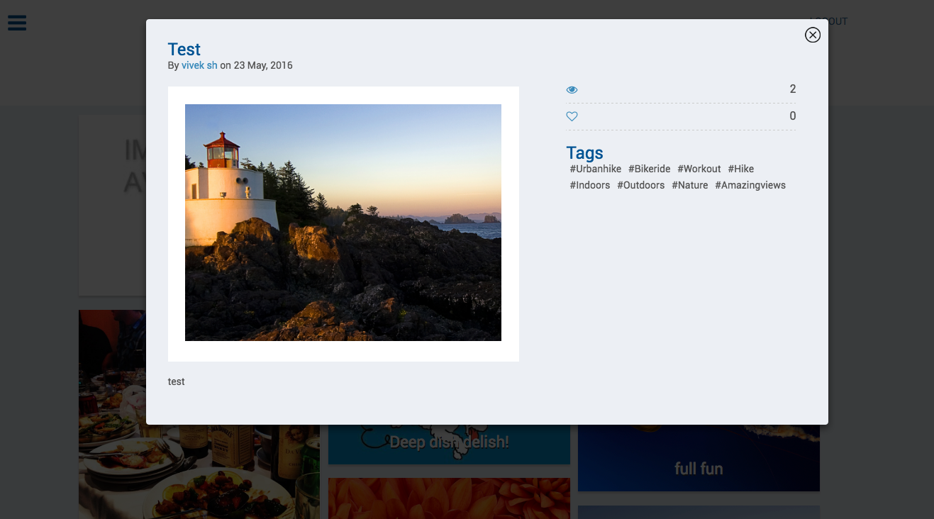

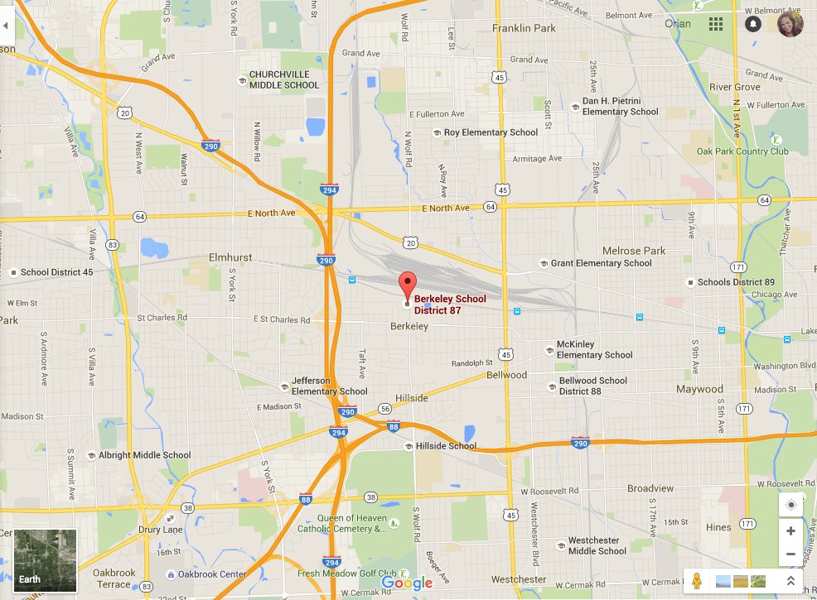
IN-CARD VIEW FROM HOMEPAGE
Bike to the Idyllic Lighthouse
Montauk Lighthouse, 123 Lighthouse Way
Orian Almog // Montauk, New York // Outdoor Activity
+20
19 friends agree
Save to your library
city/state from Google Maps address
Title
Name of place on Gmaps and Address
City, Category & Username
If food then also include cuisine (from Google API?)
Map view in-card to give location context
Pro Tip: Wear sneakers, these hills are no joke.
Good for Groups
Doable in Rain
See other friends’ cards for this place
Solid Workout
No Bike Path
Tags selected by user during card creation process. Options are based on category.
Pro tip is open-ended form, limited to 100 characters

Slide 6
Homepage

Slide 7
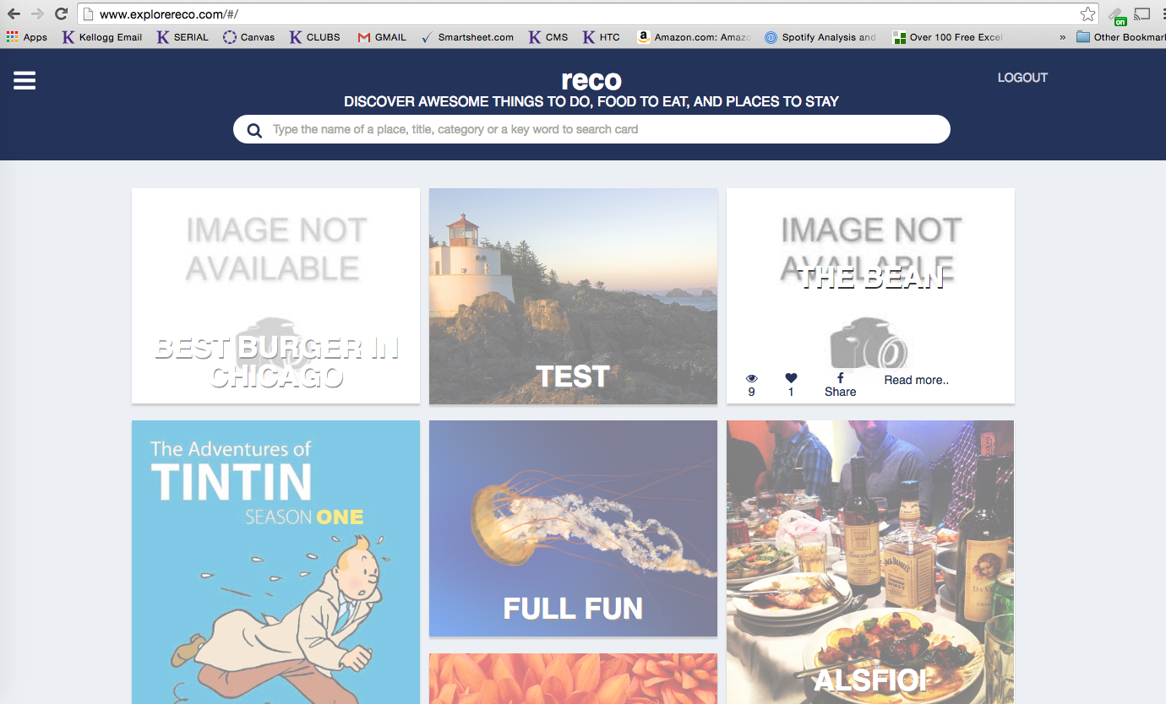
Should include username, city, category
No need to include F like from this screen
Entire card should be clickable (not just Read more…)
Left justify text
Should show how many friends have card for the same place

Slide 8
My Reco |
Can get rid of the menu in laptop view. Will need it for mobile
“My Reco” Link

Slide 9
Combine My cards + My trips on one single page

Slide 10
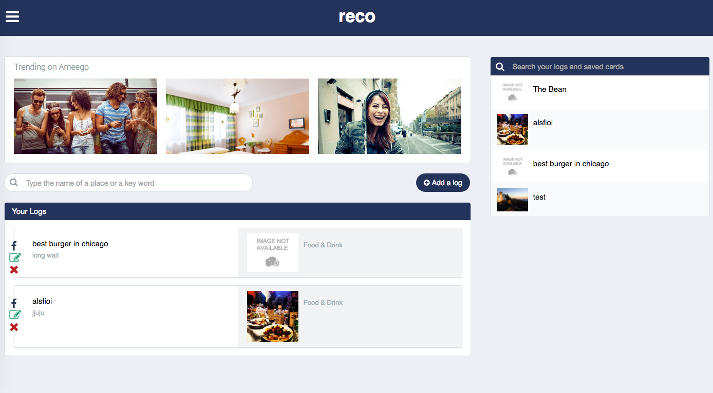
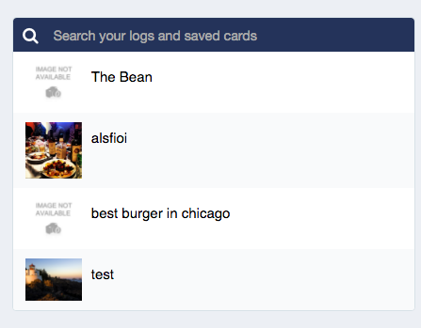
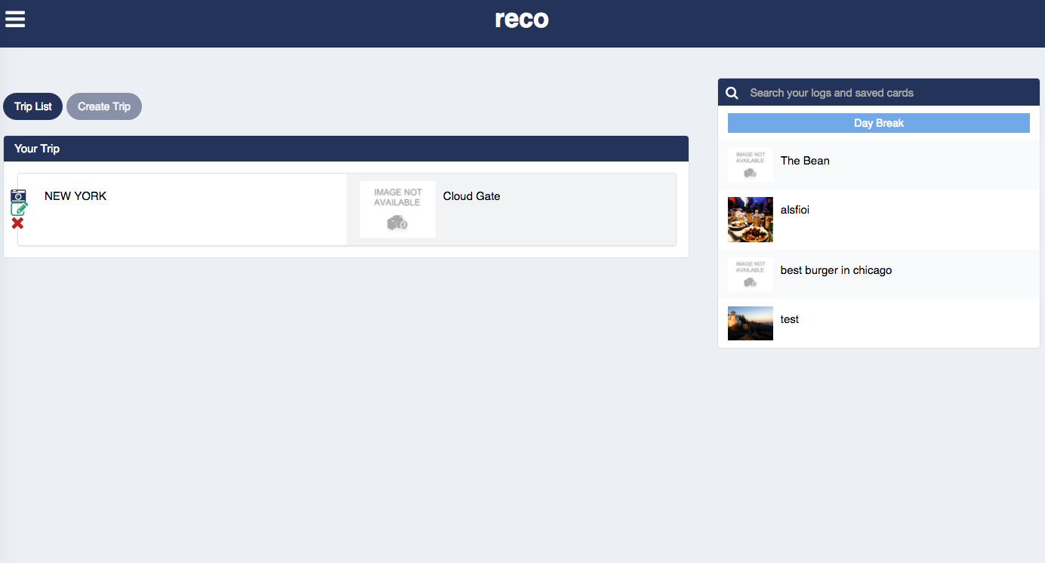
My Reco | Logout
My Reco contains option to
Edit Profile
Create Trip
Create / Edit cards
@Gaurav
Same drag and drop functionality to create trips from all cards (including yours and those you’ve saved)
Cards created by you are editable/deletable from this list, cards created by others have username in corner.
*Want it to be quickly visible whether card is yours or not – maybe use an icon

