Slide 1
Digital Book Application
Digital Book is an online web Application.

Slide 2
Abstract
The Goal of this application is to design and develop an online digital book web application named “Digital Book”.
There are 2 Roles supported by application-
Reader
Author
Any User can access the website content and search books based on Author name, Price and Category.
A Guest user can search books and provide name and Email Id to purchase any existing book without any login and check buying history.
An Author can Update/Add a new book, create a new account and able to login/logout.
Author can block/unblock a book as well.
A Reader can search and buy the book by providing his name and emailed.

Slide 3
Design and Methodology
In this Project, several technical approaches are used:
SSMS/Sql Server for relational database system.
.Net Web Api Core 5.0 is used to connect to database and work on all the records/tables present in database.
Ocelot Api Gateway is used to have a common entry point for the whole application.
Azure Function and Rabbit Mq
Microservices have been made to achieve single responsibility principle.
Angular is used for designing the front end part of application.

Slide 4
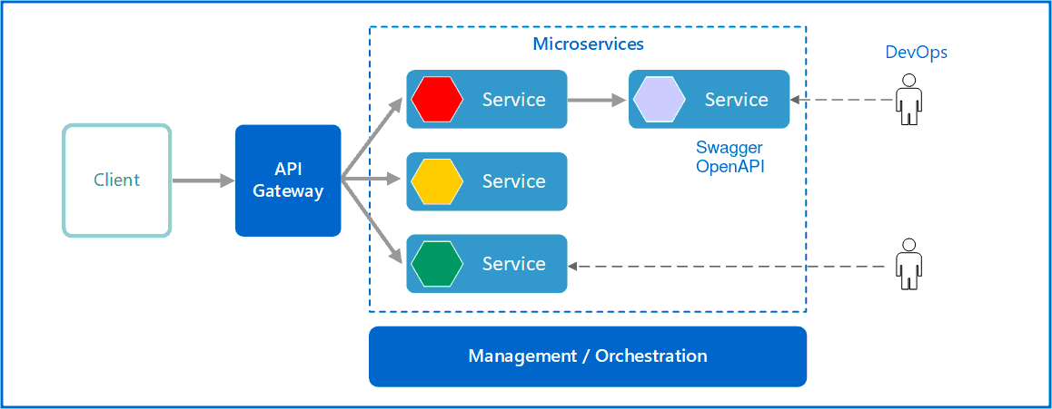
Design-

Slide 5
Database OverView
The Digital book database has 3 primary tables
Book Table
UserDetail Table
Payment Table
Book table is used to store and manipulate data related to books
User Detail table is used to store/ manipulate User data based on roles i.e Author/Reader.
Payment Table is used to keep track of all purchase history by a particular user.

Slide 6
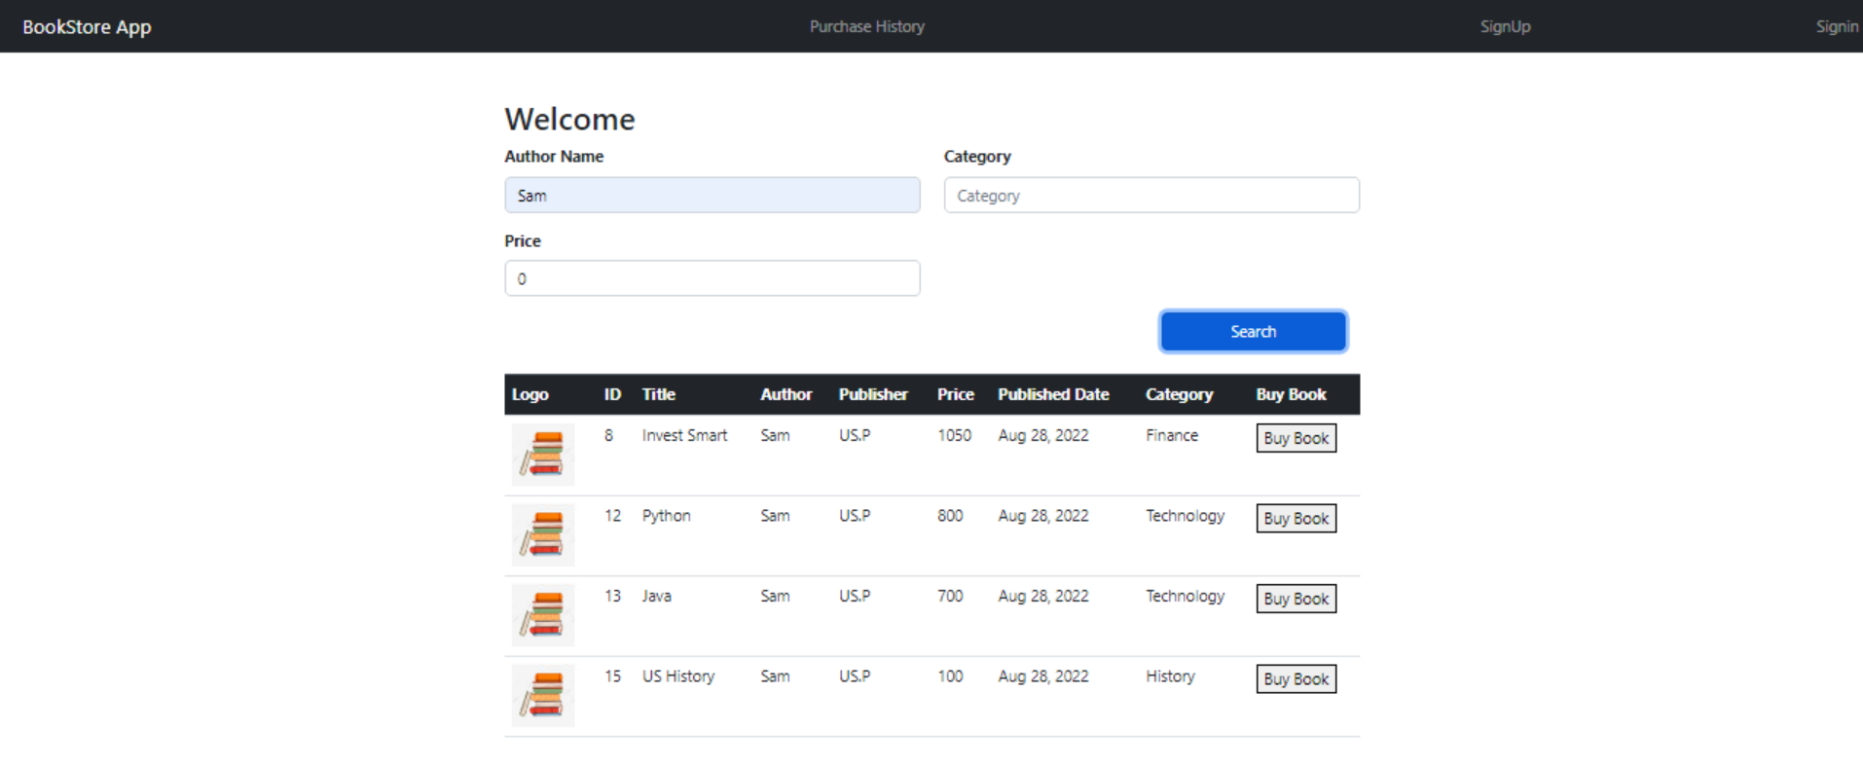
HomePage Screenshot

Slide 7
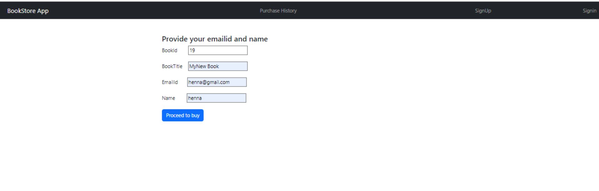
Buy Book Page

Slide 8
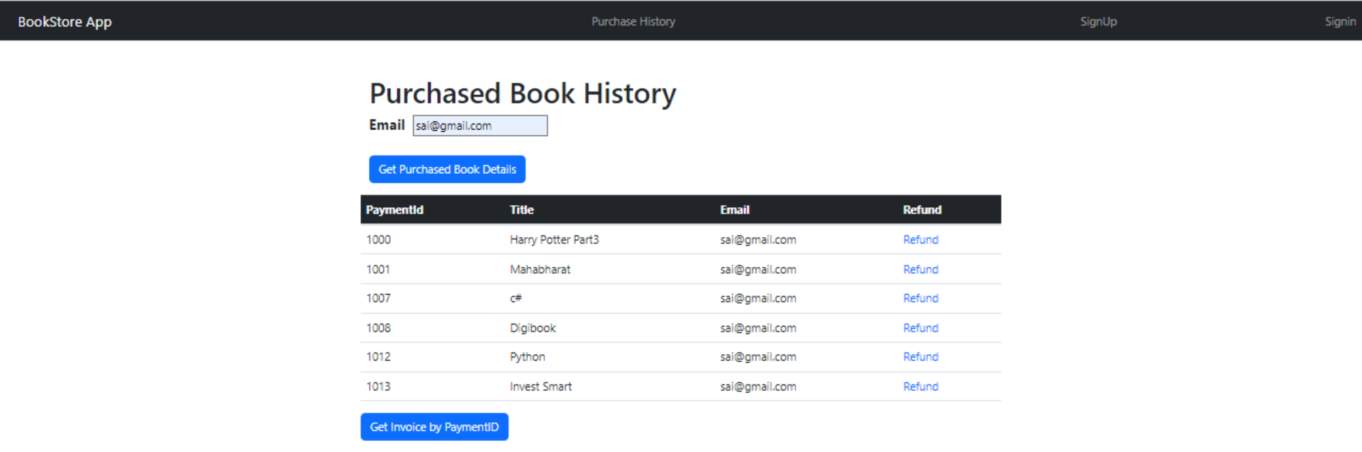
Search Purchased Book By EmailId

Slide 9
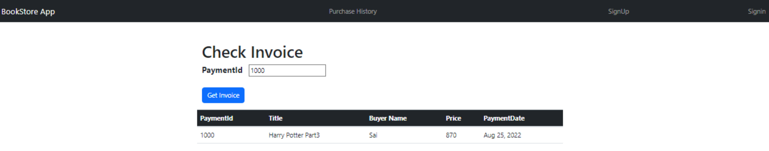
Get Invoice By using PaymentId-

Slide 10
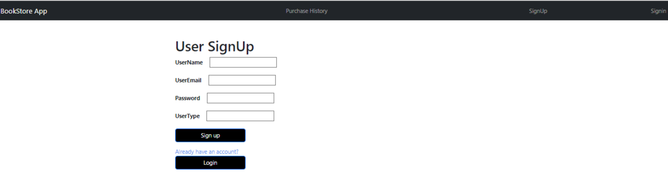
Sign Up Landing Page

Slide 11
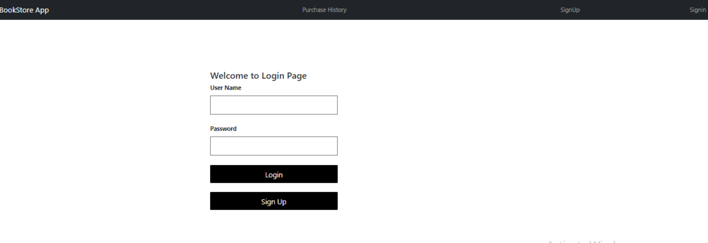
Login Page

Slide 12
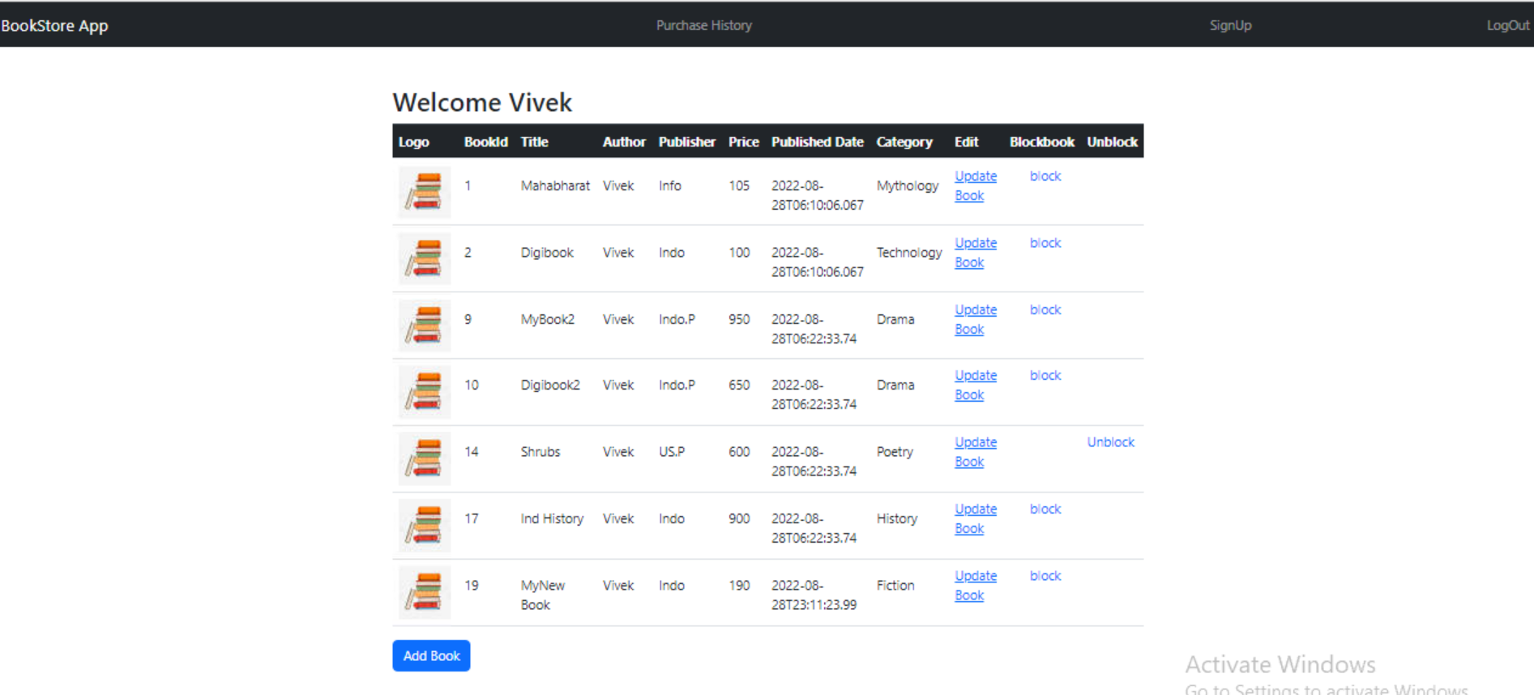
Author Home Page

Slide 13
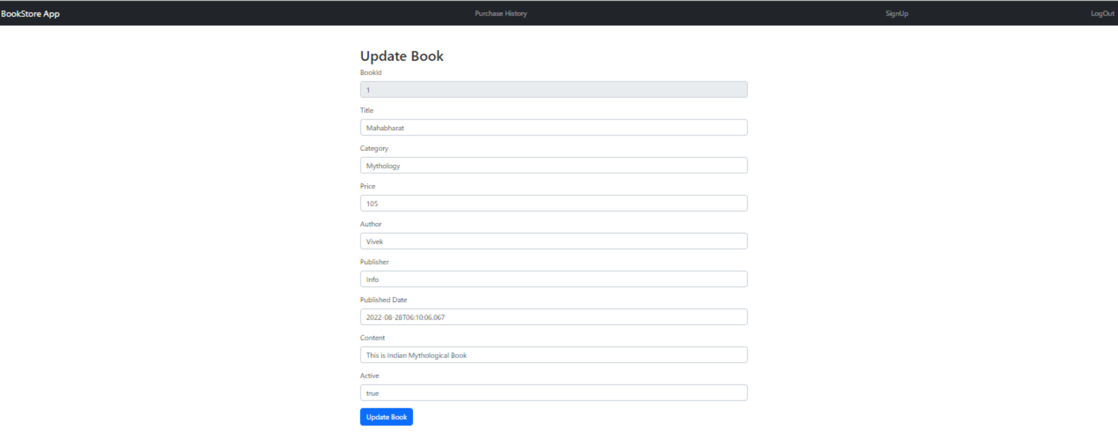
Author Update Book Page

Slide 14
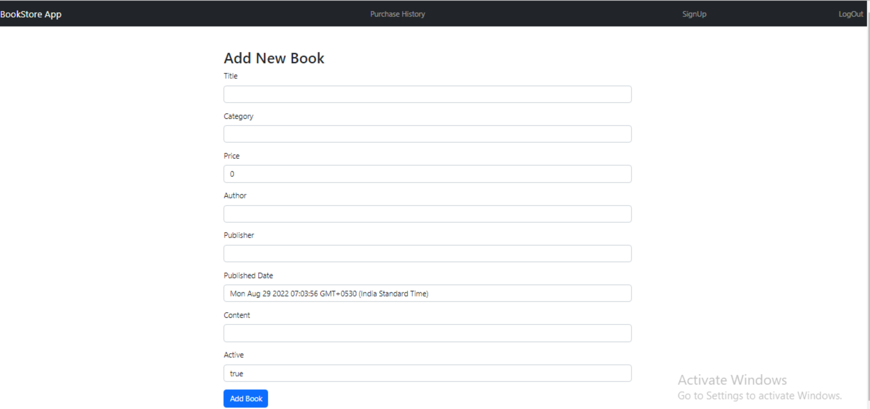
Author Add Book Page

Slide 15
Thank You.

