Slide 1
Group-6
File created on: 4/22/22 11:33:34 PM EDT

Slide 2
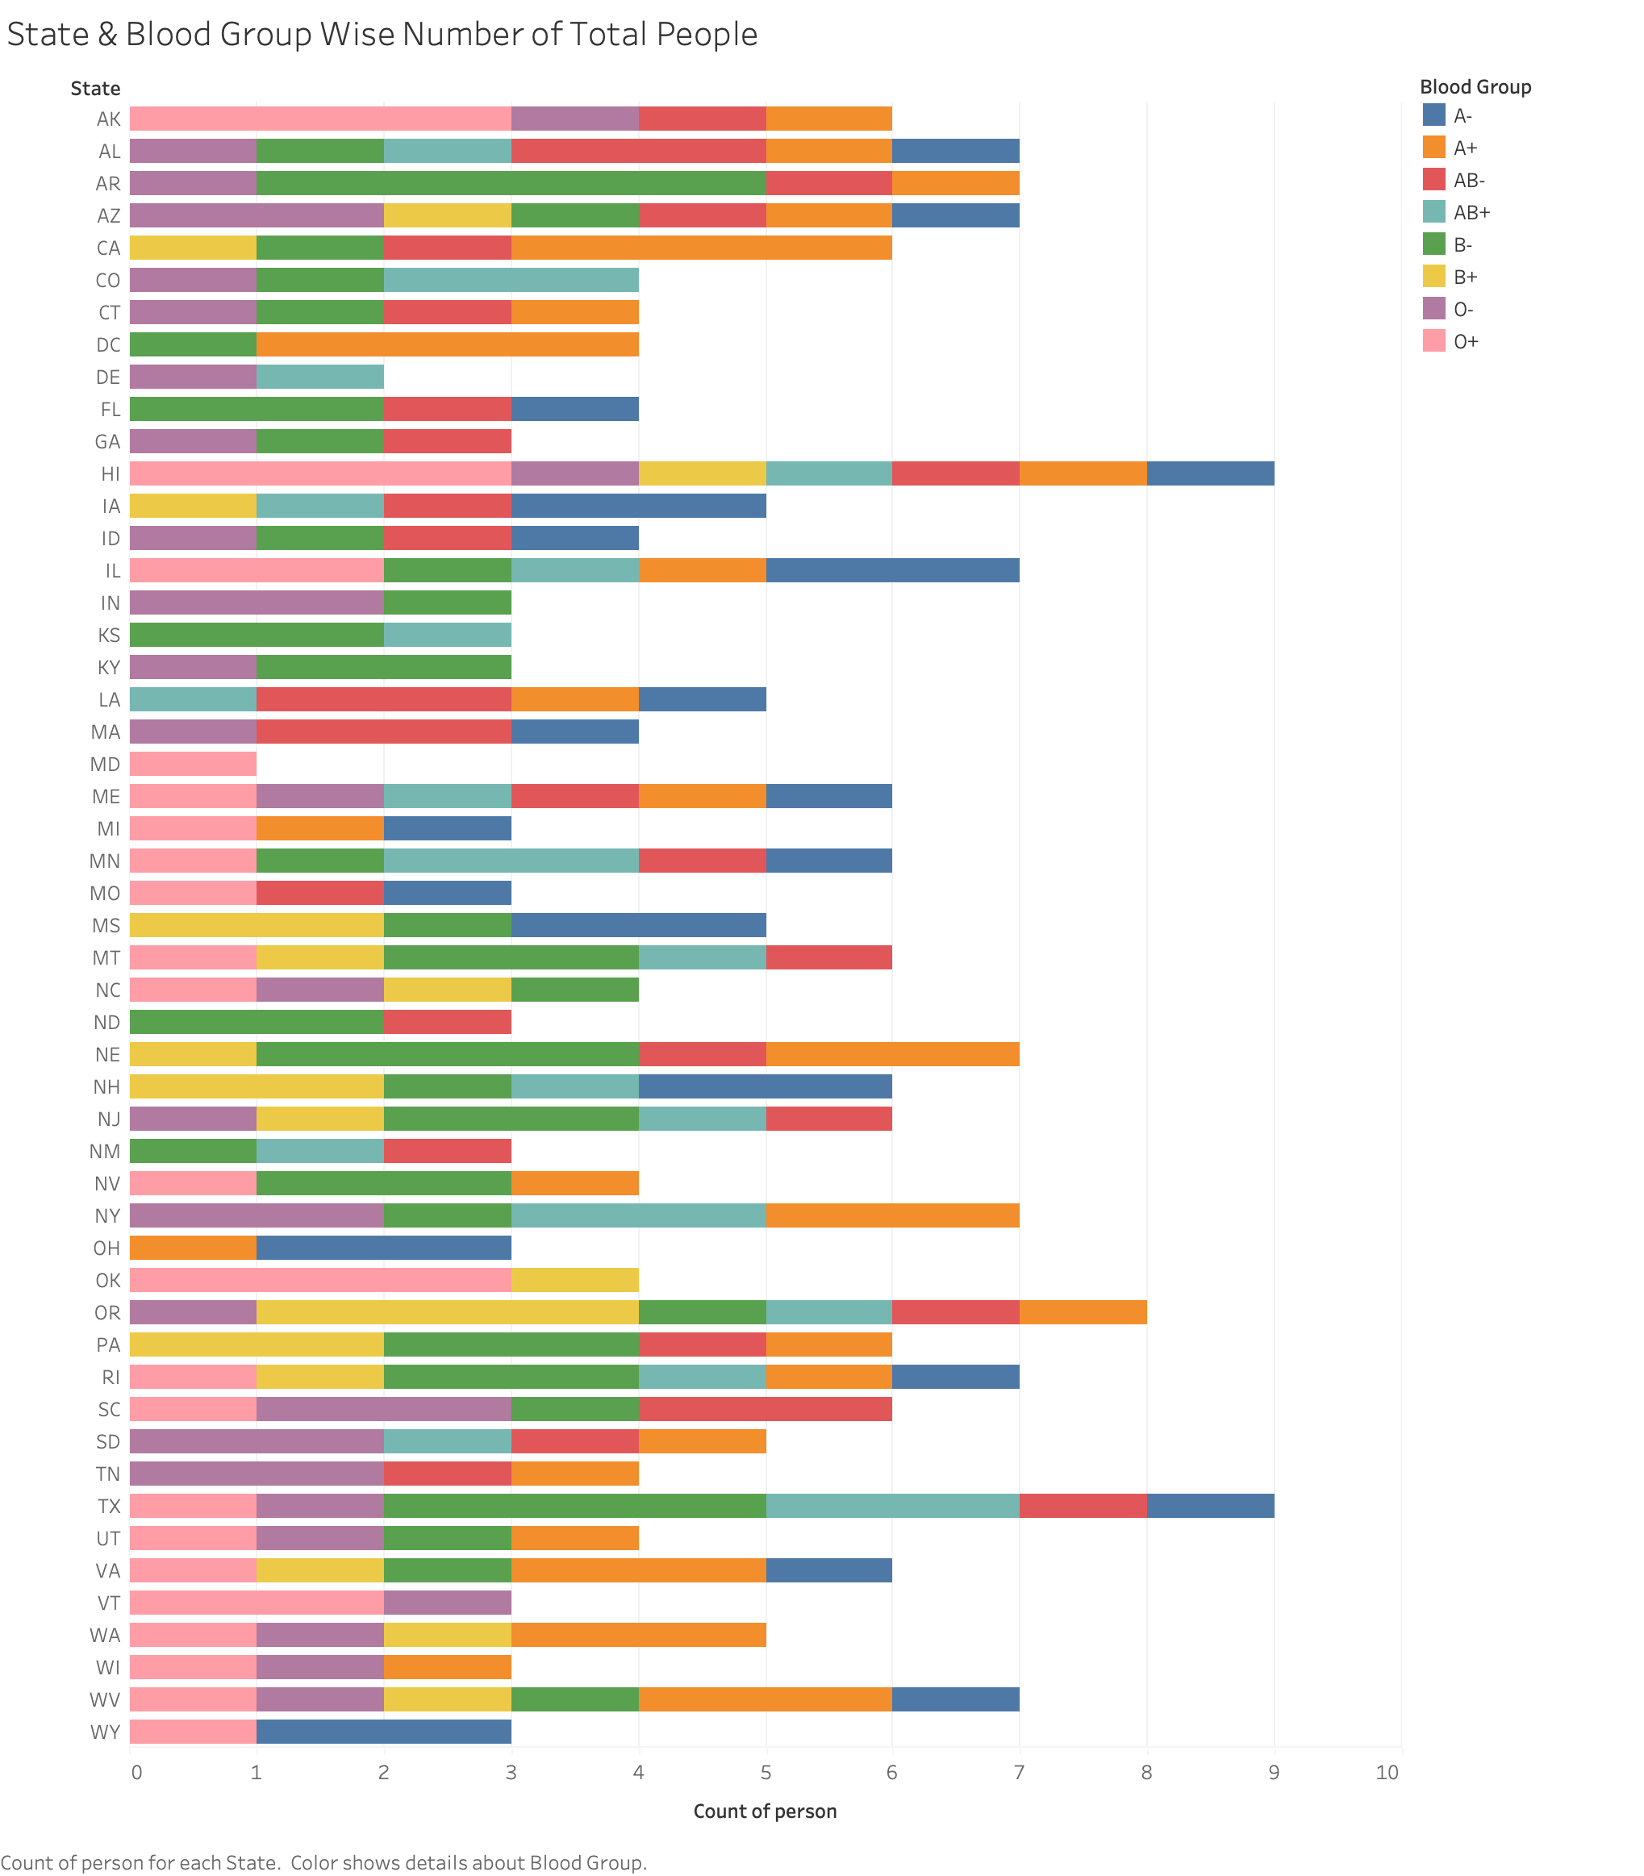

Slide 3
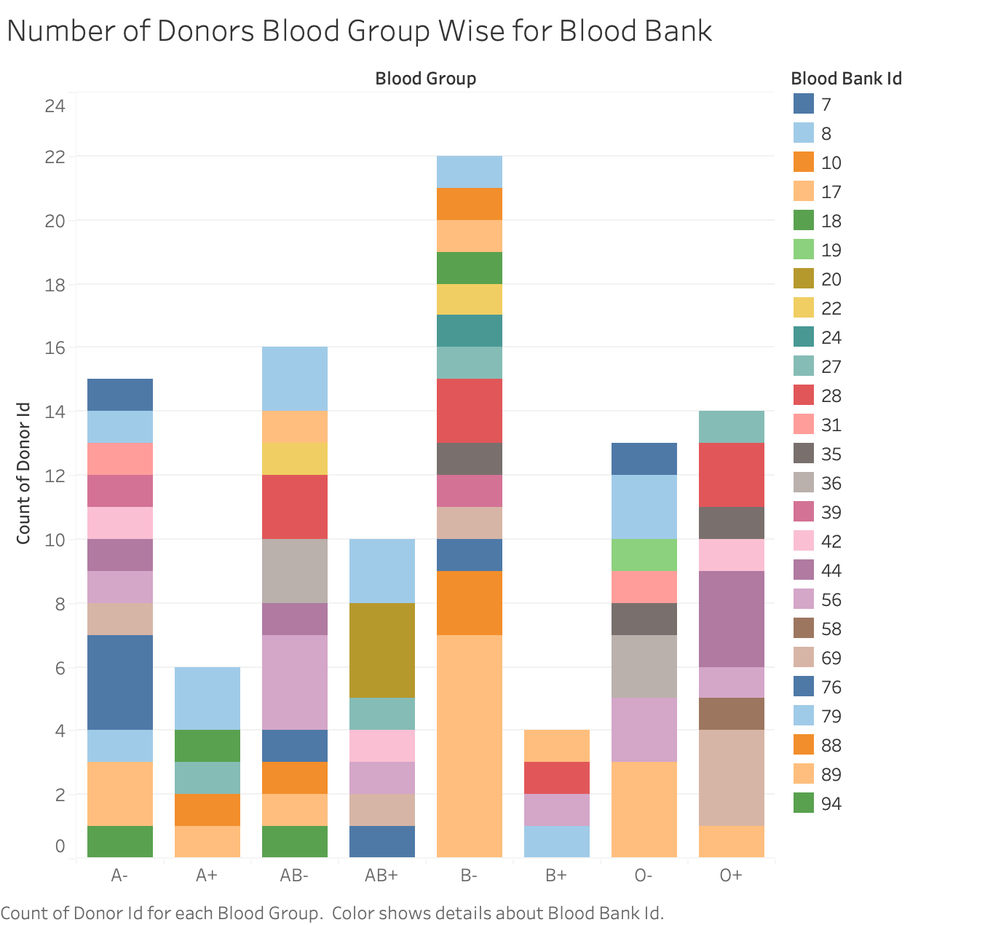

Slide 4
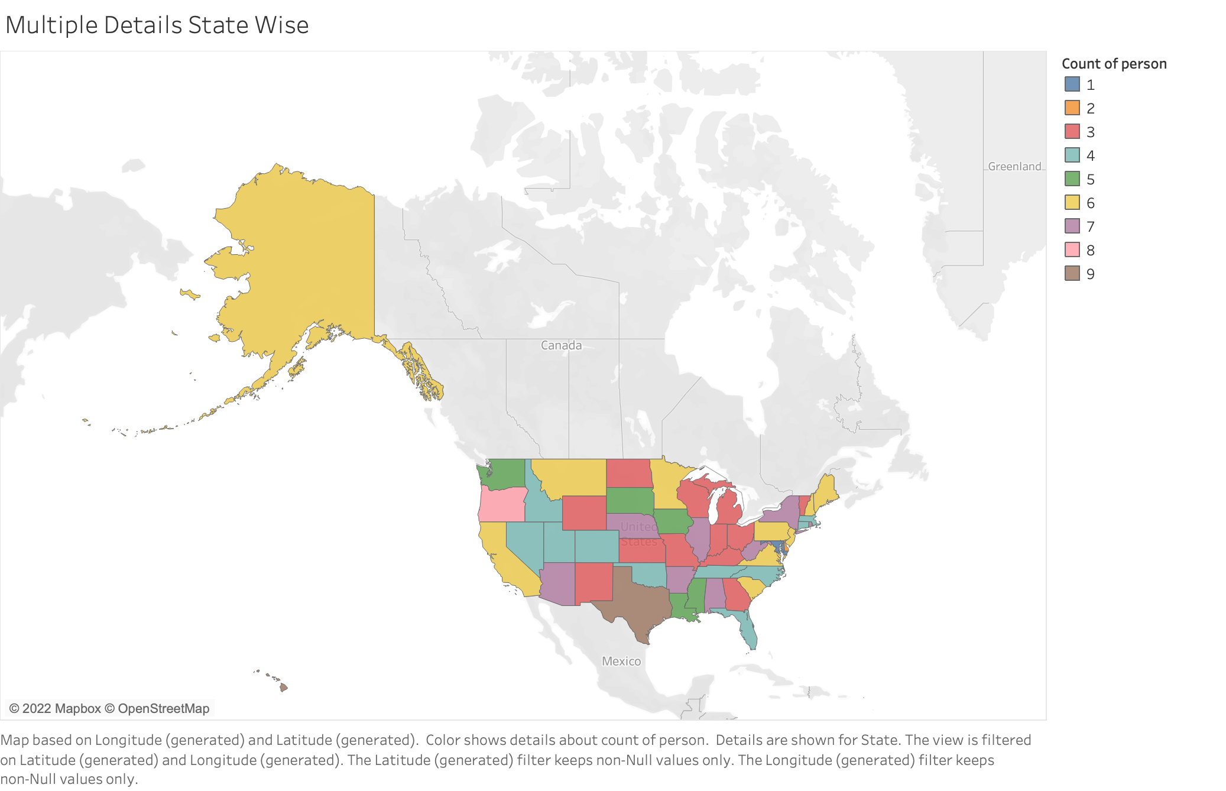

Slide 5
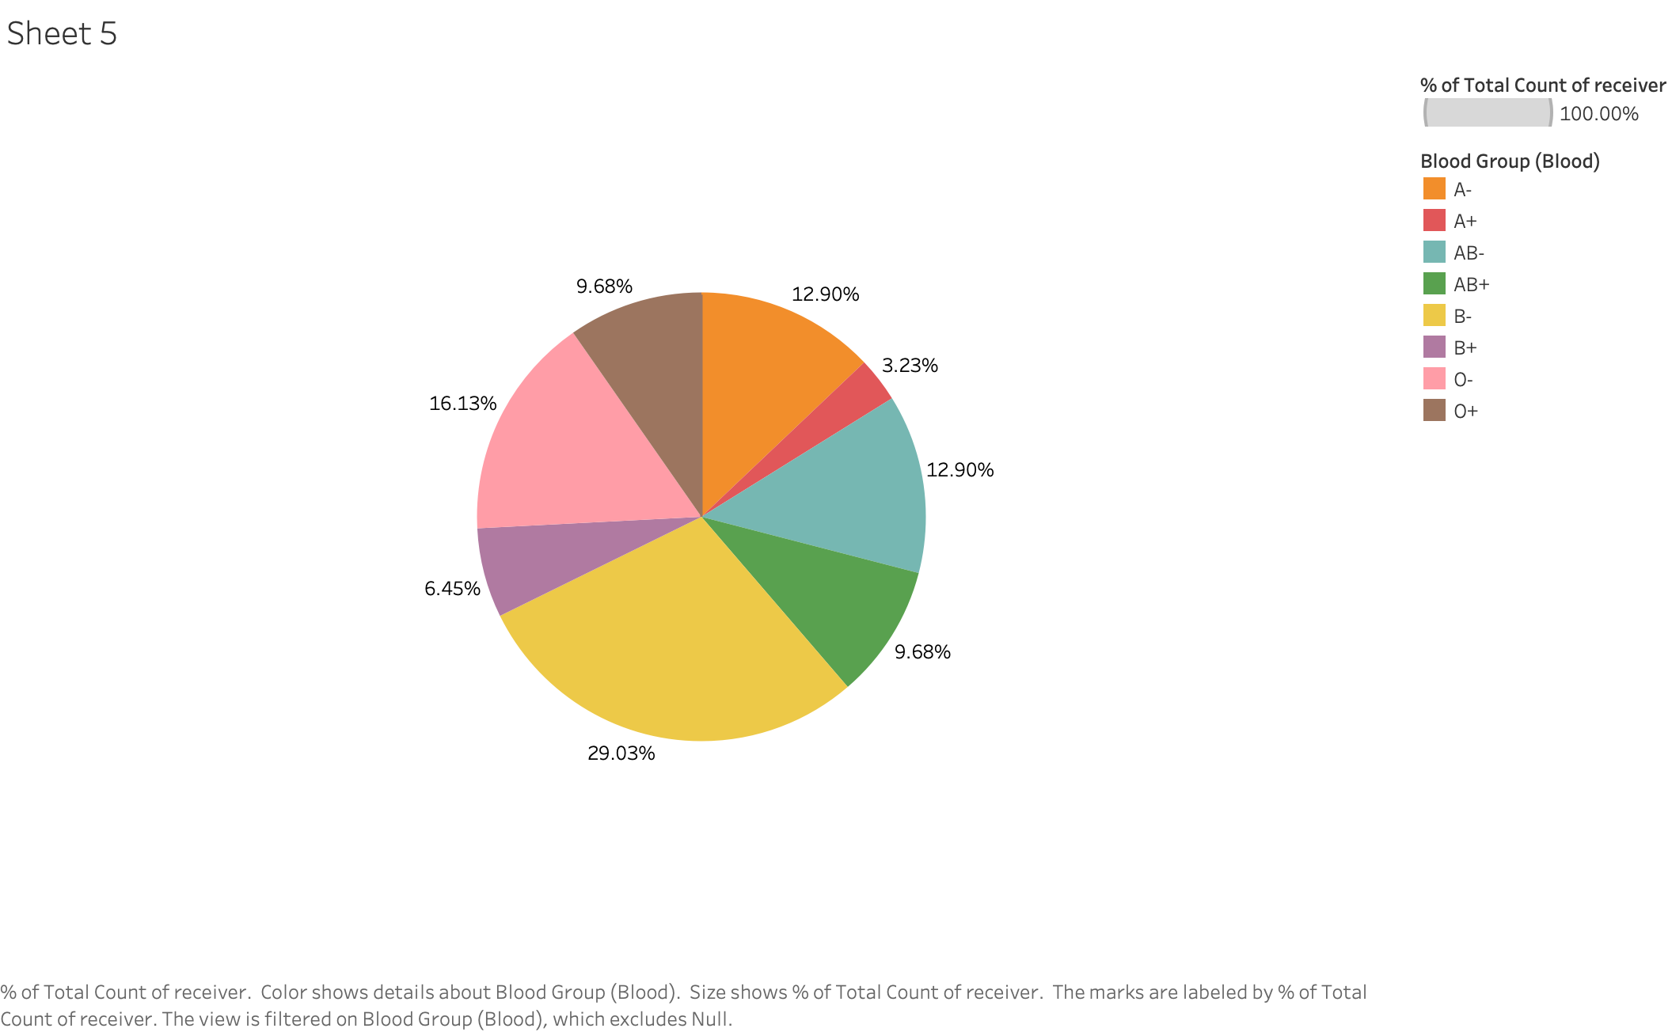

Slide 6
