Slide 1





DMDD Group 6
Blood Bank Management System
Vivek Sharma
002105272
Shreya Ghate
001502858
Aayushi Pandey
002136336
Peng Chen
001098655
Mayuri More
002191194

Slide 2
Summary
A blood bank is a place where blood is collected and stored before providing it to the patients in need. Blood banks are usually scattered all over the place and are not easily accessible to the individuals who need them because of either health emergencies or blood shortages.
Hence it is vital that the blood banks have an organized database by which blood units can be supplied within the shortest time possible. In this database we are managing information of blood donors, Organizations, partners of the blood bank, receivers and records of blood units consumed.
In this database we have the following 12 main entities - Blood Bank, Blood, Hospital, Organization, Partners, Donor, Collector, Receiver, Record, System Administrators, Person, and Order Request.

Slide 3
Objectives
Creating a centralized database system for managing blood banks and the donor data. This data will be available to the blood banks in the state
Database to capture data of the organized blood donation drives and based on donor rich localities to organize donor rich localities
Partner with hospitals to prioritize providing blood, whenever required. This will help in regularly blood assistance to patients in need
Maintain a database of donors. This will help us in keeping a track of their frequency of blood donations and contact them in case of emergency
This centralized database can be accessed by authorized personnel only. We will create a secured system as we will be maintaining sensitive information
Generating a monthly report of quantities of blood donated and collected. This will help required authorities to analyze data and manage blood accordingly

Slide 4
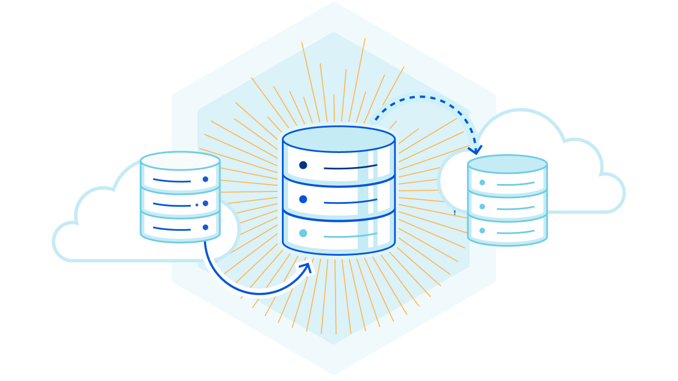
High Level Design
In the ERD we are displaying different entities and their relationship using draw.io
Record is one of the main entities in the ERD as it connects to all the entities providing main information
This application will start with a system administrator who will login into the system and perform various activities on different entities

Slide 5
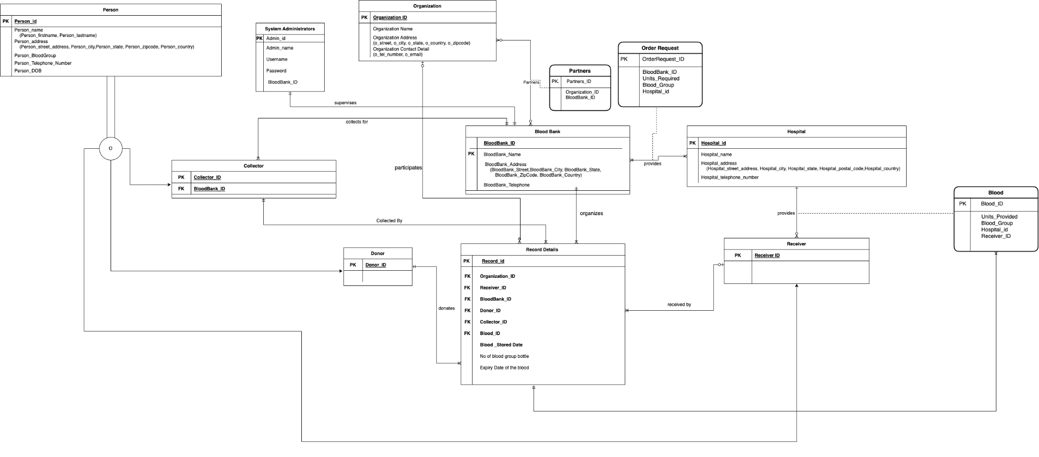
E-R Diagram

Slide 6
Database Objects
Stored Procedure:
Get Donor Details State Wise
Get Donors of Particular Blood Group
Get Organizations parterned with Blood Banks in a particular State
Triggers:
Automatically insert data to BloodUnit_Audit
Encryption:
Encrypted the username of admin
Encrypted the password of admin
Transaction:
Insert data, and rollback if errors happen
Tables:
14 tables
Views:
Donor List,
DONOR_LIST_ONegative
Total Units of blood
UDF:
Storage Time of blood
Role of person
Information of person
Computed Column based on UDF:
Person_age
Person_fullName

Slide 7
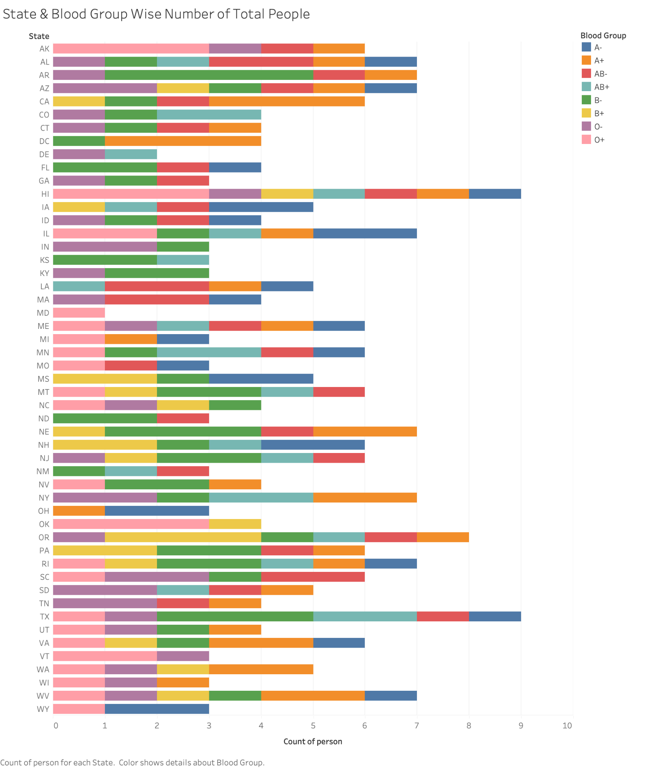
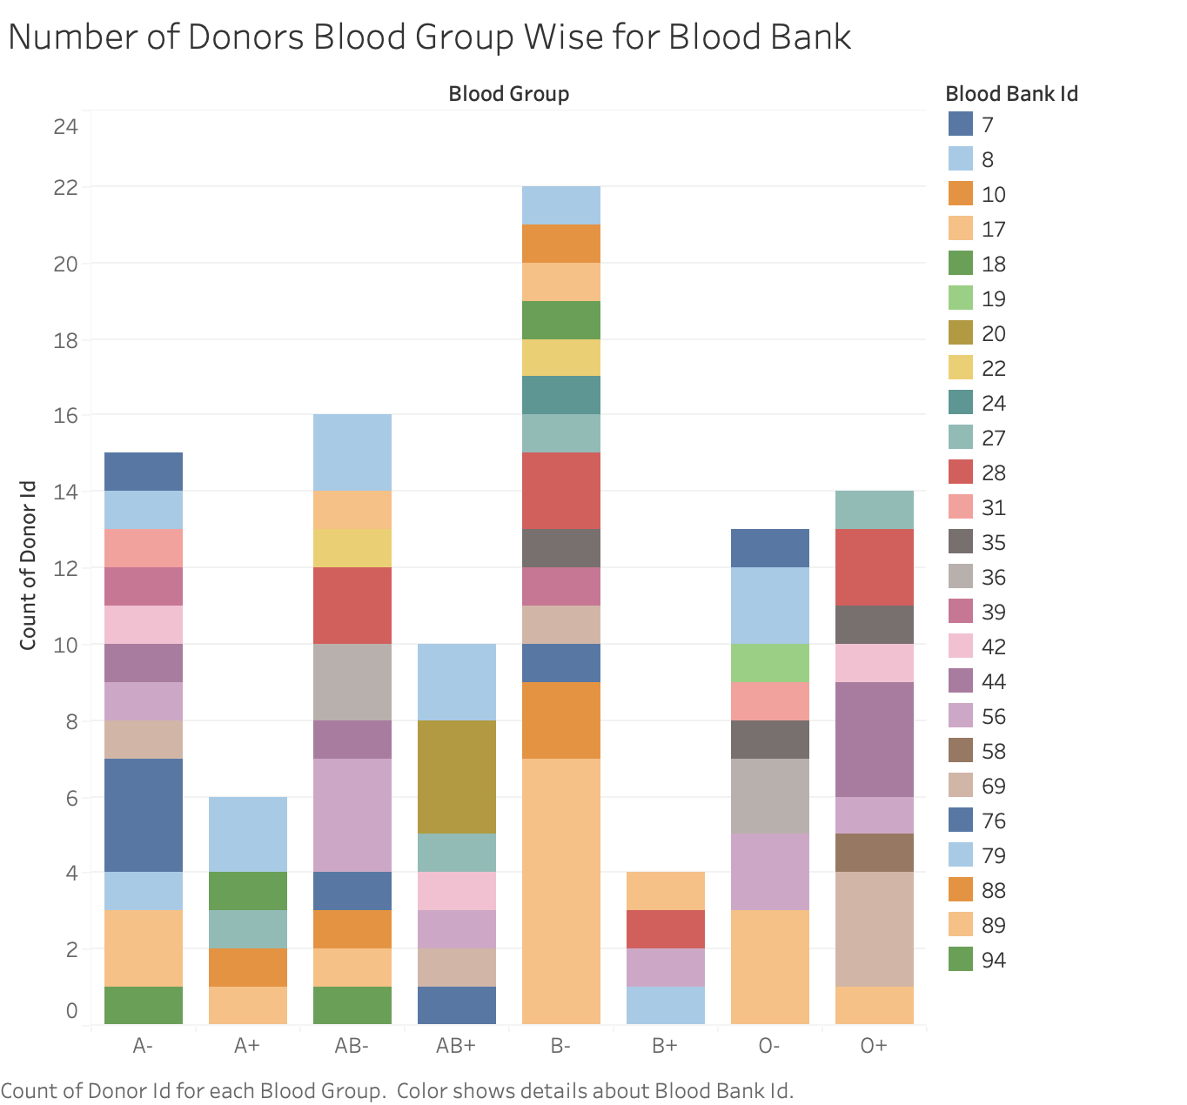

Slide 8
