Slide 1

Banking management System
Department of Computer Engineering
Mini Project Presentation
Name :- VIVEK KUMAR
Enrollment No :– 92201703084
Division :– 3EC2

Slide 2
Abstract
Introduction to Project
Feature of BMS
Challenges and Risks
Tools and Technologies
Existing System
Proposed System
Screenshots
Conclusion
Contents

Slide 3
The Banking Management System project aims to streamline and modernize the operations of financial institutions, ensuring efficiency, accuracy, and enhanced customer service. In today's rapidly evolving banking landscape, where customers demand convenient and secure services, this system addresses the need for a robust, versatile, and user-friendly platform.
Abstract

Slide 4
A Banking Management System, also known (BMS), is a comprehensive software solution designed to facilitate and streamline the operations and processes of a bank or financial institution. It provides an integrated platform that allows banks to efficiently manage various aspects of their operations, including customer accounts, transactions, financial products, and regulatory compliance
Introduction to Banking management system

Slide 5
A Banking Management System (BMS) is a comprehensive software application that helps banks and financial institutions manage their operations efficiently.Some points of feature of BMS
Customer Management:
Account Management
Transaction Processing
Loan and Create Management
ATM and Card management
Alerts and Notifications
Feature of BMS

Slide 6
When developing a Banking Management System project, there are several challenges and risks that should be considered
Security and Data Privacy
Interest rate risk :
User Training
Data Backups and Recovery
Cybersecurity Risks
Data management and Privacy
Challenges and Risk

Slide 7
Programming Language
Java
Html
SQL Query
JDBC
Swing and GUI
Tools and Technologies
Data Management System
My SQL
Xampp conncetion PhpAdmin.

Slide 8
BMS using Core Java, you will rely on various fundamental Java concepts to create a robust and functional application. Some core concepts commonly used in such projects
Classes and Objects:
Inheritance and Interfaces
Exception Handling
Collections Framework
File Handling
Database Connectivity
Date and time handling
Core Java Concepts used in Project

Slide 9
The term "Existing System" in a banking management system typically refers to the current state of the bank's software, hardware, and processes that are in use at a given point in time. It represents the technology and procedures that are currently being used to manage various aspects of banking operations. The details of the existing system can vary from one bank to another, but some common elements typically found in banking management systems include:
Existing System

Slide 10
The "Proposed System" in a banking management system refers to the new or updated software, hardware, and processes that an organization plans to implement in order to improve its banking operations. The proposed system is often designed to address shortcomings in the existing system, enhance efficiency, security, and customer service, and stay compliant with evolving regulatory requirements. Here are some common elements that may be part of a proposed system in a banking management context:
Proposed System

Slide 11
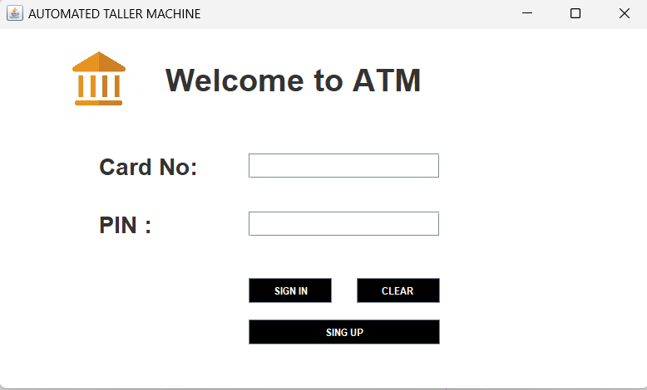
Screenshot 1
Screenshots
Click

Slide 12
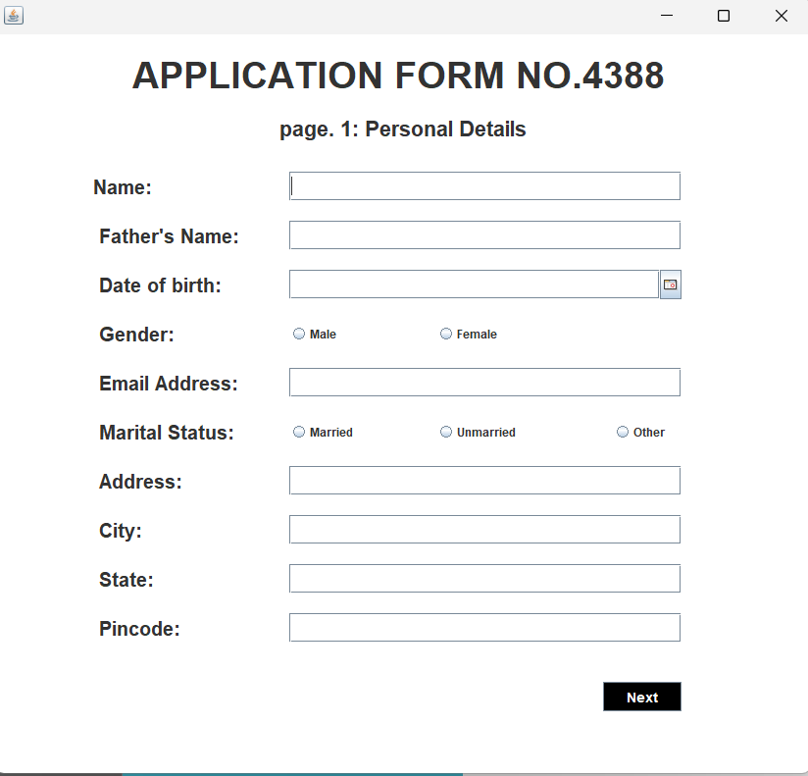
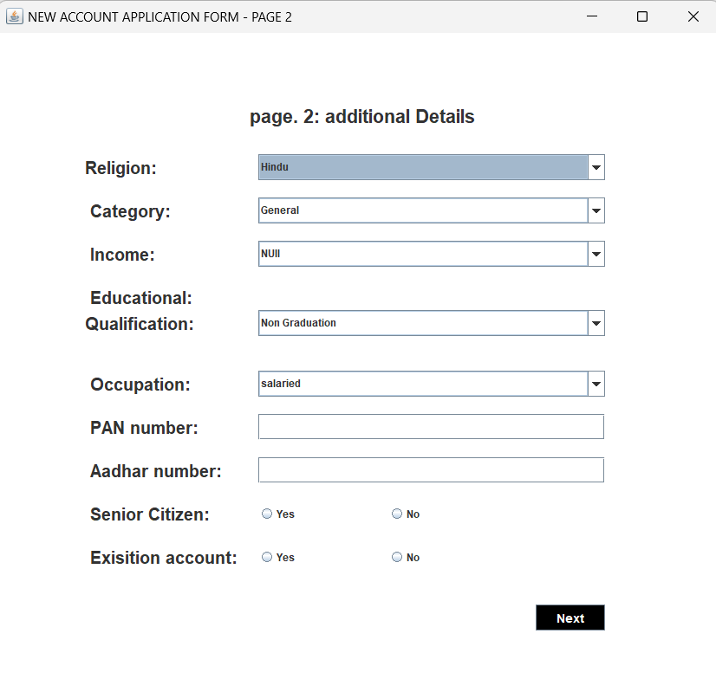
Screenshot 2
Fill the form
Screenshots
Click
Click

Slide 13
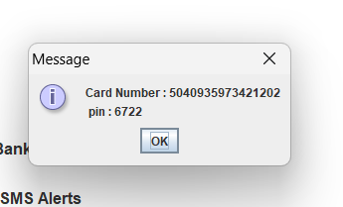
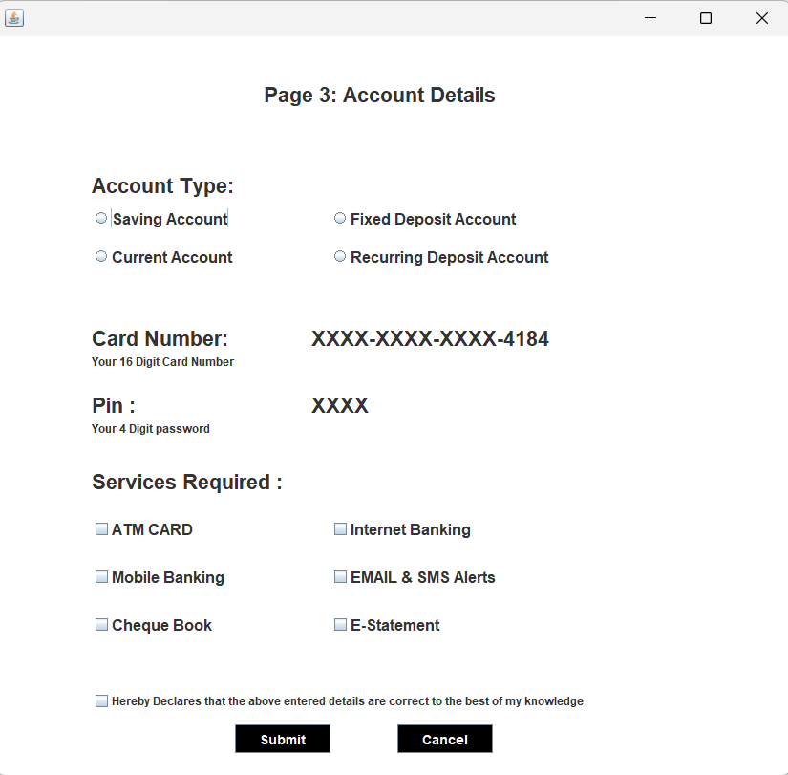
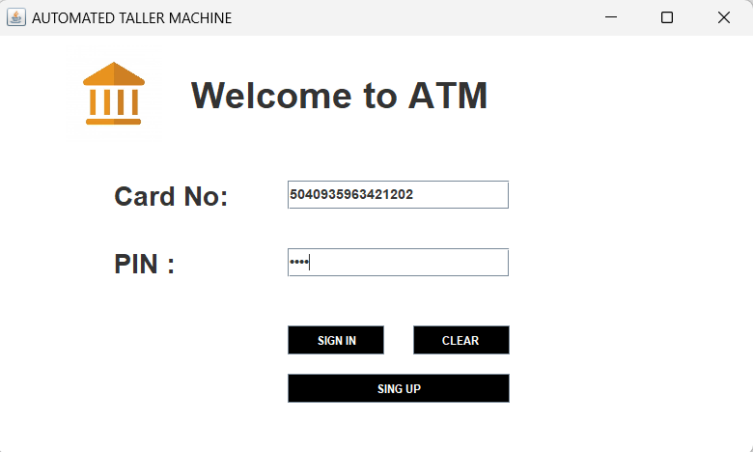
Screenshot 3
Generate the cardnumber and pin
Screenshots
signin
submit

Slide 14
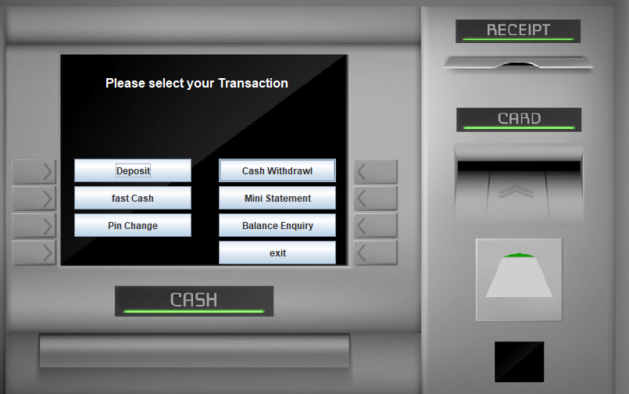
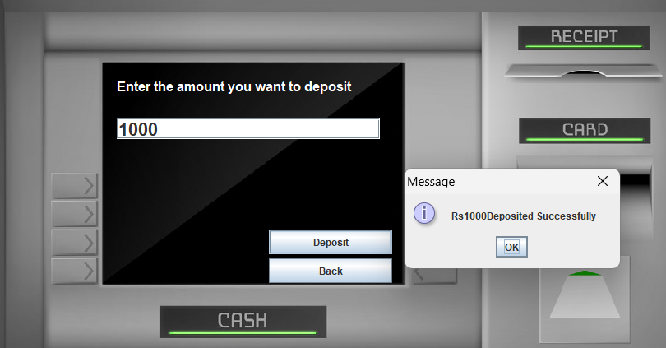
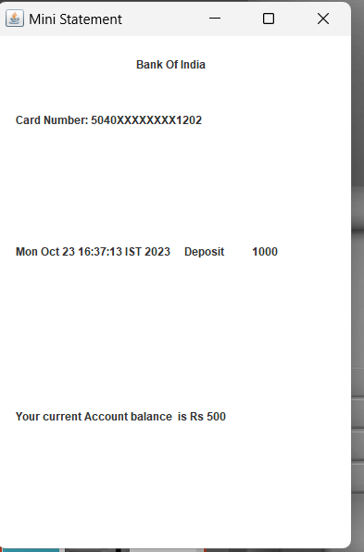
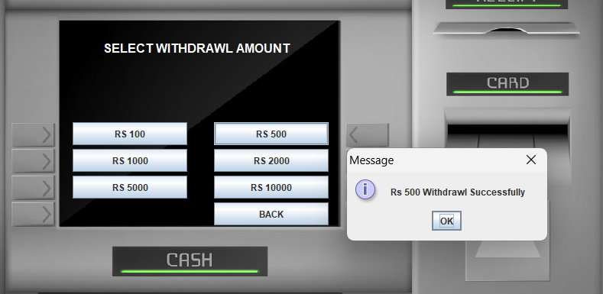
Screenshot 4
Click
Screenshots

Slide 15
The completion of the Banking Management System project represents a significant milestone in the journey to modernize and optimize the operations of the banking industry. This project was undertaken with the primary goal of addressing the limitations and challenges of the existing banking system while introducing advanced features and functionalities to enhance the efficiency, security, and overall customer experience within the financial sector
Conclusion

Slide 16
YouTube
Chatgpt
References

Slide 17


The End
Jay shree ram

