Slide 1

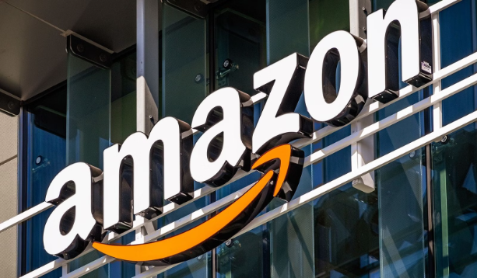
Amazon Sales Analysis
This presentation will provide a comprehensive analysis of Amazon's profits, examining key trends and insights to help business analysts, investors, and Amazon stakeholders gain a deeper understanding of the company's financial performance.
by Vivek Shirsat

Slide 2
Introduction
Amazon is a leading global e-commerce platform known for its vast selection of products and convenient shopping experience. With millions of customers worldwide, it has established itself as one of the largest retail e-commerce sites.

Slide 3
Sales Management Importance
Sales management has become increasingly crucial due to growing competition and the need for more efficient distribution methods to reduce costs and maximize profits. In fact, sales management is now considered the most vital function in commercial and business enterprises.

Slide 4
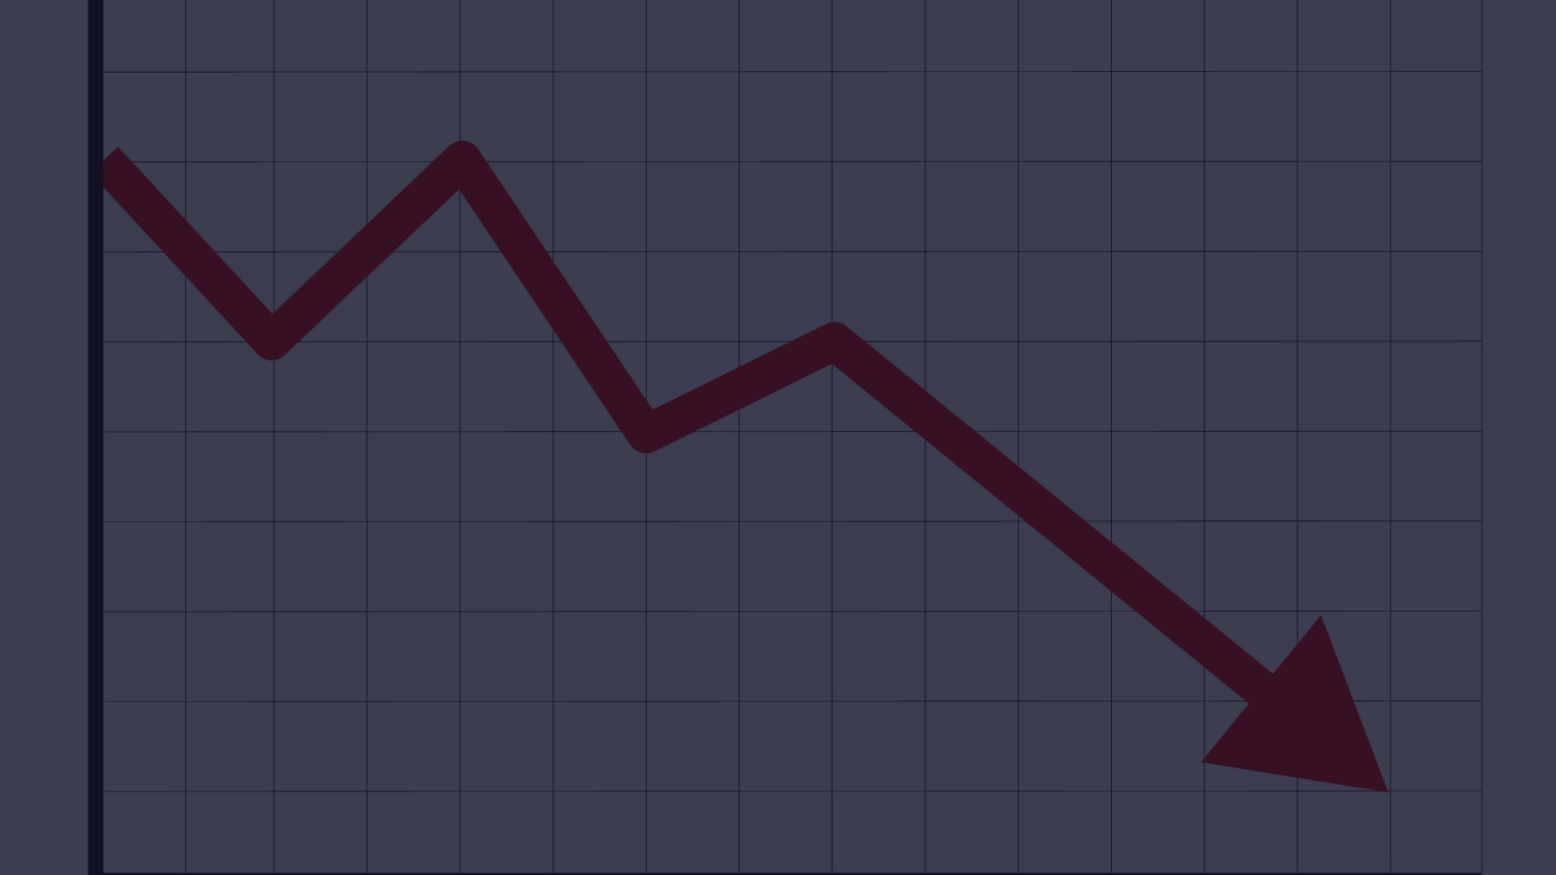
Declining Profits
Total Revenue and Total Profit have both trended downward between 2010 and 2017, with a 30.30% decrease in Total Revenue and a 38.32% decrease in Total Profit. This decline highlights the need for Amazon to identify and address the factors contributing to this negative trend.

Slide 5
Profit Composition
Highest Profit
Lowest Profit
Profit Trends
The Cosmetics product category had the highest Total Profit at $145,56,048.66, accounting for 32.96% of Amazon's total profits.
In contrast, the Fruits category had the lowest Total Profit at only $120,495.18, which was 11,980.19% lower than Cosmetics.
Total Profit dropped significantly from $66,29,567.43 to $40,89,353.45 during its steepest decline between 2010 and 2017.

Slide 6

Profit and Revenue Relationship
Quarterly Trends
Correlation
Across all quarters, Total Profit ranged from $85,01,905.76 to $133,20,753.97, while Total Revenue ranged from $221,12,445.97 to $431,05,261.49.
Total Profit and Total Revenue are positively correlated, indicating that as revenue increases, profits also tend to rise.
1
2
3
Divergence
However, the greatest divergence between Total Revenue and Total Profit occurred in Q4, with Total Revenue being $297,84,507.52 higher than Total Profit.

Slide 7
Sales Channel Performance
Offline Sales
Online Sales
Regional Insights
Offline sales accounted for 53.97% of total Units Sold, indicating that Amazon's physical retail channels are a significant contributor to its overall sales.
Online sales, at 236,089 Units Sold, were lower than Offline sales at 276,782 Units Sold, highlighting the importance of Amazon's multichannel approach.
Geographically, Sub-Saharan Africa had the highest Total Revenue at $396,72,031.43, while North America had the lowest at $56,43,356.55.

Slide 8
Profit Drivers
1
Cosmetics Lead
2
Offline Dominance
The Cosmetics product category was the largest contributor to Amazon's Total Profit, accounting for nearly one-third of the company's overall profits.
Offline sales channels accounted for the majority of Units Sold, highlighting the importance of Amazon's physical retail presence.
3
Regional Variations
4
Profit Decline
Total Revenue varied significantly across regions, with Sub-Saharan Africa generating the highest and North America the lowest.
The steep 38.32% decrease in Total Profit from 2010 to 2017 is a cause for concern and requires further analysis.

Slide 9




Quarterly Profit Trends
Q1
Q2
Q3
Q4
Total Profit ranged from $85,01,905.76 to $95,53,108.18 across the quarters.
Total Profit varied between $89,26,686.04 and $110,98,604.19.
Total Profit fluctuated from $90,13,896.59 to $119,31,449.55.
The highest Total Profit was observed in Q4, ranging from $114,89,753.97 to $133,20,753.97.

Slide 10

Power BI Dashboard

Slide 11
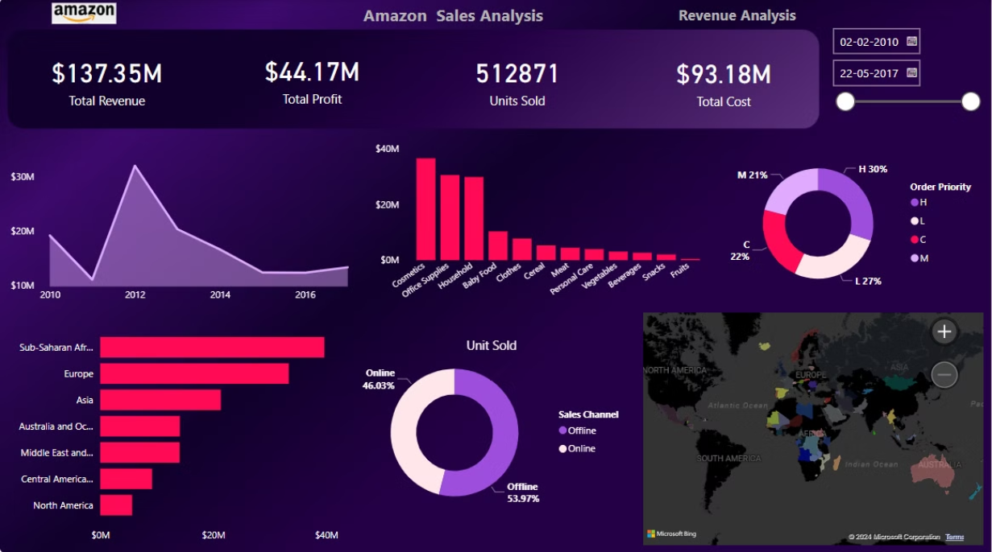
Power BI Dashboard

Slide 12
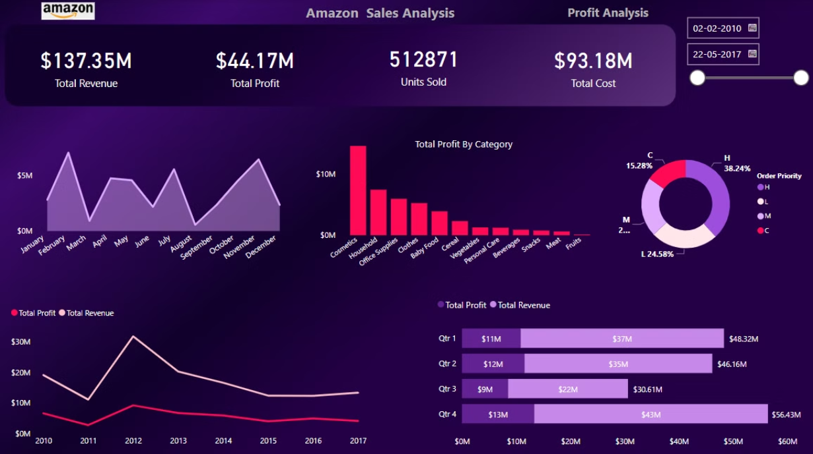
Power BI Dashboard

Slide 13
Key Takeaways
Profit Decline
Profit Composition
Amazon's Total Profit has declined significantly, dropping 38.32% between 2010 and 2017, which requires further investigation.
The Cosmetics category was the largest contributor to Amazon's Total Profit, accounting for nearly one-third of the company's overall profits.
Sales Channels
Regional Performance
Offline sales channels accounted for the majority of Units Sold, highlighting the importance of Amazon's physical retail presence.
Total Revenue varied significantly across regions, with Sub-Saharan Africa generating the highest and North America the lowest.

Slide 14
Thank You !

