Slide 1
Automated CI/CD Pipeline for Microservices on Kubernetes using Jenkins & AI-Driven Remediation
Project Phase-1 (24MCAP1) - Internal Assessment 1
Vivek Kumar Singh | USN: 1MS24MC111
Guide: Dr. D. Evangelin Geetha, Professor
Department of MCA
Ramaiah Institute of Technology, Bengaluru

Slide 2
Problem Statement
Manual deployment of microservices is slow, error-prone, and causes configuration drift across Dev / Test / Prod environments.
Traditional "fail-fast" CI/CD pipelines halt on every build error and wait for a human to debug, increasing Mean Time to Recovery (MTTR).
The "works on my machine" syndrome and lack of integrated security scanning lead to vulnerable, inconsistent production releases.
Real-world relevance: enterprises need self-healing, secure, zero-downtime delivery pipelines to keep up with modern release velocity.

Slide 3
Objectives
Design an end-to-end automated CI/CD workflow that builds, tests, secures, and deploys containerized applications.
Enforce Immutable Infrastructure using Docker for consistency across all environments.
Embed DevSecOps by integrating Trivy vulnerability scanning early in the pipeline ("Shift Left").
Leverage Kubernetes Rolling Updates for resilient, zero-downtime deployments.
Validate AI-based self-correction (LLM agent) for autonomous resolution of common build/test errors.

Slide 4
Methodology
Approach: Modular, event-driven CI/CD pipeline integrating SCM, build, security, orchestration, and an AI remediation layer.
Tools / techniques: GitHub Webhooks trigger Jenkins; Docker for containerization; Trivy for CVE scanning; Kubernetes (EKS / MicroK8s) for orchestration; LLM (OpenAI / local Ollama) for log analysis.
Justification: Jenkins + Kubernetes is the dominant DevOps standard; adding an AI layer closes the gap of intelligent self-healing identified in the literature.
Validation: pipeline tested under varying load and induced failure scenarios, comparing manual vs. automated metrics.

Slide 5
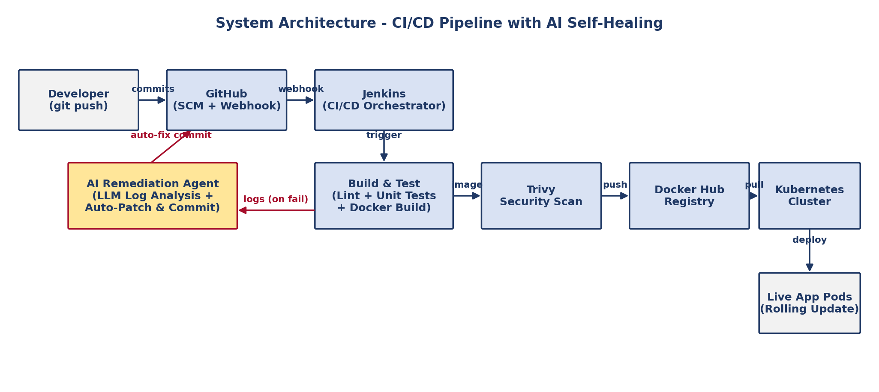
System Design - Architecture
Modular pipeline integrates SCM, CI, security scan, registry, K8s and an AI Remediation feedback loop.
Change incorporated: AI-Driven Remediation Agent (red path) replaces traditional fail-fast with self-healing.

Slide 6
Tools & Technologies
Languages: Python 3.9+ (AI agent), Groovy (Jenkinsfile), YAML (Kubernetes manifests), Bash (helper scripts).
Frameworks / Engines: Jenkins (LTS) for CI/CD orchestration; OpenAI API / local LLM (Ollama) for remediation.
Tools: Git & GitHub (SCM + Webhooks), Docker (containerization), Trivy (vulnerability scanning), kubectl (K8s CLI).
Platforms: Kubernetes (AWS EKS / MicroK8s), Docker Hub , Ubuntu 20.04 LTS hosts on AWS EC2.

Slide 7
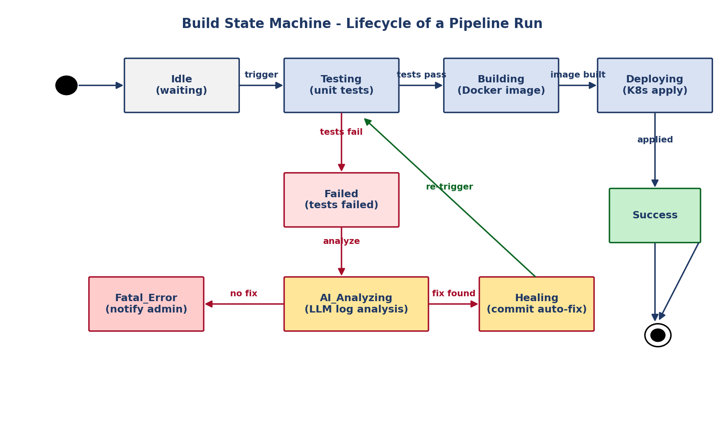
Implementation - Build Lifecycle
Each pipeline run flows through Idle -> Testing -> Building -> Deploying -> Success.
On test failure the AI Remediation Agent enters AI_Analyzing -> Healing (commit auto-fix) -> re-trigger; if no fix is found within RetryLimit (=2), the build moves to Fatal_Error and notifies the admin.

Slide 8
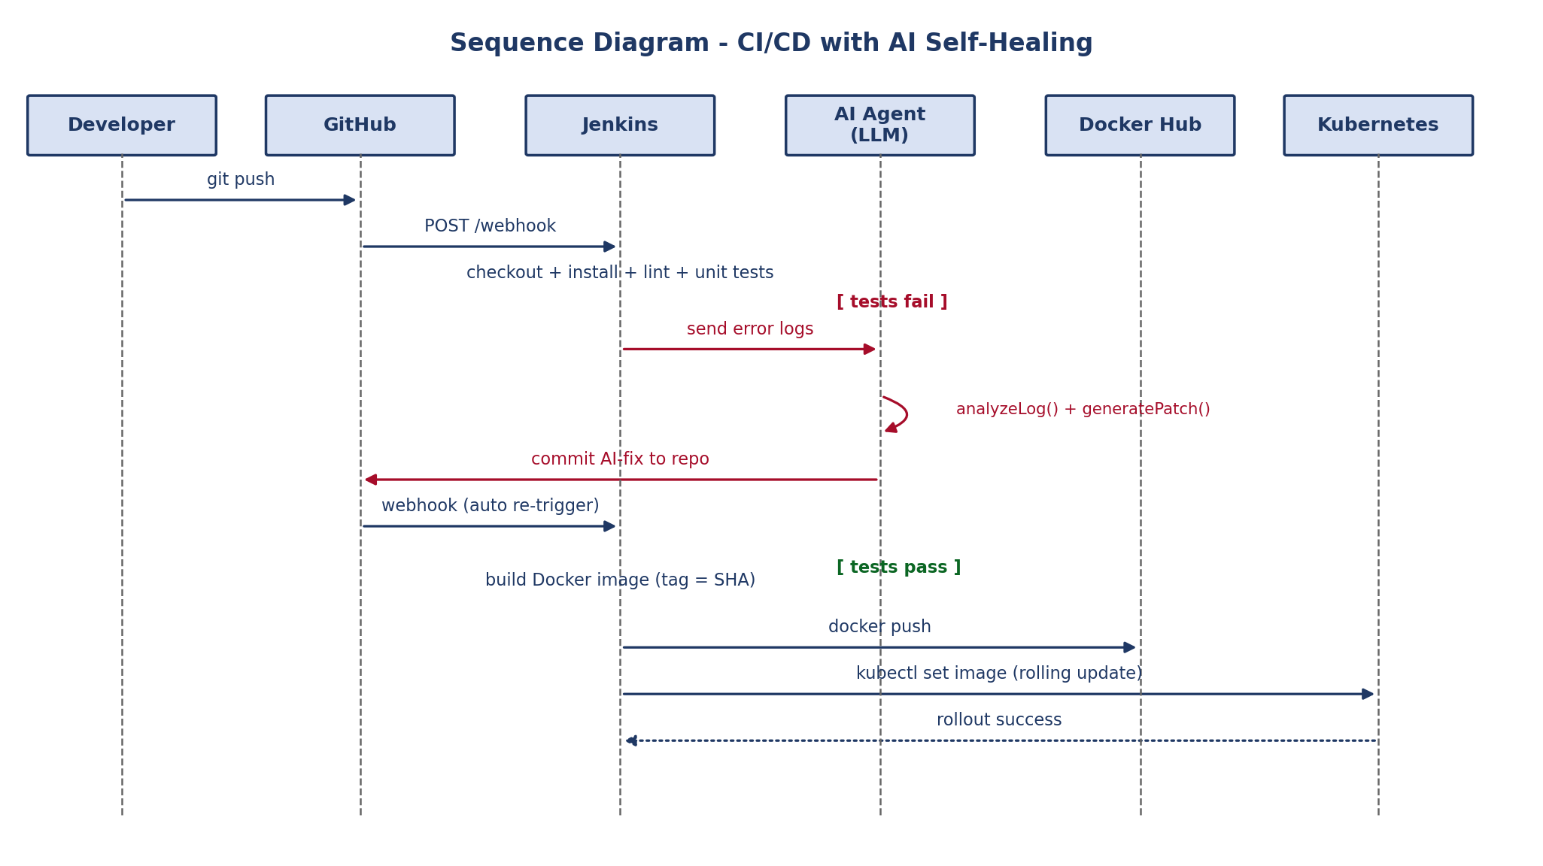
Workflow - Sequence Diagram
GitHub webhook triggers Jenkins, which runs checkout, install, lint and tests; on failure the AI Agent (LLM) analyzes logs, commits a patch and re-triggers the pipeline.
On success: Docker image (tagged with Commit SHA) is pushed to Docker Hub and rolled out to Kubernetes with zero downtime.

Slide 9
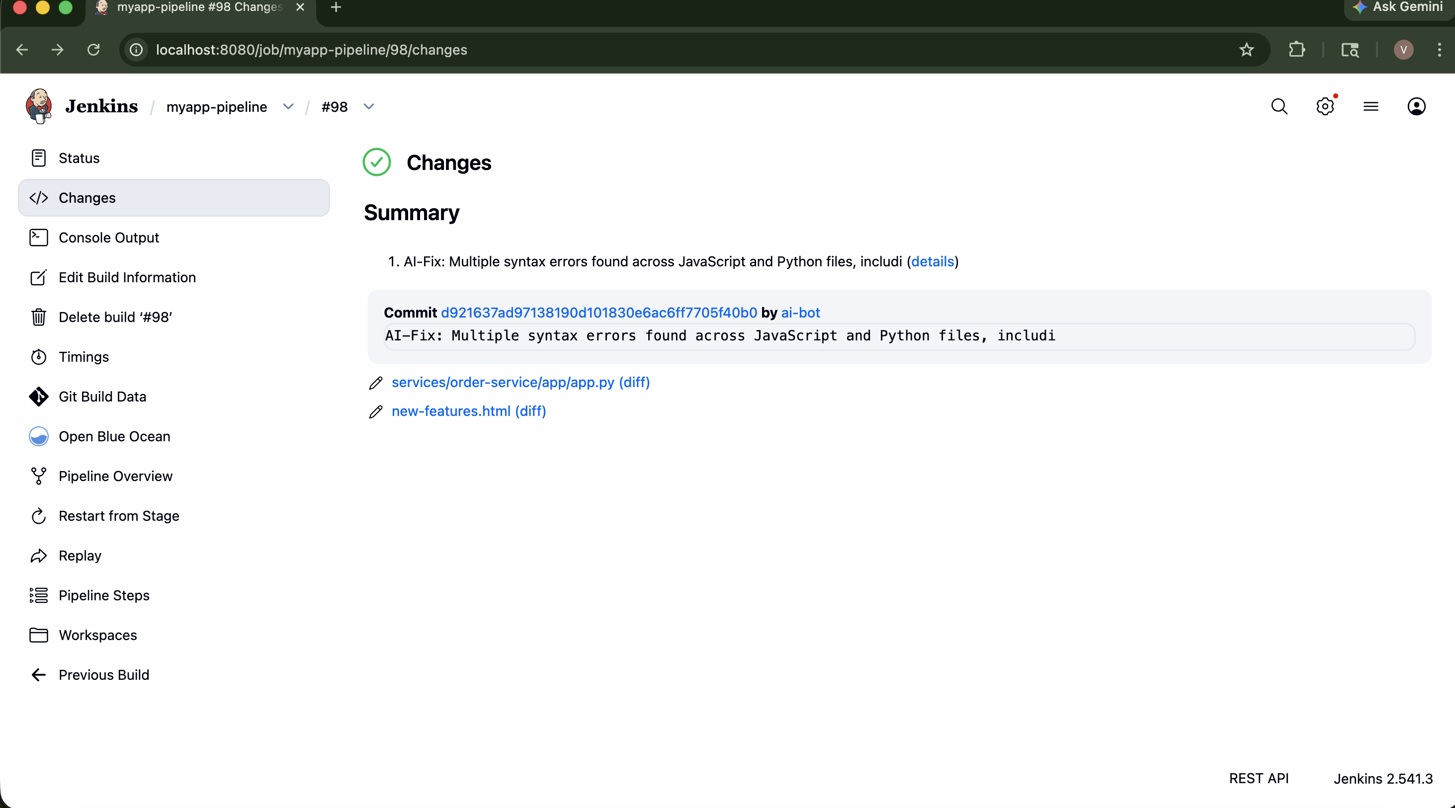
Results

Slide 10
Challenges
Issue: AI hallucinations producing unsafe code patches. Solution: enforce Confidence-Score threshold (>0.8) and Max-Retry limit; log every prompt + patch for audit.
Issue: leakage of secrets to external LLM APIs. Solution: scrub credentials from logs before sending; restrict prompt context to error window only.
Issue: limited hardware (AWS Free Tier - 1 vCPU / 1 GB) slowed parallel builds. Solution: dynamic Jenkins agents and lightweight MicroK8s for local testing.
Issue: integrating Trivy without breaking developer flow. Solution: "fail fast" only on High / Critical CVEs; warnings for the rest.

Slide 11
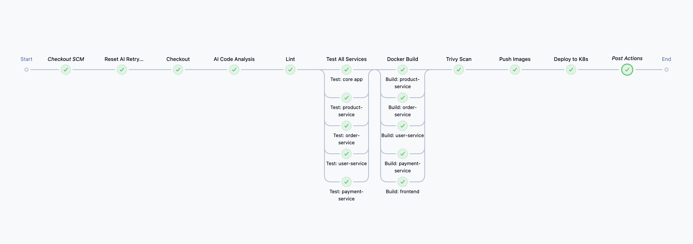
Demo / Current Status

Slide 12
References
[1] A. K. Manukonda, "Building CI/CD Pipelines for Automated Deployments Using Jenkins," Int. J. of Core Engg. & Mgmt., vol. 7(5), pp. 409-434, 2023.
[2] A. Yaqoob, "Automating CI/CD Pipelines for Containerized Microservices Deployment on Kubernetes Using Jenkins and AWS EC2," M.S. thesis, Tampere Univ., 2025.
[3] M. K. Abhishek, D. R. Rao, K. Subrahmanyam, "Framework to Deploy Containers using Kubernetes and CI/CD Pipeline," IJACSA, vol. 13(4), 2022.
[4] N. Deshpande, M. Pandey, "Secure End-to-End Deployment with Integration of On-Premise and AWS Jenkins," Infosys View Point, vol. 1, 2022.
[5] R. Shrestha, A. Ray, "Streamlining Application Deployment: A CI/CD Pipeline for Kubernetes," IEEE IC2E, 2024.

