Slide 1

Data as a Service
Powered by

Slide 2

Guide : Dr. Hardik Joshi
Vivek Barbhaya : MCA-VI : 32
Data as a Service
Rohit Moga : MCA-VI : 32

Slide 3
Internship Details
Company Name : GlobalVox Inc.
Mentor Name : Jay Trivedi
Project Definition : Data and API as a Service
Project URL : http://150.136.150.122:8080/DAAS

Slide 4
What is Daas / Aaas ?
E-commerce platform
Selling of Watchlist Screenings
Selling of International Trade Data
B2B Modal

Slide 5
Technology Architecture
Front End
Back End
Other Tools
HTML, CSS, JavaScript
MySQL (Workbench)
Microsoft Teams
Thymeleaf
Java SpringBoot (IntellijIDEA)
ZOHO
Ajax, jQuery
Hibernate
Jenkins

Slide 6
Problem Statement
Hard to identify the genuineness of a customer
Very difficult to track record of International Trade Data
No system was available to smooth the International Trade

Slide 7
Proposed Solution
Our CDR team monitors the black listings of all countries around the globe
Provides the data and API to authenticate the customer / person / organization
Covers the International trade data ranging from customs to list of ports to product classification
Provides reach features in Watchlist Screening with categories such as Financial Frauds, International Terrorists, Interpole Bans etc.

Slide 8
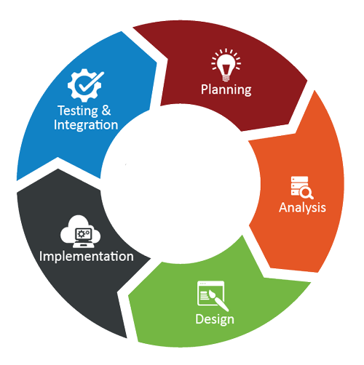

Software Building Approach
Agile Software Development Life Cycle

Slide 9





System Process Flow
Shop for
Customs Data
Web Services
Order Placed
Fired a mail
Download Invoice
Download Data file
Customer
Login and
Registration
My Account
Online
Payment
via Stripe
My Orders
Subscription Details
View / Edit Profile
Change Password

Slide 10
Use Case Diagram

Slide 11
Activity Diagram

Slide 12
Entity Relationship
Diagram

Slide 13
Sequence Diagram

Slide 14
Deployment
Diagram

Slide 15
THANKS!
ANY QUESTIONS?

