Slide 1
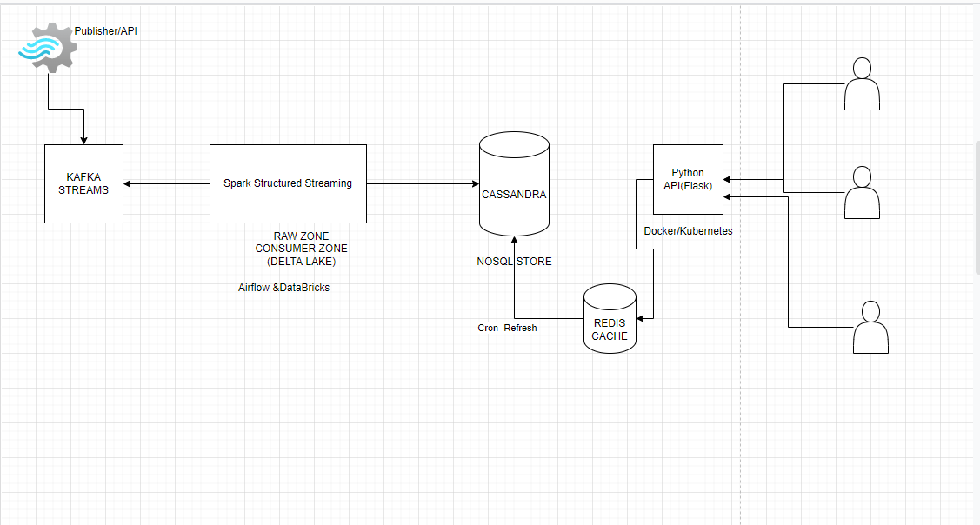
Architecture

Slide 2
Horizontal Scalable Components
API on Docker/Kubernetes
Cassandra &Redis
Structured Streaming App hosted on Databricks

