Slide 1

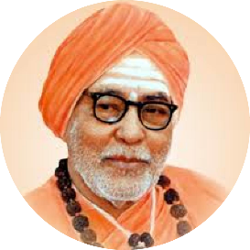


An ISO 21001:2018 certified institution | S. S. Education Trust’s CET Code: E-175 (UG)/T-942 (PG) S. G. BALEKUNDRI INSTITUTE OF TECHNOLOGY Shivabasavanagar, Belagavi- 590 010, Karnataka- India • Approved by AICTE New Delhi • Recognised by Govt. of Karnataka • Affiliated to V T U, Belagavi
 | Department of Computer Science & Engineering Email: hod-ec@sgbit.edu.in, Dept. Extn.: 520 | Accredited by NBA, New Delhi
Project Phase – 2 Presentation
On
“Tourism Recommendation System based on Machine Learning"
Group No. 15 | Name of the Student | University Seat Number
 | Ms.Soumya Bailkeri | 2BU19CS045
 | Ms.Spoorti Koshavar | 2BU19CS046
 | Mr.Vivek Tigadi | 2BU19CS057
 | Mr.Shreyas Karadiguddi | 2BU20CS406
 | Under the Guidance of Prof. Siddharth Bhatkande Assistant Professor, Dept. of CSE S. G. Balekundri Institute of Technology, Belagavi-10

Slide 2
Tourism Recommendation System based on Machine Learning

Slide 3
Contents
Introduction
Literature Review
Problem statement
Objectives
Requirement Specification
Proposed Architecture diagram
Design Diagrams
Screenshots
References

Slide 4
INTRODUCTION
Tourism and taking breaks from work reduces the stress felt by workers. Stress impacts focus, so stress-relieving vacations can help return focus through a reduction in stress. People have different destination options for the holidays but sometimes our options for vacations are not good all the time to visit every place, because some destination are only famous and worth visiting at a particular season. Hence choosing a destination based on the information available on the Internet and from various sources are the most difficult task during planning, before or after travel. There are many travel recommendation systems which provides many suggestions to users, but some technical, system and usability accuracy have been neglected. To overcome this problem, in-depth understanding of decision-making is necessary for searching information. Hence, we have proposed a Decision tree-based tourism recommendation system. This system will help for getting more information on the basis of the people’s review who visited the places. It will give the suggestion of all the desired place. This recommender system consists of two modules namely, Admin and User. Admin has authority to add the locations and view the added location. Users can view their desired location and the opinion analytics related to it on the basis of reviews.

Slide 5
Literature Review

Slide 6
PROBLEM STATEMENT
The most common difficulty faced by people is to decide which would be the most optimal path to be taken to reach their destination while planning for a trip.
Also people would want to know whether there are any site-seeing places that could be visited on the way to their destination and what would be the best time to travel to their destination.
The existing works have been focusing on how to find routes that minimize a single kind of trip cost such as trip time or distance, amongst others. However, it has been noticed that the existing systems have not considered the user interest in their recommendation systems. Some only suggest the best time to travel to the destinations.

Slide 7
OBJECTIVES
The application takes the source and destination as input from the user. It also asks the user to select his/her interest. An optimal path from the source to the destination is created which covers all the site-seeing places according to the user’s interest. It displays this optimal path that is generated based on the user’s interest on a map for better user readability.
It also displays a directions panel where the distance from every source to every other destination is mentioned so that the user can have a clear idea of the distance he/she will have to travel between source and destination by covering the intermediate places. It also recommends the best time to travel by analysing the weather data.

Slide 8
REQUIRED SPECIFICATIONS
Software Requirements:
Software requirement specifies the minimum software that is required for the application to run smoothly. The following are the software requirement for our project:
Windows 7 or higher
Python
Django framework
MySQL database

Slide 9
Hardware Requirements:
Hardware requirement specifies the minimum hardware that is required for the application to run smoothly. The following are the hardware requirement for our project:
Processor –Core i3
Hard Disk – 160 GB
Memory – 1GB RAM
Monitor

Slide 10
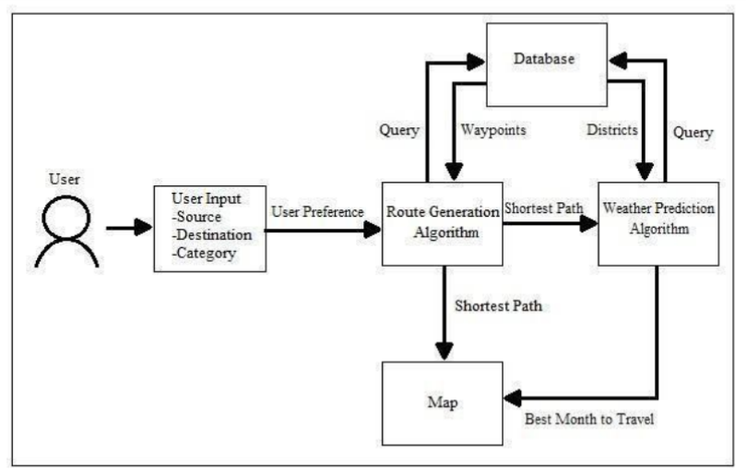
Proposed Architecture Diagram

