Slide 1
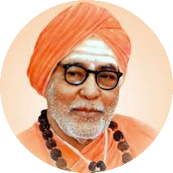


S. S. Education Trust’s
S. G. Balekundri Institute of Technology
Shivabasava Nagar, Belagavi - 590010, Karnataka, India.
Approved by AICTE, New Delhi & Affiliated to VTU, Belagavi
An ISO 21001:2018 Certified Institute | 5 UG Programs are NBA Accredited
Department of Computer Science and Engineering
VISVESVARAYA TECHNOLOGICAL UNIVERSITY
Jnana Sangama, Belagavi, Karnataka
Bachelor of Engineering Internship Project
on
Front-End Web Development
Presented By
Vivek T (2BU19CS057)
Company Name
Hamdan InfoCom
Under the Guidance of
Internship Coordinator Company Supervisor
Ms. Namratah Karade Mr. Mujahid Gokak

Slide 2

TABLE OF CONTENT
INTERNSHIP CERTIFICATE
COMPANY DESCRIPTION
COMPANY PROFILE
ABOUT THE COMPANY.
INTRODUCTION
TECHNOLOGY USED
IMPLEMENTATION
APPLICATIONS
ADVANTAGES OF INTERNSHIP
CONCLUSION
RESULT
REFERENCES

Slide 3
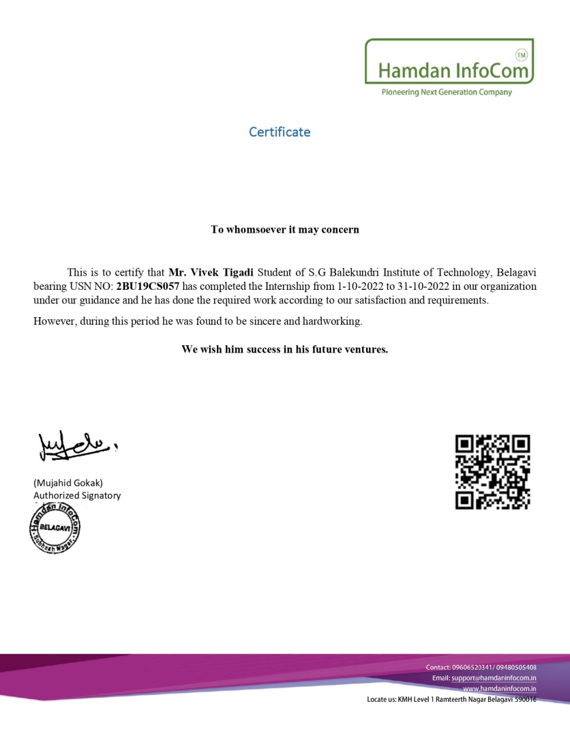
INTERNSHIP CERTIFICATE

Slide 4
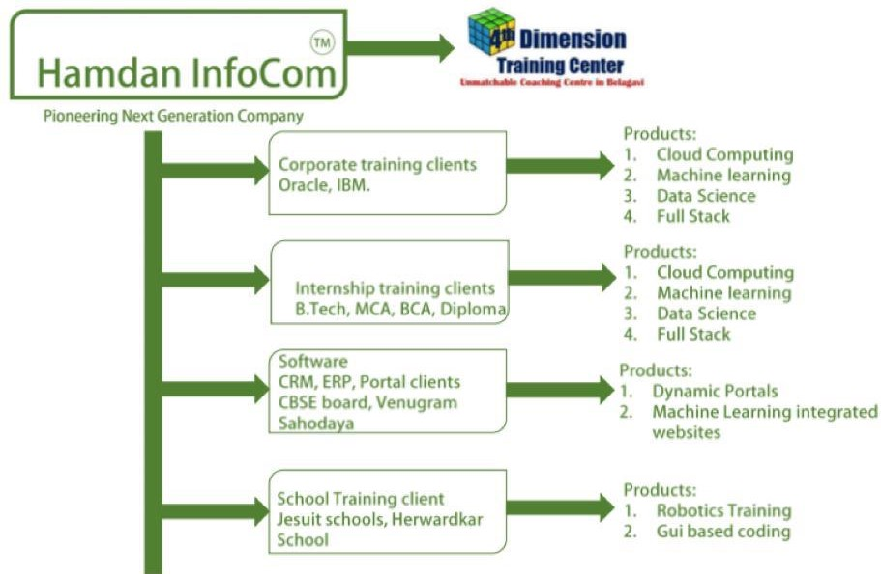
COMPANY DESCRIPTION
Company website : https://hamdaninfocom.in

Slide 5
INTRODUCTION
Front-end web development is the process of creating webpages and applications that are interactive and visually appealing. The Front end is the visible part of website or web application which is responsible for user experience.
The front-end part of web development is responsible for creating a visually appealing and interactive user interface.
It includes designing and implementing user interfaces, handling user events, and ensuring that the website is responsive and user-friendly on different devices.

Slide 6
TECHNOLOGY USED
HTML: (Hypertext Markup Language) It is the standard markup language used to create web pages. I learnt how to structure and organize content using HTML.
CSS: (Cascading Style Sheets) It is used to style and format web pages. I learnt how to use CSS to control the layout, typography, and colors of web pages.
JavaScript: JavaScript is a programming language used to create dynamic and interactive web pages. I learnt the basics of JavaScript to add interactivity and functionality to web pages.
Bootstrap: It is a popular front-end framework that makes it easy to create responsive and mobile-first web pages and applications.

Slide 7
IMPLEMENTATION
I first created the basic layout and structure of the web page using HTML. This includes defining the HTML tags, elements, and attributes that will be used to display text, images, and other media on the page.
Then applied styling and formatting to the HTML using CSS. This includes defining the layout, color scheme, font styles, and other visual elements of the page.
Then Bootstrap 4 is a popular CSS framework that provides pre-built UI components, such as buttons, forms, and navigation menus, that can be easily integrated into the web page.
I used JavaScript to add interactivity and dynamic behavior to the web page.
Overall I created Home page and About Us page using HTML, CSS, JavaScript, and Bootstrap.

Slide 8
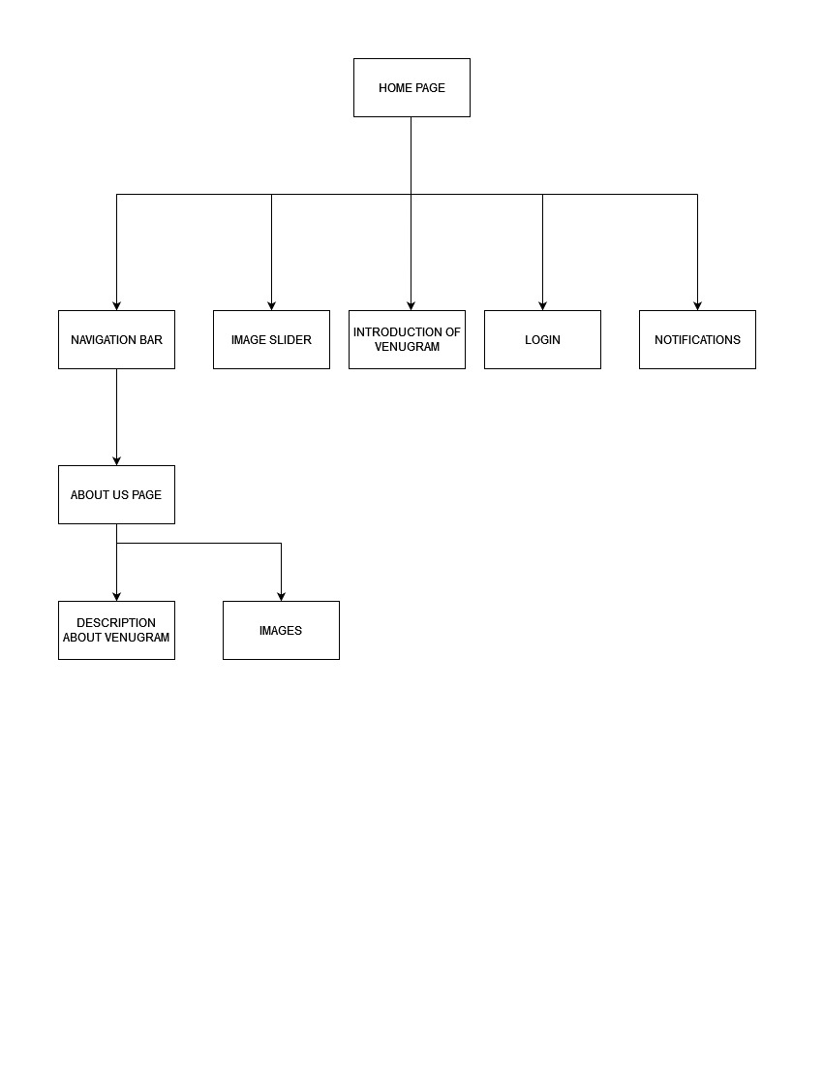
IMPLEMENTATION
Block Diagram:
Fig 1. Block Diagram of Home page and About us page

Slide 9
APPLICATIONS
Website design: Front-end web development is often used to design the layout and structure of a website, including choosing colors, typography, images, and other visual elements.
E-commerce development: Front-end web development is often used to create the user interface and shopping cart functionality of e-commerce websites.
Web animations and effects: Front-end web development is often used to create animations, transitions, and other visual effects on websites.
Responsive web design: Front-end web development is used to design websites that are optimized for different screen sizes, including desktops, laptops, tablets, and smartphones.

Slide 10
ADVANTAGES OF INTERNSHIP
Improved user experience: Front-end development ensures that the website is easy to navigate, visually appealing, and engaging, which leads to better user experience.
Wide Reach: With the internet being accessible worldwide websites have a vast reach, and they can target a broad audience with ease.
Cost-Effective: Building a website is relatively cheaper than other forms of advertising, such as print, TV, or radio.
Customizable: Websites can be tailored to meet specific business needs and can be designed to match the brand's aesthetics.
Enhanced functionality: Front-end development uses various frameworks and libraries to enhance the functionality of the website, making it more interactive and engaging.

Slide 11
CONCLUSION
Front-end web development is an essential aspect of web development that involves designing, coding and modifying the user interface of website.
Front-end web development is a constantly evolving field that requires a combination of technical expertise, creativity, and problem-solving skills.
With the rise of mobile devices and the increasing demand for fast, secure, and responsive websites and web applications, front-end web development has become even more challenging.
Front-end web development is a crucial aspect of businesses today as websites and web applications have become essential tools for marketing and communication.

Slide 12
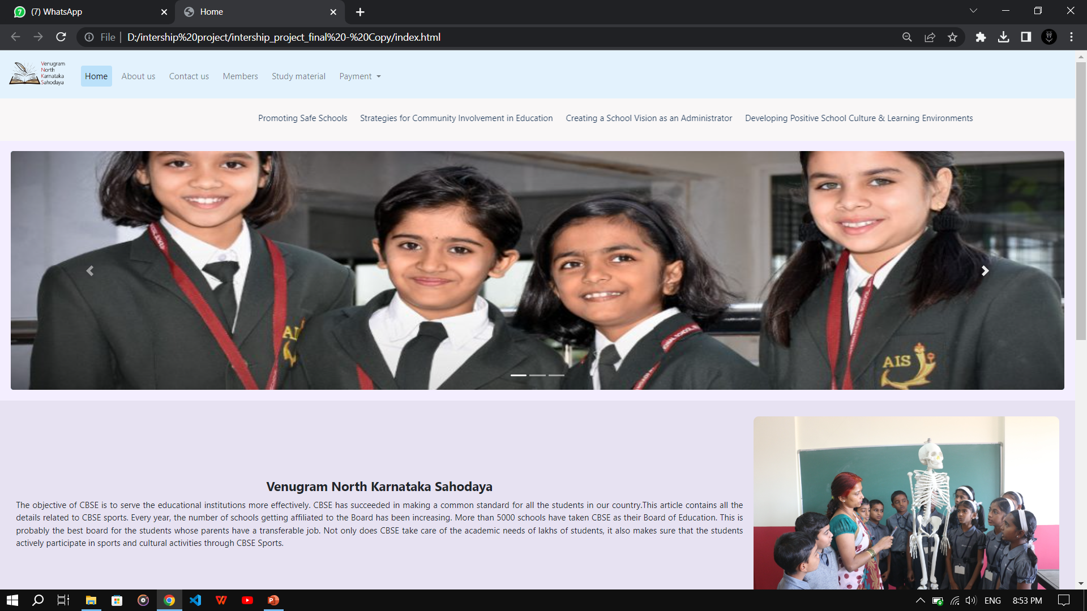
RESULTS
Home page

Slide 13
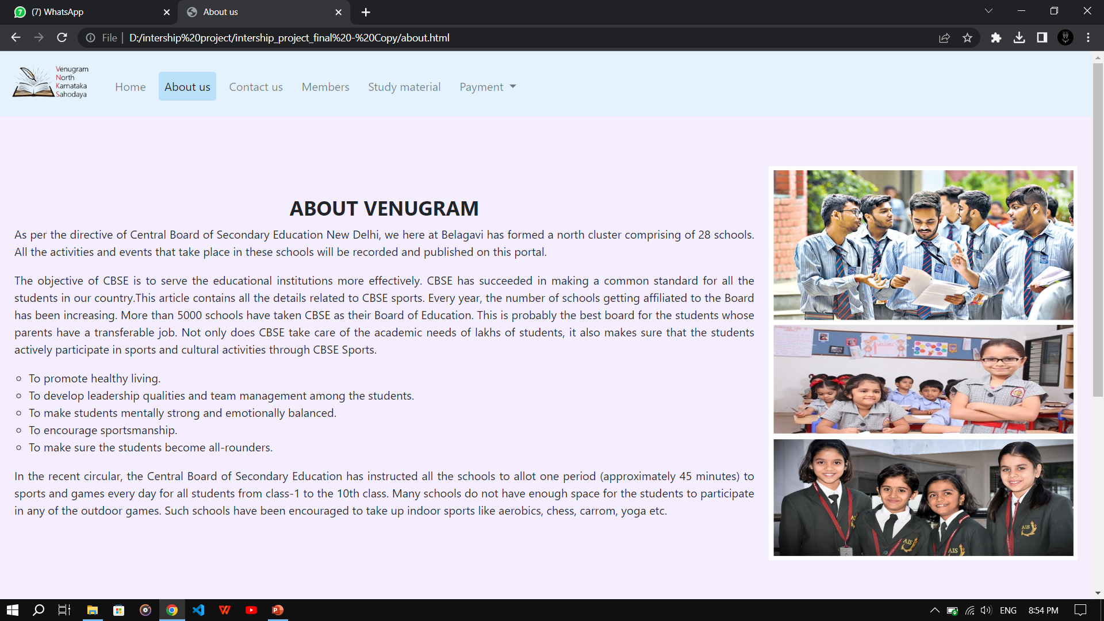
RESULTS
About us page

Slide 14
REFERENCES
[1] S K. Patel, Developing Responsive Web Applications, 2018.
[2] S. Murugesan, Y. Deshpande, S. Hansen et al., Web Engineering: a New Discipline for Development of Web-Based Systems[J], 2018.
[3] A.V. Akhil Krishna, Dr. Padmashree T," A Survey on Current Technologies for Web Development",International Journal of Engineering Research & Technology (IJERT),June 2020.
[4] Nian Li1, Bo Zhang1,"The Research on Single Page Application Front-end development Based on Vue ", 2021.
[5] Arnav Awasthi, Shubham More, Warren Viega,"Research and Analysis of the Front-end Frameworks and Libraries in Web Development", IJRASET, 2022.

Slide 15
THANK YOU

