Slide 1
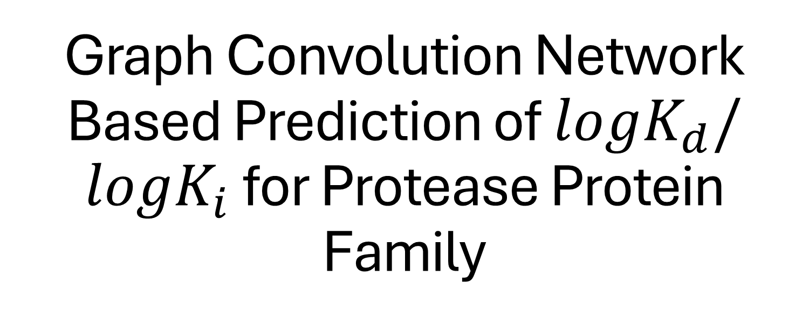
Graph Convolution Network Based Prediction of $logK_{d}/logK_{i}$ for Protease Protein Family
Vivek Tara

Slide 2
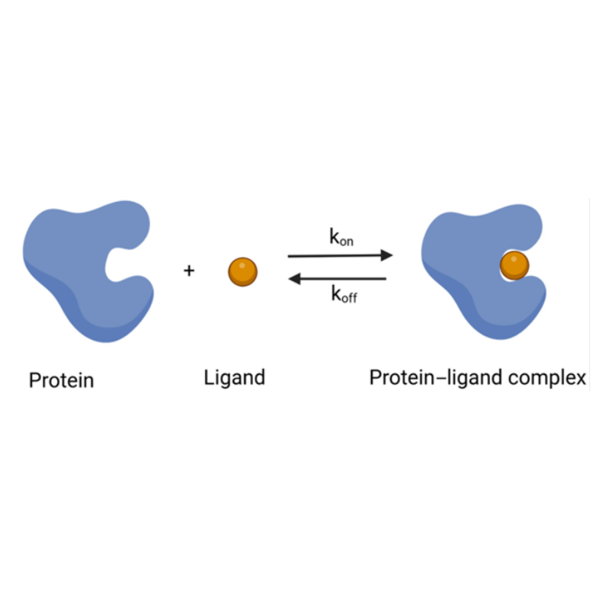

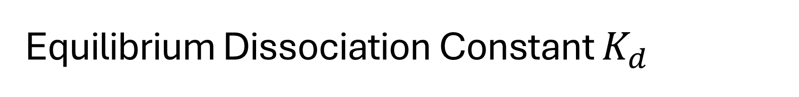


Equilibrium Dissociation Constant $K_{d}$
A measure of the affinity between a ligand and receptor.
Calculated when 50% of the receptors are bound to ligands.
For a given ligand-receptor binding reaction,
$$L+R ⟺LR$$
The equilibrium dissociation constant is given by,
$$K_{d}= \frac{\left[L\right][R]}{[LR]}$$
$K_{i}$ -> Inhibitory Constant

Slide 3
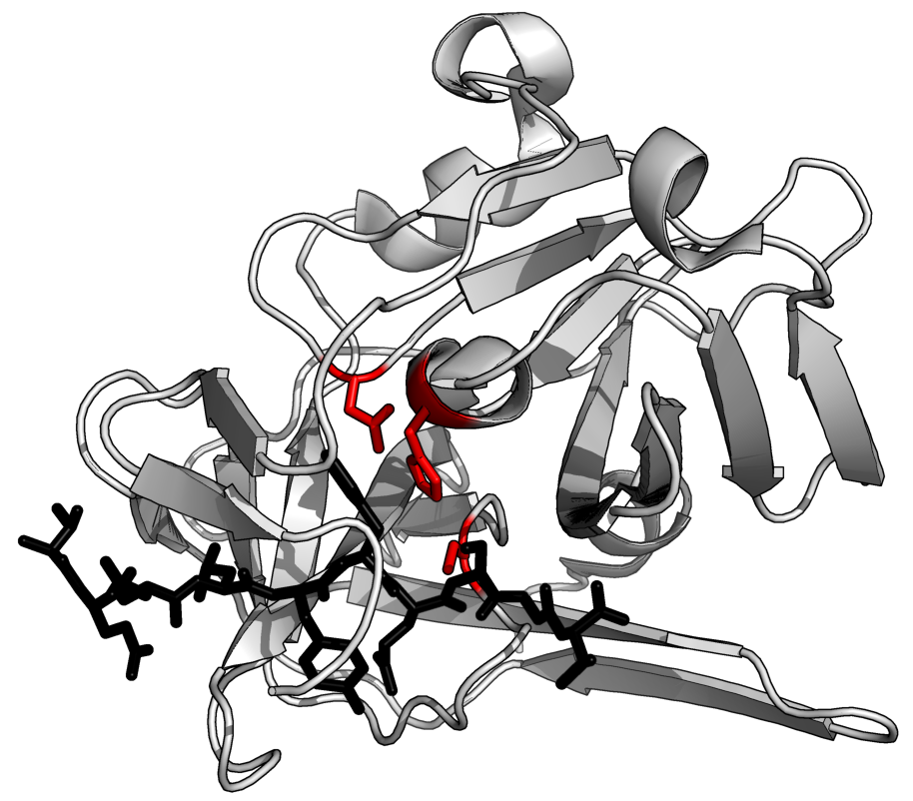
Protease
Enzymes that catalyzes proteolysis
  7 Broad Groups
  Inhibited by protease inhibitors

Slide 4
Raw Data and File Hierarchy
Root Directory
4858 total protein–ligand complexes
  Mol2 files contained ligand data
  SDF files contained ligand data
  PDB files contained protein data
Model files
refinded-set
1a1e
MolFromPDBFile()
MolFromMol2File()
1a4k
1a1e_ligand.mol2
RDKit Mol Objects
  4844 Protein Structures from PDB
  4841 Ligan Structures from Mol2
  2787 Ligan Structures from LDF
1a1e_ligand.sdf
1a1e_pocket.pdb
966c
1a1e_protein.pdb
index
Protease Only
  295 total Protein-Ligand Complexes
INDEX.geral_PL_data.2019
Protease_202524_004747.xlsx

Slide 5
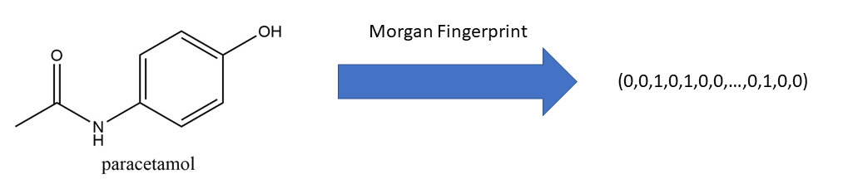
Tabular Data: Molecular Properties and Morgan Fingerprints
Molecular Properties Pulled from Protein and Ligand Mol Objects:
Exact Molecular Weight
Number of Radical Electrons
Number of Valence Electrons
Max Partial Charge
Min Partial Charge
Number of Hydrogen Donors
Number of Hydrogen Acceptors
Topological Polar Surface Area
Morgan Fingerprints:
Map certain structures of a molecule w/ a given radius into a hash table.
nBits = 2048
Radius = 4
$$8x2+2048x2=4112 Total Tabular Features$$

Slide 6
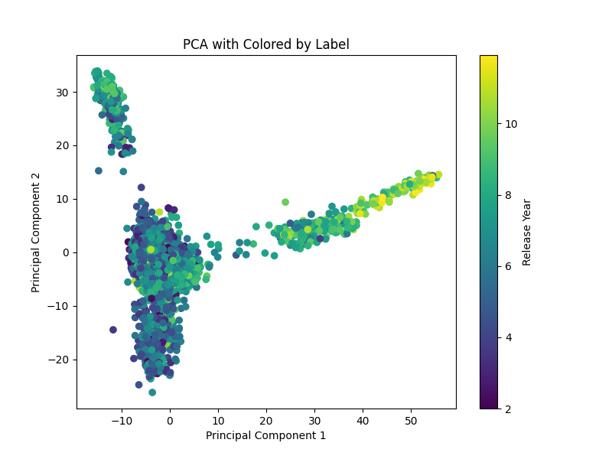
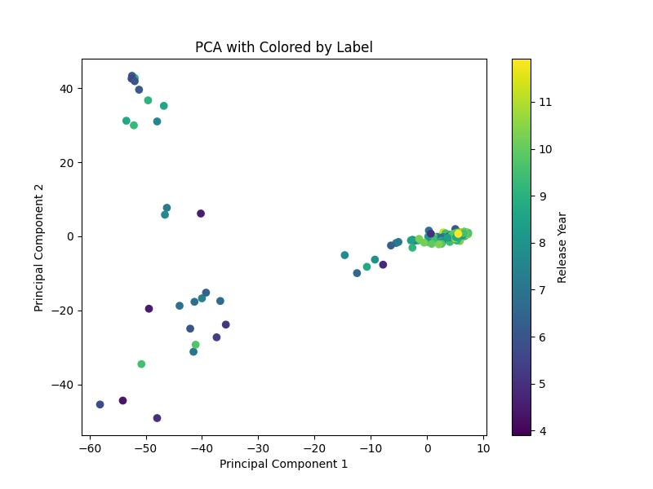
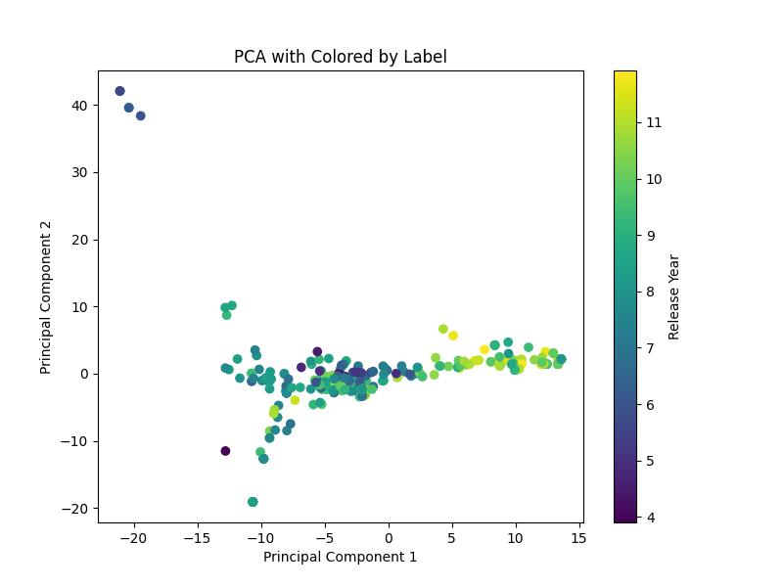
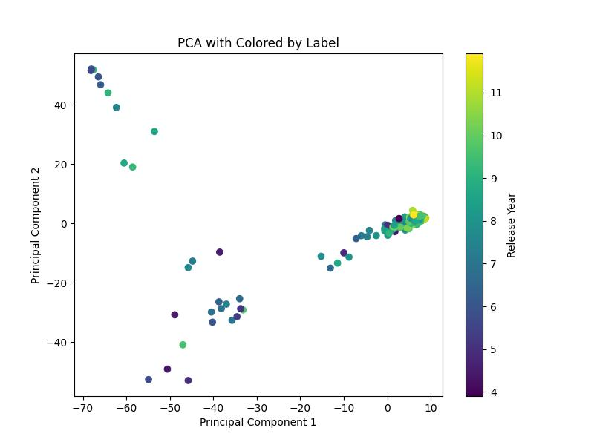
Principle Component Analysis
Of
Features
2D PCA Reduction of All Protein-Ligand Complex Tabular Data
2D PCA Reduction of Protein Tabular Data Only
2D PCA Reduction of Protease Protein-Ligand Complex Tabular Data Only
2D PCA Reduction of Ligand Tabular Data Only

Slide 7



Graph Representation of Molecules
$$H^{(l)}=$$
$$A=$$
E $=$
Node Features
m, n = (# atoms, # features)
30 Features in Implementation
Molecule Coordinate List
m, n = (2, 2*number of bonds)
Edge Features
m, n = (# atoms, # features)
11 Features in Implementation

Slide 8

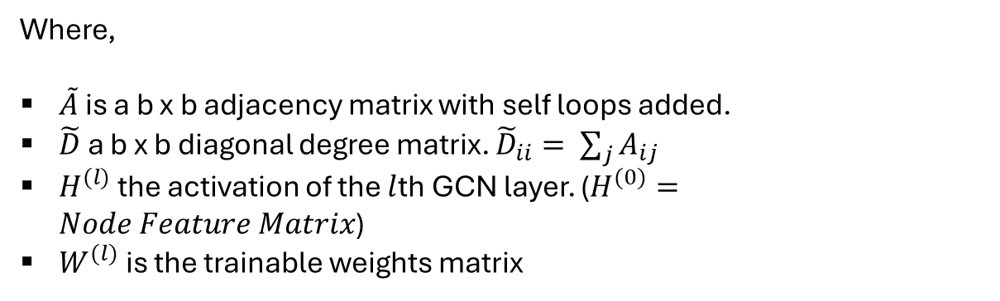






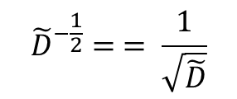

Graph Convolution Layer
The output of a GCN layer is given by,
Example: Input Layer from Implemented Model:
15,395 Atoms in Batch
30 Node Features per atom
64 Hidden Dimensions
$$H^{(l+1)}= σ({\tilde{D}}^{−\frac{1}{2}}\tilde{A}{\tilde{D}}^{−\frac{1}{2}}H^{(l)}W^{l})$$
Where,
$\tilde{A}$ is a b x b adjacency matrix with self loops added.
$\tilde{D}$ a b x b diagonal degree matrix. ${\tilde{D}}_{ii}= \sum_{j}{A_{ij}}$
$H^{(l)}$ the activation of the $l$th GCN layer. ($H^{(0)}=Node Feature Matrix$)
$W^{(l)}$ is the trainable weights matrix
$$H^{(1)}$$
$${\tilde{D}}^{−\frac{1}{2}}$$
$$\tilde{A}$$
$${\tilde{D}}^{−\frac{1}{2}}$$
$$H^{(0)}$$
$$W^{(0)}$$
$$=$$
15,395 x 64
15,395 x 15,395
15,395 x 15,395
15,395 x 15,395
15,395 x 30
$${\tilde{D}}^{−\frac{1}{2}}= = \frac{1}{\sqrt{\tilde{D}}}$$
30 x 64

Slide 9
Implemented Model
The model implemented in this project was a slight modification of the GCN Architecture from chapter 6.
Protein Node Features
BatchNorm1d
GCNConv
(30, 8)
ReLU
GCNConv
(64, 8)
RelU
Pooilng
Protein Coordinate List (COO)
Linear
Output
Ligand Protein Features
BatchNorm1d
GCNConv
(30, 8)
ReLU
GCNConv
(64, 8)
RelU
Pooilng
Ligand Coordinate List (COO)
Tabular Data

Slide 10
Experiments
Trial # | Epochs | Hidden Dims | Total Training Time (s) | RMSE | Relative Error
1 | 1000 | [64, 64] | 892.67 | 1.4049 | 0.167
2 | 500 | [64, 64] | 387.34 | 1.4457
3 | 500 | [32, 32] | 356.04 | 1.3790
4 | 250 | [32, 32] | 180.28 | 1.3129
5 | 250 | [16, 16] | 170.08 | 1.2735
6 | 250 | [8, 8] | 176.00 | 1.2539 | 0.148
Constant Training Parameters:
MSELoss
Adam Optimize
Learning Rate = 0.001

Slide 11
Possible Model Improvements
Normalize Tabular Data
Better Feature Selection For Tabular Data
Incorporate Edge Feature Data
Add Connections Earlier In the Model Between

Slide 12

Questions

