Slide 1


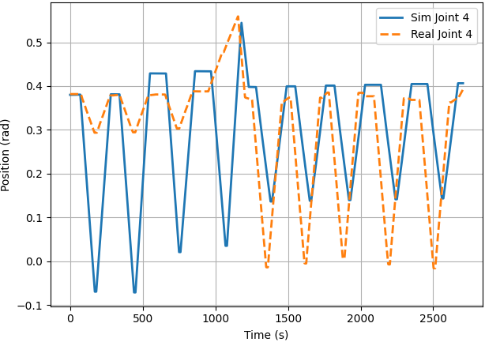
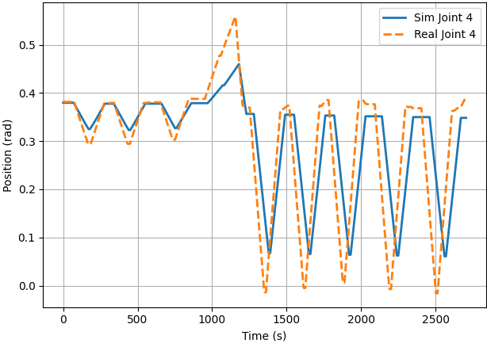


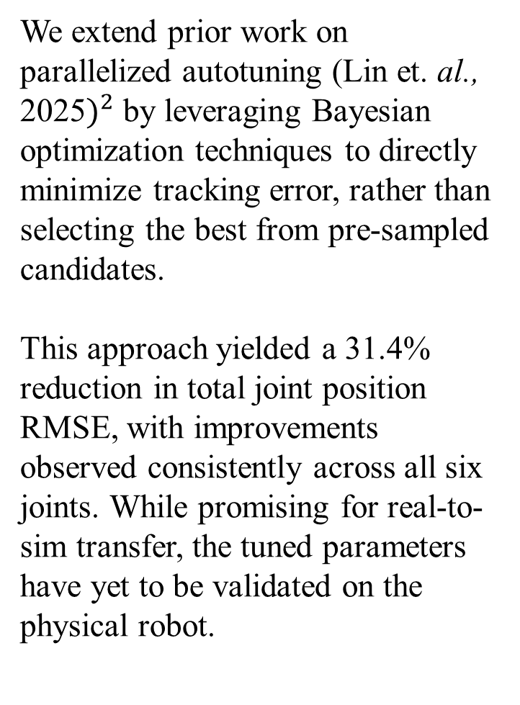

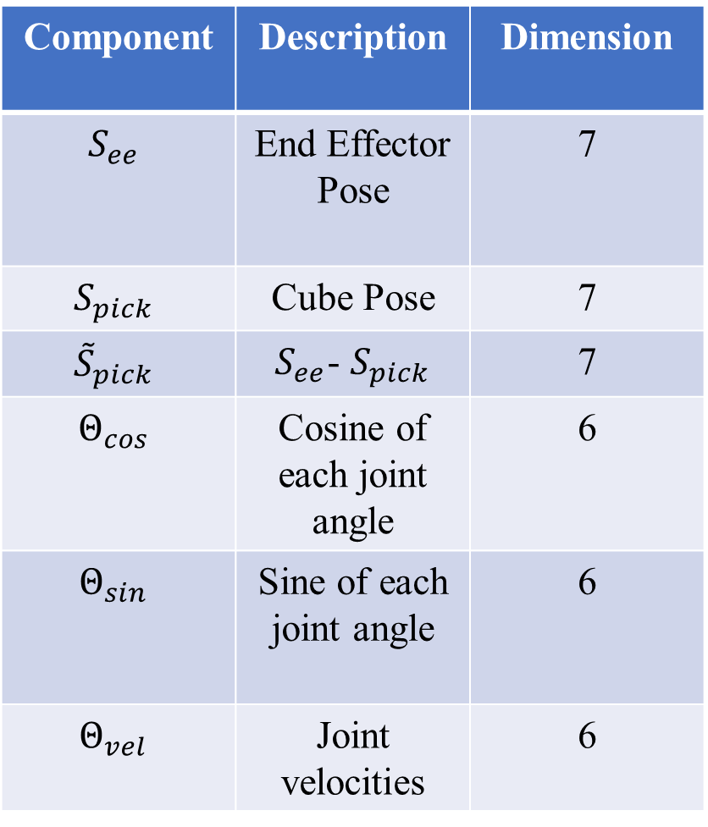
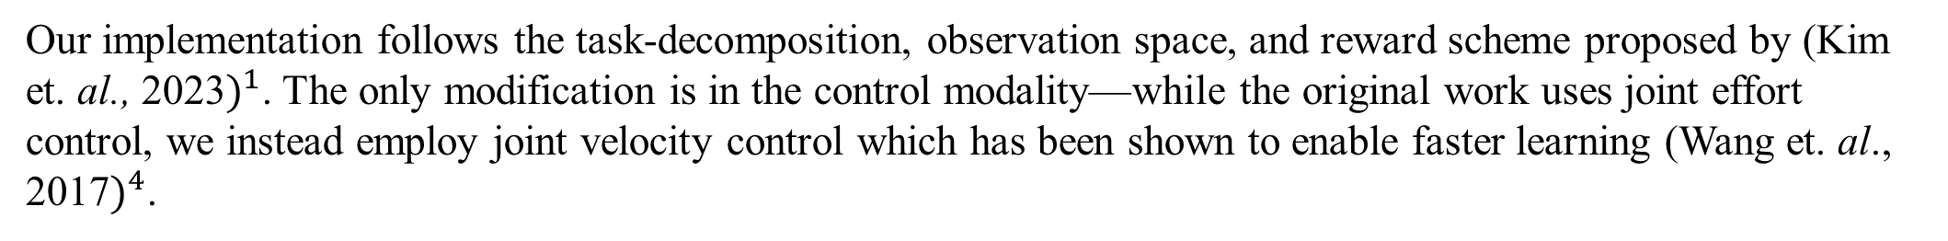

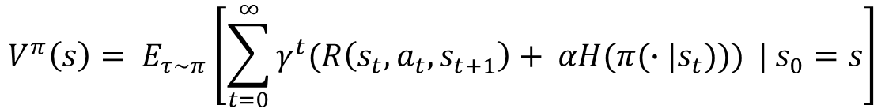
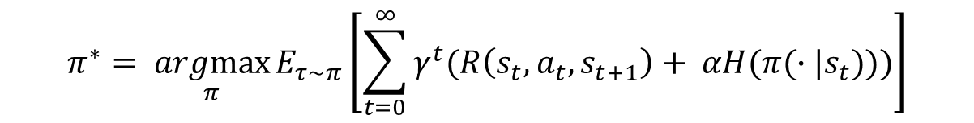
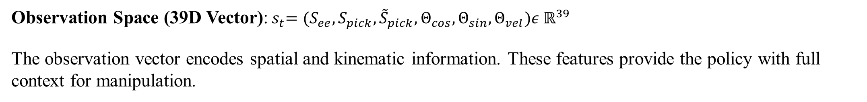

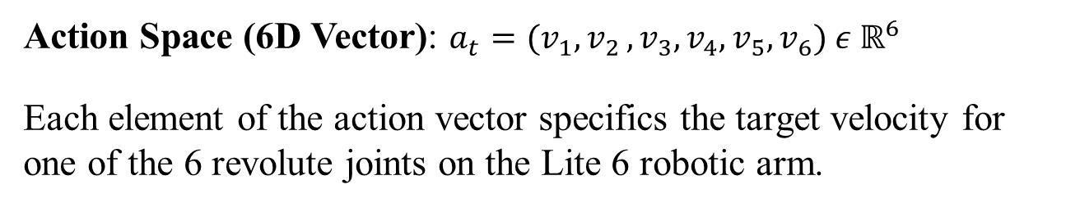
Sim-to-Real Reinforcement Learning for Robotic Arm Control in Radiochemical Workflows Vivek Tar${\text{a}}^{1}$, Andrew Blade$s^{2}$, Dohyun Ki$m^{3}$, Cathy Cutle$r^{3}$
Department of Medical Physics, University of Wisconsin School of Medicine and Public Health, Madison, W$I^{1}$
College of Engineering, Texas A&M University, College Station, T$X^{2}$
Isotope Research and Production, Brookhaven National Lab, Upton, N$Y^{3}$
Motivation and Objectives
Simulation Environment Setup
Proposed Solution
The increasing discovery and development of novel radiopharmaceuticals and radiolabeling techniques demands an expanded capacity for radiochemistry experimentation. Robotic manipulators have been used in industrial and laboratory settings to automate time- and labor-intensive tasks that pose hazards to human operators. However, conventional control strategies often restrict task flexibility. This study aims to train a robotic arm to perform a multi-step separation process using deep reinforcement learning. As an initial step, we apply the Soft Actor-Critic (SAC) algorithm to train a policy for pick-and-place operations in simulation.
Robot Arm: We use the UFACTORY Lite 6, a lightweight 6-axis robot with a reach of 440mm, a 600 g payload capacity, and 0.5mm repeatability. We equip the Lite 6 Gripper, a two-finger gripper featuring a 16mm stroke range and maximum payload $≤1k$g
Table: We use the Seattle Lab Table, a standard simulated lab bench asset provided by Isaac Sim. The table serves as the primary workspace for all manipulation tasks.
Grasping Object: We use a cube, modeled as a rigid body with collisions and contact sensing enabled, with a dimension of 27.8mm, mass of 600g, and $μ_{s}=1.0$. It serves as the primary manipulation target during pick-and-place tasks.
Target Pad: A static 10x10cm landing pad with a thickness of 5mm. It serves as the placement target for a successful pick-and-place execution.
Our implementation follows the task-decomposition, observation space, and reward scheme proposed by (Kim et. al., 2023$)^{1}$. The only modification is in the control modality—while the original work uses joint effort control, we instead employ joint velocity control which has been shown to enable faster learning (Wang et. al., 2017$)^{4}$.
Observation Space (39D Vector):${ s}_{t}=(S_{ee}, S_{pick}, {\tilde{S}}_{pick},Θ_{cos}, Θ_{sin}, Θ_{vel})ε ℝ^{39}$
The observation vector encodes spatial and kinematic information. These features provide the policy with full context for manipulation.
Component | Description | Dimension
$$S_{ee}$$ | End Effector Pose | 7
$$S_{pick}$$ | Cube Pose | 7
$${\tilde{S}}_{pick}$$ | $S_{ee}$- $S_{pick}$ | 7
$$Θ_{cos}$$ | Cosine of each joint angle | 6
$$Θ_{sin}$$ | Sine of each joint angle | 6
$$Θ_{vel}$$ | Joint velocities | 6
Action Space (6D Vector): $a_{t}=(v_{1}{, v}_{2},v_{3},v_{4},v_{5}, v_{6}) ε ℝ^{6}$
Each element of the action vector specifics the target velocity for one of the 6 revolute joints on the Lite 6 robotic arm.
Execute Action of Real Robot
Log Joint Trajectories & Joint Velocity Control Inputs
Execute Control Sequence in Simulation
Calculate Tracking Discrepancy
Optimize Physics Parameters via Optuna
Subtask Dependent Reward Structure:
$$\left\{\begin{aligned}r_{x}= K_{x} ∗{(x_{ee} − x_{g})}^{2} \\ r_{y}= K_{y} ∗{(y_{ee} − y_{g})}^{2} \\ r_{z}= K_{z} ∗{(z_{ee} − z_{g})}^{2}\end{aligned}\right.$$
$$r_{pos}= r_{x}+ r_{y}+ r_{z}$$
$$r_{energy}=−0.00003 × \sum_{i=1}^{6}{|F_{i}|}$$
$$r= r_{pos}+r_{energy}$$
Autotuned Robot Modeling
Soft-Actor Critic Algorithm
Soft Actor Critic is an off-policy actor-critic deep reinforcement learning algorithm based on the maximum entropy reinforcement learning framework.
In entropy regularized reinforcement learning, the standard RL objective is augmented to favor stochastic policies.
Joint | Initial RMSE (rad) | Initial RMSE (deg) | Tuned RMSE (rad) | Tuned RMSE (deg)
Joint 0 | 0.3026 | 17.33 | 0.1929 | 11.05
Joint 1 | 0.1696 | 9.71 | 0.1533 | 8.78
Joint 2 | 0.1366 | 7.83 | 0.0768 | 4.40
Joint 3 | 0.0830 | 4.76 | 0.0825 | 4.72
Joint 4 | 0.1576 | 9.03 | 0.0872 | 4.99
Joint 5 | 0.0785 | 4.50 | 0.0436 | 2.50
Total | 0.9279 | 53.16 | 0.6362 | 36.45
We extend prior work on parallelized autotuning (Lin et. al., 2025$)^{2}$ by leveraging Bayesian optimization techniques to directly minimize tracking error, rather than selecting the best from pre-sampled candidates.
This approach yielded a 31.4% reduction in total joint position RMSE, with improvements observed consistently across all six joints. While promising for real-to-sim transfer, the tuned parameters have yet to be validated on the physical robot.
$$π^{∗}= \underset{π}{argmax}{E_{τ\sim π}\left[\sum_{t=0}^{∞}{γ^{t}(R\left(s_{t}, a_{t}, s_{t+1}\right)+ αH(π(∙|s_{t})))}\right]}$$
The standard state-value function is changed to include the entropy bonuses from every timestep
Table 3. Observation Space Components
$$V^{π}\left(s\right)= E_{τ\sim π}\left[\sum_{t=0}^{∞}{γ^{t}(R\left(s_{t}, a_{t}, s_{t+1}\right)+ αH(π(∙|s_{t})))} | s_{0}=s\right]$$
The Pick-and Place task is divided into three subtasks:
Reaching: The end effector moves to a point 5cm above the cube’s center of mass, oriented relative to the cube’s pose.
$K_{x}, K_{y}=−2.0$
$K_{z}=−1.0$
$\left(x_{ee}, y_{ee}, z_{ee}\right)= P_{pick} +R\left(q_{pick}\right)∙ ο_{local}$
Grasping: The end effector descends to the exact center of mass of the cube, preparing for grasp execution.
$K_{x}, K_{y}=−2.0$
$K_{z}=−2.5$
$\left(x_{ee}, y_{ee}, z_{ee}\right)=$ $P_{pick}$
Placing: The end effector transports the cube and aligns it with the center of mass of the placement target.
$K_{x}, K_{y}=−1.0$
$K_{z}=−1.0$
$\left(x_{ee}, y_{ee}, z_{ee}\right)=$ $P_{place}$
The action value function is changed to include bonuses from every timestep except the first
$$Q^{π}\left(s, a\right)= E_{τ\sim π}\left[\sum_{t=0}^{∞}{γ^{t}(R\left(s_{t}, a_{t}, s_{t+1}\right)}+ α\sum_{t=1}^{∞}{γ^{t}H\left(π\left(∙ | s_{t}\right)\right) | s_{0}=s, } a_{0}=a\right]$$
SAC learns a policy $π_{θ}$ and two Q-functions $Q_{φ_{1}}$, $Q_{φ_{2}}$. The loss functions for the Q-networks are
Table 1. Joint-Wise MSE Post Physics Parameter Optimization
$$L\left(φ_{i}, 𝒟\right)= E_{\left(s, a, r, s^{′}, d\right)\sim 𝒟} \left[{(Q_{φ_{i}}\left(s, a\right)−y(r, s^{′}, d))}^{2}\right]$$
$$τ=stiffness ∗\left(q − q_{target}\right)+damping ∗(\dot{q} − {\dot{q}}_{target})$$
Where the target is driven by
$$y\left(r, s^{′}, d\right)=r+ γ(1−d)(\min_{j=1,2}{Q_{φ_{targ, j}}\left(s^{′}, {\tilde{a}}^{′}\right)− αlogπ_{θ}({\tilde{a}}^{′}|\tilde{s}′)}),$$
Figure 1. Initial Physical vs Simulated Joint 4 Trajectory
Figure 2. Final Physical vs Simulated Joint 4 Trajectory
The reparameterization trick allows the expectation over actions to be rewritten into an expectation over noise.
$$E_{a\sim π_{θ}}\left[Q^{π_{θ}}\left(s, a\right)− αlogπ_{θ}(a|s)\right]= E_{ξ\sim 𝒩}\left[Q^{π_{θ}}\left(s, {\tilde{a}}_{θ}\left(s, ξ\right)\right)− αlogπ_{θ}\left({\tilde{a}}_{θ}\left(s, ξ\right), \right| s)\right]$$
To get the policy loss, we substitute $\min_{j=1,2}{Q_{φ_{j}}}$ with one of the function approximators. The policy is thus optimized according to
$$\max_{θ}{E_{ξ\sim 𝒩}\left[\min_{j=1,2}{Q^{π_{θ}}\left(s, {\tilde{a}}_{θ}\left(s, ξ\right)\right)− αlogπ_{θ}\left({\tilde{a}}_{θ}\left(s, ξ\right), \right|s)}\right]}$$
NVIDIA’s Isaac Lab
Results
Training reinforcement learning policies on physical robots is impractical due to time, wear, and safety constraints—Isaac Lab offers a simulation framework that enables policy development leveraging the latest simulation capabilities for high fidelity physics, photo-realistic scenes, and fast and efficient execution.
The core objectives of the framework are as follows:
Modularity: Easily customizable and add new environments, robots, and sensors
Agility: Adapt to the changing needs of the community
Openness: Remain open-sourced to allow the community to contribute and extend the framework.
Batteries-included: Includes a number of environments, sensors, and tasks that are ready to use.
Domain Randomization
We define task success as completion of the grasping subtask, since the UFACTOR Lite 6 gripper model lacks actuated finger joints and cannot perform full grasp-and-place actions in simulation. Grasping is considered successful when the gripper’s center aligns within the cubes volume. From this point, the grasp can be manually executed on the physical robot. Grasping performance across 4 trials is summarized in Table 4.
Domain Randomization is a simple technique for training policies in simulation that transfer to the physical world by randomizing simulation parameters.
Trial 1 | Trial 2 | Trial 3 | Trial 4 | Average
8/10 | 10/10 | 9/10 | 8/10 | 8.75/10
Domain Parameter | Applied Noise Distribution
Object Initial Position | $$+ 𝒰(−0.02cm, 0.02cm)$$
Object Pos Observation Noise | $$× 𝒰(0cm, 0.02cm)$$
Joint Observation Noise | $$× 𝒰(0rad, 0.1rad)$$
Action Noise | $$× 𝒰(0rad, 0.1rad)$$
Table 4. Grasping Success Rate Across Trials
Acknowledgement & References
"This material is based upon work supported by the U.S. Department of Energy, Office of Science, Isotope Program, under Award Number DE-SC0022550 through the Horizon-broadening Isotope Production Pipeline Opportunities (HIPPO) program.“
No export control
Kim, B., Kwon, G., Park, C., & Kwon, N. K. (2023). The task Decomposition and dedicated Reward-System-Based Reinforcement learning algorithm for Pick-and-Place. Biomimetics, 8(2), 240. https://doi.org/10.3390/biomimetics8020240
Sim-to-Real Reinforcement Learning for Vision-Based Dexterous Manipulation on Humanoids. (n.d.). https://arxiv.org/html/2502.20396v1?utm_source=chatgpt.com
Soft Actor-Critic — Spinning Up documentation. (n.d.). https://spinningup.openai.com/en/latest/algorithms/sac.html
Wang, K., & Li, B. (2017). Mastering robotic manipulation with contact dynamics. Unpublished manuscript, CS234: Reinforcement Learning, Stanford University. Retrieved from https://cs.stanford.edu/
Table 2. Domain Randomization Setup

