Slide 1
Activity Detection
(Violence and smoking)
Team:
Sharvani
Abhinav
Harivara Prasad
Vivek Vardhan

Slide 2
Outline
The Problem
Our Idea
Why this?
Draw backs
Future scope
Sample images

Slide 3
The Problem:
In this contemporary world the need for advanced surveillance cameras to ensure public safety and prevent violent incidents has increasingly evident.
And they are no smoking areas in which we have to prevent smoking and Drinking in Public areas

Slide 4
Problem statement
Detecting and responding to violence in real-time is critical challenge in today’s day to day life.
with information reaching authorities only after an event occurs,like we see generally in our country.

Slide 5
Our idea
Creating a surveillance system using machine learning.
The surveillance system will detect the feed through cameras,it detects the human activity if there is any disturbed activity then the model detects it and sends an alert to the authorities.

Slide 6
Why this?
we
Generally in our country we see the cc cameras manually monitored,
By integrating such technology with cameras we can minimal the responsive time and save the lives of many.

Slide 7
Draw back of our solution
Our model is incomplete
False detection.
Cost and infrastructure
Privacy concerns

Slide 8
Future Scope
Ours is just a basic model there is no hesitation for us to accept it.
Using more data and training them with better algorithms to make sure it detects the activity correctly.
Even we can use such Machine learning models in colleges to detect smoking, violence activities if happens.
Integrating with IOT to get accurate result.

Slide 9
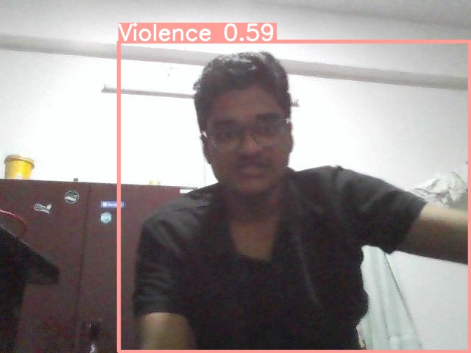
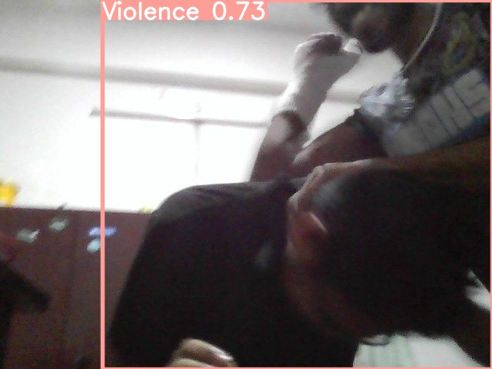
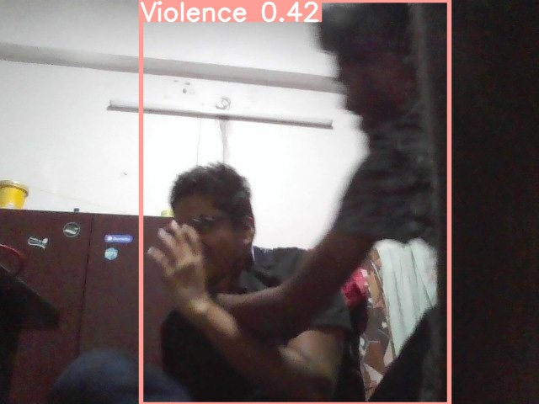
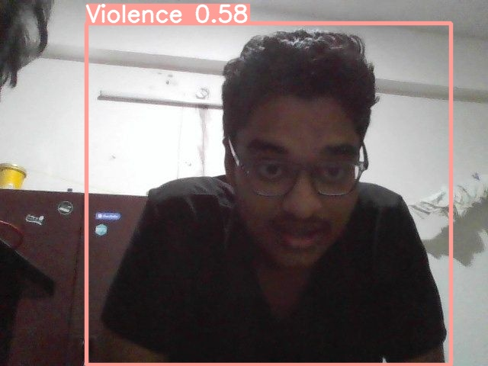

Slide 10
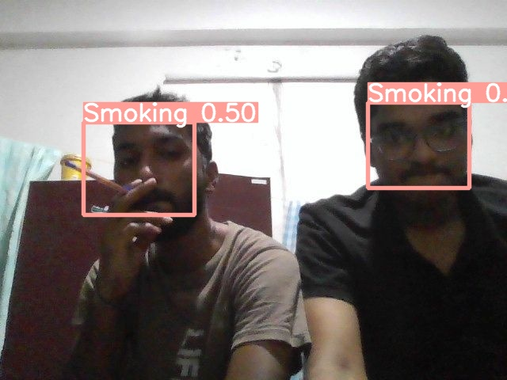
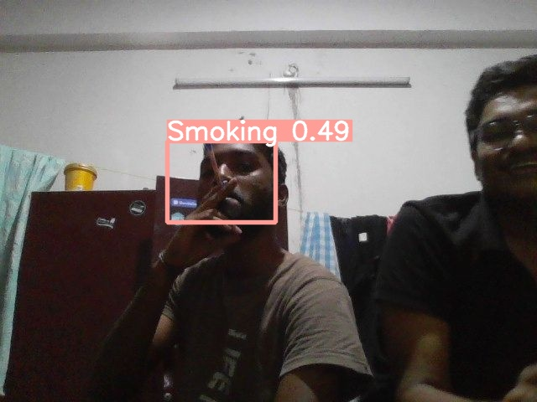
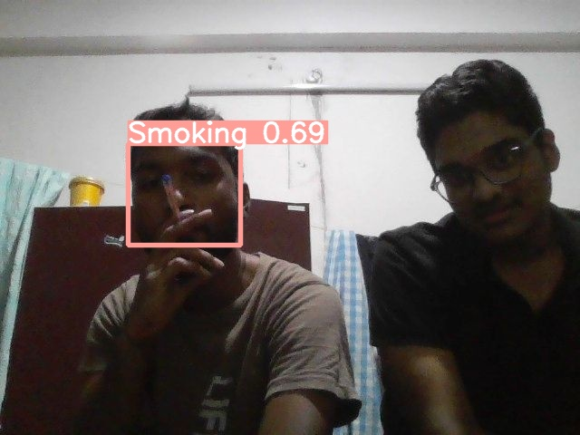


Slide 11
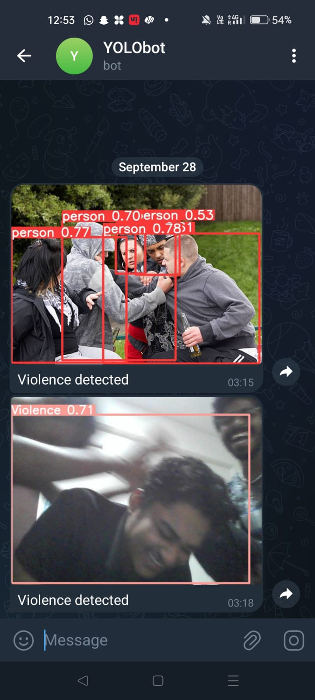

Slide 12
Thank You

