Slide 1

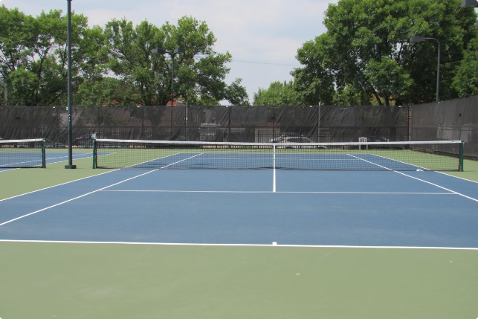


AcePredict: Tennis Match Outcome Predictor
Using XGBoost for Predictive Analytics in Tennis, this project aims to predict the outcome of tennis matches by leveraging machine learning techniques. Presented by Vivekavardhan Berila, the goal is to create an accurate model that can forecast match results, benefiting coaches, analysts, and sports enthusiasts alike.
by Vivek Vardhan

Slide 2

Introduction
1
Goal of the Project
2
Leveraging Machine Learning
3
Why Tennis?
The goal of this project is to predict the outcome of tennis matches using player statistics and match data.
Tennis is a sport with rich statistical data that can be analyzed to uncover patterns and insights, making it an ideal subject for predictive analytics.
By leveraging machine learning, specifically the XGBoost algorithm, the aim is to create a model that accurately forecasts match results.

Slide 3
Data Description
Dataset Overview
Key Features
Target Variable
The dataset includes historical match data with features like player height, age, hand preference, aces, double faults, and rankings.
Player Attributes: Height, age, handedness (left or right)
The target variable is the match outcome (win/loss), which the model aims to predict.
Match Statistics: Aces, double faults, break points saved and faced
Rankings: Player rankings and ranking points

Slide 4


Technologies Used
Python
The programming language used for the entire script. Python is popular for data science, machine learning, and general-purpose programming.
Pandas
Used for data manipulation and analysis. Pandas provide data structures like DataFrames, which are essential for handling and processing structured data.
NumPy
Provides support for large multi-dimensional arrays and matrices, along with a large collection of mathematical functions to operate on these arrays.
Seaborn
A statistical data visualization library based on Matplotlib, providing a high-level interface for drawing attractive and informative statistical graphics.

Slide 5

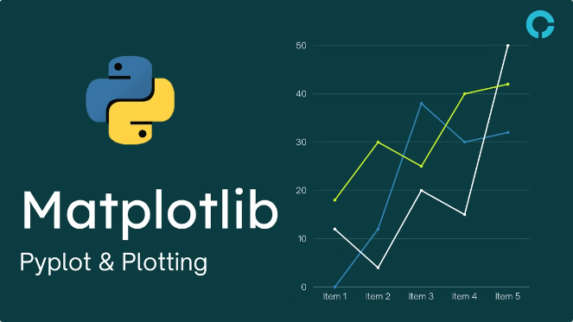
Technologies Used (continued)
Matplotlib
A plotting library used for creating static, animated, and interactive visualizations in Python.
Scikit-learn (sklearn)
A machine learning library for Python, providing simple and efficient tools for data mining and data analysis.
XGBoost
An optimized distributed gradient boosting library designed to be highly efficient, flexible, and portable. XGBoost provides a powerful framework for supervised learning.
Pickle
A Python module used to serialize and deserialize Python object structures, commonly used to save machine learning models for later use.

Slide 6

Methodology
Model Selection
The XGBoost algorithm was chosen for its efficiency and accuracy in handling structured data and large datasets. XGBoost is an ensemble learning method that combines the predictions of multiple decision trees to improve accuracy.
1
2
Data Processing
Data was cleaned and preprocessed, with missing values handled and categorical variables encoded. Feature engineering was performed to create new features and enhance the model's predictive power.

Slide 7
Model Training and Evaluation
Training Process
Key Metrics
The dataset was split into training and testing sets. The model's performance was evaluated using metrics like accuracy, precision, recall, and F1-score.
Accuracy: The proportion of correct predictions
Precision: The accuracy of positive predictions
Recall: The ability to find all positive instances
F1-Score: The balance between precision and recall

Slide 8

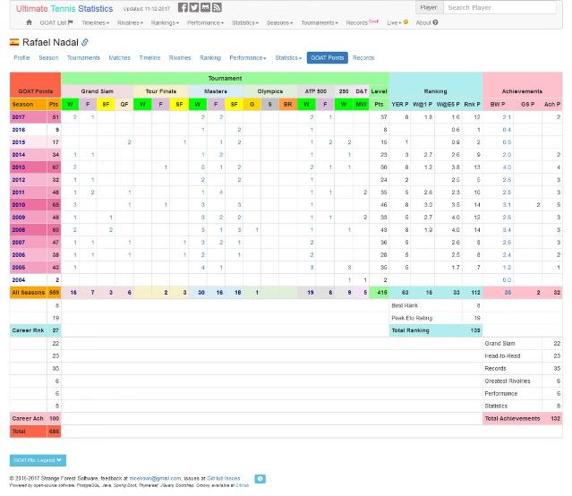
Results
Model Performance
The XGBoost model achieved an accuracy of [X%], with a precision of [Y%] and a recall of [Z%]. Feature importance analysis revealed that [key features] were the most significant predictors of match outcomes.
Visualizations
The presentation includes a bar chart of feature importance and a confusion matrix to show the distribution of predictions.

Slide 9




Conclusion
Summary
The project successfully built a model that can predict tennis match outcomes with a high degree of accuracy. XGBoost proved to be an effective algorithm for this task, highlighting the importance of specific player and match attributes in determining outcomes.
Future Work
Exploring other machine learning models like Random Forest or Neural Networks, incorporating additional features like weather conditions or player injuries, and extending the model to predict match scores, not just outcomes.

